Slide 1

English Proofs and Sets
CSE 311 Winter 22
Lecture 9

Slide 2
Announcements
We corrected typos in HW3 Problem 7 (the find the bug problem).
  There were two bugs other than the typos, so please go back and find the intended bugs ☺
President Cauce’s office sent an email today confirming the intended return to in-person next week.
  We’ll have official announcements soon.
  We’ll have a survey for preferred office hours mode coming soon.

Slide 3
What’s Next
We’re taking off the training wheels!
Our goal with writing symbolic proofs was to prepare us to write proofs in English.
Let’s get started.
The next 3 weeks:
  Practice communicating clear arguments to others.
  Learn new proof techniques.
  Learn fundamental objects (sets, number theory) that will let us talk more easily about computation at the end of the quarter.

Slide 4
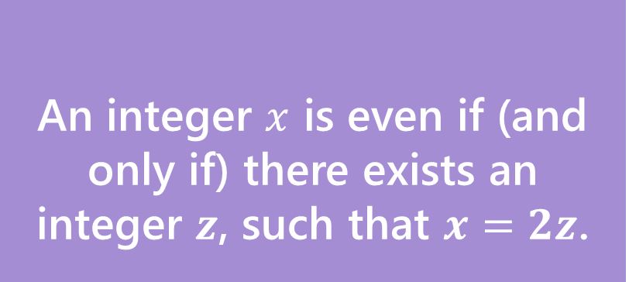
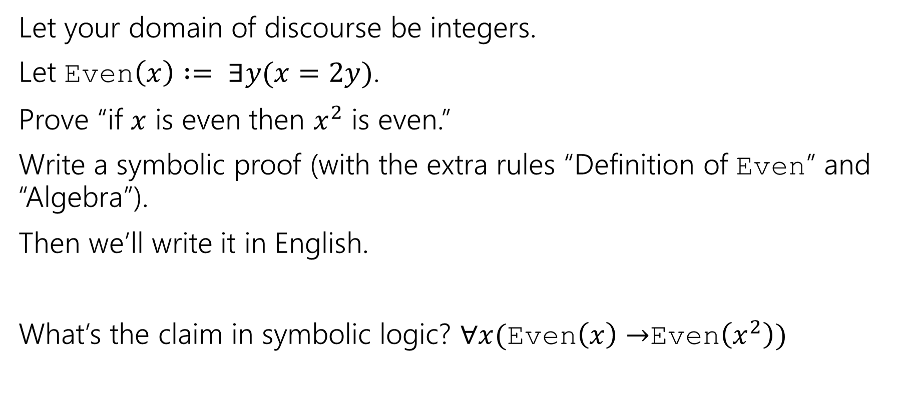
Warm-up
An integer $x$ is even if (and only if) there exists an integer $z$, such that $x=2z$.
Even
Let your domain of discourse be integers.
Let Even$\left(x\right) := ∃y(x=2y)$.
Prove “if $x$ is even then $x^{2}$ is even.”
Write a symbolic proof (with the extra rules “Definition of Even” and “Algebra”).
Then we’ll write it in English.
What’s the claim in symbolic logic? $∀x($Even$\left(x\right)→$Even$\left(x^{2}\right))$

Slide 5
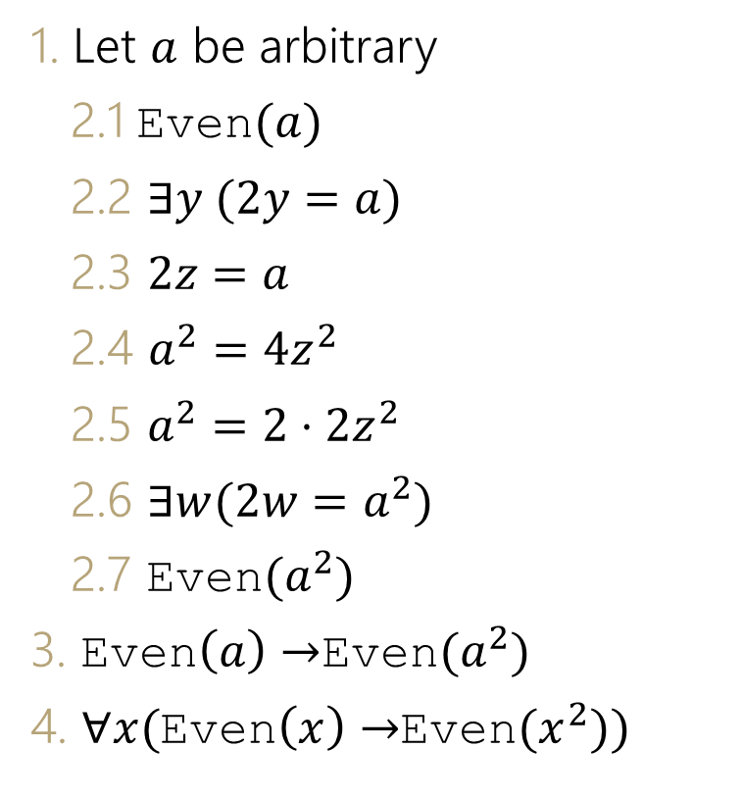
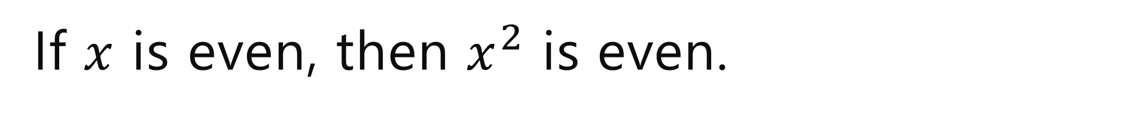

If $x$ is even, then $x^{2}$ is even.
1. Let $a$ be arbitrary
2.1 Even$(a)$
2.2 $∃y (2y=a)$
2.3 $2z=a$
2.4 $a^{2}=4z^{2}$
2.5 $a^{2}=2⋅2z^{2}$
2.6 $∃w(2w=a^{2})$
2.7 Even$(a^{2})$
3. Even$\left(a\right)→$Even$(a^{2})$
4. $∀x($Even$\left(x\right)→$Even$(x^{2}))$
Assumption
Definition of Even (2.1)
Elim $∃\left(2.2\right)$
Algebra (2.3)
Alegbra (2.4)
Intro $∃$ (2.5)
Definition of Even
Direct Proof Rule (2.1-2.7)
Intro $∀$(3)

Slide 6
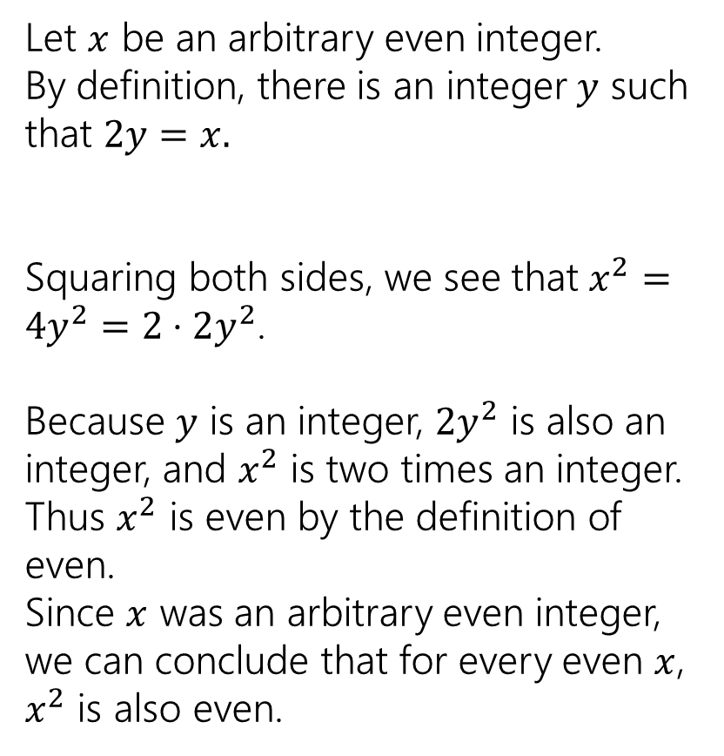
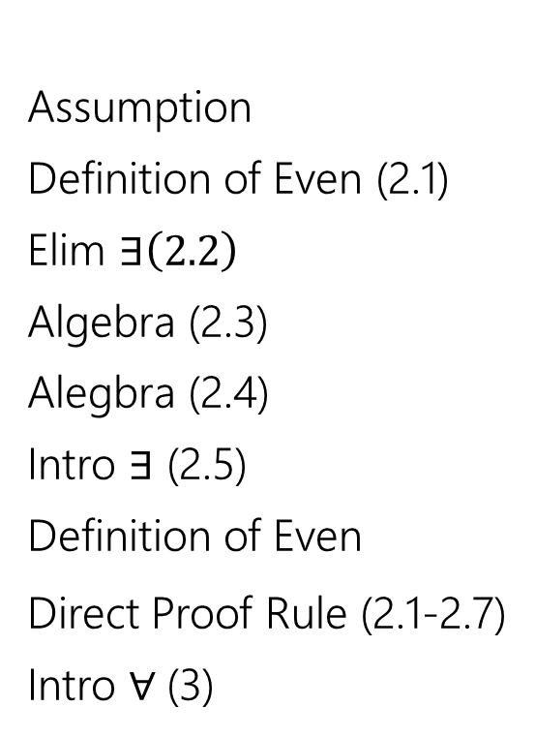
If $x$ is even, then $x^{2}$ is even.
1. Let $a$ be arbitrary
2.1 Even$(a)$
2.2 $∃y (2y=a)$
2.3 $2z=a$
2.4 $a^{2}=4z^{2}$
2.5 $a^{2}=2⋅2z^{2}$
2.6 $∃w(2w=a^{2})$
2.7 Even$(a^{2})$
3. Even$\left(a\right)→$Even$(a^{2})$
4. $∀x($Even$\left(x\right)→$Even$(x^{2}))$
Assumption
Definition of Even (2.1)
Elim $∃\left(2.2\right)$
Algebra (2.3)
Alegbra (2.4)
Intro $∃$ (2.5)
Definition of Even
Direct Proof Rule (2.1-2.7)
Intro $∀$(3)
Let $x$ be an arbitrary even integer.
By definition, there is an integer $y$ such that $2y=x.$
Squaring both sides, we see that $x^{2}=4y^{2}=2⋅2y^{2}$.
Because $y$ is an integer, $2y^{2}$ is also an integer, and $x^{2}$ is two times an integer.
Thus $x^{2}$ is even by the definition of even.
Since $x$ was an arbitrary even integer, we can conclude that for every even $x$, $x^{2}$ is also even.

Slide 7
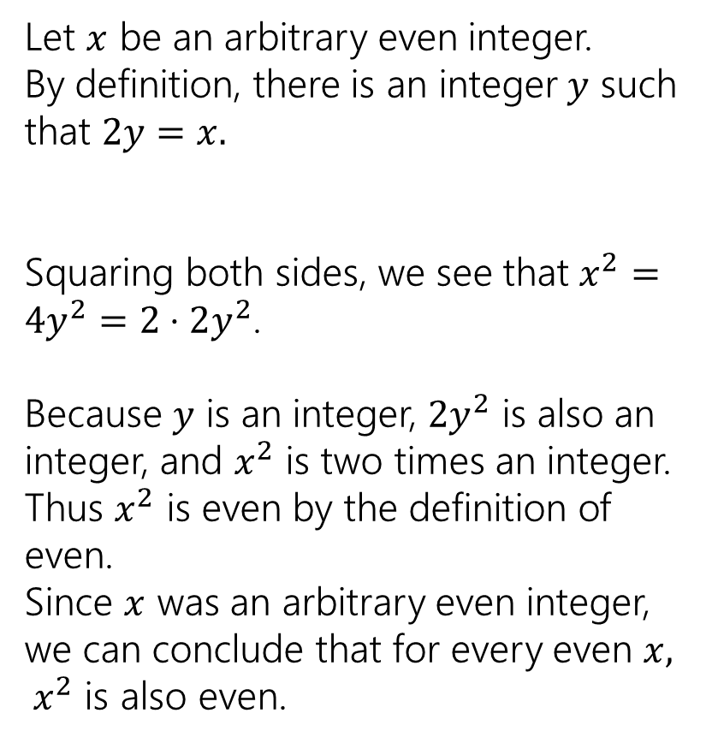
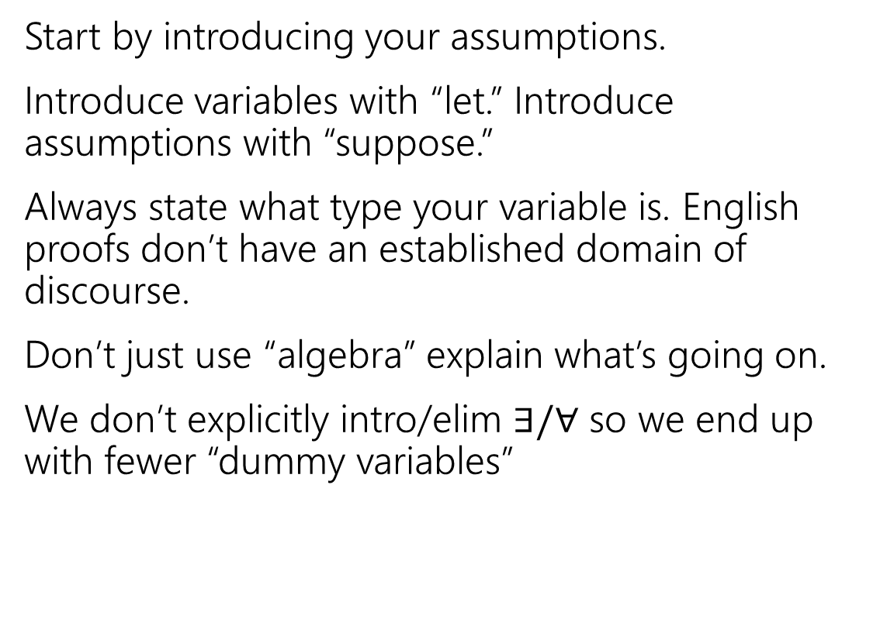
Converting to English
Start by introducing your assumptions.
Introduce variables with “let.” Introduce assumptions with “suppose.”
Always state what type your variable is. English proofs don’t have an established domain of discourse.
Don’t just use “algebra” explain what’s going on.
We don’t explicitly intro/elim $∃/∀$ so we end up with fewer “dummy variables”
Let $x$ be an arbitrary even integer.
By definition, there is an integer $y$ such that $2y=x.$
Squaring both sides, we see that $x^{2}=4y^{2}=2⋅2y^{2}$.
Because $y$ is an integer, $2y^{2}$ is also an integer, and $x^{2}$ is two times an integer.
Thus $x^{2}$ is even by the definition of even.
Since $x$ was an arbitrary even integer, we can conclude that for every even $x, x^{2}$ is also even.

Slide 8
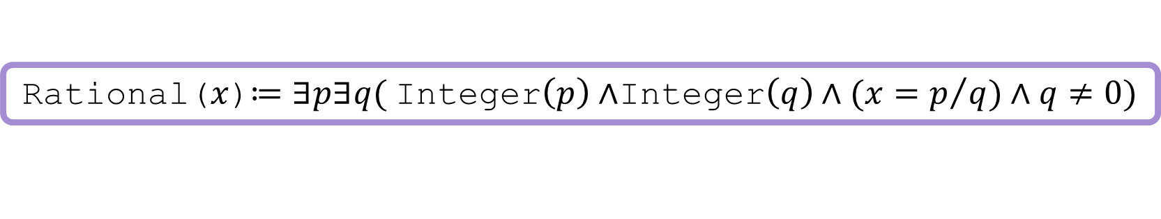
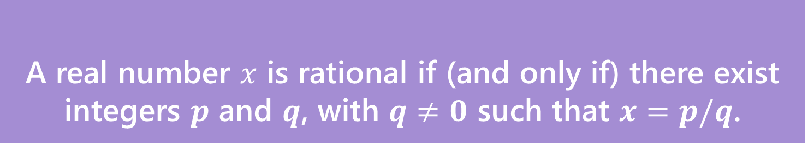
Let’s do another!
First a definition
A real number $x$ is rational if (and only if) there exist integers $p$ and $q$, with $q≠0$ such that $x=p/q$.
Rational
Rational($x$)$≔∃p∃q($Integer$\left(p\right)∧$Integer$\left(q\right)∧(x=p/q)∧q≠0)$

Slide 9
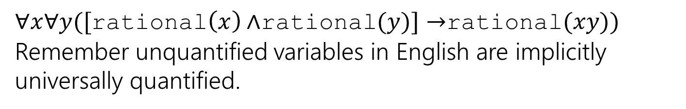
Let’s do another!
“The product of two rational numbers is rational.”
What is this statement in predicate logic?
$∀x∀y([$rational$\left(x\right)∧$rational$(y)]→$rational$(xy))$
Remember unquantified variables in English are implicitly universally quantified.

Slide 10
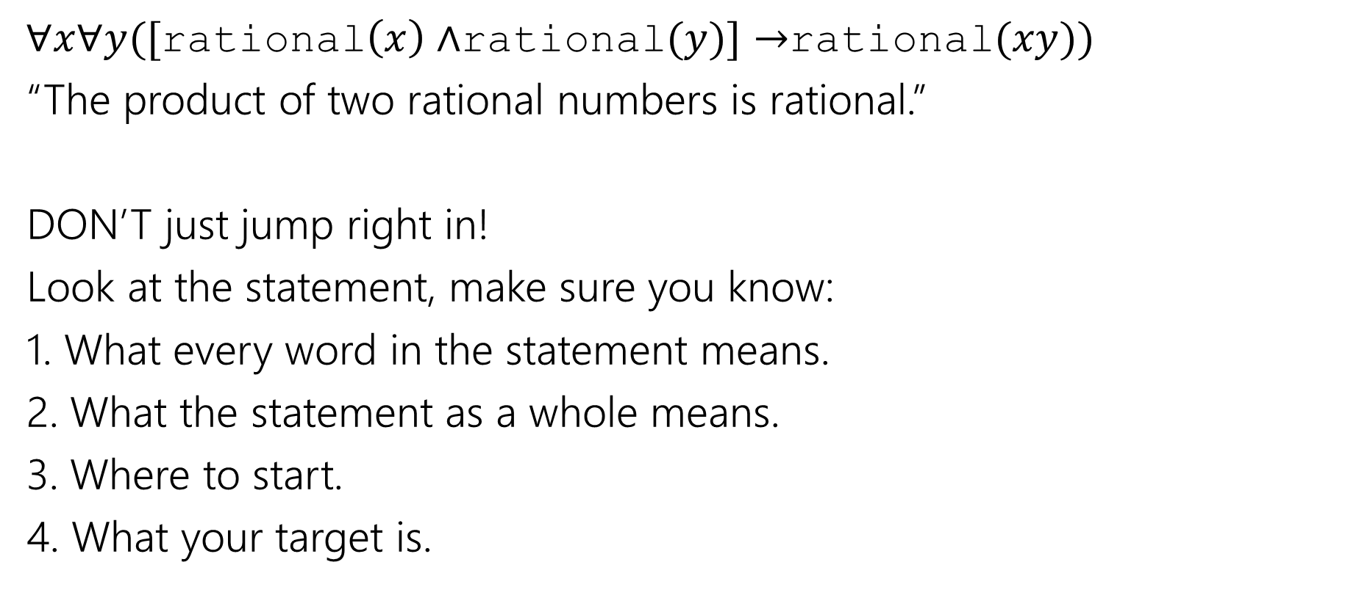
Doing a Proof
$∀x∀y([$rational$\left(x\right)∧$rational$(y)]→$rational$(xy))$
“The product of two rational numbers is rational.”
DON’T just jump right in!
Look at the statement, make sure you know:
1. What every word in the statement means.
2. What the statement as a whole means.
3. Where to start.
4. What your target is.

Slide 11
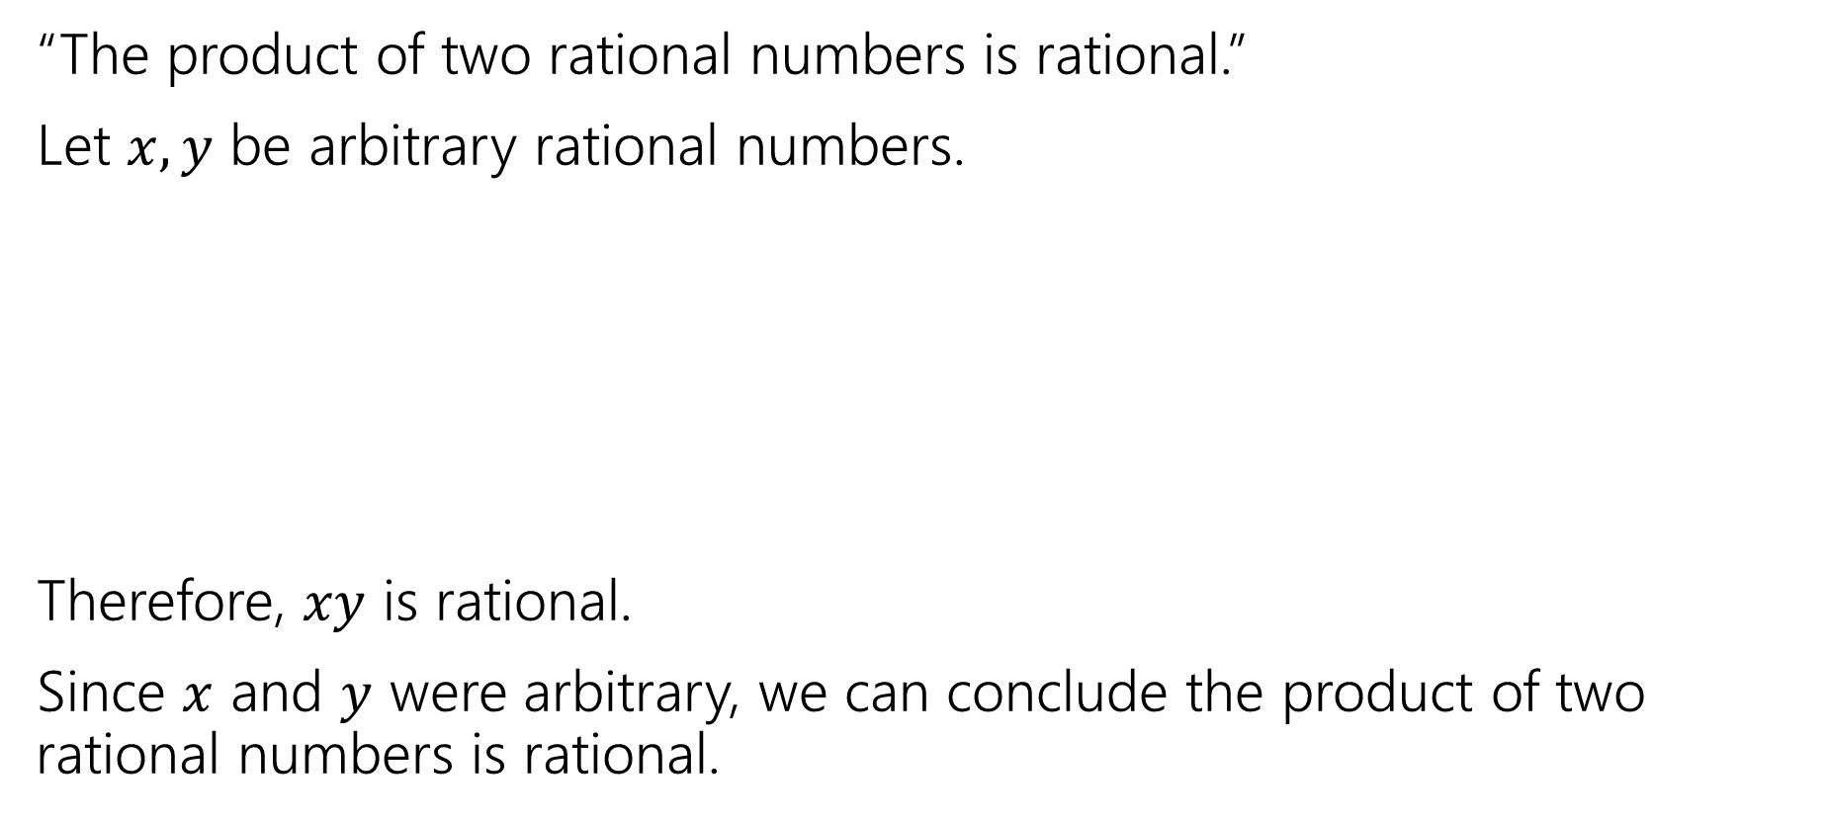
Let’s do another!
“The product of two rational numbers is rational.”
Let $x,y$ be arbitrary rational numbers.
Therefore, $xy$ is rational.
Since $x$ and $y$ were arbitrary, we can conclude the product of two rational numbers is rational.

Slide 12
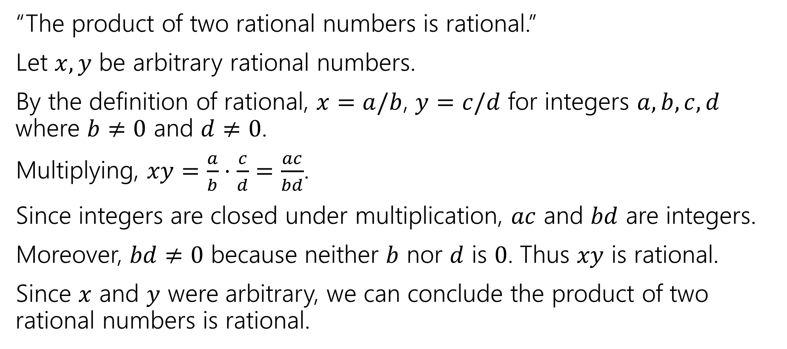
Let’s do another!
“The product of two rational numbers is rational.”
Let $x,y$ be arbitrary rational numbers.
By the definition of rational, $x=a/b$, $y=c/d$ for integers $a,b,c,d$ where $b≠0$ and $d≠0$.
Multiplying, $xy=\frac{a}{b}⋅\frac{c}{d}=\frac{ac}{bd}$.
Since integers are closed under multiplication, $ac$ and $bd$ are integers.
Moreover, $bd≠0$ because neither $b$ nor $d$ is $0$. Thus $xy$ is rational.
Since $x$ and $y$ were arbitrary, we can conclude the product of two rational numbers is rational.

Slide 13
Now You Try
The sum of two even numbers is even.
1. Write the statement in predicate logic.
2. Write an English proof.
3. If you have lots of extra time, try writing the symbolic proof instead.

Slide 14

Now You Try
An integer $x$ is even if (and only if) there exists an integer $z$, such that $x=2z$.
Even
The sum of two even numbers is even.
Make sure you know:
1. What every word in the statement means.
2. What the statement as a whole means.
3. Where to start.
4. What your target is.
Pollev.com/uwcse311
Help me adjust my explanation!
1. Write the statement in predicate logic.
2. Write an English proof.
3. If you have lots of extra time, try writing the symbolic proof instead.

Slide 15
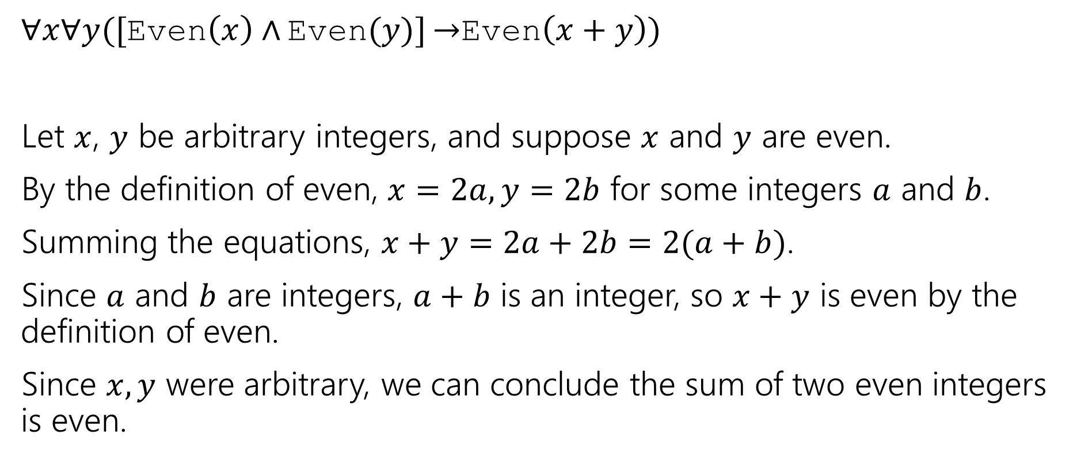
Here’s What I got.
$∀x∀y([$Even$\left(x\right)∧$ Even$(y)]$ $→$Even$\left(x+y\right))$
Let $x$, $y$ be arbitrary integers, and suppose $x$ and $y$ are even.
By the definition of even, $x=2a,y=2b$ for some integers $a$ and $b$.
Summing the equations, $x+y=2a+2b=2(a+b)$.
Since $a$ and $b$ are integers, $a+b$ is an integer, so $x+y$ is even by the definition of even.
Since $x,y$ were arbitrary, we can conclude the sum of two even integers is even.

Slide 16
Why English Proofs?
Those symbolic proofs seemed pretty nice. Computers understand them, and can check them.
So what’s up with these English proofs?
They’re far easier for people to understand.
But instead of a computer checking them, now a human is checking them.

Slide 17
Sets

Slide 18
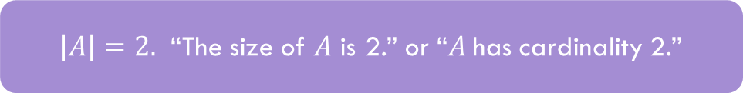
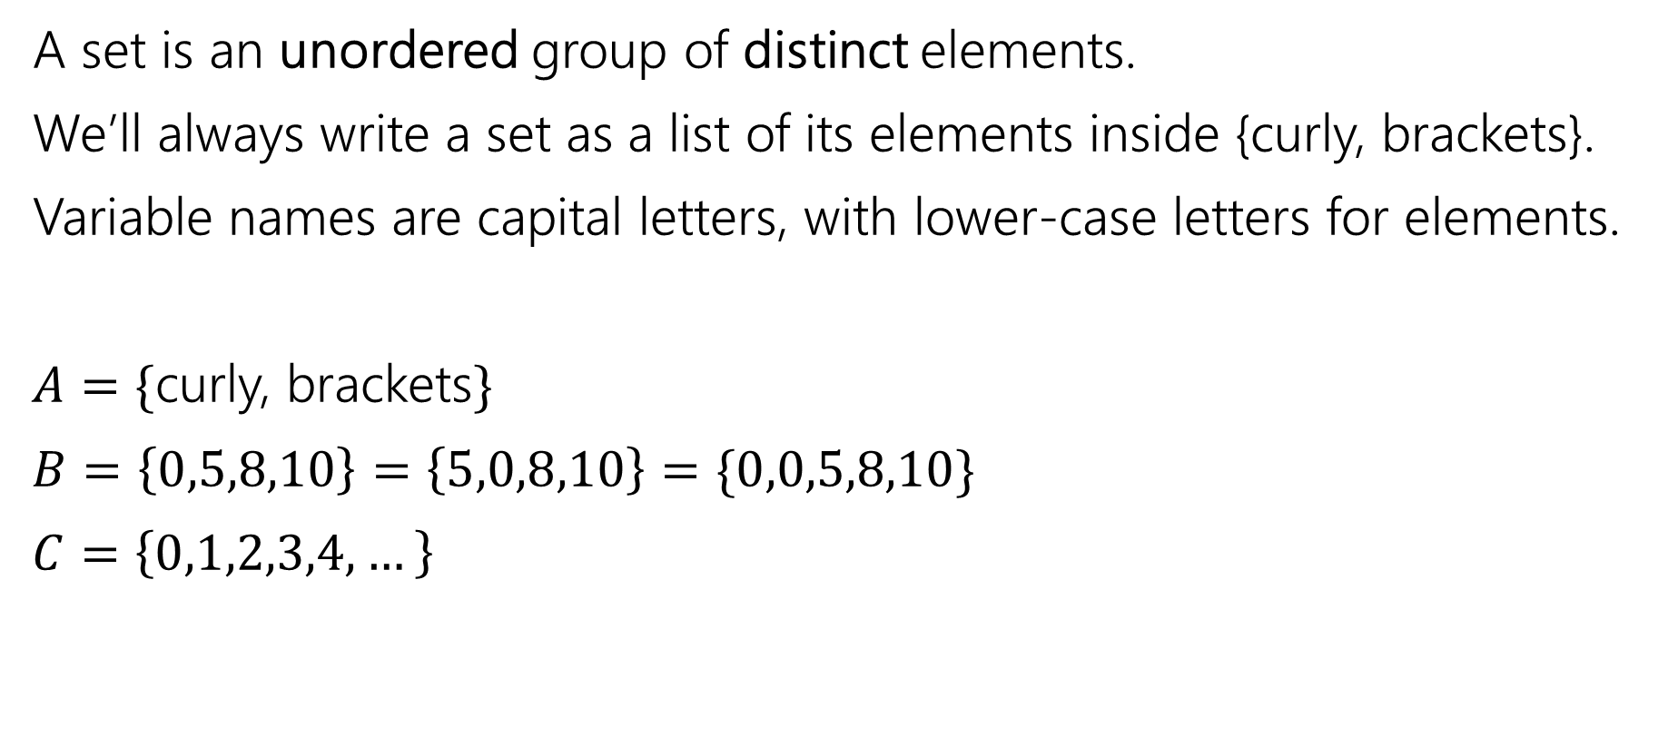
Sets
A set is an unordered group of distinct elements.
We’ll always write a set as a list of its elements inside {curly, brackets}.
Variable names are capital letters, with lower-case letters for elements.
$A=\{$curly, brackets$\}$
$B=\left\{0,5,8,10\right\}=\left\{5,0,8,10\right\}=\{0,0,5,8,10\}$
$C=\left\{0,1,2,3,4,…\right\}$
$\left|A\right|=2.$ “The size of $A$ is 2.” or “$A$has cardinality 2.”

Slide 19
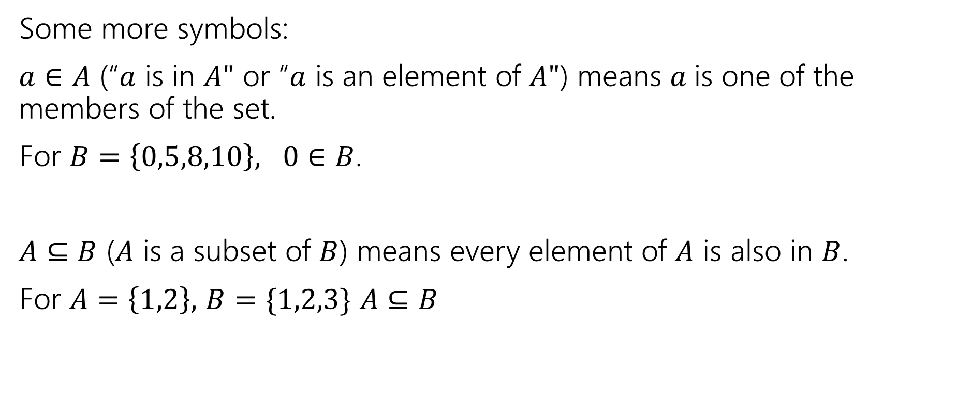
Sets
Some more symbols:
$a∈A$ (“$a$ is in $A"$ or “$a$ is an element of $A"$) means $a$is one of the members of the set.
For $B=\left\{0,5,8,10\right\}, 0∈B$.
$A⊆B$ ($A$ is a subset of $B$) means every element of $A$ is also in $B$.
For $A=\left\{1,2\right\},$ $B=\{1,2,3\}$ $A⊆B$

Slide 20

Sets
Be careful about these two operations:
If $A=\{1,2,3,4,5\}$
$\left\{1\right\}⊆A$, but $\left\{1\right\}∉A$
$∈$ asks: is this item in that box?
$⊆$ asks: is everything in this box also in that box?

Slide 21

Try it!
Let $A=\left\{1,2,3,4,5\right\}$
$B=\{1,2,5\}$
Is $A⊆A?$
Is $B⊆A?$
Is $A⊆B$?
Is $\left\{1\right\}∈A$?
Is $1∈A$?
Yes!
Yes
No
No
Yes

