Slide 1
Quantifier Proofs, English Proofs
CSE 311 Winter 22
Lecture 8

Slide 2


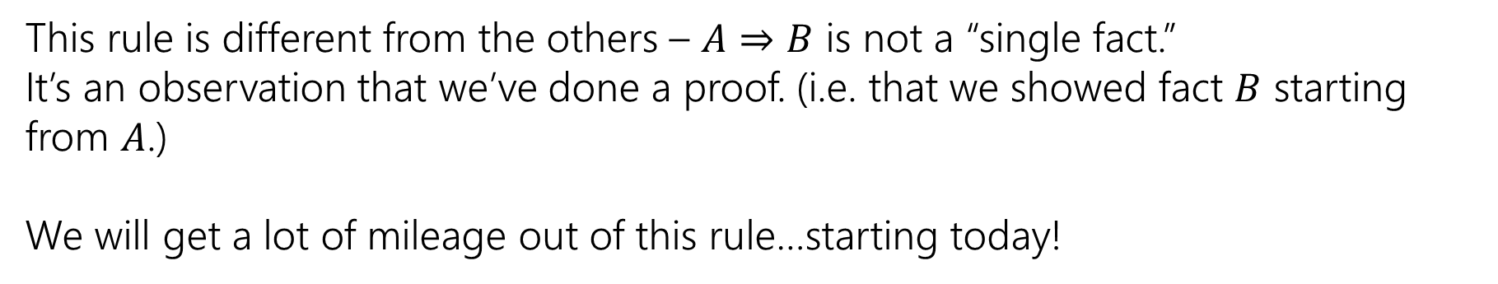

The Direct Proof Rule
Write a proof “given $A$ conclude $B$”
$$A⇒B$$
Direct Proof rule
$$A→B$$
$$A→B$$
This rule is different from the others – $A⇒B$ is not a “single fact.”
It’s an observation that we’ve done a proof. (i.e. that we showed fact $B$ starting from $A$.)
We will get a lot of mileage out of this rule…starting today!

Slide 3



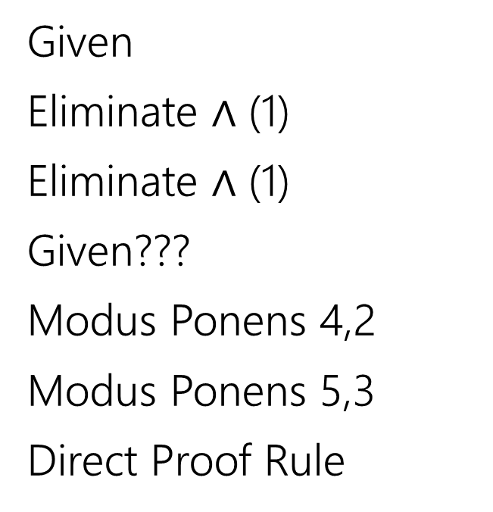
Given: (($p→q)∧(q→r))$ Show: $(p→r)$
Here’s an incorrect proof.
$\left(p→q\right)∧\left(q→r\right)$
$p→q$
$q→r$
$p$
$q$
$r$
$p→r$
Given
Eliminate $∧$ (1)
Eliminate $∧$ (1)
Given???
Modus Ponens 4,2
Modus Ponens 5,3
Direct Proof Rule

Slide 4

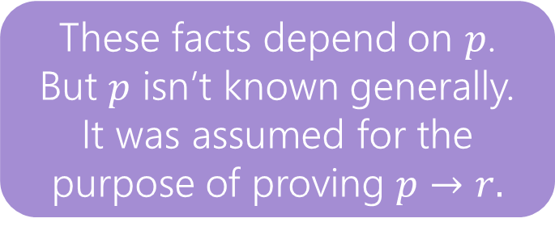

Given: (($p→q)∧(q→r))$ Show: $(p→r)$
Here’s an incorrect proof.
Proofs are supposed to be lists of facts.
Some of these “facts” aren’t really facts…
$\left(p→q\right)∧\left(q→r\right)$
$p→q$
$q→r$
$p$
$q$
$r$
$p→r$
Given
Eliminate $∧$ 1
Eliminate $∧$ (1)
Given ????
Modus Ponens 4,2
Modus Ponens 5,3
Direct Proof Rule
These facts depend on $p$.
But $p$ isn’t known generally. It was assumed for the purpose of proving $p→r.$

Slide 5
Given: (($p→q)∧(q→r))$ Show: $(p→r)$
Here’s an incorrect proof.
Proofs are supposed to be lists of facts.
Some of these “facts” aren’t really facts…
$\left(p→q\right)∧\left(q→r\right)$
$p→q$
$q→r$
$p$
$q$
$r$
$p→r$
Given
Eliminate $∧$ 1
Eliminate $∧$ (1)
Given ????
Modus Ponens 4,2
Modus Ponens 5,3
Direct Proof Rule
These facts depend on $p$.
But $p$ isn’t known generally. It was assumed for the purpose of proving $p→r.$

Slide 6
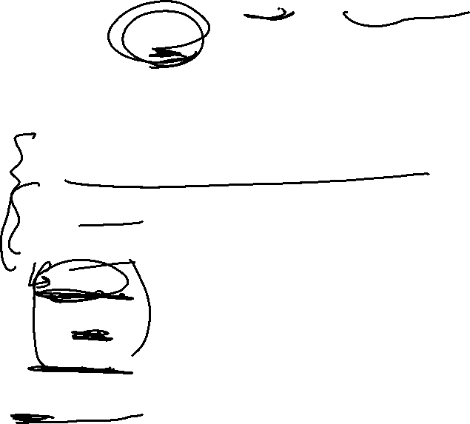


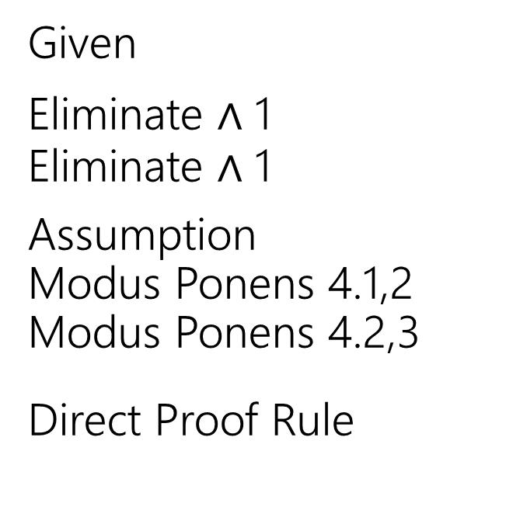
Given: (($p→q)∧(q→r))$ Show: $(p→r)$
Here’s a corrected version of the proof.
$\left(p→q\right)∧\left(q→r\right)$
$p→q$
$q→r$
4.1 $p$
4.2 $q$
4.3 $r$
$p→r$
Given
Eliminate $∧$ 1
Eliminate $∧$ 1
Assumption
Modus Ponens 4.1,2
Modus Ponens 4.2,3
Direct Proof Rule
When introducing an assumption to prove an implication:
Indent, and change numbering.
When reached your conclusion, use the Direct Proof Rule to observe the implication is a fact.
The conclusion is an unconditional fact (doesn’t depend on $p$) so it goes back up a level

Slide 7
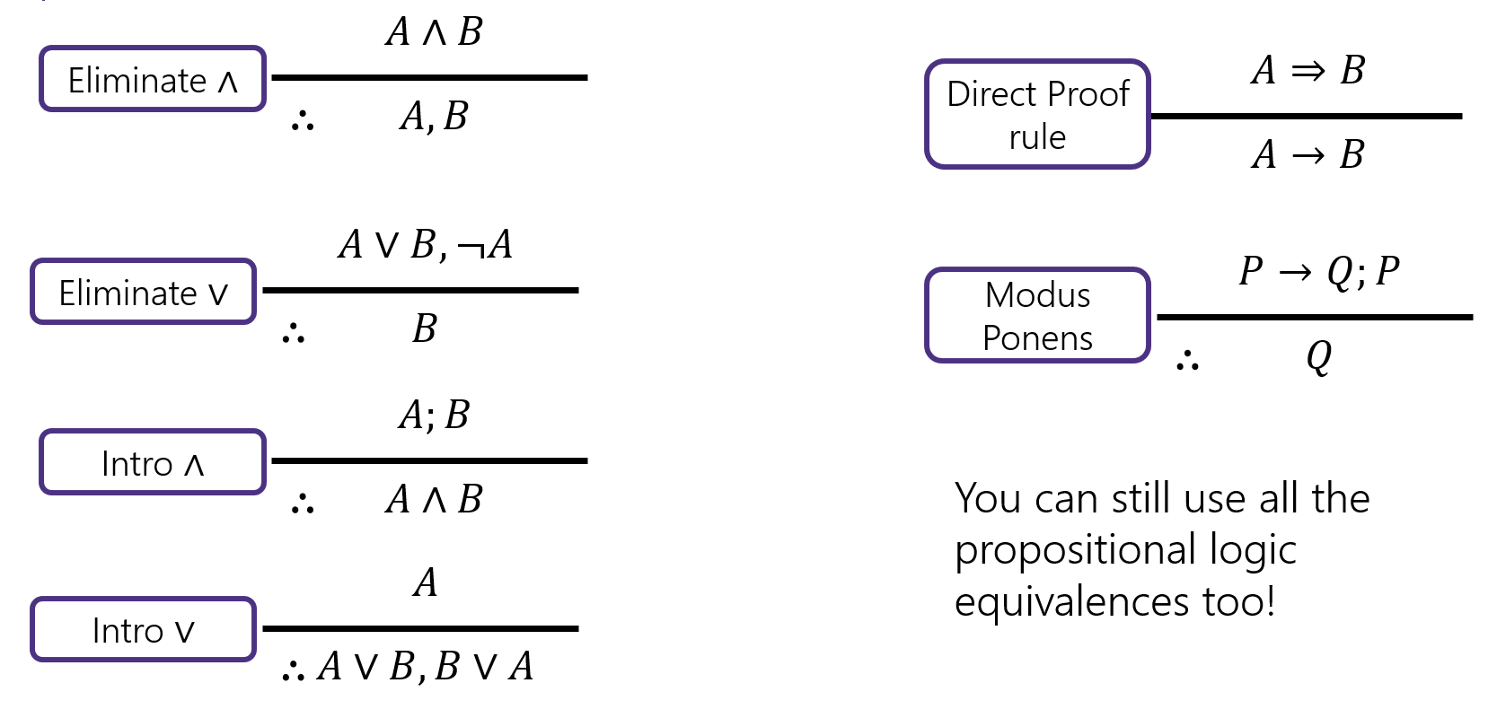

Try it!
Given: $p∨q$, $\left(r∧s\right)→¬q$, $r$. Show: $s→p$

Slide 8


Try it!
Given: $p∨q$, $\left(r∧s\right)→¬q$, $r$. Show: $s→p$
$p∨q$
$\left(r∧s\right)→¬q$
$r$
4.1 $s$
4.2 $r∧s$
4.3 $¬q$
4.4 $q∨p$
4.5 $p$
$s→p$
Given
Given
Given
Assumption
Intro $∧$(3,4.1)
Modus Ponens (2, 4.2)
Commutativity (1)
Eliminate $∨$ (4.4, 4.3)
Direct Proof Rule

Slide 9
















Inference Rules
$$A∧B$$
Eliminate ∧
$$A⇒B$$
Direct Proof rule
$$∴$$
$$A, B$$
$$A→B$$
$$A∨B, ¬A$$
$$P→Q;P$$
Eliminate $∨$
Modus Ponens
$$∴$$
$$B$$
$$∴$$
$$Q$$
$$A;B$$
Intro ∧
$$∴$$
$$A∧B$$
You can still use all the propositional logic equivalences too!
$$A$$
Intro $∨$
$$∴$$
$$A∨B, B∨A$$

Slide 10
Inference Proofs in Predicate Logic

Slide 11


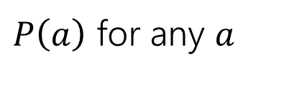





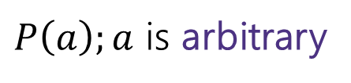


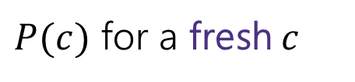
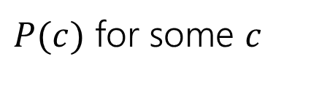



Proofs with Quantifiers
We’ve done symbolic proofs with propositional logic.
To include predicate logic, we’ll need some rules about how to use quantifiers.
$$∀x P(x)$$
$P(c)$ for some $c$
Eliminate $∀$
Intro $∃$
$$∴$$
$$∴$$
$P\left(a\right)$ for any $a$
$$∃x P(x)$$
$P\left(a\right);a$ is arbitrary
$$∃xP(x)$$
Intro $∀$
Eliminate $∃$
$$∴$$
$$∴$$
$P(c)$ for a fresh $c$
$$∀x P(x)$$
Let’s see a good example, then come back to those “arbitrary” and “fresh” conditions.

Slide 12
Proof Using Quantifiers
Suppose we know $∃xP(x)$ and $∀y[ P\left(y\right)→Q\left(y\right)]$. Conclude $∃xQ(x)$.
$$∀x P(x)$$
$P(c)$ for some $c$
Eliminate $∀$
Intro $∃$
$$∴$$
$$∴$$
$P\left(a\right)$ for any $a$
$$∃x P(x)$$
$P\left(a\right);a$ is arbitrary
$$∃xP(x)$$
Intro $∀$
Eliminate $∃$
$$∴$$
$$∴$$
$P(c)$ for a fresh $c$
$$∀x P(x)$$
Notes:
Have a good example here.

Slide 13
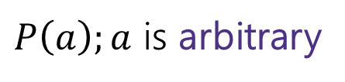



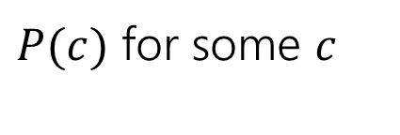




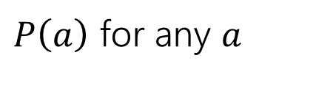






Proof Using Quantifiers
Suppose we know $∃xP(x)$ and $∀y[ P\left(y\right)→Q\left(y\right)]$. Conclude $∃xQ(x)$.
$P(c)$ for some $c$
Intro $∃$
$$∴$$
$$∃x P(x)$$
$$∃xP(x)$$
Eliminate $∃$
$$∴$$
$P(c)$ for a fresh $c$
$$∀x P(x)$$
Eliminate $∀$
$$∴$$
$P\left(a\right)$ for any $a$
$P\left(a\right);a$ is arbitrary
Intro $∀$
$$∴$$
$$∀x P(x)$$
Notes:
Have a good example here.

Slide 14
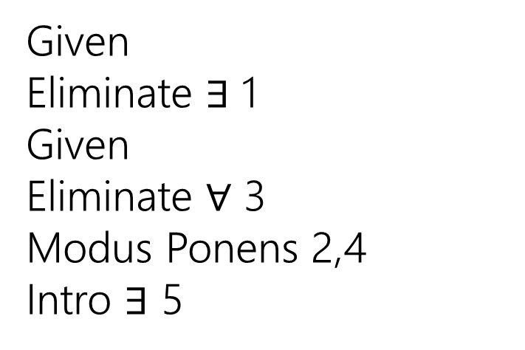
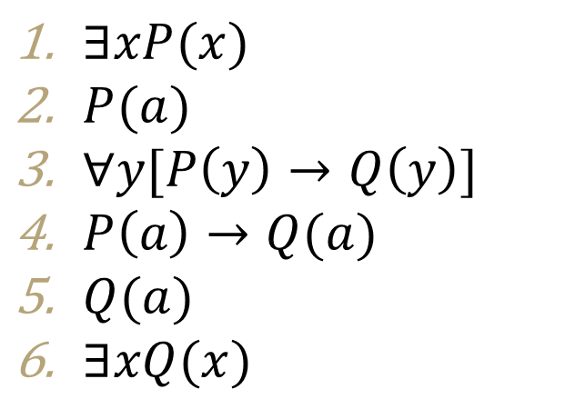
Proof Using Quantifiers
Suppose we know $∃xP(x)$ and $∀y[ P\left(y\right)→Q\left(y\right)]$. Conclude $∃xQ(x)$.
$P(c)$ for some $c$
$∃xP(x)$
$P(a)$
$∀y[P\left(y\right)→Q\left(y\right)]$
$P\left(a\right)→Q(a)$
$Q(a)$
$∃xQ(x)$
Given
Eliminate $∃$ 1
Given
Eliminate $∀$ 3
Modus Ponens 2,4
Intro $∃$ 5
Intro $∃$
$$∴$$
$$∃x P(x)$$
$$∃xP(x)$$
Eliminate $∃$
$$∴$$
$P(c)$ for a fresh $c$
$$∀x P(x)$$
Eliminate $∀$
$$∴$$
$P\left(a\right)$ for any $a$
$P\left(a\right);a$ is arbitrary
Intro $∀$
$$∴$$
$$∀x P(x)$$
Notes:
Have a good example here.

Slide 15
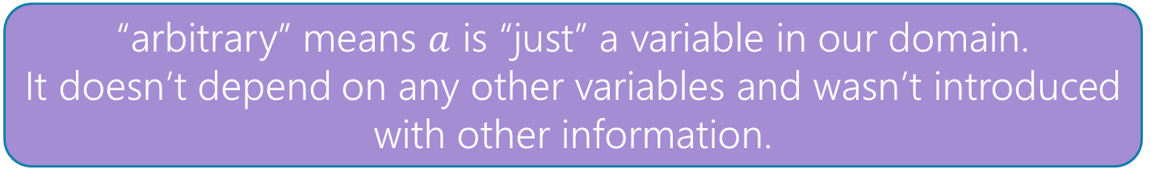
Proofs with Quantifiers
We’ve done symbolic proofs with propositional logic.
To include predicate logic, we’ll need some rules about how to use quantifiers.
$$∀x P(x)$$
$P(c)$ for some $c$
Eliminate $∀$
Intro $∃$
$$∴$$
$$∴$$
$P\left(a\right)$ for any $a$
$$∃x P(x)$$
$P\left(a\right);a$ is arbitrary
$$∃xP(x)$$
Intro $∀$
Eliminate $∃$
$$∴$$
$$∴$$
$P(c)$ for a fresh $c$
$$∀x P(x)$$
“arbitrary” means $a$ is “just” a variable in our domain.
It doesn’t depend on any other variables and wasn’t introduced with other information.

Slide 16
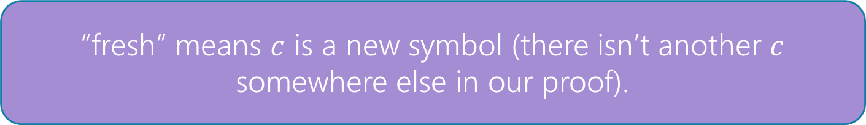
Proofs with Quantifiers
We’ve done symbolic proofs with propositional logic.
To include predicate logic, we’ll need some rules about how to use quantifiers.
$$∀x P(x)$$
$P(c)$ for some $c$
Eliminate $∀$
Intro $∃$
$$∴$$
$$∴$$
$P\left(a\right)$ for any $a$
$$∃x P(x)$$
$P\left(a\right);a$ is arbitrary
$$∃xP(x)$$
Intro $∀$
Eliminate $∃$
$$∴$$
$$∴$$
$P(c)$ for a fresh $c$
$$∀x P(x)$$
“fresh” means $c$ is a new symbol (there isn’t another $c$ somewhere else in our proof).

Slide 17
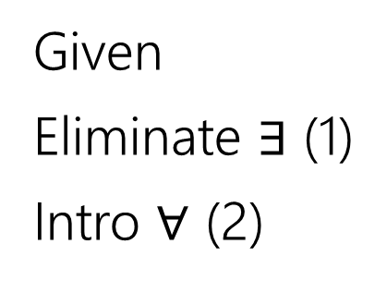
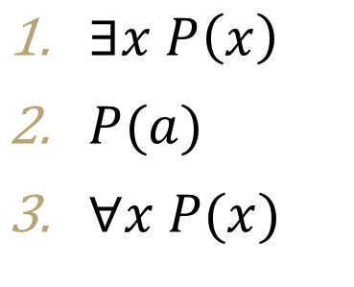
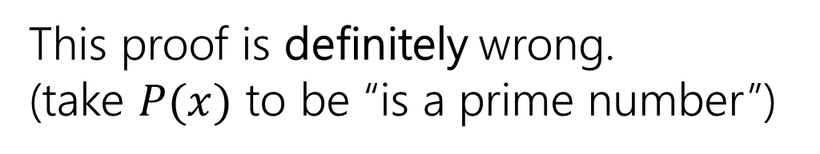
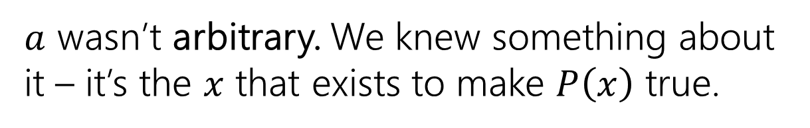
Fresh and Arbitrary
Suppose we know $∃xP\left(x\right)$. Can we conclude $∀xP\left(x\right)$?
$P(c)$ for some $c$
$∃x P\left(x\right)$
$P(a)$
$∀x P(x)$
Given
Eliminate $∃$ (1)
Intro $∀$ (2)
Intro $∃$
$$∴$$
$$∃x P(x)$$
$$∃xP(x)$$
Eliminate $∃$
$$∴$$
$P(c)$ for a fresh $c$
This proof is definitely wrong.
(take $P(x)$ to be “is a prime number”)
$$∀x P(x)$$
Eliminate $∀$
$$∴$$
$P\left(a\right)$ for any $a$
$a$ wasn’t arbitrary. We knew something about it – it’s the $x$ that exists to make $P\left(x\right)$ true.
$P\left(a\right);a$ is arbitrary
Intro $∀$
$$∴$$
$$∀x P(x)$$

Slide 18

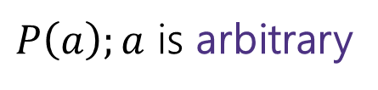

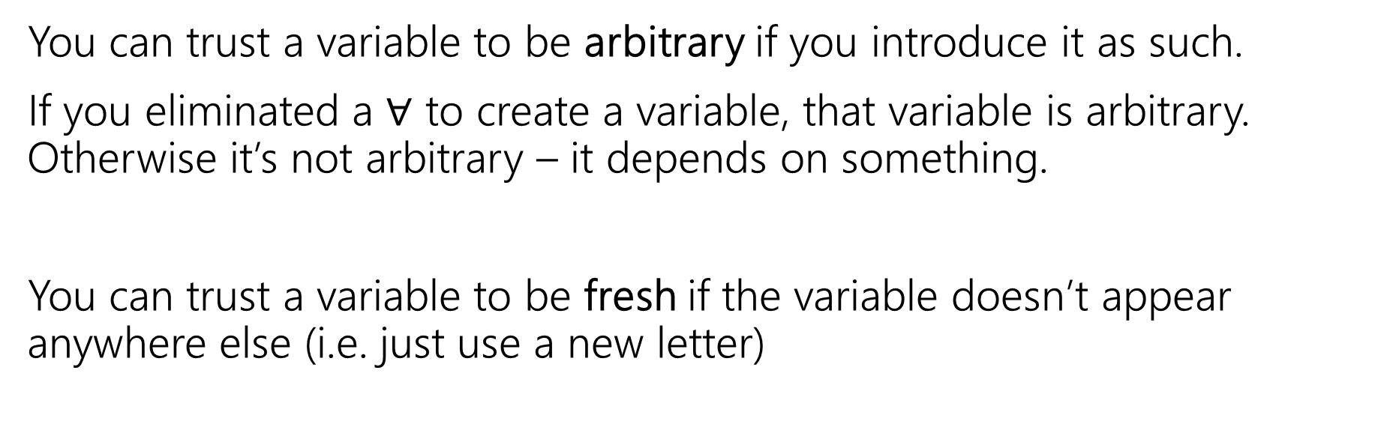





Fresh and Arbitrary
$P\left(a\right);a$ is arbitrary
$$∃xP(x)$$
Intro $∀$
Eliminate $∃$
$$∴$$
$$∴$$
$P(c)$ for a fresh $c$
$$∀x P(x)$$
You can trust a variable to be arbitrary if you introduce it as such.
If you eliminated a $∀$ to create a variable, that variable is arbitrary. Otherwise it’s not arbitrary – it depends on something.
You can trust a variable to be fresh if the variable doesn’t appear anywhere else (i.e. just use a new letter)

Slide 19


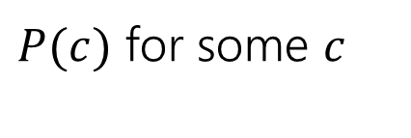
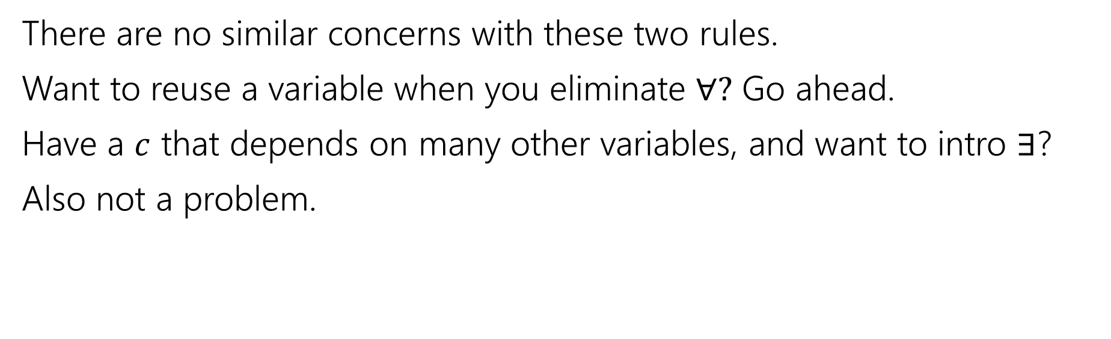



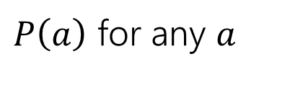

Fresh and Arbitrary
$$∀x P(x)$$
$P(c)$ for some $c$
Eliminate $∀$
Intro $∃$
$$∴$$
$$∴$$
$P\left(a\right)$ for any $a$
$$∃x P(x)$$
There are no similar concerns with these two rules.
Want to reuse a variable when you eliminate $∀?$ Go ahead.
Have a $c$ that depends on many other variables, and want to intro $∃$?
Also not a problem.

Slide 20
Arbitrary
In section, you said: $\left[∃y∀x P\left(x,y\right)\right]→[∀x∃y P\left(x,y\right)]$. Let’s prove it!!

Slide 21
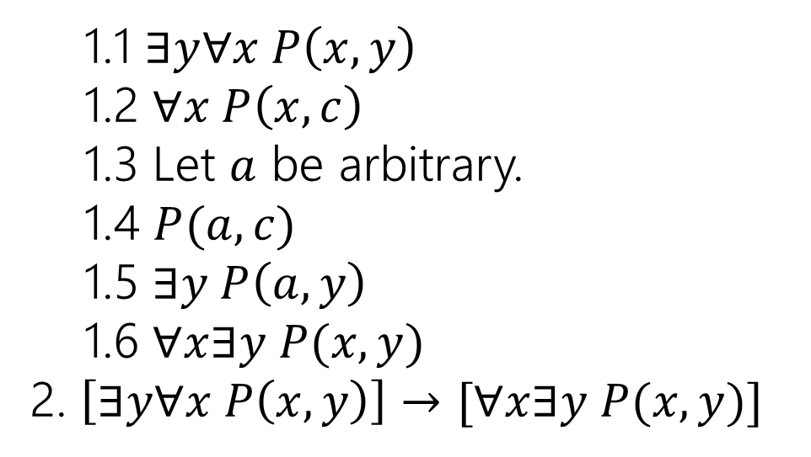
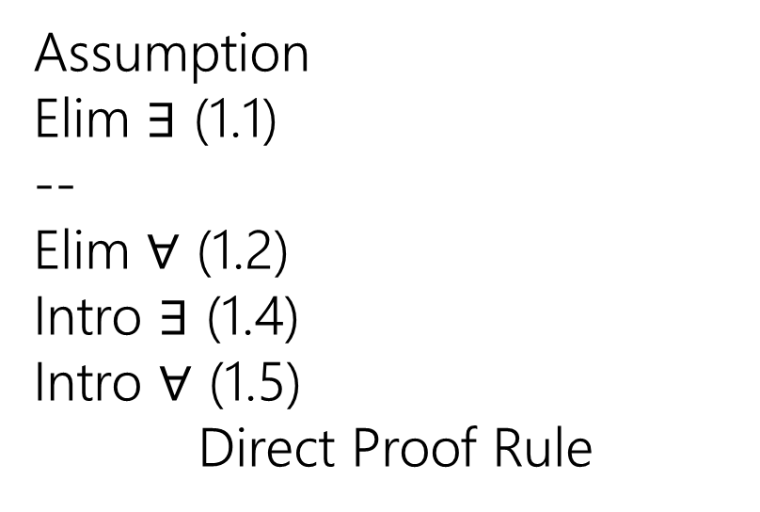
Arbitrary
In section, you said: $\left[∃y∀x P\left(x,y\right)\right]→[∀x∃y P\left(x,y\right)]$. Let’s prove it!!
1.1 $∃y∀x P\left(x,y\right)$
1.2 $∀x P\left(x,c\right)$
1.3 Let $a$ be arbitrary.
1.4 $P(a,c)$
1.5 $∃y P\left(a,y\right)$
1.6 $∀x∃y P(x,y)$
2. $\left[∃y∀x P\left(x,y\right)\right]→[∀x∃y P(x,y)]$
Assumption
Elim $∃$ (1.1)
--
Elim $∀$ (1.2)
Intro $∃$ (1.4)
Intro $∀$ (1.5)
Direct Proof Rule

Slide 22
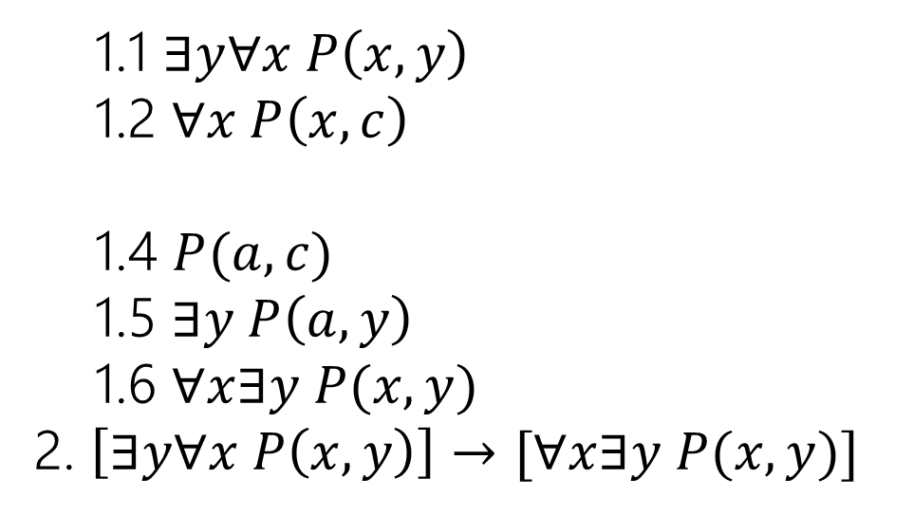
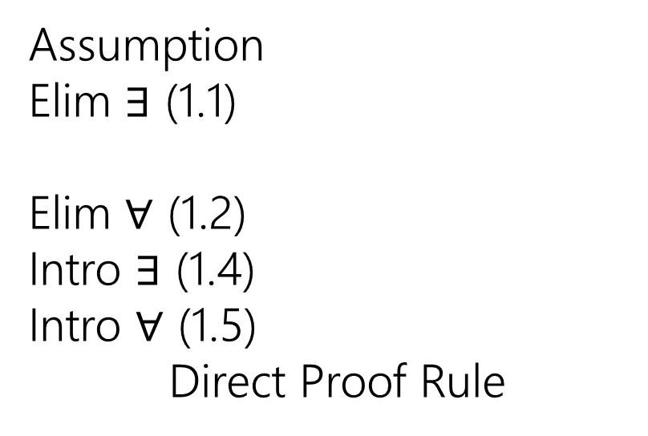
Arbitrary
In section, you said: $\left[∃y∀x P\left(x,y\right)\right]→[∀x∃y P\left(x,y\right)]$. Let’s prove it!!
1.1 $∃y∀x P\left(x,y\right)$
1.2 $∀x P\left(x,c\right)$
1.4 $P(a,c)$
1.5 $∃y P\left(a,y\right)$
1.6 $∀x∃y P(x,y)$
2. $\left[∃y∀x P\left(x,y\right)\right]→[∀x∃y P(x,y)]$
Assumption
Elim $∃$ (1.1)
Elim $∀$ (1.2)
Intro $∃$ (1.4)
Intro $∀$ (1.5)
Direct Proof Rule
It is not required to have “variable is arbitrary” as a step before using it. But many people (including Robbie) find it helpful.

Slide 23
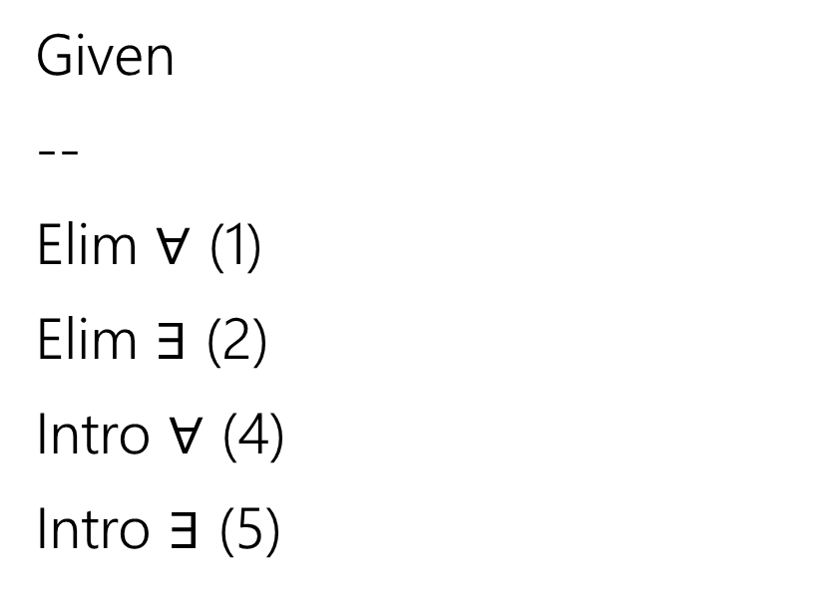
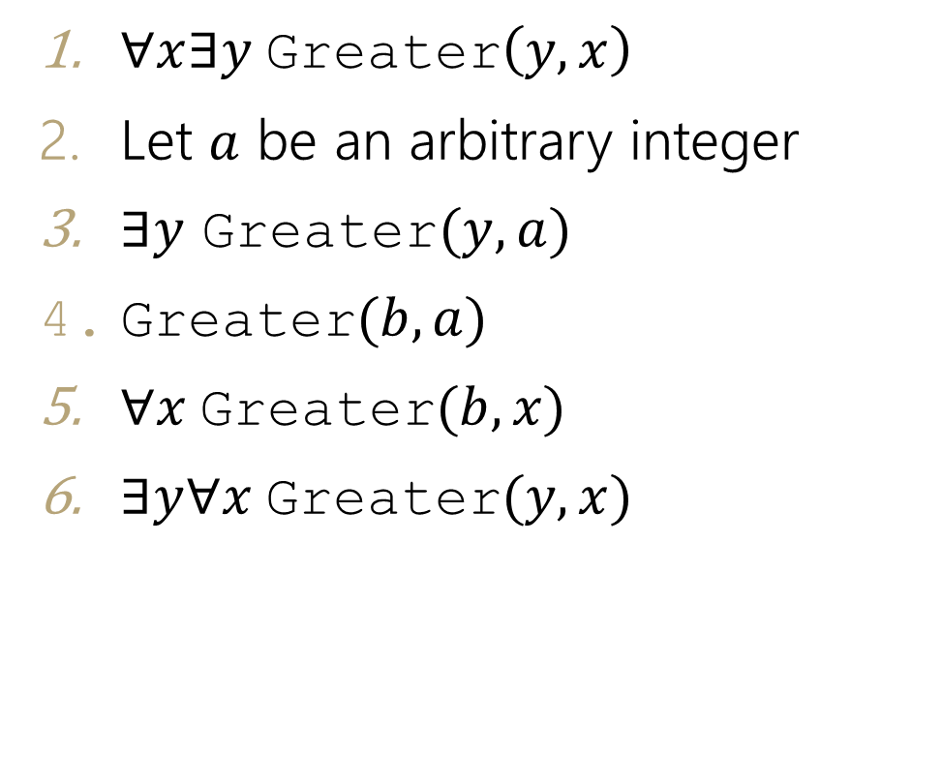
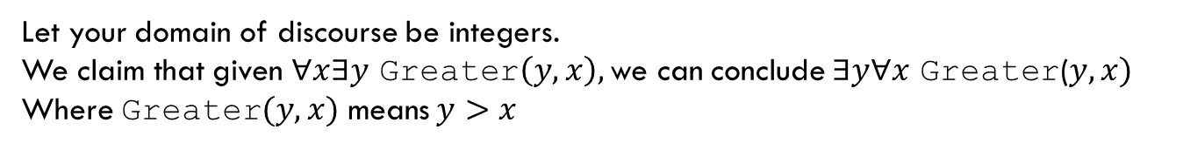
Find The Bug
Let your domain of discourse be integers.
We claim that given $∀x∃y$ Greater$\left(y,x\right),$ we can conclude $∃y∀x$ Greater($y,x)$
Where Greater$(y,x)$ means $y>x$
$∀x∃y$Greater$\left(y,x\right)$
Let $a$ be an arbitrary integer
$∃y$ Greater$(y,a)$
Greater$(b,a)$
$∀x$Greater$(b,x)$
$∃y∀x$Greater$(y,x)$
Given
--
Elim $∀$ (1)
Elim $∃$ (2)
Intro $∀$ (4)
Intro $∃$ (5)

Slide 24
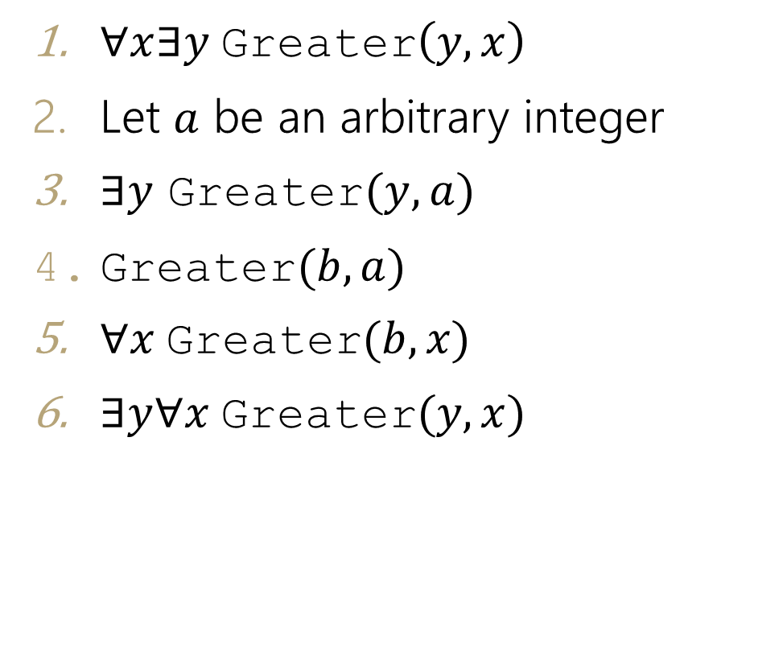
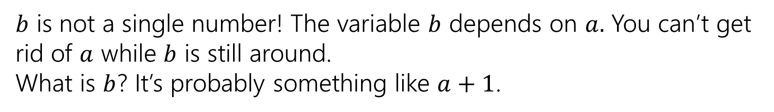
Find The Bug
$∀x∃y$Greater$\left(y,x\right)$
Let $a$ be an arbitrary integer
$∃y$ Greater$(y,a)$
$\text{Greater}(b,a)$
$∀x$Greater$(b,x)$
$∃y∀x$Greater$(y,x)$
Given
--
Elim $∀$ (1)
Elim $∃$ (2)
Intro $∀$ (4)
Intro $∃$ (5)
$b$ is not a single number! The variable $b$ depends on $a.$ You can’t get rid of $a$ while $b$ is still around.
What is $b$? It’s probably something like $a+1$.

Slide 25
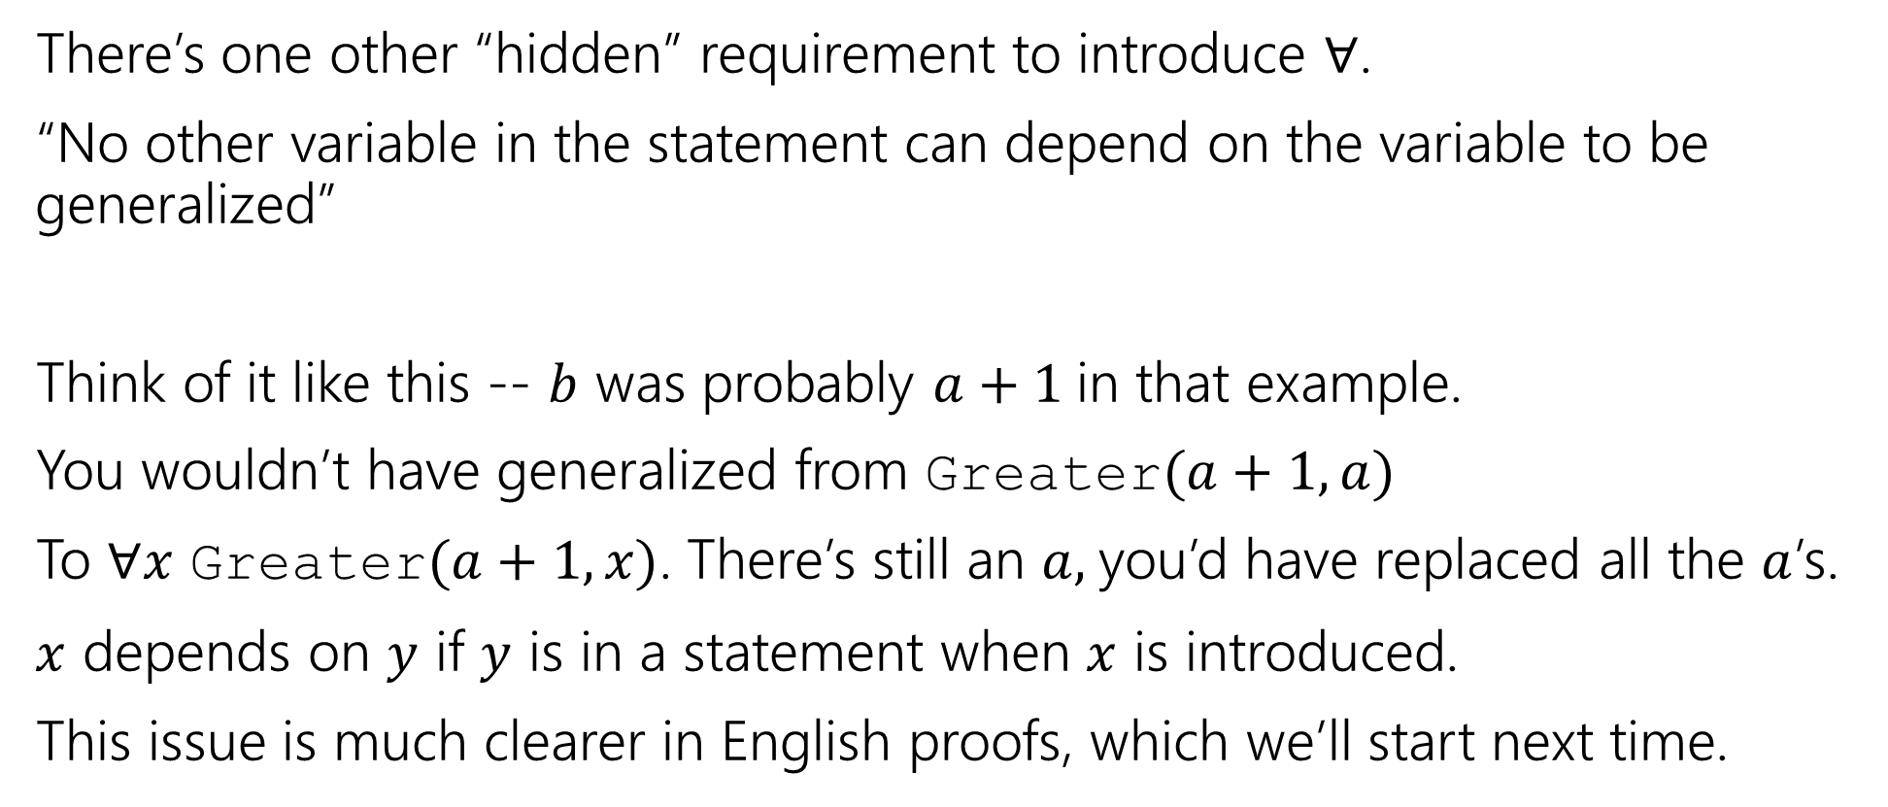
Bug Found
There’s one other “hidden” requirement to introduce $∀$.
“No other variable in the statement can depend on the variable to be generalized”
Think of it like this -- $b$ was probably $a+1$in that example.
You wouldn’t have generalized from Greater$(a+1,a)$
To $∀x$ Greater$(a+1, x)$. There’s still an $a,$you’d have replaced all the $a$’s.
$x$ depends on $y$ if $y$ is in a statement when $x$ is introduced.
This issue is much clearer in English proofs, which we’ll start next time.

Slide 26

English Proofs

Slide 27
What’s Next
We’re taking off the training wheels!
Our goal with writing symbolic proofs was to prepare us to write proofs in English.
Let’s get started.
The next 3 weeks:
Practice communicating clear arguments to others.
Learn new proof techniques.
Learn fundamental objects (sets, number theory) that will let us talk more easily about computation at the end of the quarter.

Slide 28
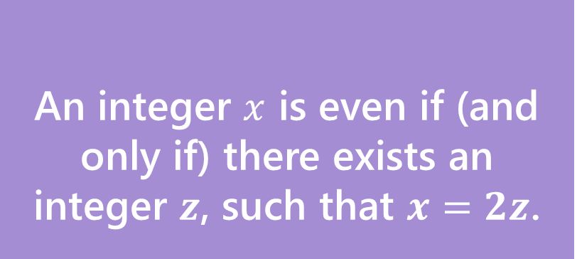
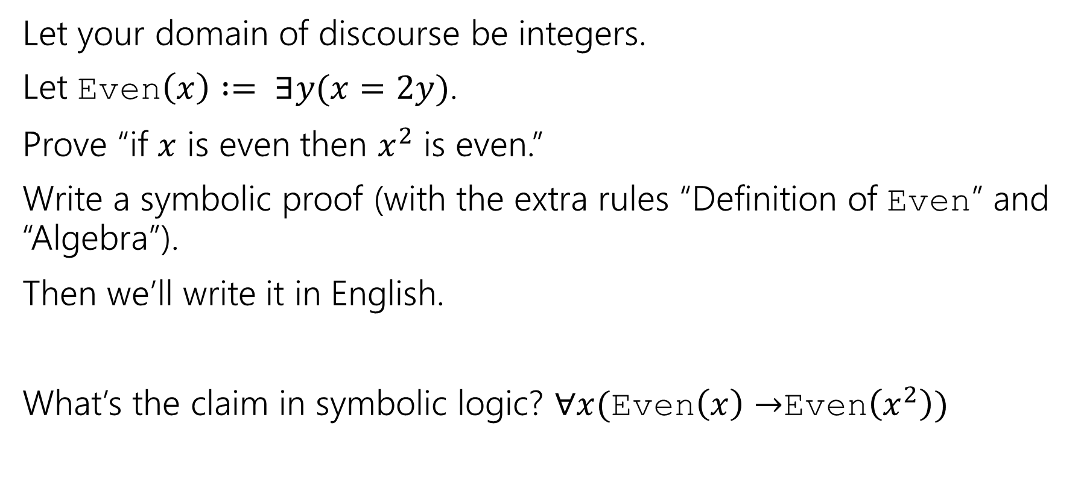
Warm-up
An integer $x$ is even if (and only if) there exists an integer $z$, such that $x=2z$.
Even
Let your domain of discourse be integers.
Let Even$\left(x\right) := ∃y(x=2y)$.
Prove “if $x$ is even then $x^{2}$ is even.”
Write a symbolic proof (with the extra rules “Definition of Even” and “Algebra”).
Then we’ll write it in English.
What’s the claim in symbolic logic? $∀x($Even$\left(x\right)→$Even$\left(x^{2}\right))$

Slide 29
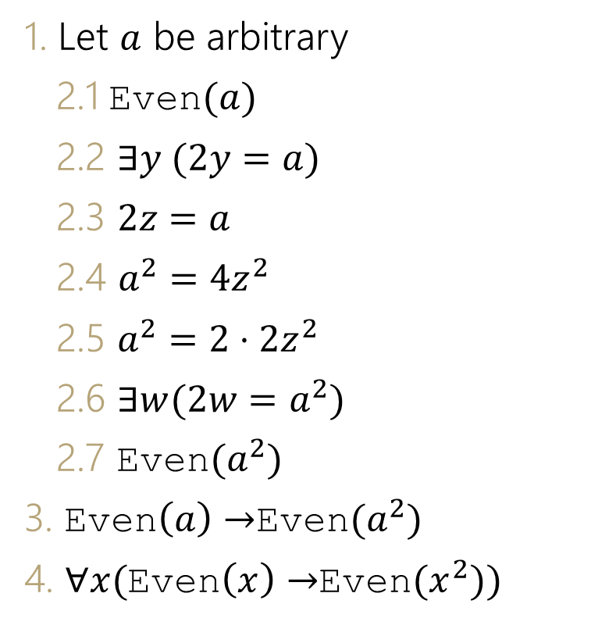
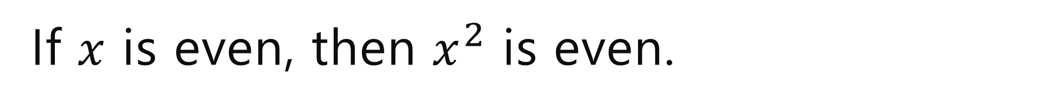

If $x$ is even, then $x^{2}$ is even.
1. Let $a$ be arbitrary
2.1 Even$(a)$
2.2 $∃y (2y=a)$
2.3 $2z=a$
2.4 $a^{2}=4z^{2}$
2.5 $a^{2}=2⋅2z^{2}$
2.6 $∃w(2w=a^{2})$
2.7 Even$(a^{2})$
3. Even$\left(a\right)→$Even$(a^{2})$
4. $∀x($Even$\left(x\right)→$Even$(x^{2}))$
Assumption
Definition of Even (2.1)
Elim $∃\left(2.2\right)$
Algebra (2.3)
Alegbra (2.4)
Intro $∃$ (2.5)
Definition of Even
Direct Proof Rule (2.1-2.7)
Intro $∀$(3)

Slide 30
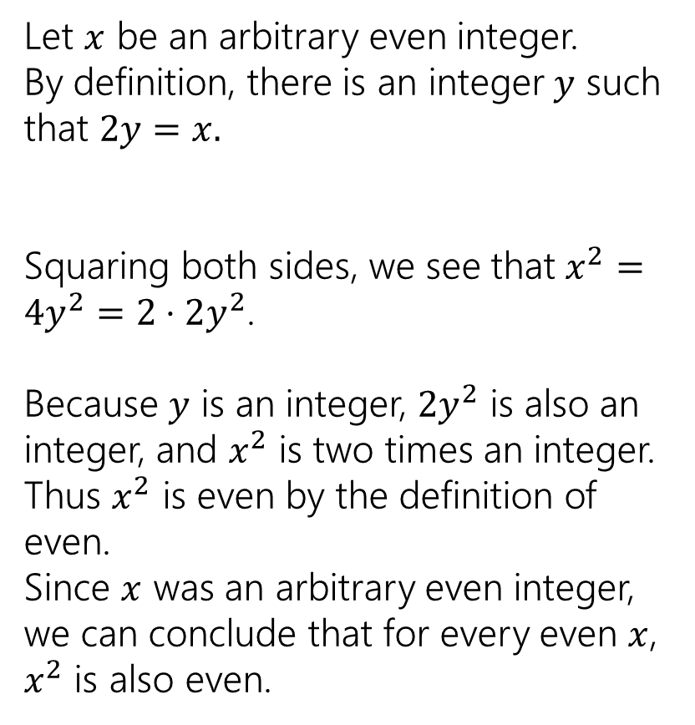
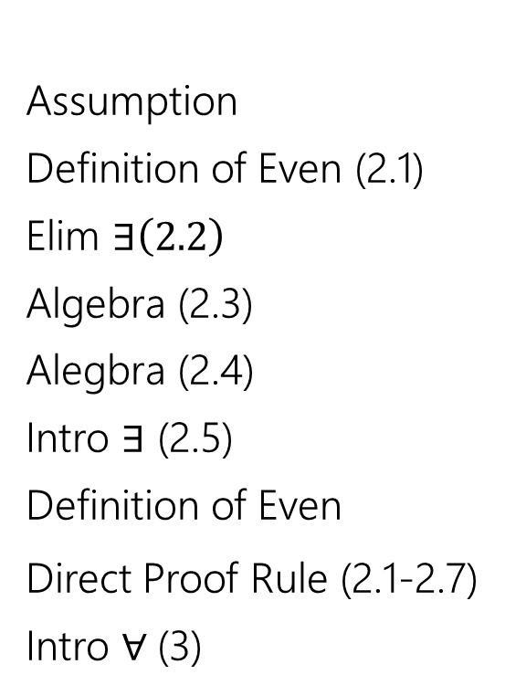
If $x$ is even, then $x^{2}$ is even.
1. Let $a$ be arbitrary
2.1 Even$(a)$
2.2 $∃y (2y=a)$
2.3 $2z=a$
2.4 $a^{2}=4z^{2}$
2.5 $a^{2}=2⋅2z^{2}$
2.6 $∃w(2w=a^{2})$
2.7 Even$(a^{2})$
3. Even$\left(a\right)→$Even$(a^{2})$
4. $∀x($Even$\left(x\right)→$Even$(x^{2}))$
Assumption
Definition of Even (2.1)
Elim $∃\left(2.2\right)$
Algebra (2.3)
Alegbra (2.4)
Intro $∃$ (2.5)
Definition of Even
Direct Proof Rule (2.1-2.7)
Intro $∀$(3)
Let $x$ be an arbitrary even integer.
By definition, there is an integer $y$ such that $2y=x.$
Squaring both sides, we see that $x^{2}=4y^{2}=2⋅2y^{2}$.
Because $y$ is an integer, $2y^{2}$ is also an integer, and $x^{2}$ is two times an integer.
Thus $x^{2}$ is even by the definition of even.
Since $x$ was an arbitrary even integer, we can conclude that for every even $x$, $x^{2}$ is also even.

Slide 31
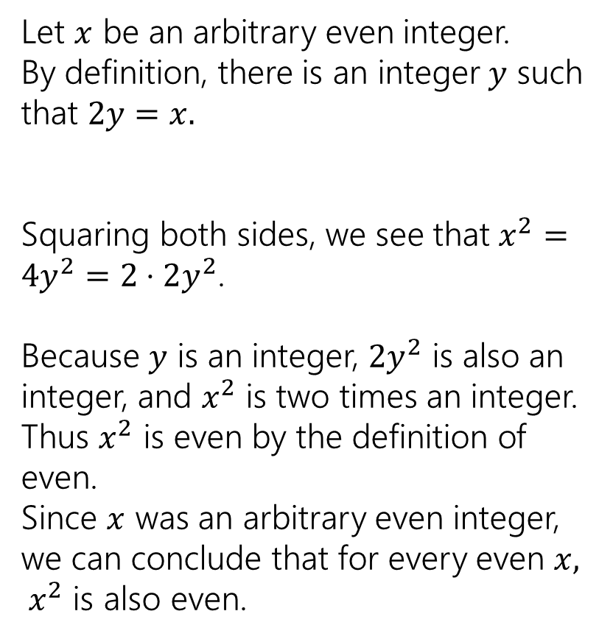

Converting to English
Start by introducing your assumptions.
Introduce variables with “let.” Introduce assumptions with “suppose.”
Always state what type your variable is. English proofs don’t have an established domain of discourse.
Don’t just use “algebra” explain what’s going on.
We don’t explicitly intro/elim $∃/∀$ so we end up with fewer “dummy variables”
Let $x$ be an arbitrary even integer.
By definition, there is an integer $y$ such that $2y=x.$
Squaring both sides, we see that $x^{2}=4y^{2}=2⋅2y^{2}$.
Because $y$ is an integer, $2y^{2}$ is also an integer, and $x^{2}$ is two times an integer.
Thus $x^{2}$ is even by the definition of even.
Since $x$ was an arbitrary even integer, we can conclude that for every even $x, x^{2}$ is also even.

Slide 32


Let’s do another!
First a definition
A real number $x$ is rational if (and only if) there exist integers $p$ and $q$, with $q≠0$ such that $x=p/q$.
Rational
Rational($x$)$≔∃p∃q($Integer$\left(p\right)∧$Integer$\left(q\right)∧(x=p/q)∧q≠0)$

Slide 33

Let’s do another!
“The product of two rational numbers is rational.”
What is this statement in predicate logic?
$∀x∀y([$rational$\left(x\right)∧$rational$(y)]→$rational$(xy))$
Remember unquantified variables in English are implicitly universally quantified.

Slide 34

Doing a Proof
$∀x∀y([$rational$\left(x\right)∧$rational$(y)]→$rational$(xy))$
“The product of two rational numbers is rational.”
DON’T just jump right in!
Look at the statement, make sure you know:
1. What every word in the statement means.
2. What the statement as a whole means.
3. Where to start.
4. What your target is.

Slide 35

Let’s do another!
“The product of two rational numbers is rational.”
Let $x,y$ be arbitrary rational numbers.
Therefore, $xy$ is rational.
Since $x$ and $y$ were arbitrary, we can conclude the product of two rational numbers is rational.

Slide 36

Let’s do another!
“The product of two rational numbers is rational.”
Let $x,y$ be arbitrary rational numbers.
By the definition of rational, $x=a/b$, $y=c/d$ for integers $a,b,c,d$ where $b≠0$ and $d≠0$.
Multiplying, $xy=\frac{a}{b}⋅\frac{c}{d}=\frac{ac}{bd}$.
Since integers are closed under multiplication, $ac$ and $bd$ are integers.
Moreover, $bd≠0$ because neither $b$ nor $d$ is $0$. Thus $xy$ is rational.
Since $x$ and $y$ were arbitrary, we can conclude the product of two rational numbers is rational.

Slide 37
Now You Try
The sum of two even numbers is even.
1. Write the statement in predicate logic.
2. Write an English proof.
3. If you have lots of extra time, try writing the symbolic proof instead.

Slide 38

Now You Try
An integer $x$ is even if (and only if) there exists an integer $z$, such that $x=2z$.
Even
The sum of two even numbers is even.
Make sure you know:
1. What every word in the statement means.
2. What the statement as a whole means.
3. Where to start.
4. What your target is.
Pollev.com/cse311
Help me adjust my explanation!
1. Write the statement in predicate logic.
2. Write an English proof.
3. If you have lots of extra time, try writing the symbolic proof instead.

Slide 39

Here’s What I got.
$∀x∀y([$Even$\left(x\right)∧$ Even$(y)]$ $→$Even$\left(x+y\right))$
Let $x$, $y$ be arbitrary integers, and suppose $x$ and $y$ are even.
By the definition of even, $x=2a,y=2b$ for some integers $a$ and $b$.
Summing the equations, $x+y=2a+2b=2(a+b)$.
Since $a$ and $b$ are integers, $a+b$ is an integer, so $x+y$ is even by the definition of even.
Since $x,y$ were arbitrary, we can conclude the sum of two even integers is even.

Slide 40
Why English Proofs?
Those symbolic proofs seemed pretty nice. Computers understand them, and can check them.
So what’s up with these English proofs?
They’re far easier for people to understand.
But instead of a computer checking them, now a human is checking them.

