Slide 1
Negating Quantifiers, Direct Proof Rule
CSE 311 Winter 2022
Lecture 7

Slide 2
Announcements
Sign up for canvas groups for your lecture breakouts.
Includes options for “quiet room” and “put me in a random group”
We added a clarification on Ed about how to translate in problem 7, because we didn’t specify a domain (we were getting questions frequently in office hours yesterday).
It’s in the HW2 Q7 megathread here
Optional reading on domain restriction on the calendar for today’s lecture.
Goes through an example more slowly and explains why the rules are what they are.

Slide 3
About Grades
Grades were critical in your lives up until now.
If you were in high school, they’re critical for getting into college.
If you were at UW or CC applying to CSE, they were key to that application
Regardless of where you’re going next, what you learn in this course matters FAR more than what your grade is in this course.
If you’re planning on industry – interviews matter more than grades.
If you’re planning on grad school – letters matter most, those are based on doing work outside of class building off what you learned in class.

Slide 4
About Grades
What that means:
The TAs and I are going to prioritize your learning over debating whether -2 or -1 is “ more fair”
If you’re worried about “have I explained enough” – write more!
It’ll take you longer to write the Ed question than write the extended answer. We don’t take off for too much work.
And the extra writing is going to help you learn more anyway.

Slide 5
Regrades
TAs make mistakes!
When I was a TA, I made errors on 1 or 2% of my grading that needed to be corrected. If we made a mistake, file a regrade request on gradescope.
But those are only for mistakes, not for whether “-1 would be more fair”
If you are confused, please talk to us!
My favorite office hours questions are “can we talk about the best way to do something on the homework we just got back?”
If after you do a regrade request on gradescope, you still think a grading was incorrect, send email to Robbie.
Regrade requests will close about 1 week after homework is returned.

Slide 6
Today
Continuing two threads:
Quantifiers
Inference Proofs
At the end (maybe) Inference Proofs with quantifiers

Slide 7
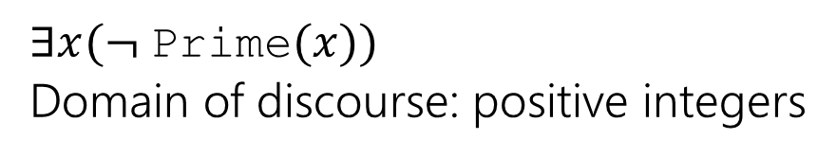
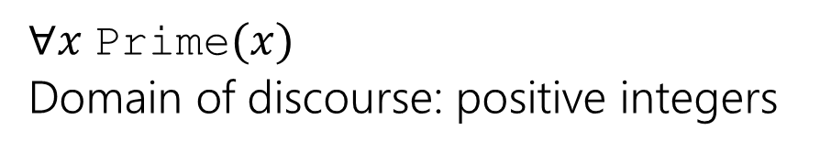
Negating Quantifiers
What happens when we negate an expression with quantifiers?
What does your intuition say?
Negation
Original
Every positive integer is prime
There is a positive integer that is not prime.
$∀x$Prime$(x)$
Domain of discourse: positive integers
$∃x(¬$Prime$(x))$
Domain of discourse: positive integers

Slide 8
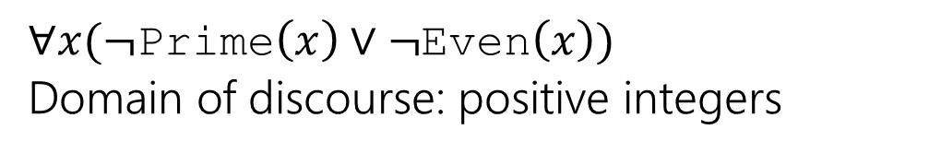
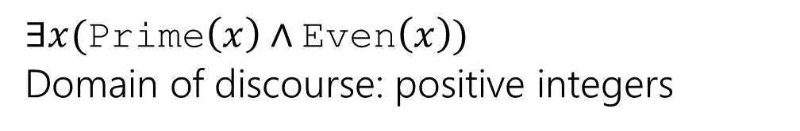
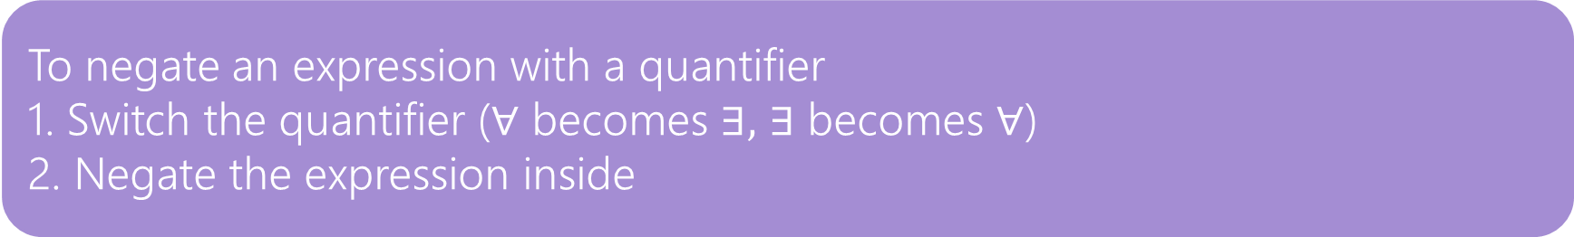
Negating Quantifiers
Let’s try on an existential quantifier…
Original
Negation
There is a positive integer which is prime and even.
Every positive integer is composite or odd.
$∃x($Prime$\left(x\right)∧$Even$\left(x\right))$
Domain of discourse: positive integers
$∀x(¬$Prime$\left(x\right)∨¬$Even$\left(x\right))$
Domain of discourse: positive integers
To negate an expression with a quantifier
1. Switch the quantifier ($∀$ becomes $∃,$ $∃$ becomes $∀$)
2. Negate the expression inside

Slide 9
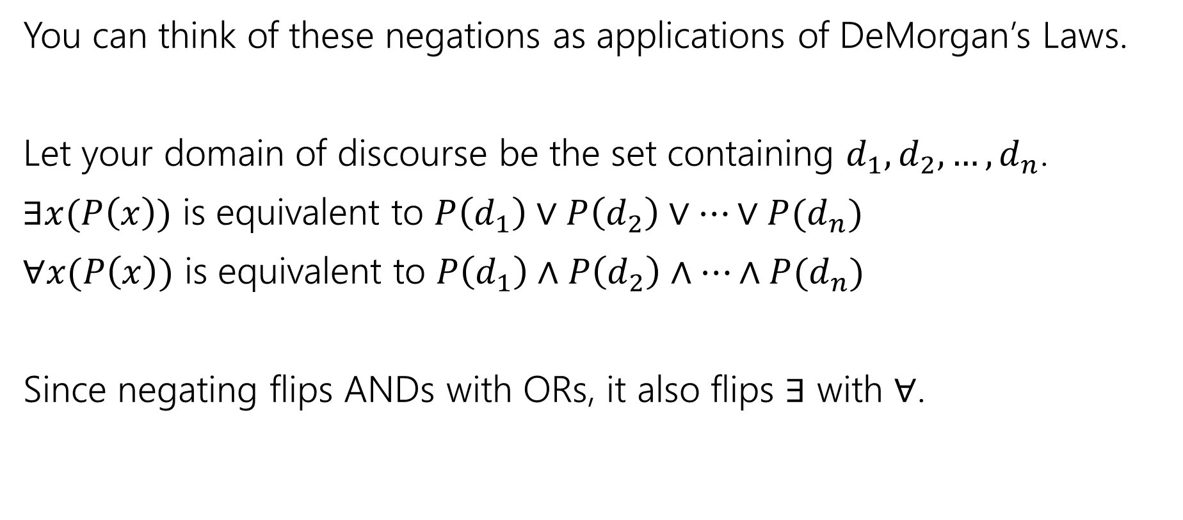
Negating Quantifiers
You can think of these negations as applications of DeMorgan’s Laws.
Let your domain of discourse be the set containing $d_{1},d_{2},…,d_{n}$.
$∃x(P\left(x\right))$ is equivalent to $P\left(d_{1}\right)∨P\left(d_{2}\right)∨…∨P(d_{n})$
$∀x(P\left(x\right))$ is equivalent to $P\left(d_{1}\right)∧P\left(d_{2}\right)∧…∧P(d_{n})$
Since negating flips ANDs with ORs, it also flips $∃$ with $∀$.

Slide 10
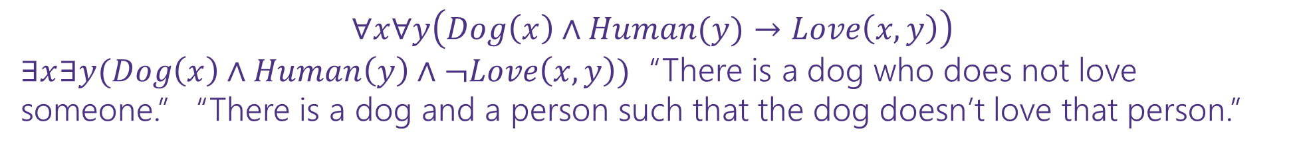
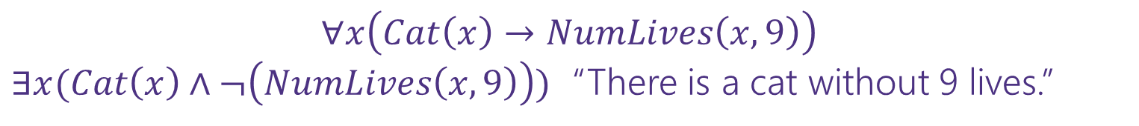
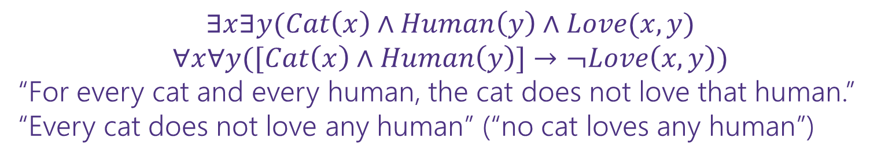
Negation
Negate these sentences in English and translate the original and negation to predicate logic.
All cats have nine lives.
All dogs love every person.
There is a cat that loves someone.
$$∀x\left(Cat\left(x\right)→NumLives\left(x,9\right)\right)$$
$∃x(Cat\left(x\right)∧¬\left(NumLives\left(x,9\right)\right))$ “There is a cat without 9 lives.”
$$∀x∀y\left(Dog\left(x\right)∧Human(y)→Love\left(x,y\right)\right)$$
$∃x∃y(Dog\left(x\right)∧Human\left(y\right)∧¬Love\left(x,y\right))$ “There is a dog who does not love someone.” “There is a dog and a person such that the dog doesn’t love that person.”
$$∃x∃y(Cat\left(x\right)∧Human\left(y\right)∧Love(x,y)$$
$$∀x∀y([Cat\left(x\right)∧Human\left(y\right)]→¬Love\left(x,y\right))$$
“For every cat and every human, the cat does not love that human.”
“Every cat does not love any human” (“no cat loves any human”)

Slide 11
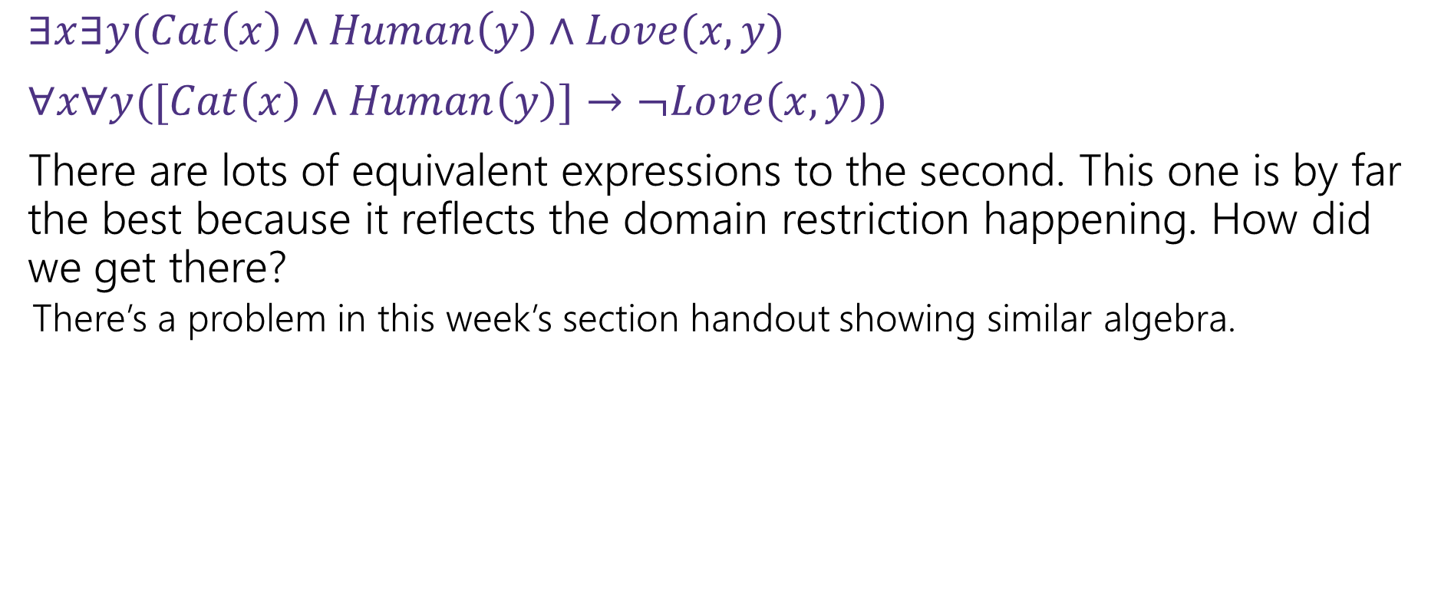
Negation with Domain Restriction
$∃x∃y(Cat\left(x\right)∧Human\left(y\right)∧Love(x,y)$
$∀x∀y([Cat\left(x\right)∧Human\left(y\right)]→¬Love\left(x,y\right))$
There are lots of equivalent expressions to the second. This one is by far the best because it reflects the domain restriction happening. How did we get there?
There’s a problem in this week’s section handout showing similar algebra.

Slide 12
Nested Quantifiers

Slide 13






Nested Quantifiers
Translate these sentences using only quantifiers and the predicate AreFriends$(x,y)$
Everyone is friends with someone.
Someone is friends with everyone.

Slide 14
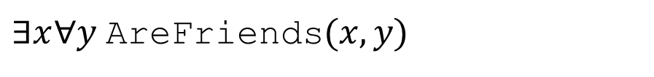
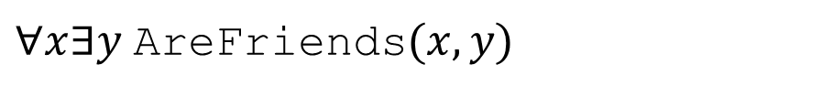
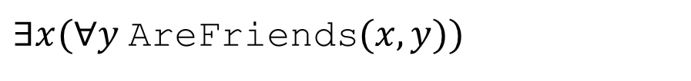
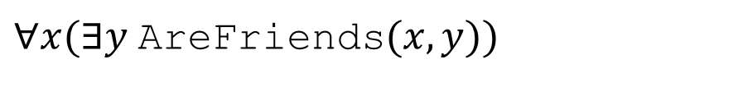
Nested Quantifiers
Translate these sentences using only quantifiers and the predicate AreFriends$(x,y)$
Everyone is friends with someone.
Someone is friends with everyone.
$∀x(∃y$AreFriends$(x,y))$
$∃x(∀y$AreFriends$(x,y))$
$∀x∃y$AreFriends$(x,y)$
$∃x∀y$AreFriends$(x,y)$

Slide 15
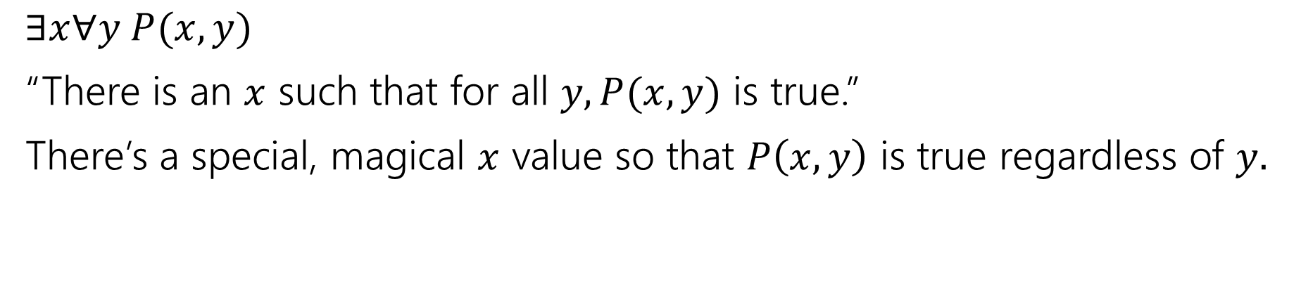
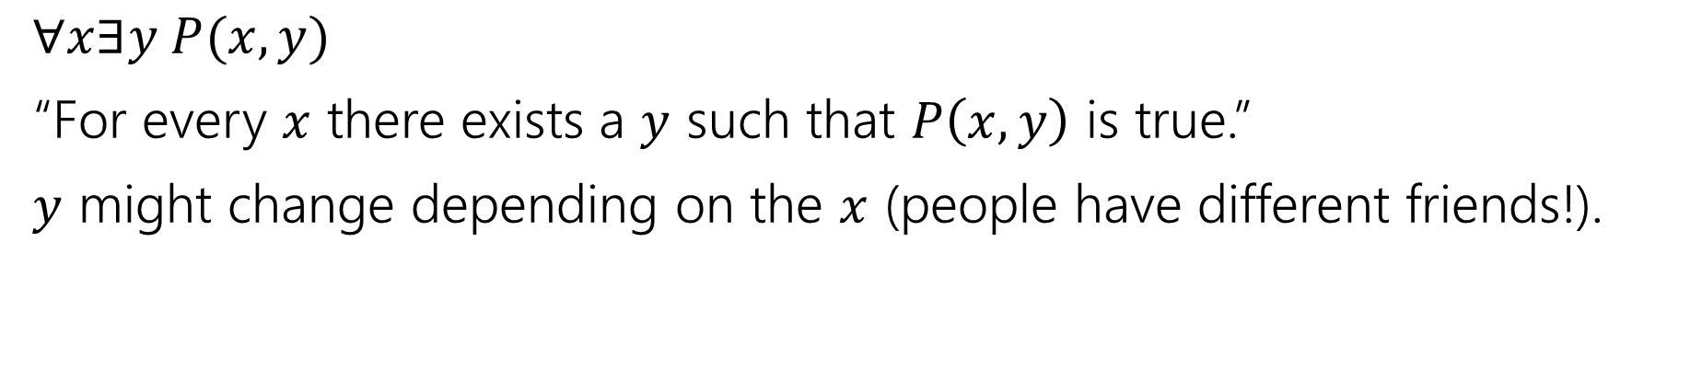
Nested Quantifiers
$∀x∃y P(x,y)$
“For every $x$ there exists a $y$ such that $P\left(x,y\right)$ is true.”
$y$ might change depending on the $x$ (people have different friends!).
$∃x∀y P(x,y)$
“There is an $x$ such that for all $y, P(x,y)$ is true.”
There’s a special, magical $x$ value so that $P\left(x,y\right)$ is true regardless of $y.$

Slide 16
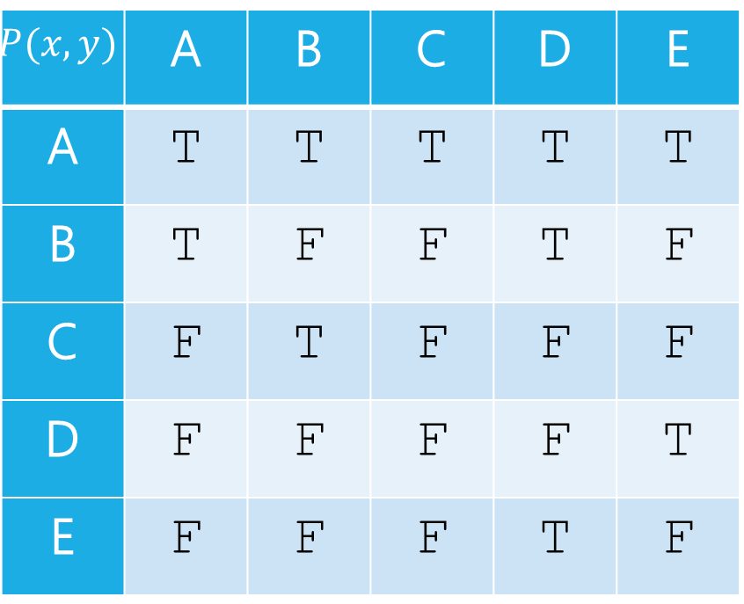
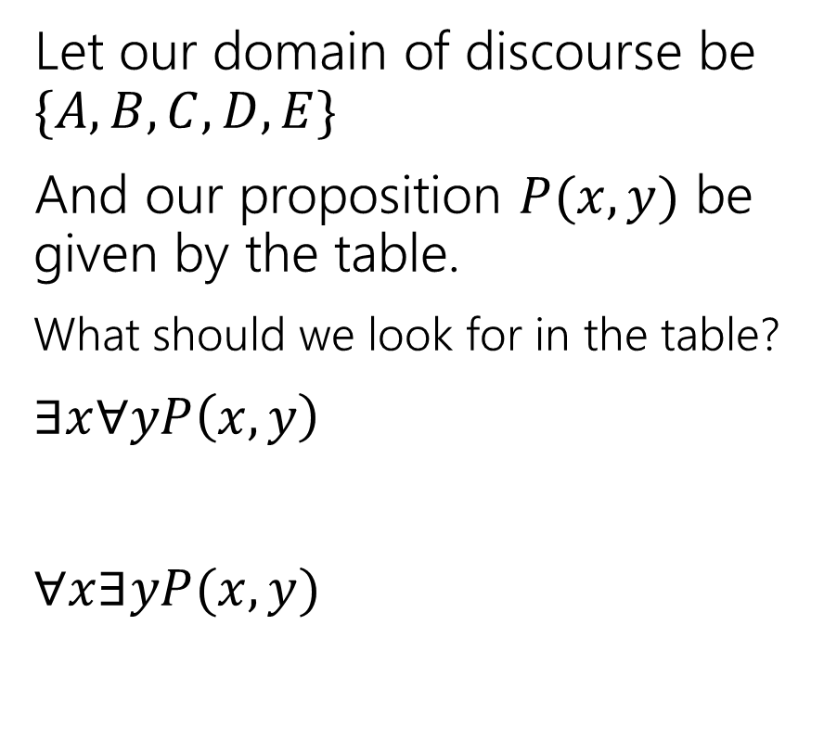


Nested Quantifiers
Let our domain of discourse be $\{A,B,C,D,E\}$
And our proposition $P(x,y)$ be given by the table.
What should we look for in the table?
$∃x∀yP\left(x,y\right)$
$∀x∃yP(x,y)$
$$y$$
$$P(x,y)$$ | A | B | C | D | E
A | T | T | T | T | T
B | T | F | F | T | F
C | F | T | F | F | F
D | F | F | F | F | T
E | F | F | F | T | F
$$x$$

Slide 17
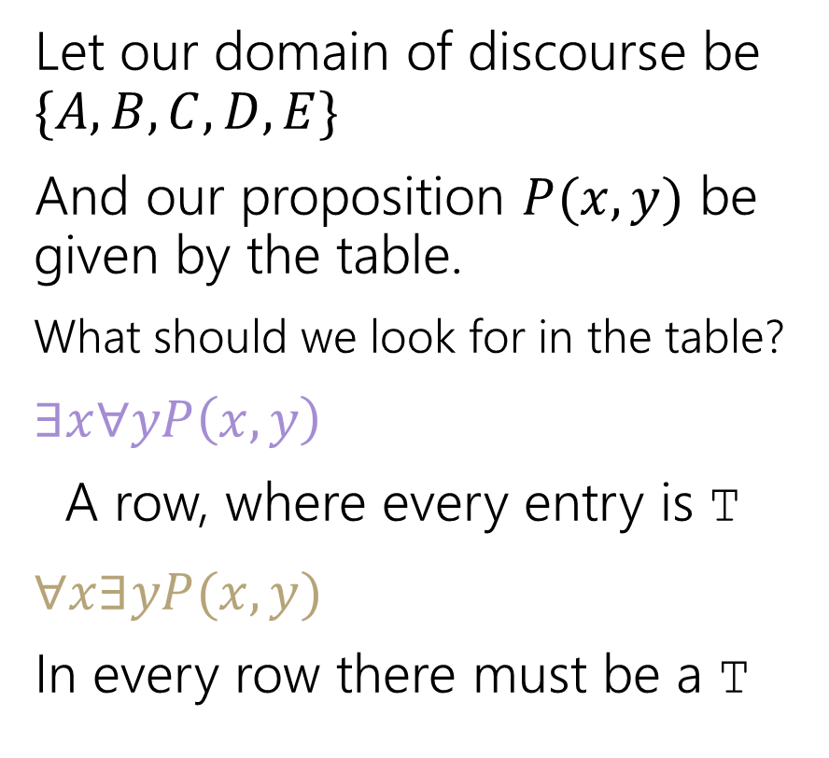
Nested Quantifiers
Let our domain of discourse be $\{A,B,C,D,E\}$
And our proposition $P(x,y)$ be given by the table.
What should we look for in the table?
$∃x∀yP\left(x,y\right)$
A row, where every entry is T
$∀x∃yP(x,y)$
In every row there must be a T
$$y$$
$$P(x,y)$$ | A | B | C | D | E
A | T | T | T | T | T
B | T | F | F | T | F
C | F | T | F | F | F
D | F | F | F | F | T
E | F | F | F | T | F
$$x$$

Slide 18
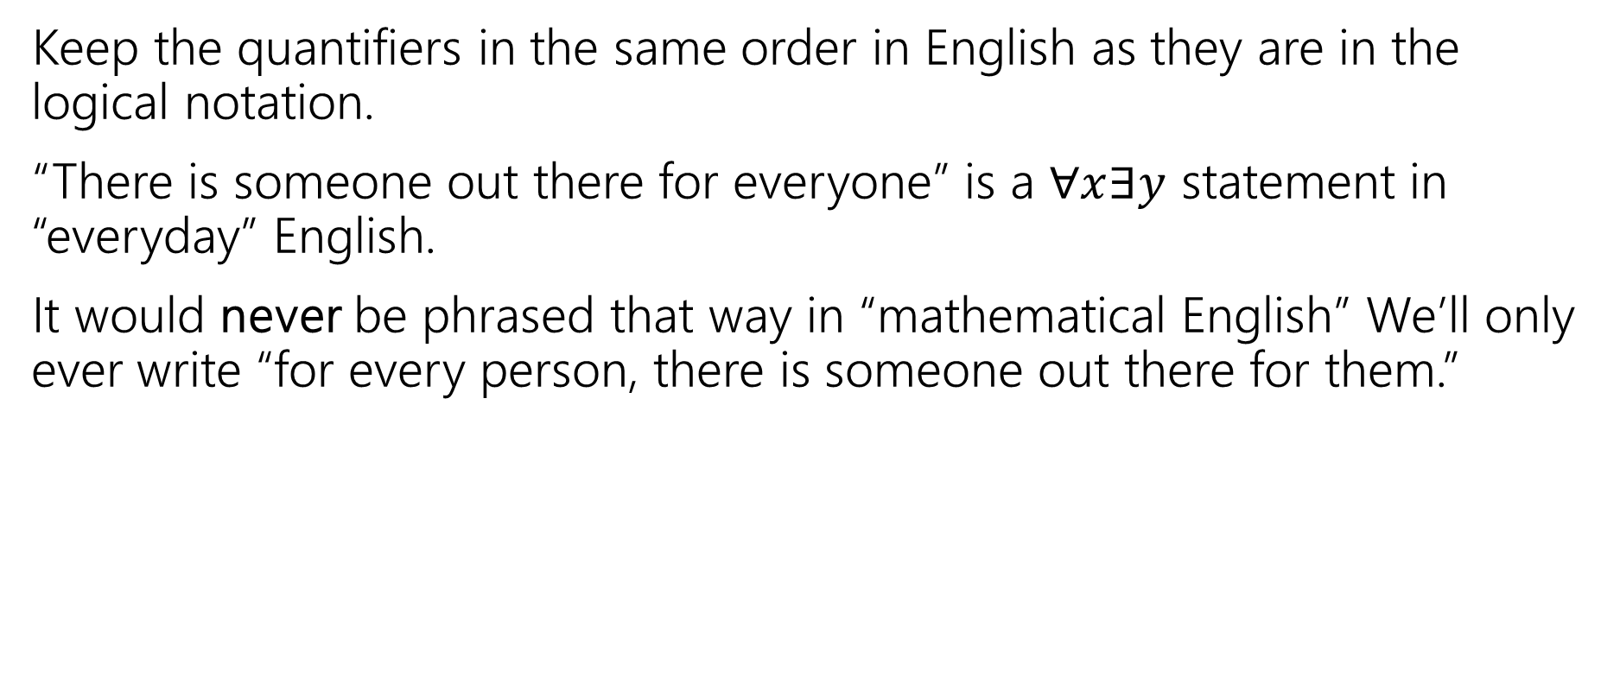
Keep everything in order
Keep the quantifiers in the same order in English as they are in the logical notation.
“There is someone out there for everyone” is a $∀x∃y$ statement in “everyday” English.
It would never be phrased that way in “mathematical English” We’ll only ever write “for every person, there is someone out there for them.”

Slide 19





Try it yourselves
Every cat loves some human.
There is a cat that loves every human.
Let your domain of discourse be mammals.
Use the predicates Cat$(x)$, Dog$(x)$, and Loves$(x,y)$ to mean $x$ loves $y$.

Slide 20
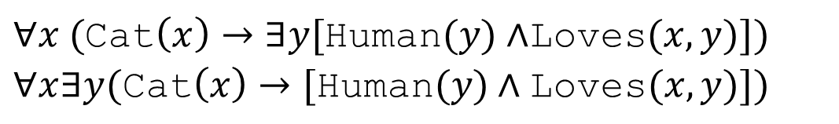
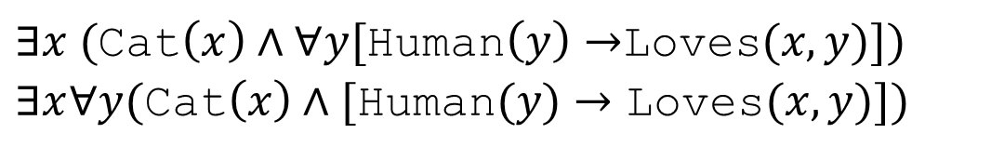
Try it yourselves
Every cat loves some human.
There is a cat that loves every human.
$∀x ($Cat$\left(x\right)→∃y[$Human$(y)∧$Loves$(x,y)])$
$∀x∃y(\text{Cat}\left(x\right)→[\text{Human}(y)∧\text{Loves}(x,y)])$
$∃x ($Cat$\left(x\right)∧∀y[$Human$\left(y\right)→$Loves$(x,y)])$
$∃x∀y(\text{Cat}\left(x\right)∧[\text{Human}(y)→\text{Loves}(x,y)])$

Slide 21
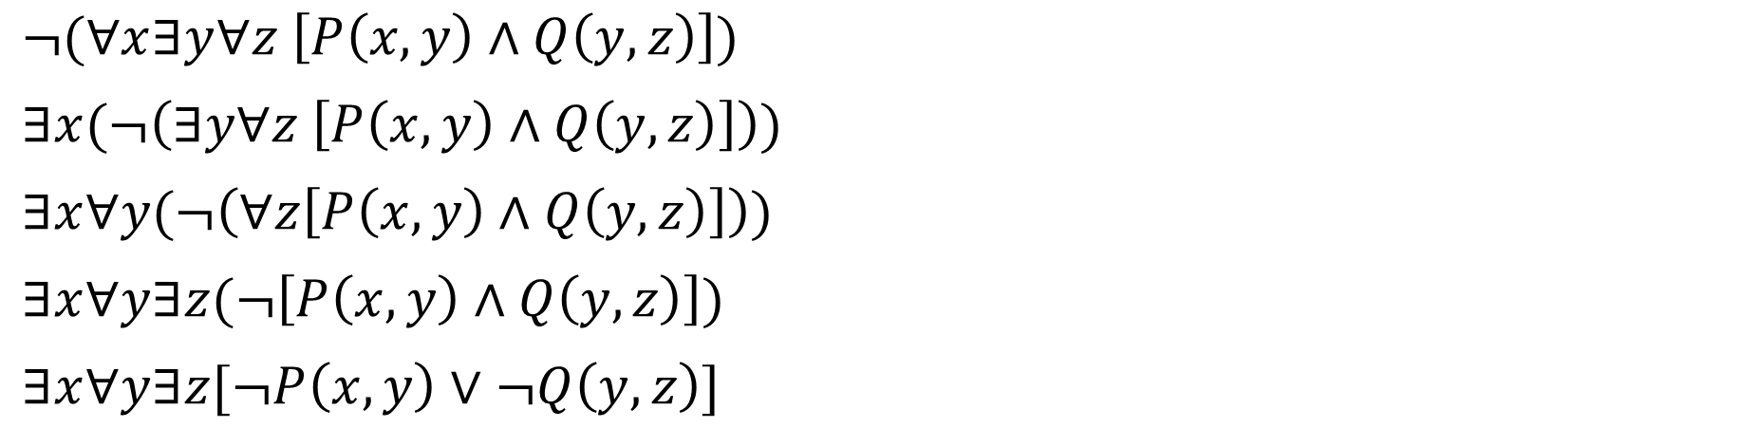
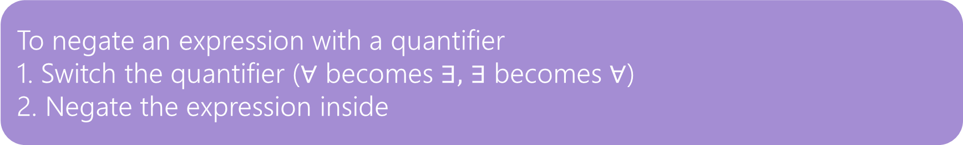
Negation
How do we negate nested quantifiers?
The old rule still applies.
To negate an expression with a quantifier
1. Switch the quantifier ($∀$ becomes $∃,$ $∃$ becomes $∀$)
2. Negate the expression inside
$¬(∀x∃y∀z \left[P\left(x,y\right)∧Q\left(y,z\right)\right])$
$∃x(¬\left(∃y∀z \left[P\left(x,y\right)∧Q\left(y,z\right)\right]\right))$
$∃x∀y(¬\left(∀z\left[P\left(x,y\right)∧Q\left(y,z\right)\right]\right))$
$∃x∀y∃z(¬\left[P\left(x,y\right)∧Q\left(y,z\right)\right])$
$∃x∀y∃z[¬P\left(x,y\right)∨¬Q\left(y,z\right)]$

Slide 22


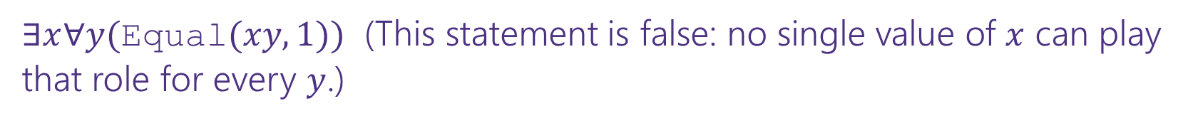
More Translation
For each of the following, translate it, then say whether the statement is true. Let your domain of discourse be integers.
For every integer, there is a greater integer.
There is an integer $x$, such that for all integers $y$, $xy$ is equal to 1.
$∀y∃x($Equal$\left(x+y,1\right))$
$∀x∃y($Greater$(y,x))$ (This statement is true: $y$ can be $x+1$ [$y$ depends on $x]$)
$∃x∀y($Equal$(xy, 1))$ (This statement is false: no single value of $x$ can play that role for every $y$.)
For every integer, $y,$there is an integer $x$ such that $x+y=1$
(This statement is true, $y$ can depend on $x$

Slide 23
Inference Proofs and the Direct Proof Rule

Slide 24

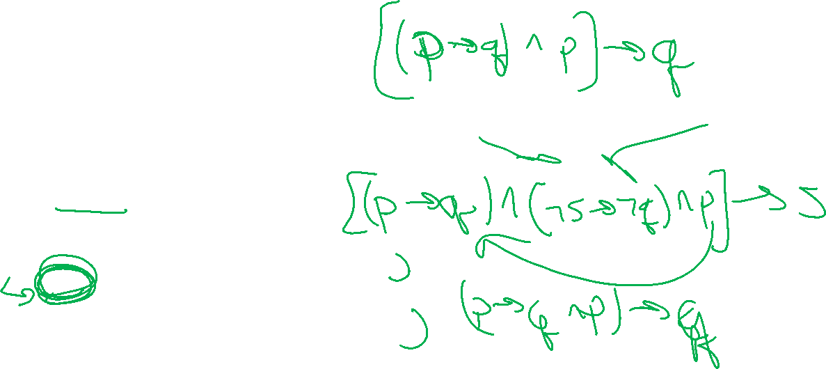

Try it yourselves
Suppose you know $p→q,¬s→¬q,$and$p.$ Give an argument to conclude $s.$
$p→q$
$¬s→¬q$
$p$
$q$
$q→s$
$s$
Given
Given
Given
Modus Ponens 1,3
Contrapositive of 2
Modus Ponens 5,4

Slide 25


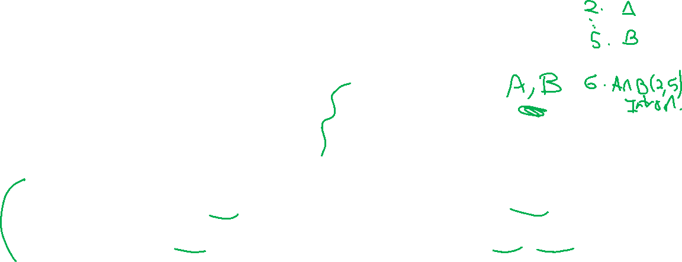



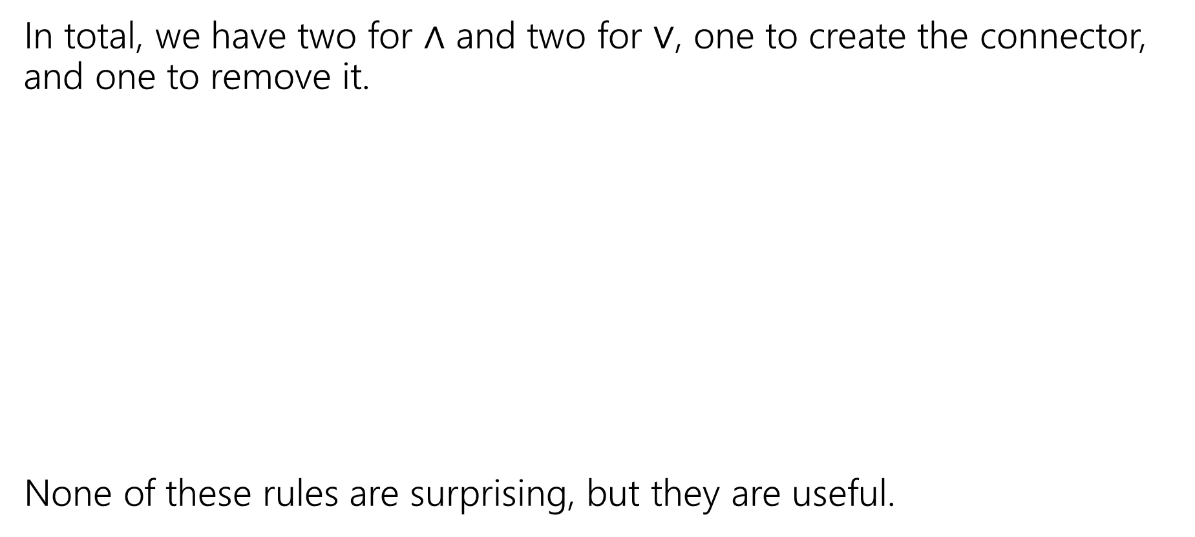









More Inference Rules
In total, we have two for $∧$ and two for $∨$, one to create the connector, and one to remove it.
None of these rules are surprising, but they are useful.
$$A∧B$$
$$A;B$$
Eliminate ∧
Intro ∧
$$∴$$
$$∴$$
$$A∧B$$
$$A, B$$
$$A∨B, ¬A$$
$$A$$
Eliminate $∨$
Intro $∨$
$$∴$$
$$∴$$
$$A∨B, B∨A$$
$$B$$

Slide 26
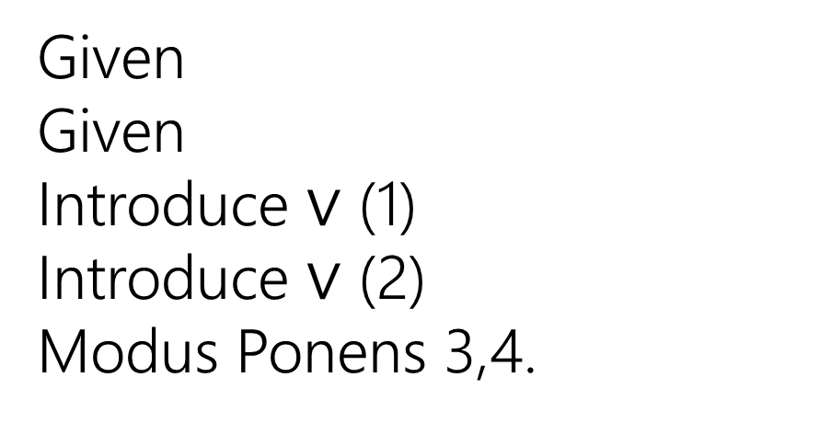

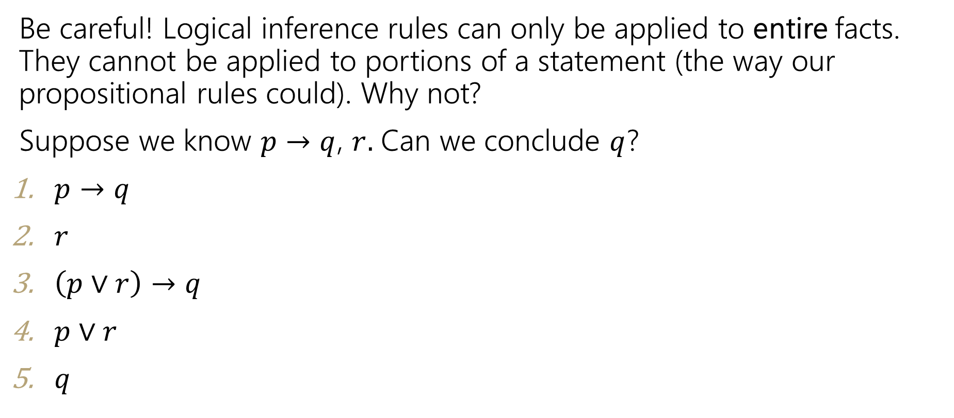



Caution
Be careful! Logical inference rules can only be applied to entire facts. They cannot be applied to portions of a statement (the way our propositional rules could). Why not?
Suppose we know $p→q$, $r.$ Can we conclude $q$?
$p→q$
$r$
$\left(p∨r\right)→q$
$p∨r$
$q$
Given
Given
Introduce $∨$ (1)
Introduce $∨$ (2)
Modus Ponens 3,4.
$$A$$
Intro $∨$
$$∴$$
$$A∨B, B∨A$$

Slide 27


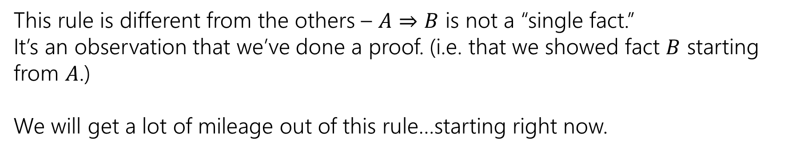

The Direct Proof Rule
We’ve been implicitly using another “rule” today, the direct proof rule
Write a proof “given $A$ conclude $B$”
$$A⇒B$$
Direct Proof rule
$$A→B$$
$$A→B$$
This rule is different from the others – $A⇒B$ is not a “single fact.”
It’s an observation that we’ve done a proof. (i.e. that we showed fact $B$ starting from $A$.)
We will get a lot of mileage out of this rule…starting right now.

Slide 28
How would you argue…
Let’s say you have a piece of code.
And you think if the code gets null input then a nullPointerExecption will be thrown.
How would you convince your friend?
You’d probably trace the code, assuming you would get null input.
The code was your given
The null input is an assumption

Slide 29
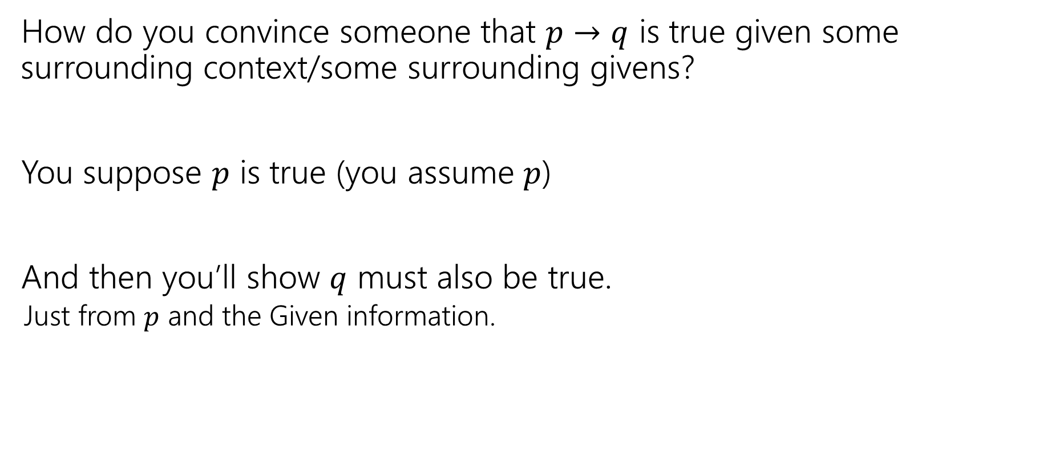
In general
How do you convince someone that $p→q$ is true given some surrounding context/some surrounding givens?
You suppose $p$ is true (you assume $p$)
And then you’ll show $q$ must also be true.
Just from $p$ and the Given information.

Slide 30
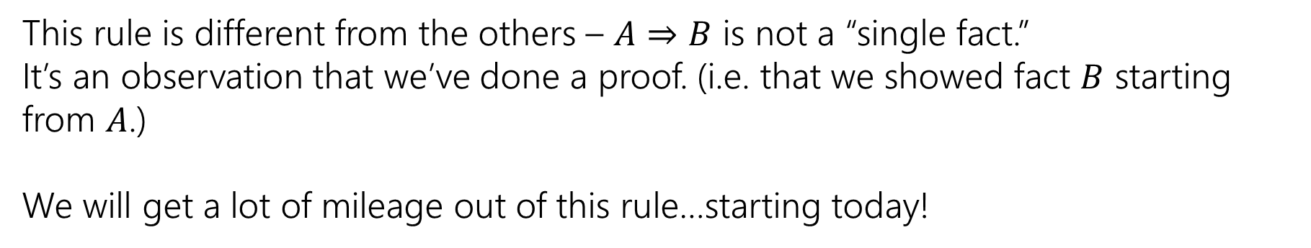
The Direct Proof Rule
Write a proof “given $A$ conclude $B$”
$$A⇒B$$
Direct Proof rule
$$A→B$$
$$A→B$$
This rule is different from the others – $A⇒B$ is not a “single fact.”
It’s an observation that we’ve done a proof. (i.e. that we showed fact $B$ starting from $A$.)
We will get a lot of mileage out of this rule…starting today!

Slide 31


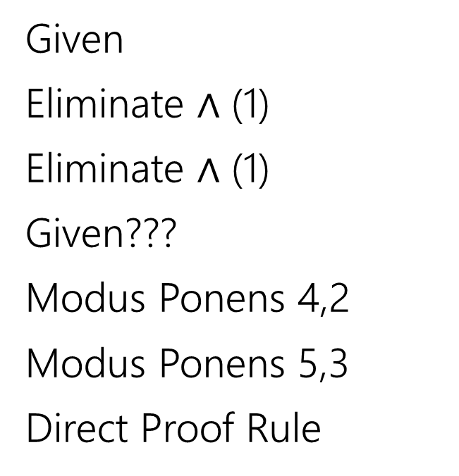
Given: (($p→q)∧(q→r))$ Show: $(p→r)$
Here’s an incorrect proof.
$\left(p→q\right)∧\left(q→r\right)$
$p→q$
$q→r$
$p$
$q$
$r$
$p→r$
Given
Eliminate $∧$ (1)
Eliminate $∧$ (1)
Given???
Modus Ponens 4,2
Modus Ponens 5,3
Direct Proof Rule

Slide 32

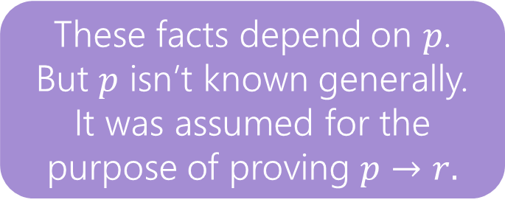

Given: (($p→q)∧(q→r))$ Show: $(p→r)$
Here’s an incorrect proof.
Proofs are supposed to be lists of facts.
Some of these “facts” aren’t really facts…
$\left(p→q\right)∧\left(q→r\right)$
$p→q$
$q→r$
$p$
$q$
$r$
$p→r$
Given
Eliminate $∧$ 1
Eliminate $∧$ (1)
Given ????
Modus Ponens 4,2
Modus Ponens 5,3
Direct Proof Rule
These facts depend on $p$.
But $p$ isn’t known generally. It was assumed for the purpose of proving $p→r.$

Slide 33
Given: (($p→q)∧(q→r))$ Show: $(p→r)$
Here’s an incorrect proof.
Proofs are supposed to be lists of facts.
Some of these “facts” aren’t really facts…
$\left(p→q\right)∧\left(q→r\right)$
$p→q$
$q→r$
$p$
$q$
$r$
$p→r$
Given
Eliminate $∧$ 1
Eliminate $∧$ (1)
Given ????
Modus Ponens 4,2
Modus Ponens 5,3
Direct Proof Rule
These facts depend on $p$.
But $p$ isn’t known generally. It was assumed for the purpose of proving $p→r.$

Slide 34


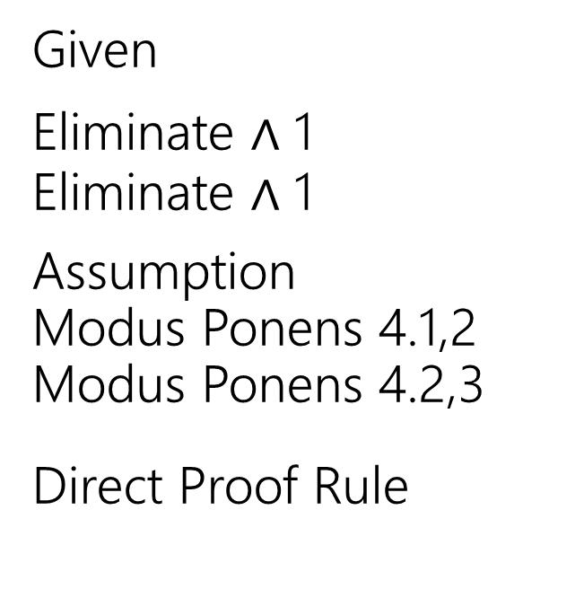
Given: (($p→q)∧(q→r))$ Show: $(p→r)$
Here’s a corrected version of the proof.
$\left(p→q\right)∧\left(q→r\right)$
$p→q$
$q→r$
4.1 $p$
4.2 $q$
4.3 $r$
$p→r$
Given
Eliminate $∧$ 1
Eliminate $∧$ 1
Assumption
Modus Ponens 4.1,2
Modus Ponens 4.2,3
Direct Proof Rule
When introducing an assumption to prove an implication:
Indent, and change numbering.
When reached your conclusion, use the Direct Proof Rule to observe the implication is a fact.
The conclusion is an unconditional fact (doesn’t depend on $p$) so it goes back up a level

Slide 35
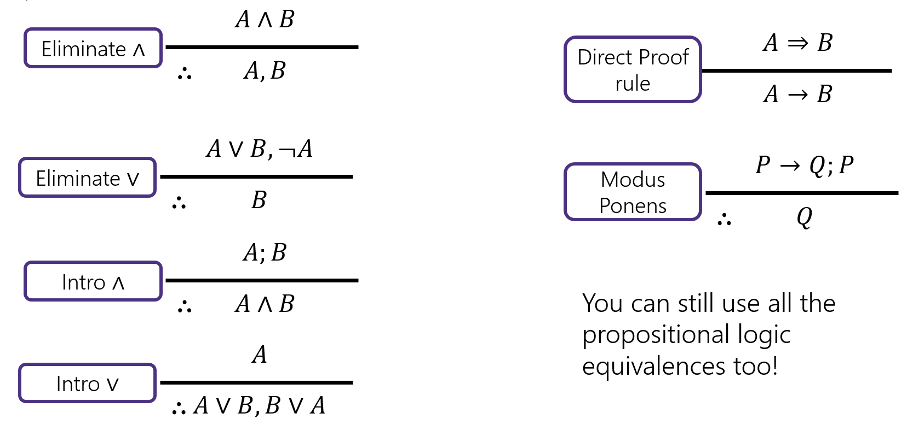

Try it!
Given: $p∨q$, $\left(r∧s\right)→¬q$, $r$. Show: $s→p$

Slide 36


Try it!
Given: $p∨q$, $\left(r∧s\right)→¬q$, $r$. Show: $s→p$
$p∨q$
$\left(r∧s\right)→¬q$
$r$
4.1 $s$
4.2 $r∧s$
4.3 $¬q$
4.4 $q∨p$
4.5 $p$
$s→p$
Given
Given
Given
Assumption
Intro $∧$(3,4.1)
Modus Ponens (2, 4.2)
Commutativity (1)
Eliminate $∨$ (4.4, 4.3)
Direct Proof Rule

Slide 37




Inference Rules
$$A∧B$$
Eliminate ∧
$$A⇒B$$
Direct Proof rule
$$∴$$
$$A, B$$
$$A→B$$
$$A∨B, ¬A$$
$$P→Q;P$$
Eliminate $∨$
Modus Ponens
$$∴$$
$$B$$
$$∴$$
$$Q$$
$$A;B$$
Intro ∧
$$∴$$
$$A∧B$$
You can still use all the propositional logic equivalences too!
$$A$$
Intro $∨$
$$∴$$
$$A∨B, B∨A$$

Slide 38
Inference Proofs in Predicate Logic

Slide 39


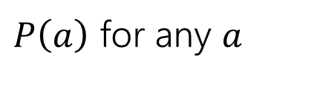





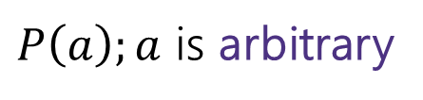


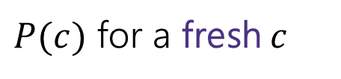
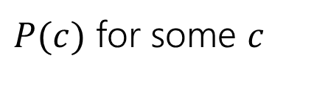



Proofs with Quantifiers
We’ve done symbolic proofs with propositional logic.
To include predicate logic, we’ll need some rules about how to use quantifiers.
$$∀x P(x)$$
$P(c)$ for some $c$
Eliminate $∀$
Intro $∃$
$$∴$$
$$∴$$
$P\left(a\right)$ for any $a$
$$∃x P(x)$$
$P\left(a\right);a$ is arbitrary
$$∃xP(x)$$
Intro $∀$
Eliminate $∃$
$$∴$$
$$∴$$
$P(c)$ for a fresh $c$
$$∀x P(x)$$
Let’s see a good example, then come back to those “arbitrary” and “fresh” conditions.

Slide 40
Proof Using Quantifiers
Suppose we know $∃xP(x)$ and $∀y[ P\left(y\right)→Q\left(y\right)]$. Conclude $∃xQ(x)$.
$$∀x P(x)$$
$P(c)$ for some $c$
Eliminate $∀$
Intro $∃$
$$∴$$
$$∴$$
$P\left(a\right)$ for any $a$
$$∃x P(x)$$
$P\left(a\right);a$ is arbitrary
$$∃xP(x)$$
Intro $∀$
Eliminate $∃$
$$∴$$
$$∴$$
$P(c)$ for a fresh $c$
$$∀x P(x)$$
Notes:
Have a good example here.

Slide 41
















Proof Using Quantifiers
Suppose we know $∃xP(x)$ and $∀y[ P\left(y\right)→Q\left(y\right)]$. Conclude $∃xQ(x)$.
$P(c)$ for some $c$
Intro $∃$
$$∴$$
$$∃x P(x)$$
$$∃xP(x)$$
Eliminate $∃$
$$∴$$
$P(c)$ for a fresh $c$
$$∀x P(x)$$
Eliminate $∀$
$$∴$$
$P\left(a\right)$ for any $a$
$P\left(a\right);a$ is arbitrary
Intro $∀$
$$∴$$
$$∀x P(x)$$
Notes:
Have a good example here.

Slide 42


Proof Using Quantifiers
Suppose we know $∃xP(x)$ and $∀y[ P\left(y\right)→Q\left(y\right)]$. Conclude $∃xQ(x)$.
$P(c)$ for some $c$
$∃xP(x)$
$P(a)$
$∀y[P\left(y\right)→Q\left(y\right)]$
$P\left(a\right)→Q(a)$
$Q(a)$
$∃xQ(x)$
Given
Eliminate $∃$ 1
Given
Eliminate $∀$ 3
Modus Ponens 2,4
Intro $∃$ 5
Intro $∃$
$$∴$$
$$∃x P(x)$$
$$∃xP(x)$$
Eliminate $∃$
$$∴$$
$P(c)$ for a fresh $c$
$$∀x P(x)$$
Eliminate $∀$
$$∴$$
$P\left(a\right)$ for any $a$
$P\left(a\right);a$ is arbitrary
Intro $∀$
$$∴$$
$$∀x P(x)$$
Notes:
Have a good example here.

Slide 43

Proofs with Quantifiers
We’ve done symbolic proofs with propositional logic.
To include predicate logic, we’ll need some rules about how to use quantifiers.
$$∀x P(x)$$
$P(c)$ for some $c$
Eliminate $∀$
Intro $∃$
$$∴$$
$$∴$$
$P\left(a\right)$ for any $a$
$$∃x P(x)$$
$P\left(a\right);a$ is arbitrary
$$∃xP(x)$$
Intro $∀$
Eliminate $∃$
$$∴$$
$$∴$$
$P(c)$ for a fresh $c$
$$∀x P(x)$$
“arbitrary” means $a$ is “just” a variable in our domain.
It doesn’t depend on any other variables and wasn’t introduced with other information.

Slide 44

Proofs with Quantifiers
We’ve done symbolic proofs with propositional logic.
To include predicate logic, we’ll need some rules about how to use quantifiers.
$$∀x P(x)$$
$P(c)$ for some $c$
Eliminate $∀$
Intro $∃$
$$∴$$
$$∴$$
$P\left(a\right)$ for any $a$
$$∃x P(x)$$
$P\left(a\right);a$ is arbitrary
$$∃xP(x)$$
Intro $∀$
Eliminate $∃$
$$∴$$
$$∴$$
$P(c)$ for a fresh $c$
$$∀x P(x)$$
“fresh” means $c$ is a new symbol (there isn’t another $c$ somewhere else in our proof).

Slide 45




Fresh and Arbitrary
Suppose we know $∃xP\left(x\right)$. Can we conclude $∀xP\left(x\right)$?
$P(c)$ for some $c$
$∃x P\left(x\right)$
$P(a)$
$∀x P(x)$
Given
Eliminate $∃$ (1)
Intro $∀$ (2)
Intro $∃$
$$∴$$
$$∃x P(x)$$
$$∃xP(x)$$
Eliminate $∃$
$$∴$$
$P(c)$ for a fresh $c$
This proof is definitely wrong.
(take $P(x)$ to be “is a prime number”)
$$∀x P(x)$$
Eliminate $∀$
$$∴$$
$P\left(a\right)$ for any $a$
$a$ wasn’t arbitrary. We knew something about it – it’s the $x$ that exists to make $P\left(x\right)$ true.
$P\left(a\right);a$ is arbitrary
Intro $∀$
$$∴$$
$$∀x P(x)$$

Slide 46









Fresh and Arbitrary
$P\left(a\right);a$ is arbitrary
$$∃xP(x)$$
Intro $∀$
Eliminate $∃$
$$∴$$
$$∴$$
$P(c)$ for a fresh $c$
$$∀x P(x)$$
You can trust a variable to be arbitrary if you introduce it as such.
If you eliminated a $∀$ to create a variable, that variable is arbitrary. Otherwise it’s not arbitrary – it depends on something.
You can trust a variable to be fresh if the variable doesn’t appear anywhere else (i.e. just use a new letter)

Slide 47









Fresh and Arbitrary
$$∀x P(x)$$
$P(c)$ for some $c$
Eliminate $∀$
Intro $∃$
$$∴$$
$$∴$$
$P\left(a\right)$ for any $a$
$$∃x P(x)$$
There are no similar concerns with these two rules.
Want to reuse a variable when you eliminate $∀?$ Go ahead.
Have a $c$ that depends on many other variables, and want to intro $∃$?
Also not a problem.

Slide 48
Arbitrary
In section, you said: $\left[∃y∀x P\left(x,y\right)\right]→[∀x∃y P\left(x,y\right)]$. Let’s prove it!!

Slide 49


Arbitrary
In section, you said: $\left[∃y∀x P\left(x,y\right)\right]→[∀x∃y P\left(x,y\right)]$. Let’s prove it!!
1.1 $∃y∀x P\left(x,y\right)$
1.2 $∀x P\left(x,c\right)$
1.3 Let $a$ be arbitrary.
1.4 $P(a,c)$
1.5 $∃y P\left(a,y\right)$
1.6 $∀x∃y P(x,y)$
2. $\left[∃y∀x P\left(x,y\right)\right]→[∀x∃y P(x,y)]$
Assumption
Elim $∃$ (1.1)
--
Elim $∀$ (1.2)
Intro $∃$ (1.4)
Intro $∀$ (1.5)
Direct Proof Rule

Slide 50


Arbitrary
In section, you said: $\left[∃y∀x P\left(x,y\right)\right]→[∀x∃y P\left(x,y\right)]$. Let’s prove it!!
1.1 $∃y∀x P\left(x,y\right)$
1.2 $∀x P\left(x,c\right)$
1.4 $P(a,c)$
1.5 $∃y P\left(a,y\right)$
1.6 $∀x∃y P(x,y)$
2. $\left[∃y∀x P\left(x,y\right)\right]→[∀x∃y P(x,y)]$
Assumption
Elim $∃$ (1.1)
Elim $∀$ (1.2)
Intro $∃$ (1.4)
Intro $∀$ (1.5)
Direct Proof Rule
It is not required to have “variable is arbitrary” as a step before using it. But many people (including Robbie) find it helpful.

Slide 51



Find The Bug
Let your domain of discourse be integers.
We claim that given $∀x∃y$ Greater$\left(y,x\right),$ we can conclude $∃y∀x$ Greater($y,x)$
Where Greater$(y,x)$ means $y>x$
$∀x∃y$Greater$\left(y,x\right)$
Let $a$ be an arbitrary integer
$∃y$ Greater$(y,a)$
$b≥a$
$∀x$Greater$(b,x)$
$∃y∀x$Greater$(y,x)$
Given
--
Elim $∀$ (1)
Elim $∃$ (2)
Intro $∀$ (4)
Intro $∃$ (5)

Slide 52

Find The Bug
$∀x∃y$Greater$\left(y,x\right)$
Let $a$ be an arbitrary integer
$∃y$ Greater$(y,a)$
$b≥a$
$∀x$Greater$(b,x)$
$∃y∀x$Greater$(y,x)$
Given
--
Elim $∀$ (1)
Elim $∃$ (2)
Intro $∀$ (4)
Intro $∃$ (5)
$b$ is not arbitrary. The variable $b$ depends on $a.$ Even though $a$ is arbitrary, $b$ is not!

Slide 53

Bug Found
There’s one other “hidden” requirement to introduce $∀$.
“No other variable in the statement can depend on the variable to be generalized”
Think of it like this -- $b$ was probably $a+1$in that example.
You wouldn’t have generalized from Greater$(a+1,a)$
To $∀x$ Greater$(a+1, x)$. There’s still an $a,$you’d have replaced all the $a$’s.
$x$ depends on $y$ if $y$ is in a statement when $x$ is introduced.
This issue is much clearer in English proofs, which we’ll start next time.

Slide 54
More Practice

Slide 55
More Practice
Show if we know: $p, q, \left[\left(p∧q\right)→\left(r∧s\right)\right], r→t$ we can conclude $t$.

Slide 56


More Practice
Show if we know: $p, q, \left[\left(p∧q\right)→\left(r∧s\right)\right], r→t$ we can conclude $t$.
$p$
$q$
$[\left(p∧q\right)→\left(r∧s\right)]$
$r→t$
$p∧q$
$r∧s$
$r$
$t$
Given
Given
Given
Given
Intro $∧$ (1,2)
Modus Ponens (3,5)
Eliminate $∧$ (6)
Modus Ponens (4,7)

