Slide 1

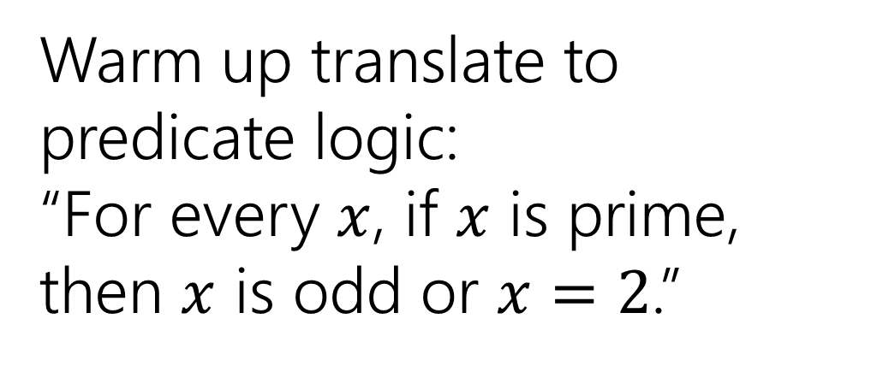
Inference Proofs and Nested Unalike Quantifiers
Warm up translate to predicate logic:
“For every $x$, if $x$ is prime, then $x$ is odd or $x=2$.”
CSE 311 Winter 2021
Lecture 6

Slide 2
Announcements
HW2 came out on Wendesday (available on the webpage).
We’ll continue zoom-only for the next two weeks (official announcement coming through Ed this evening).
Monday is a university holiday (observing Martin Luther King Day)
No lecture!
Office hours will be moved to other times (we’ll update the calendar tonight).

Slide 3
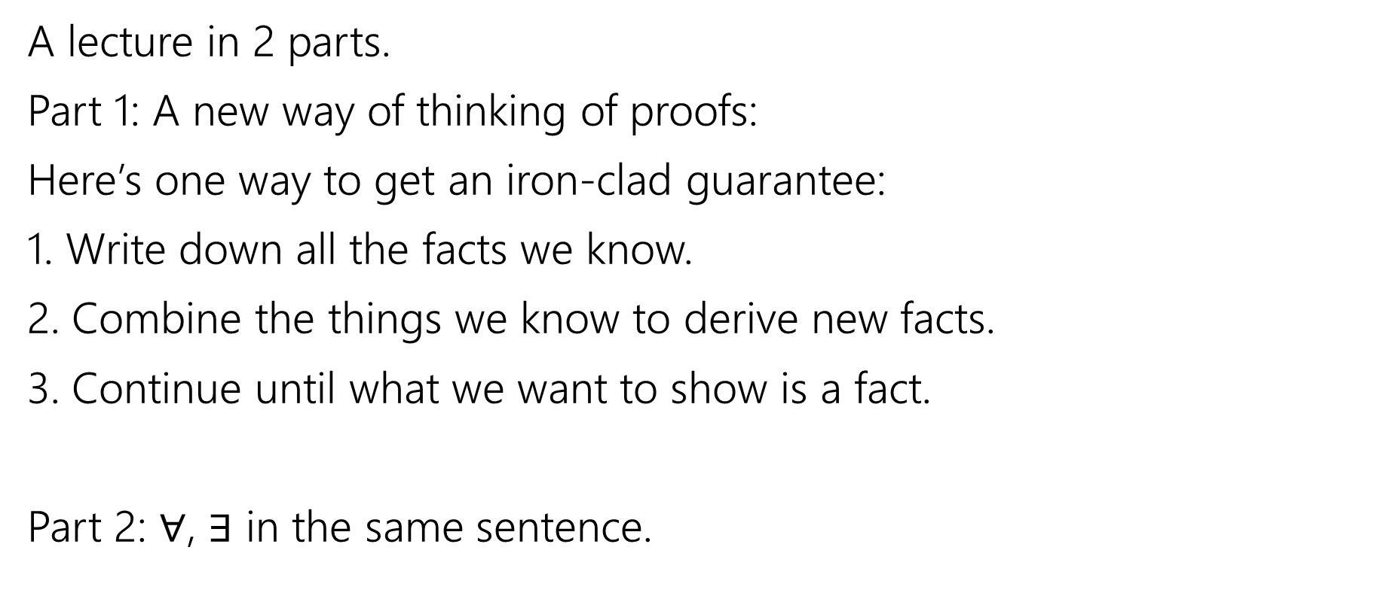
Today
A lecture in 2 parts.
Part 1: A new way of thinking of proofs:
Here’s one way to get an iron-clad guarantee:
1. Write down all the facts we know.
2. Combine the things we know to derive new facts.
3. Continue until what we want to show is a fact.
Part 2: $∀$, $∃$ in the same sentence.

Slide 4

Drawing Conclusions
You know “If it is raining, then I have my umbrella”
And “It is raining”
You should conclude….
For whatever you conclude, convert the statement to propositional logic – will your statement hold for any propositions, or is it specific to raining and umbrellas?
I have my umbrella!
I know $(p→q)$ and $p$, I can conclude $q$
Or said another way: $\left[\left(p→q\right)∧p\right]→q$

Slide 5

Modus Ponens
The inference from the last slide is always valid. I.e.
$$\left[\left(p→q\right)∧p\right]→q≡T$$

Slide 6

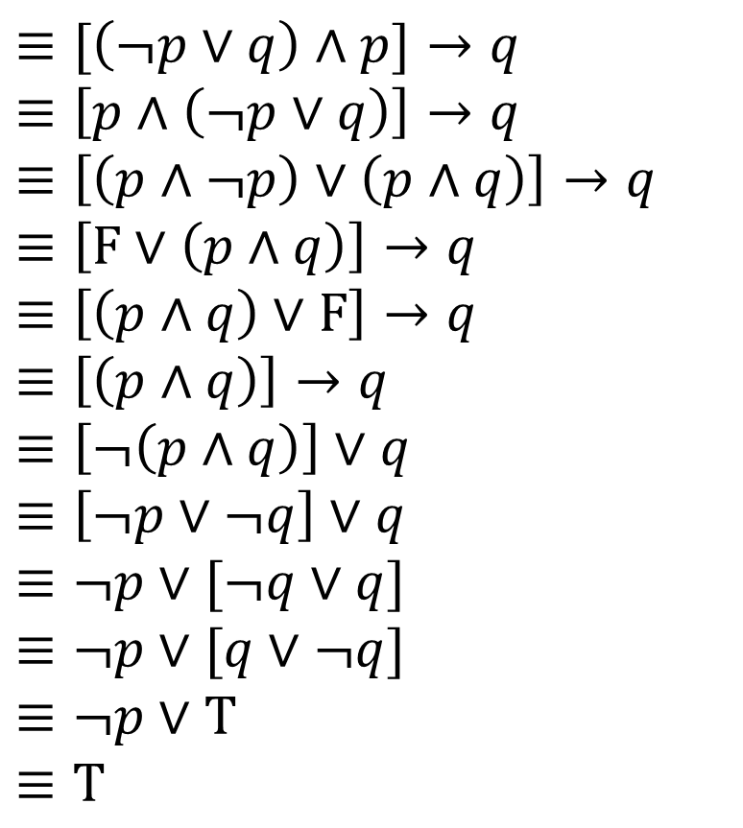
Modus Ponens – a formal proof
$$\left[\left(p→q\right)∧p\right]→q$$
$≡[\left(¬p∨q\right)∧p]→q$
$≡\left[p∧\left(¬p∨q\right)\right]→q$
$≡\left[\left(p∧¬p\right)∨\left(p∧q\right)\right]→q$
$≡\left[F∨\left(p∧q\right)\right]→q$
$≡\left[\left(p∧q\right)∨F\right]→q$
$≡\left[\left(p∧q\right)\right]→q$
$≡\left[¬\left(p∧q\right)\right]∨q$
$≡\left[¬p∨¬q\right]∨q$
$≡¬p∨[¬q∨q]$
$≡¬p∨[q∨¬q]$
$≡¬p∨T$
$≡T$
Law of Implication
Commutativity
Distributivity
Negation
Commutativity
Identity
Law of Implication
DeMorgan’s Law
Associativity
Commutativity
Negation
Domination

Slide 7
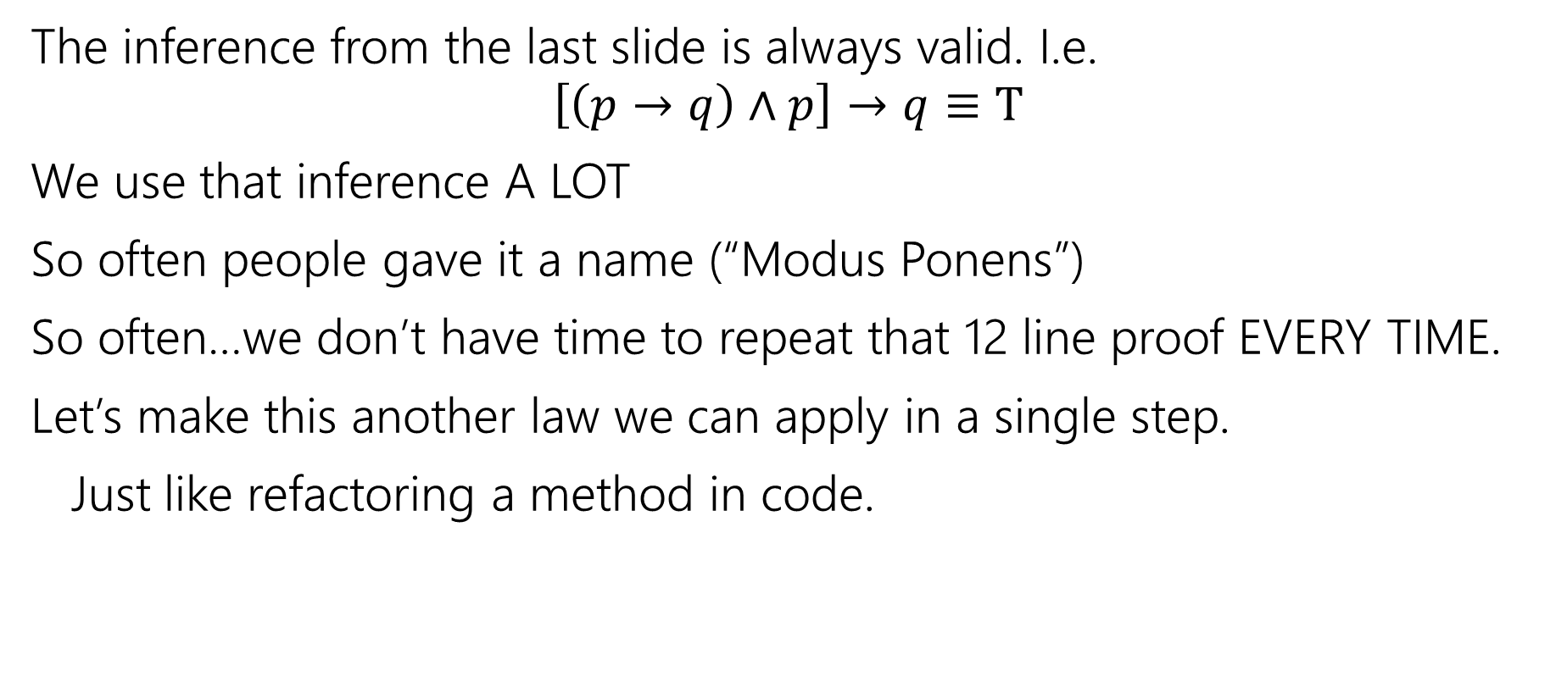
Modus Ponens
The inference from the last slide is always valid. I.e.
$$\left[\left(p→q\right)∧p\right]→q≡T$$
We use that inference A LOT
So often people gave it a name (“Modus Ponens”)
So often…we don’t have time to repeat that 12 line proof EVERY TIME.
Let’s make this another law we can apply in a single step.
Just like refactoring a method in code.

Slide 8

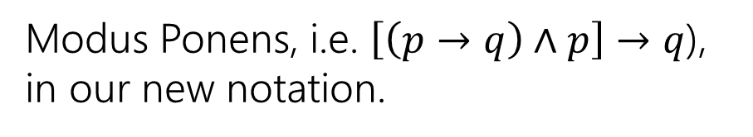








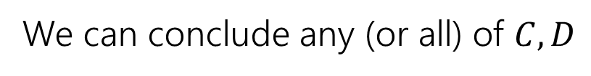
Notation – Laws of Inference
We’re using the “$→“$ symbol A LOT.
Too much
Some new notation to make our lives easier.
If we know both $A$and$B$
$$A,B$$
$$∴$$
We can conclude any (or all) of $C,D$
$$∴$$
$$C,D$$
“$∴$” means “therefore” – I knew $A,B$ therefore I can conclude $C,D$.
$$p→q,p$$
Modus Ponens, i.e. $\left[\left(p→q\right)∧p\right]→q$), in our new notation.
$$∴$$
$$q$$

Slide 9

Another Proof
Let’s keep going.
I know “If it is raining then I have my umbrella” and “I do not have my umbrella”
I can conclude…
What’s the general form?
How do you think the proof will go?
If you had to convince a friend of this claim in English, how would you do it?
It is not raining!
$$[(p→q)∧¬q]→¬p$$

Slide 10
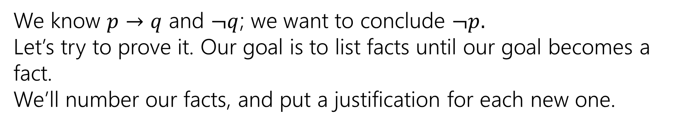
A proof!
We know $p→q$ and $¬q$; we want to conclude $¬p.$
Let’s try to prove it. Our goal is to list facts until our goal becomes a fact.
We’ll number our facts, and put a justification for each new one.

Slide 11

A proof!
We know $p→q$ and $¬q$; we want to conclude $¬p.$
Let’s try to prove it. Our goal is to list facts until our goal becomes a fact.
We’ll number our facts, and put a justification for each new one.
$p→ q$
$¬q$
$¬q→¬p$
$¬p$
Given
Given
Contrapositive of 1.
Modus Ponens on 3,2.

Slide 12

Try it yourselves
Suppose you know $p→q,¬s→¬q,$and$p.$ Give an argument to conclude $s.$
pollev.com/uwcse311
Help me adjust my explanation

Slide 13

Try it yourselves
Suppose you know $p→q,¬s→¬q,$and$p.$ Give an argument to conclude $s.$
$p→q$
$¬s→¬q$
$p$
$q$
$q→s$
$s$
Given
Given
Given
Modus Ponens 1,3
Contrapositive of 2
Modus Ponens 5,4

Slide 14





More Inference Rules
We need a couple more inference rules.
These rules set us up to get facts in exactly the right form to apply the really useful rules.
A lot like commutativity and distributivity in the propositional logic rules.
$$A∧B$$
I know the fact $A∧B$
Eliminate ∧
$$∴$$
$$A, B$$
$$∴$$
I can conclude $A$is a fact and $B$is a fact separately.

Slide 15





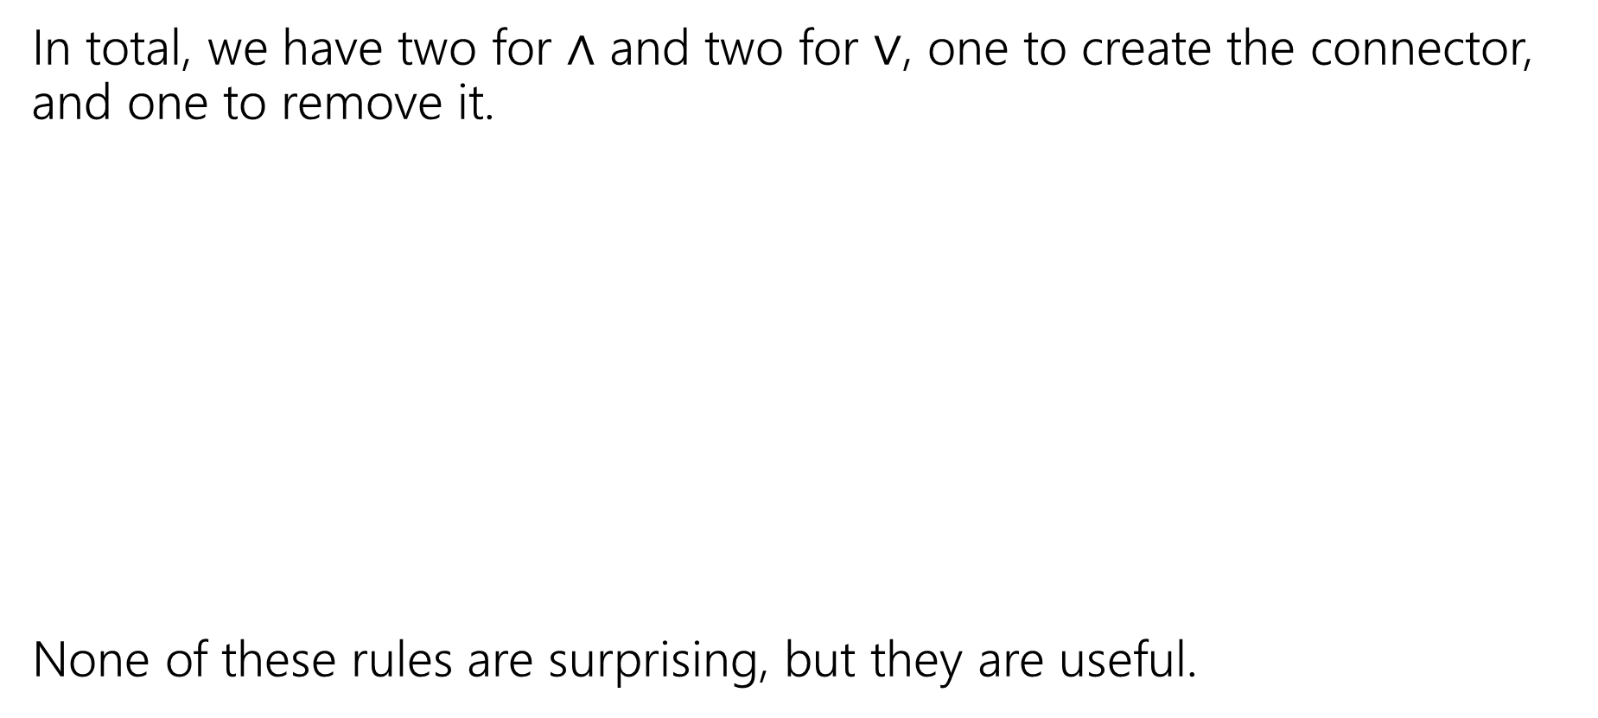









More Inference Rules
In total, we have two for $∧$ and two for $∨$, one to create the connector, and one to remove it.
None of these rules are surprising, but they are useful.
$$A∧B$$
$$A;B$$
Eliminate ∧
Intro ∧
$$∴$$
$$∴$$
$$A∧B$$
$$A, B$$
$$A∨B, ¬A$$
$$A$$
Eliminate $∨$
Intro $∨$
$$∴$$
$$∴$$
$$A∨B, B∨A$$
$$B$$

Slide 16


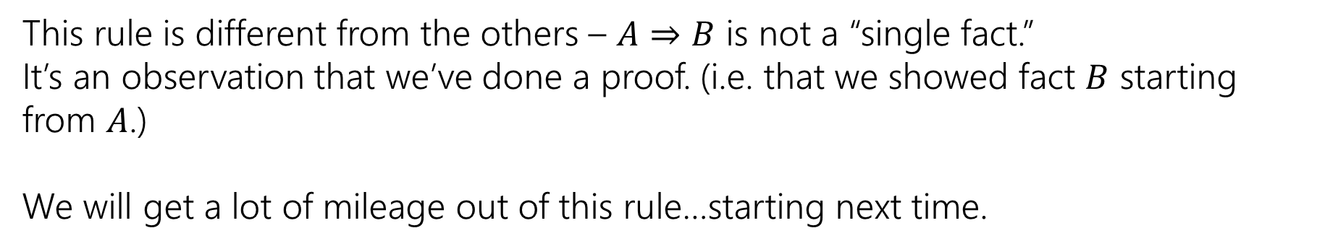

The Direct Proof Rule
We’ve been implicitly using another “rule” today, the direct proof rule
Write a proof “given $A$ conclude $B$”
$$A⇒B$$
Direct Proof rule
$$A→B$$
$$A→B$$
This rule is different from the others – $A⇒B$ is not a “single fact.”
It’s an observation that we’ve done a proof. (i.e. that we showed fact $B$ starting from $A$.)
We will get a lot of mileage out of this rule…starting next time.

Slide 17
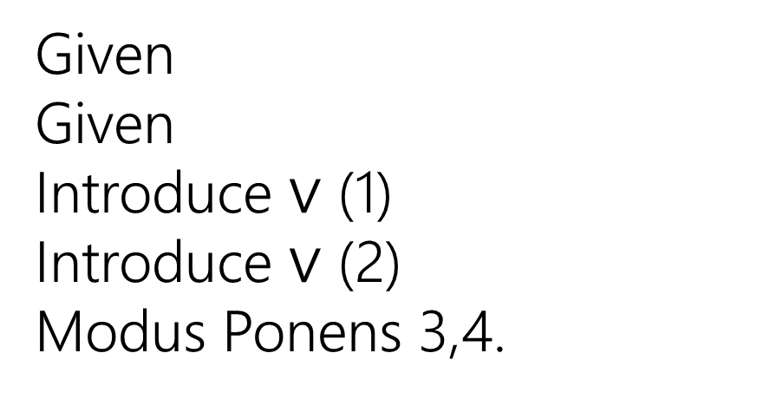

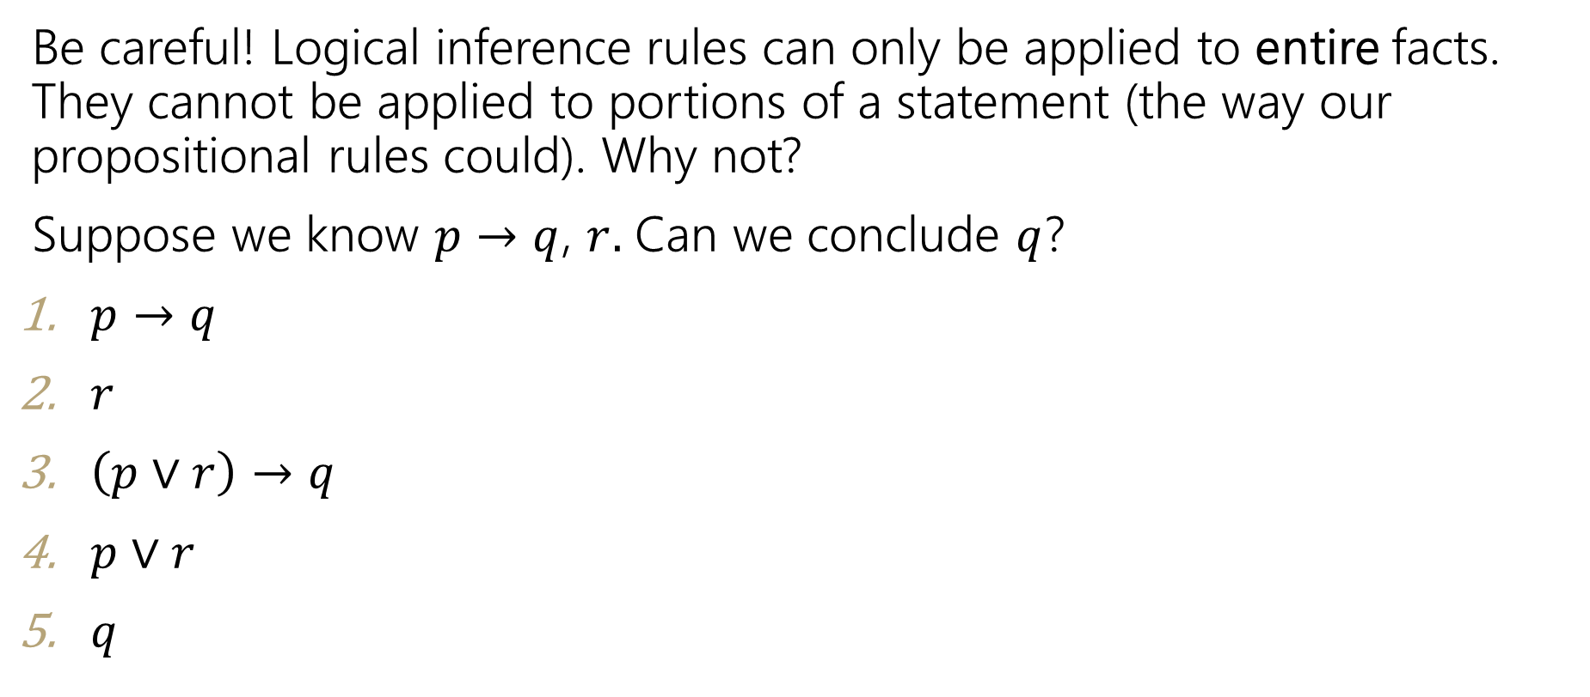



Caution
Be careful! Logical inference rules can only be applied to entire facts. They cannot be applied to portions of a statement (the way our propositional rules could). Why not?
Suppose we know $p→q$, $r.$ Can we conclude $q$?
$p→q$
$r$
$\left(p∨r\right)→q$
$p∨r$
$q$
Given
Given
Introduce $∨$ (1)
Introduce $∨$ (2)
Modus Ponens 3,4.
$$A$$
Intro $∨$
$$∴$$
$$A∨B, B∨A$$

Slide 18
One more Proof
Show if we know: $p, q, \left[\left(p∧q\right)→\left(r∧s\right)\right], r→t$ we can conclude $t$.

Slide 19
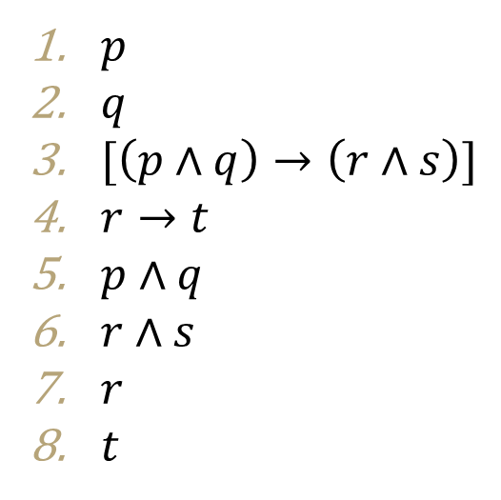
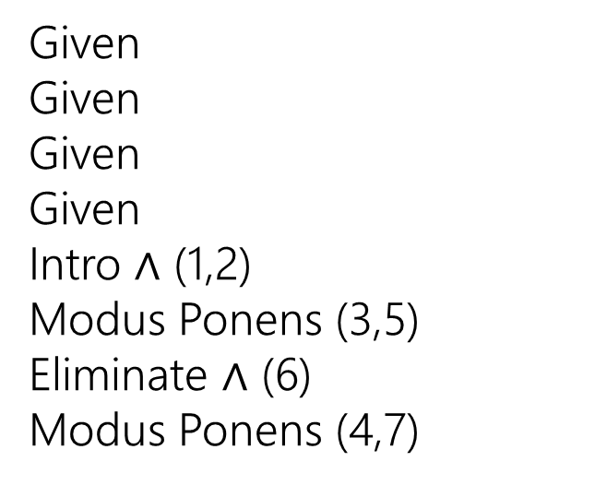
One more Proof
Show if we know: $p, q, \left[\left(p∧q\right)→\left(r∧s\right)\right], r→t$ we can conclude $t$.
$p$
$q$
$[\left(p∧q\right)→\left(r∧s\right)]$
$r→t$
$p∧q$
$r∧s$
$r$
$t$
Given
Given
Given
Given
Intro $∧$ (1,2)
Modus Ponens (3,5)
Eliminate $∧$ (6)
Modus Ponens (4,7)

Slide 20




Inference Rules
$$A∧B$$
Eliminate ∧
$$A⇒B$$
Direct Proof rule
$$∴$$
$$A, B$$
$$A→B$$
$$A∨B, ¬A$$
$$P→Q;P$$
Eliminate $∨$
Modus Ponens
$$∴$$
$$B$$
$$∴$$
$$Q$$
$$A;B$$
Intro ∧
$$∴$$
$$A∧B$$
You can still use all the propositional logic equivalences too!
$$A$$
Intro $∨$
$$∴$$
$$A∨B, B∨A$$

Slide 21
Quantifiers

Slide 22

Quantifiers
$∀$ (for All) and $∃$ (there Exists)
Write these statements in predicate logic with quantifiers. Let your domain of discourse be “cats”
If a cat is fat, then it is happy.
This sentence implicitly makes a statement about all cats!
$∀x[$Fat$\left(x\right)→$ Happy$\left(x\right)]$

Slide 23
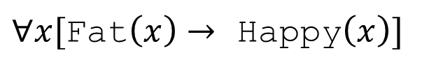
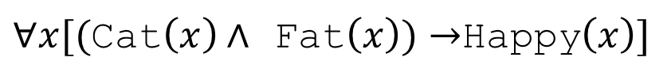
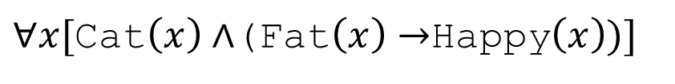

Quantifiers
Writing implications can be tricky when we change the domain of discourse.
For every cat: if the cat is fat, then it is happy.
Domain of Discourse: cats
$∀x[$Fat$\left(x\right)→$ Happy$\left(x\right)]$
What if we change our domain of discourse to be all mammals?
We need to limit $x$ to be a cat. How do we do that?
$∀x[($Cat$\left(x\right)∧$ Fat$\left(x\right))→$Happy$\left(x\right)]$
$∀x[$Cat$\left(x\right)∧$(Fat$\left(x\right)→$Happy$\left(x\right))]$

Slide 24
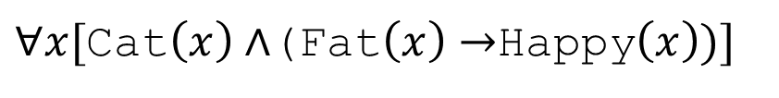
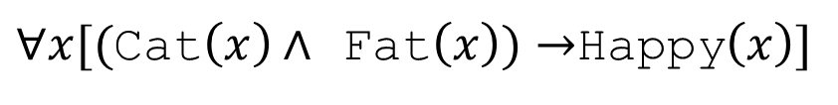
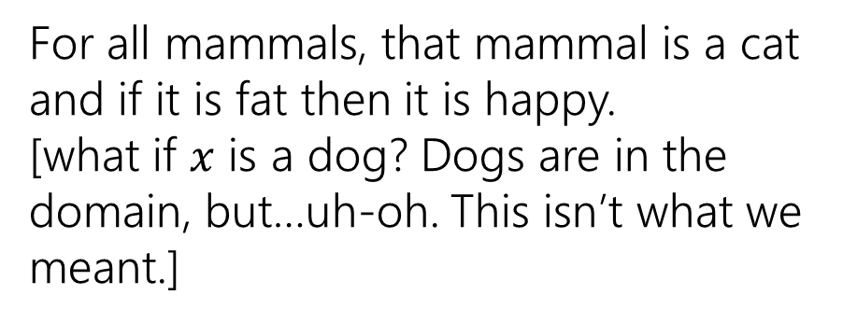
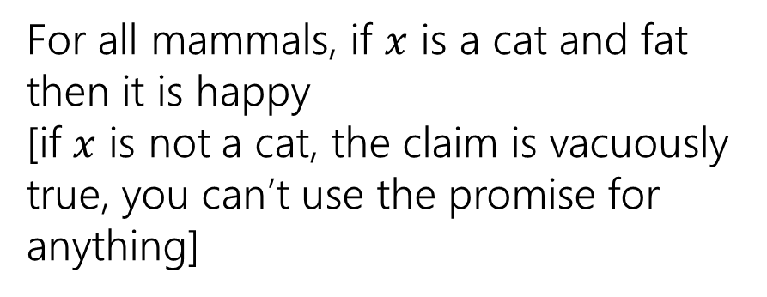
Quantifiers
Which of these translates “For every cat: if a cat is fat then it is happy.” when our domain of discourse is “mammals”?
$∀x[($Cat$\left(x\right)∧$ Fat$\left(x\right))→$Happy$\left(x\right)]$
$∀x[$Cat$\left(x\right)∧$(Fat$\left(x\right)→$Happy$\left(x\right))]$
For all mammals, if $x$ is a cat and fat then it is happy
[if $x$ is not a cat, the claim is vacuously true, you can’t use the promise for anything]
For all mammals, that mammal is a cat and if it is fat then it is happy.
[what if $x$ is a dog? Dogs are in the domain, but…uh-oh. This isn’t what we meant.]
To “limit” variables to a portion of your domain of discourse under a universal quantifier add a hypothesis to an implication.

Slide 25
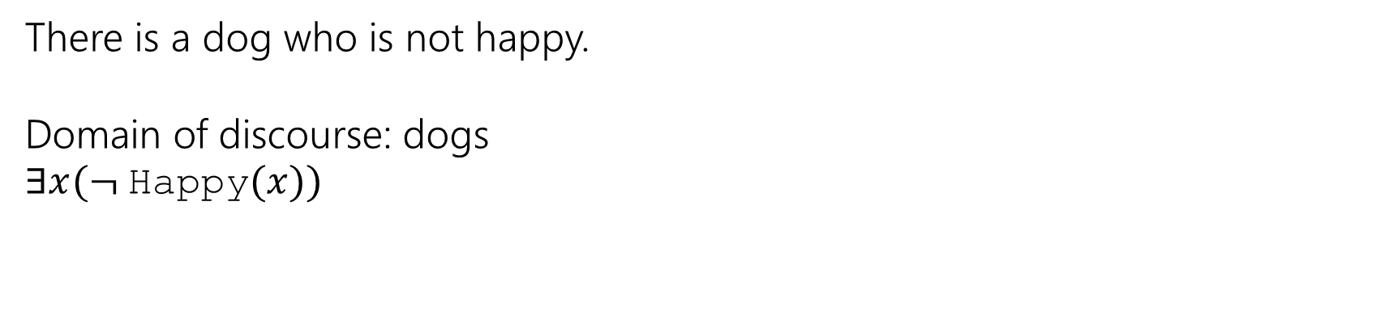
Quantifiers
Existential quantifiers need a different rule:
To “limit” variables to a portion of your domain of discourse under an existential quantifier AND the limitation together with the rest of the statement.
There is a dog who is not happy.
Domain of discourse: dogs
$∃x(¬$Happy$(x))$

Slide 26
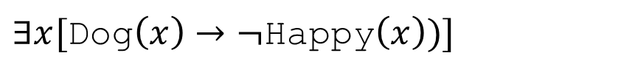
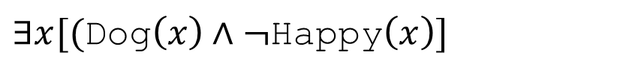
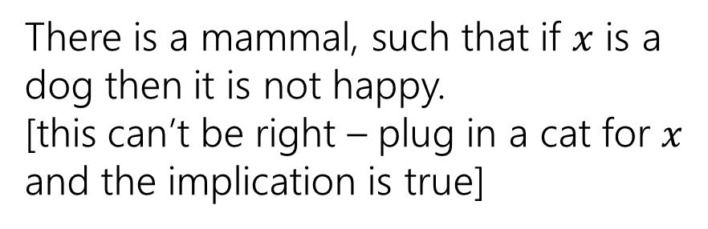
Quantifiers
Which of these translates “There is a dog who is not happy.” when our domain of discourse is “mammals”?
$∃x[$Dog$\left(x\right)→¬$Happy$\left(x\right))]$
$∃x[($Dog$\left(x\right)∧¬$Happy$\left(x\right)]$
There is a mammal, such that if $x$ is a dog then it is not happy.
[this can’t be right – plug in a cat for $x$ and the implication is true]
There is a mammal that is both a dog and not happy.
[this one is correct!]
To “limit” variables to a portion of your domain of discourse under an existential quantifier AND the limitation together with the rest of the statement.

Slide 27
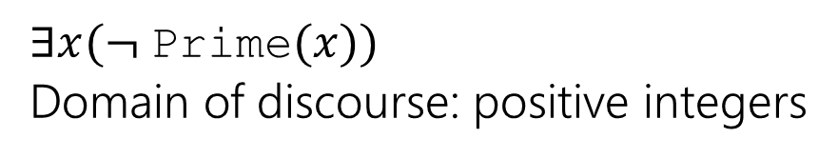
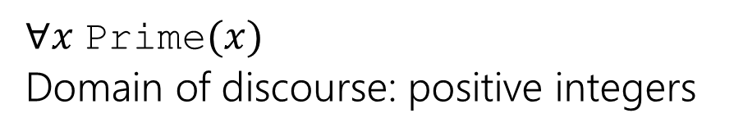
Negating Quantifiers
What happens when we negate an expression with quantifiers?
What does your intuition say?
Negation
Original
Every positive integer is prime
There is a positive integer that is not prime.
$∀x$Prime$(x)$
Domain of discourse: positive integers
$∃x(¬$Prime$(x))$
Domain of discourse: positive integers

Slide 28
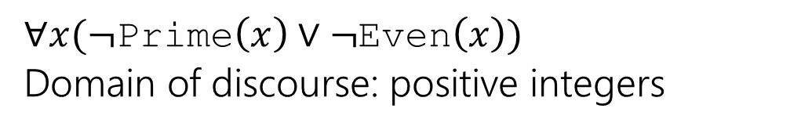
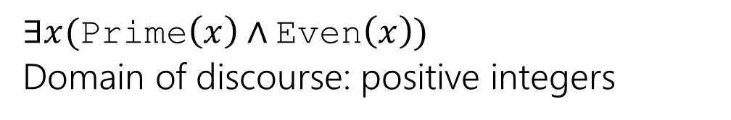
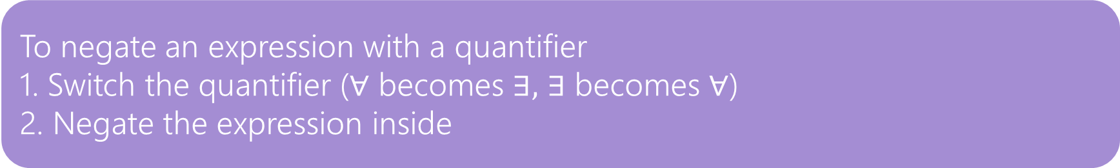
Negating Quantifiers
Let’s try on an existential quantifier…
Original
Negation
There is a positive integer which is prime and even.
Every positive integer is composite or odd.
$∃x($Prime$\left(x\right)∧$Even$\left(x\right))$
Domain of discourse: positive integers
$∀x(¬$Prime$\left(x\right)∨¬$Even$\left(x\right))$
Domain of discourse: positive integers
To negate an expression with a quantifier
1. Switch the quantifier ($∀$ becomes $∃,$ $∃$ becomes $∀$)
2. Negate the expression inside

Slide 29
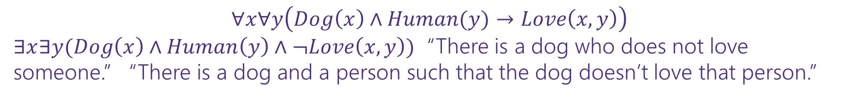
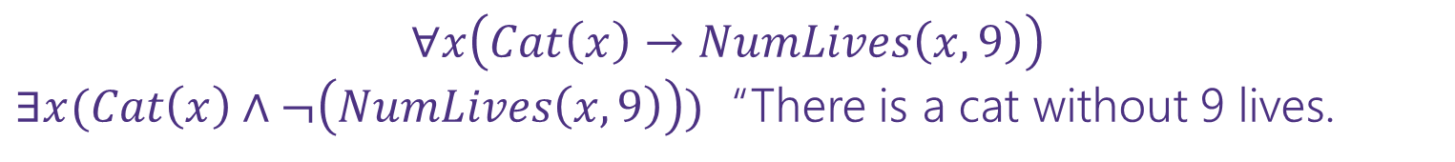
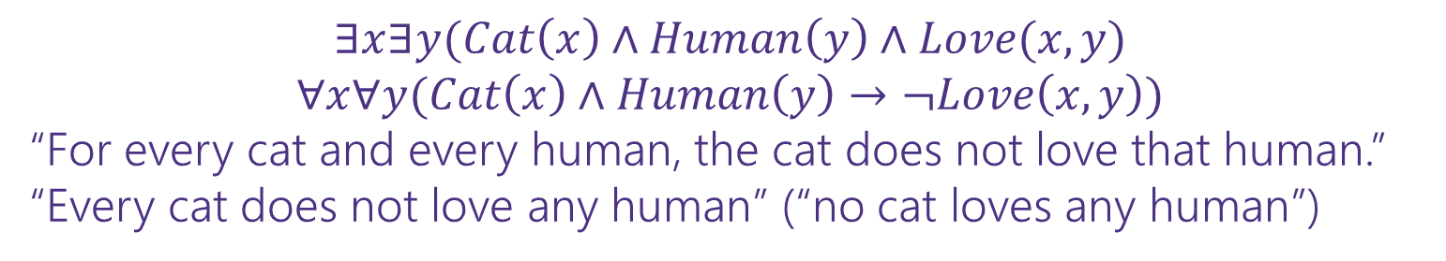
Negation
Translate these sentences to predicate logic, then negate them.
All cats have nine lives.
All dogs love every person.
There is a cat that loves someone.
$$∀x\left(Cat\left(x\right)→NumLives\left(x,9\right)\right)$$
$∃x(Cat\left(x\right)∧¬\left(NumLives\left(x,9\right)\right))$ “There is a cat without 9 lives.
$$∀x∀y\left(Dog\left(x\right)∧Human(y)→Love\left(x,y\right)\right)$$
$∃x∃y(Dog\left(x\right)∧Human\left(y\right)∧¬Love\left(x,y\right))$ “There is a dog who does not love someone.” “There is a dog and a person such that the dog doesn’t love that person.”
$$∃x∃y(Cat\left(x\right)∧Human\left(y\right)∧Love(x,y)$$
$$∀x∀y(Cat\left(x\right)∧Human\left(y\right)→¬Love\left(x,y\right))$$
“For every cat and every human, the cat does not love that human.”
“Every cat does not love any human” (“no cat loves any human”)

Slide 30
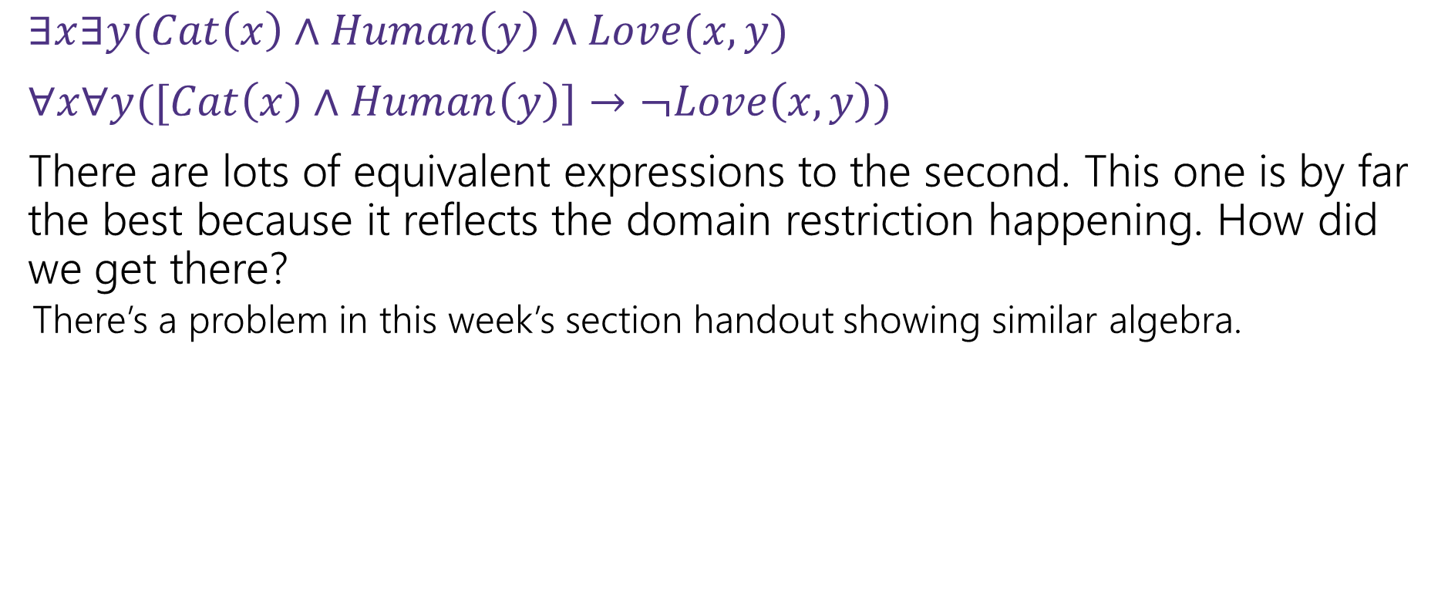
Negation with Domain Restriction
$∃x∃y(Cat\left(x\right)∧Human\left(y\right)∧Love(x,y)$
$∀x∀y([Cat\left(x\right)∧Human\left(y\right)]→¬Love\left(x,y\right))$
There are lots of equivalent expressions to the second. This one is by far the best because it reflects the domain restriction happening. How did we get there?
There’s a problem in this week’s section handout showing similar algebra.

Slide 31
Nested Quantifiers

Slide 32






Nested Quantifiers
Translate these sentences using only quantifiers and the predicate AreFriends$(x,y)$
Everyone is friends with someone.
Someone is friends with everyone.

Slide 33
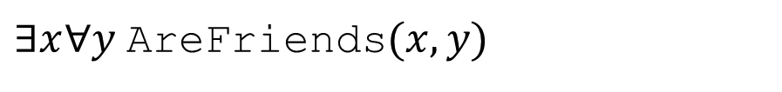
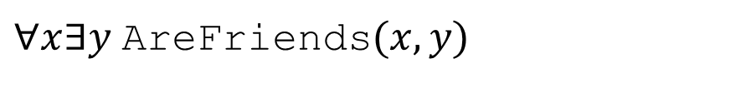
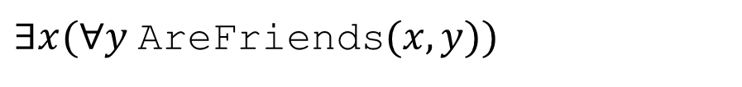
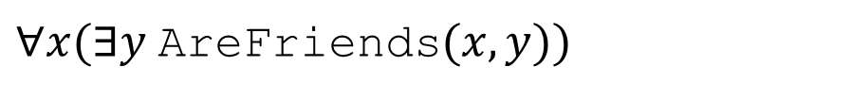
Nested Quantifiers
Translate these sentences using only quantifiers and the predicate AreFriends$(x,y)$
Everyone is friends with someone.
Someone is friends with everyone.
$∀x(∃y$AreFriends$(x,y))$
$∃x(∀y$AreFriends$(x,y))$
$∀x∃y$AreFriends$(x,y)$
$∃x∀y$AreFriends$(x,y)$

Slide 34
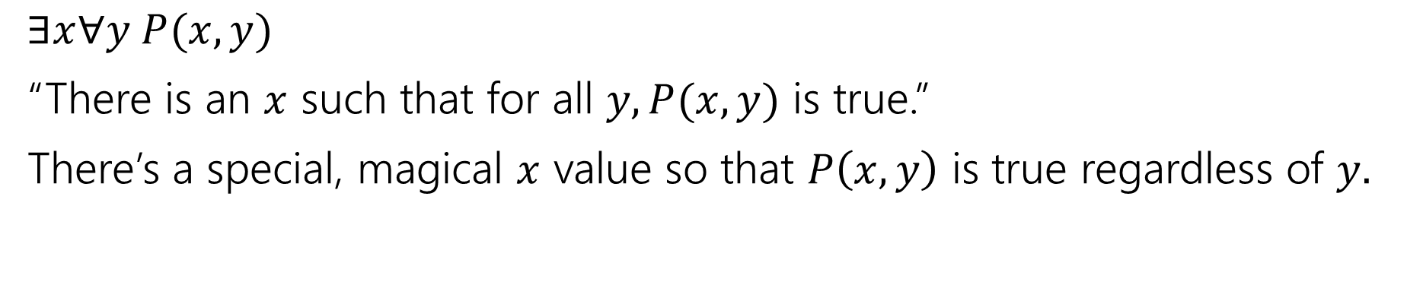
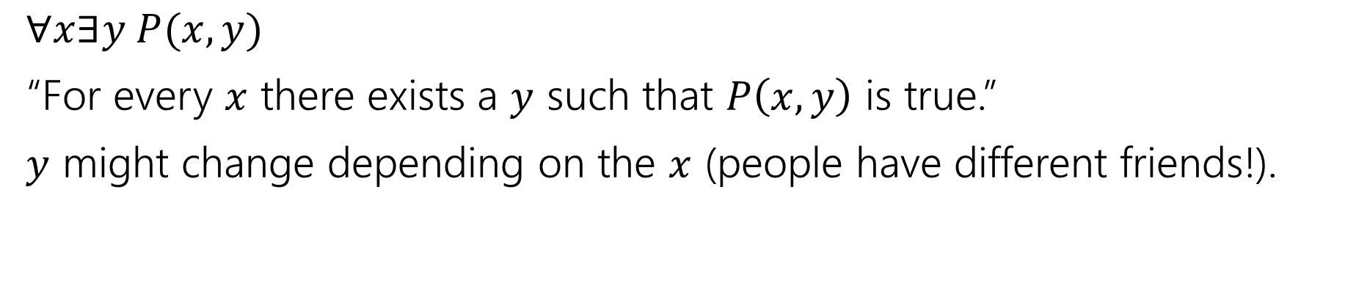
Nested Quantifiers
$∀x∃y P(x,y)$
“For every $x$ there exists a $y$ such that $P\left(x,y\right)$ is true.”
$y$ might change depending on the $x$ (people have different friends!).
$∃x∀y P(x,y)$
“There is an $x$ such that for all $y, P(x,y)$ is true.”
There’s a special, magical $x$ value so that $P\left(x,y\right)$ is true regardless of $y.$

Slide 35
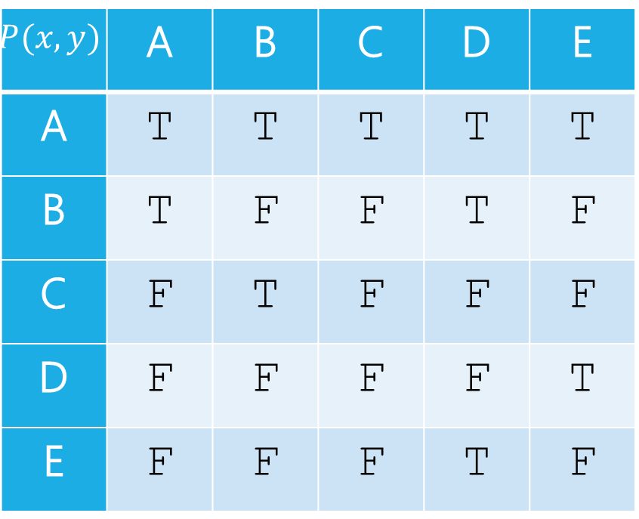
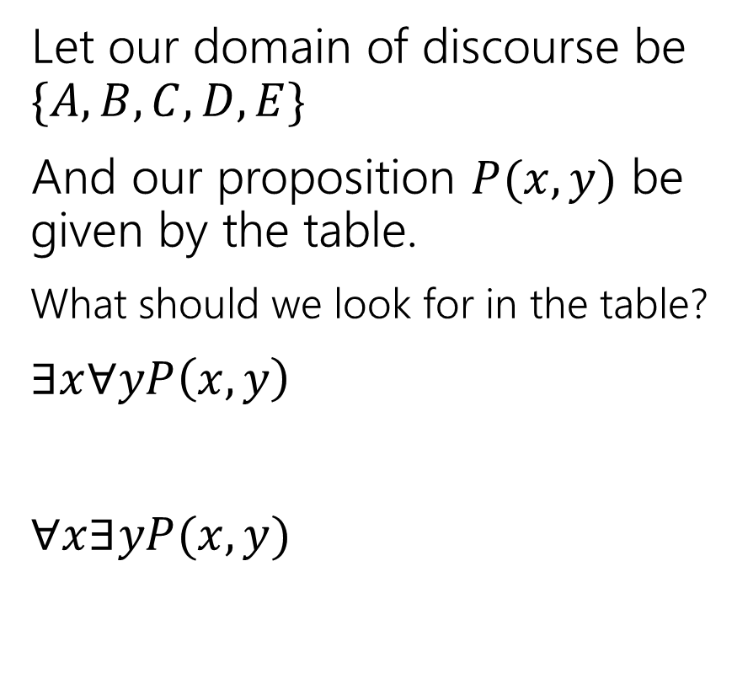


Nested Quantifiers
Let our domain of discourse be $\{A,B,C,D,E\}$
And our proposition $P(x,y)$ be given by the table.
What should we look for in the table?
$∃x∀yP\left(x,y\right)$
$∀x∃yP(x,y)$
$$y$$
$$P(x,y)$$ | A | B | C | D | E
A | T | T | T | T | T
B | T | F | F | T | F
C | F | T | F | F | F
D | F | F | F | F | T
E | F | F | F | T | F
$$x$$

Slide 36
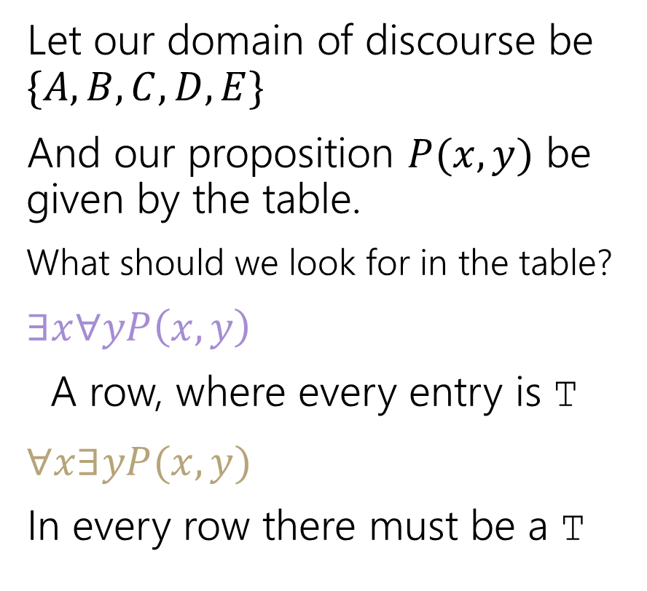
Nested Quantifiers
Let our domain of discourse be $\{A,B,C,D,E\}$
And our proposition $P(x,y)$ be given by the table.
What should we look for in the table?
$∃x∀yP\left(x,y\right)$
A row, where every entry is T
$∀x∃yP(x,y)$
In every row there must be a T
$$y$$
$$P(x,y)$$ | A | B | C | D | E
A | T | T | T | T | T
B | T | F | F | T | F
C | F | T | F | F | F
D | F | F | F | F | T
E | F | F | F | T | F
$$x$$

Slide 37
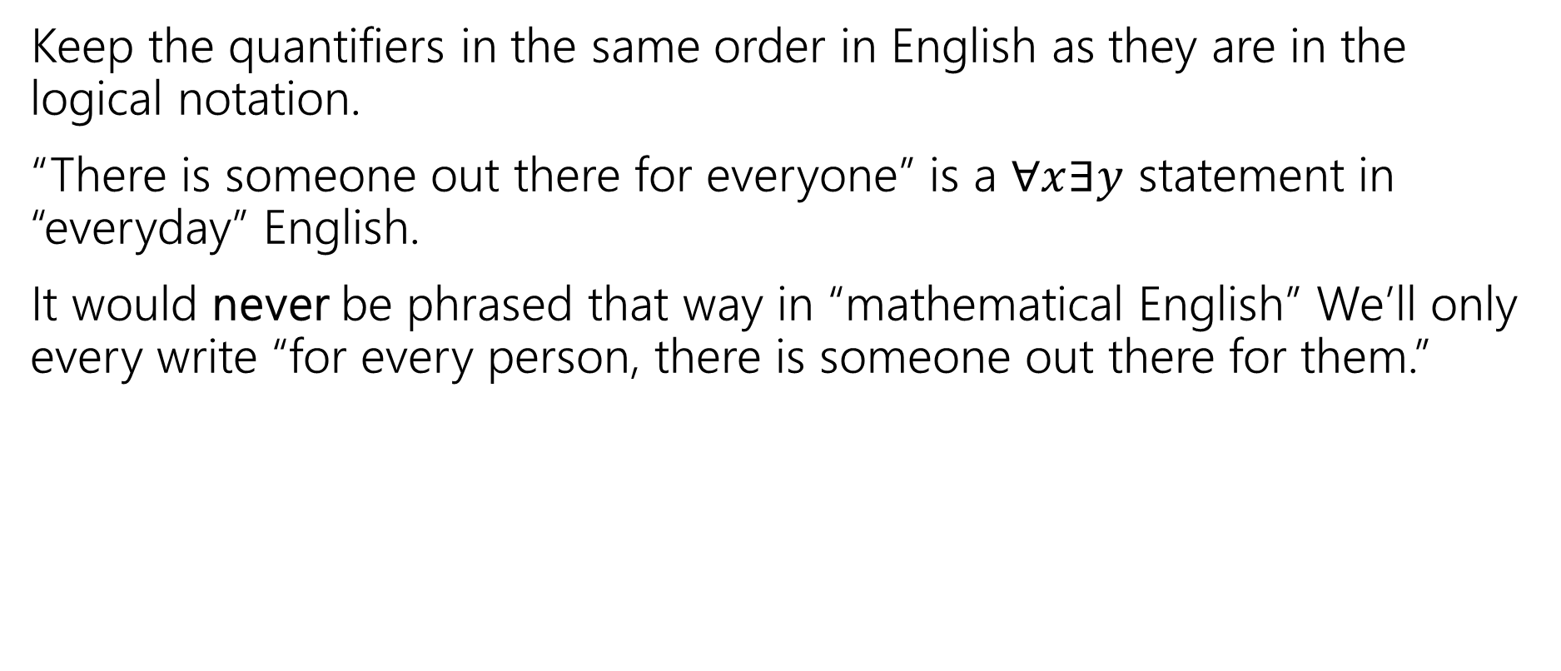
Keep everything in order
Keep the quantifiers in the same order in English as they are in the logical notation.
“There is someone out there for everyone” is a $∀x∃y$ statement in “everyday” English.
It would never be phrased that way in “mathematical English” We’ll only every write “for every person, there is someone out there for them.”

Slide 38





Try it yourselves
Every cat loves some human.
There is a cat that loves every human.
Let your domain of discourse be mammals.
Use the predicates Cat$(x)$, Dog$(x)$, and Loves$(x,y)$ to mean $x$ loves $y$.

Slide 39
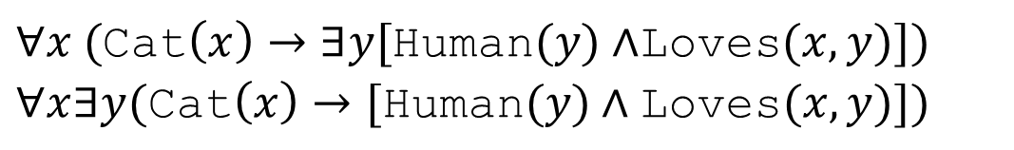

Try it yourselves
Every cat loves some human.
There is a cat that loves every human.
$∀x ($Cat$\left(x\right)→∃y[$Human$(y)∧$Loves$(x,y)])$
$∀x∃y(\text{Cat}\left(x\right)→[\text{Human}(y)∧\text{Loves}(x,y)])$
$∃x ($Cat$\left(x\right)∧∀y[$Human$\left(y\right)→$Loves$(x,y)])$
$∃x∀y(\text{Cat}\left(x\right)∧[\text{Human}(y)→\text{Loves}(x,y)])$

Slide 40


Negation
How do we negate nested quantifiers?
The old rule still applies.
To negate an expression with a quantifier
1. Switch the quantifier ($∀$ becomes $∃,$ $∃$ becomes $∀$)
2. Negate the expression inside
$¬(∀x∃y∀z \left[P\left(x,y\right)∧Q\left(y,z\right)\right])$
$∃x(¬\left(∃y∀z \left[P\left(x,y\right)∧Q\left(y,z\right)\right]\right))$
$∃x∀y(¬\left(∀z\left[P\left(x,y\right)∧Q\left(y,z\right)\right]\right))$
$∃x∀y∃z(¬\left[P\left(x,y\right)∧Q\left(y,z\right)\right])$
$∃x∀y∃z[¬P\left(x,y\right)∨¬Q\left(y,z\right)]$

Slide 41



More Translation
For each of the following, translate it, then say whether the statement is true. Let your domain of discourse be integers.
For every integer, there is a greater integer.
There is an integer $x$, such that for all integers $y$, $xy$ is equal to 1.
$∀y∃x($Equal$\left(x+y,1\right))$
$∀x∃y($Greater$(y,x))$ (This statement is true: $y$ can be $x+1$ [$y$ depends on $x]$)
$∃x∀y($Equal$(xy, 1))$ (This statement is false: no single value of $x$ can play that role for every $y$.)
For every integer, $y,$there is an integer $x$ such that $x+y=1$
(This statement is true, $y$ can depend on $x$)

