Slide 1
Warm Up
Translate this sentence into symbolic logic, and describe a weather pattern and transportation method that causes the proposition to be false.
It is snowing today, and if it is raining or snowing then we won’t walk to school.

Slide 2
Warm Up – Solution
Translate this sentence into symbolic logic, and describe a weather pattern and transportation method that causes the proposition to be false.
It is snowing today, and if it is raining or snowing then we won’t walk to school.
Robbie’s process: identify connecting words, identify propositions, figure out parentheses.

Slide 3
Warm Up – Solution
Translate this sentence into symbolic logic, and describe a weather pattern and transportation method that causes the proposition to be false.
It is snowing today, and if it is raining or snowing then we won’t walk to school.
Identify connecting words: look for and, or, not, if-then, etc.

Slide 4





Warm Up – Solution
Translate this sentence into symbolic logic, and describe a weather pattern and transportation method that causes the proposition to be false.
It is snowing today, and if it is raining or snowing then we won’t walk to school.
Identify propositions: What’s left are propositions, look for repeats and hidden negations.
$$p$$
$$q$$
$$¬r$$
$$p$$
$p:$it is snowing today.
$q:$ it is raining.
$r:$ we walk to school.

Slide 5
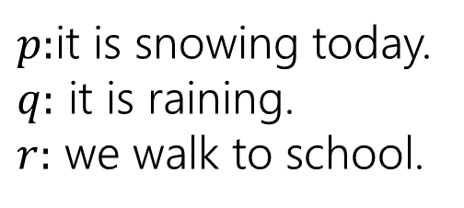
Warm Up – Solution
Translate this sentence into symbolic logic, and describe a weather pattern and transportation method that causes the proposition to be false.
It is snowing today, and if it is raining or snowing then we won’t walk to school.
Figure out parentheses
$$p$$
$$q$$
$$¬r$$
$$p$$
$p:$it is snowing today.
$q:$ it is raining.
$r:$ we walk to school.
$$p∧[(q∨p)→¬r]$$
“raining or snowing” is the condition of the implication, not walking to school is the conclusion. Omitted words in other clauses hint that “It is snowing today” stands on its own.

Slide 6
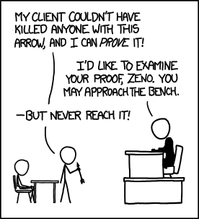
Our First Proof and Digital Logic
xkcd.com/1153
CSE 311 Fall 2020
Lecture 3

Slide 7
Announcements: Office Hours
A chance to talk to staff about the class.
Advice:
  You don’t have to have a question to come to office hours! (It can help, though)
  Aim early on in the “homework cycle” (i.e., long before the deadline).
  We won’t answer every kind of question in office hours:
  We don’t “pregrade” homework. We won’t tell you whether something is right or wrong.
  We will help on homework, but not usually by “giving hints.” We’ll usually ask questions about what you’ve tried, ask questions to help you decide what to do next, or point you to good examples to look at.
  You’re allowed to talk to others at office hours, as long as you’re still following the collaboration policy.

Slide 8
Announcements: Section Materials
Handouts and solutions from yesterday’s sections are on the calendar.
Section solutions should be one of your most-used resources.
They’re staff-written solutions for problems that are often similar to homeworks.
  When you’re wondering how much explanation to give, or what kind of formatting we might expect, section solutions are the first place to look (along with lecture slides).
A section 1 “recap video” is also up on panopto.
  We’re recycling a video from 20Au this week; the questions covered were the same, but some logistical comments may be out of date.

Slide 9
Announcements
President Cauce sent an email to the university around noon today allowing us more flexibility for in-person vs. zoom.
I’m talking to other instructors/the TAs (and trying to clarify any official requirements/recommendations).
We’ll send an email via Ed tonight with what’s happening next week.

Slide 10
Today
Our first proof!
Contrapositives and digital logic.

Slide 11
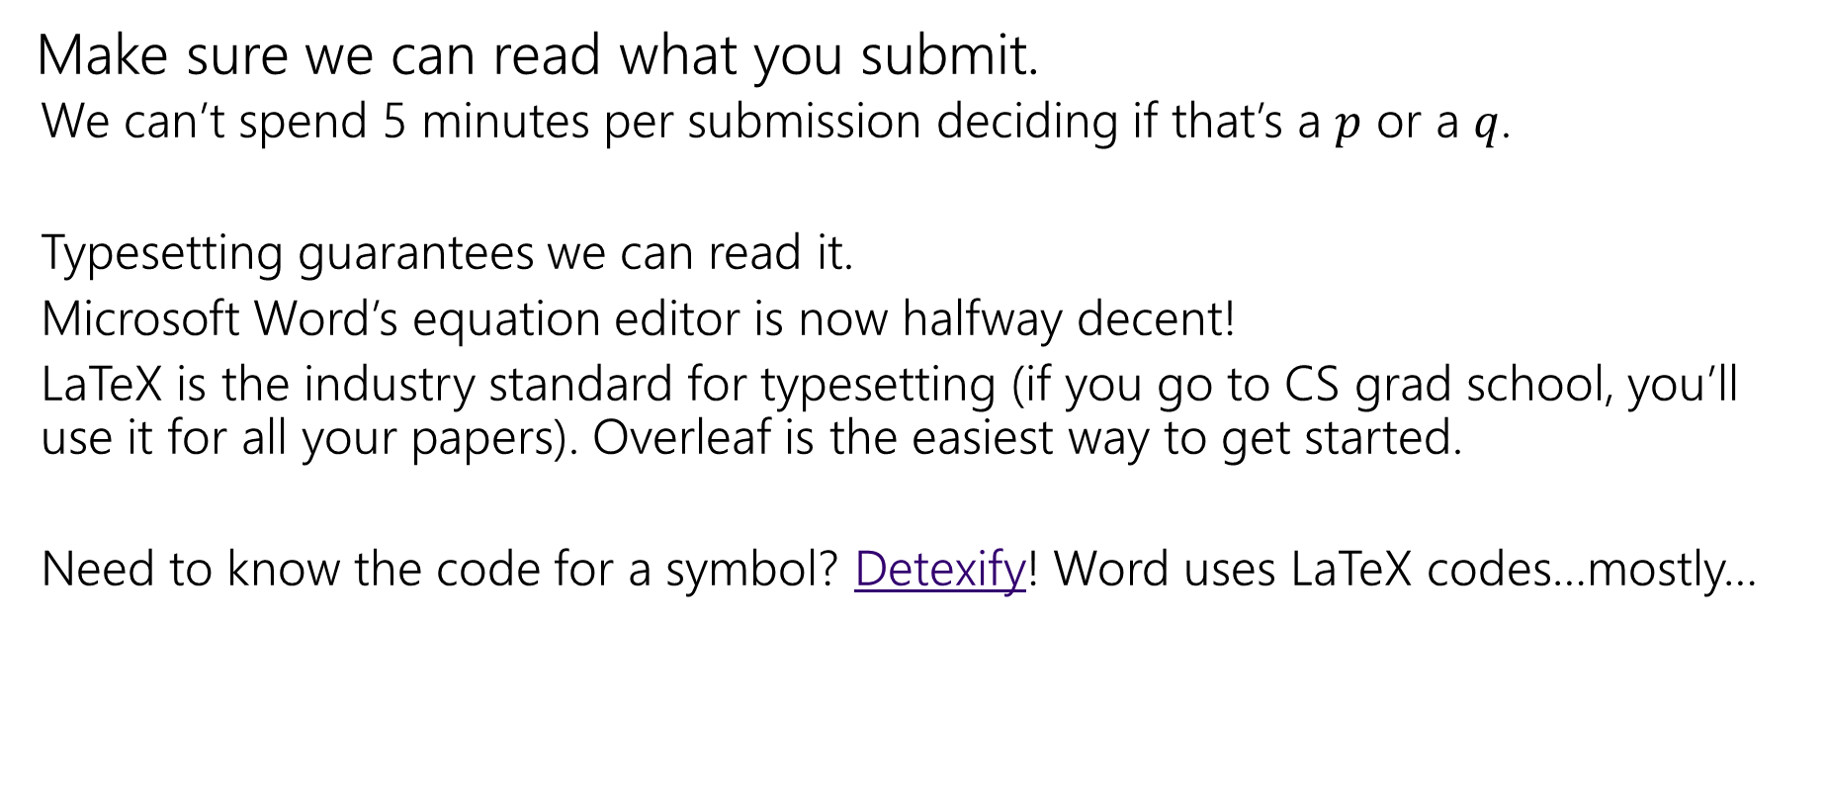
Homework Submissions
Make sure we can read what you submit.
  We can’t spend 5 minutes per submission deciding if that’s a $p$ or a $q$.
  Typesetting guarantees we can read it.
  Microsoft Word’s equation editor is now halfway decent!
  LaTeX is the industry standard for typesetting (if you go to CS grad school, you’ll use it for all your papers). Overleaf is the easiest way to get started.
  Need to know the code for a symbol? Detexify! Word uses LaTeX codes…mostly…

Slide 12
Our First Proof

Slide 13

Last Time
We showed
DeMorgan’s Laws:
$¬\left(p∨q\right)≡¬p∧¬q$ and $¬\left(p∧q\right)≡¬p∨¬q$
And the Law of Implication
$p→q≡¬p∨q$

Slide 14
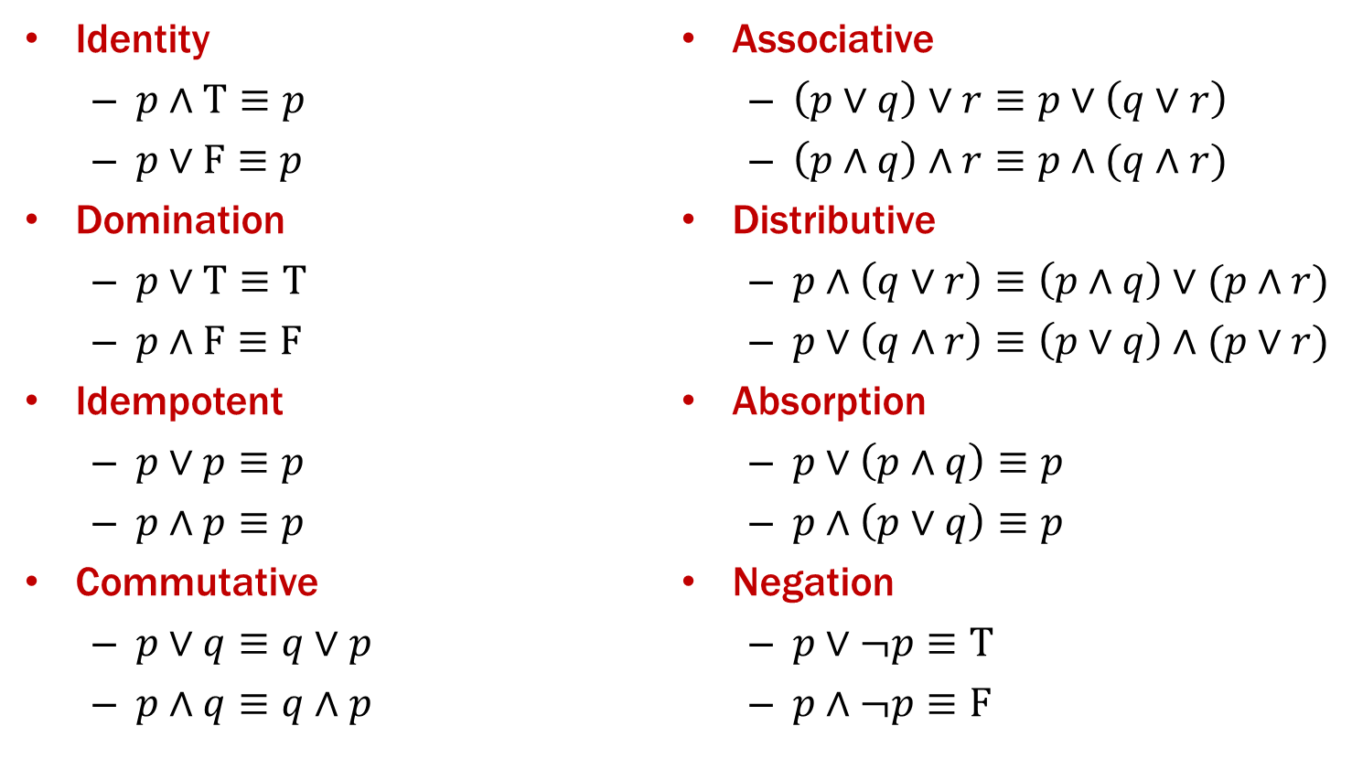
Properties of Logical Connectives
We will always give you this list!
For every propositions $p,q,r$ the following hold:

Slide 15
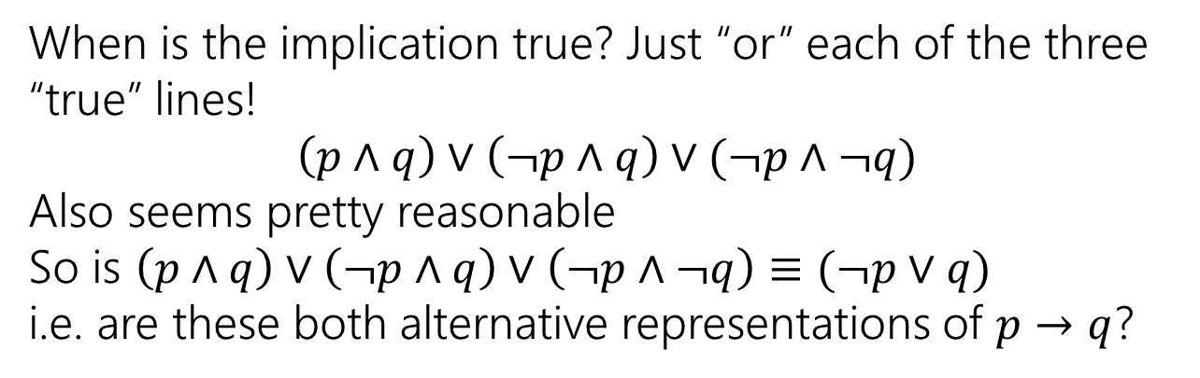
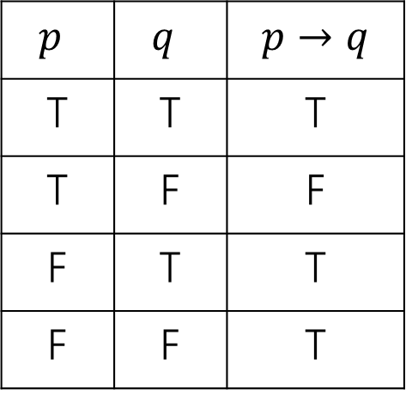
Using Our Rules
WOW that was a lot of rules.
Why do we need them? Simplification!
Let’s go back to the “law of implication” example.
$p$ | $q$ | $$p→q$$
T | T | T
T | F | F
F | T | T
F | F | T
When is the implication true? Just “or” each of the three “true” lines!
$$\left(p∧q\right)∨\left(¬p∧q\right)∨(¬p∧¬q)$$
Also seems pretty reasonable
So is $\left(p∧q\right)∨\left(¬p∧q\right)∨\left(¬p∧¬q\right)≡(¬p∨q)$
i.e. are these both alternative representations of $p→q$?

Slide 16
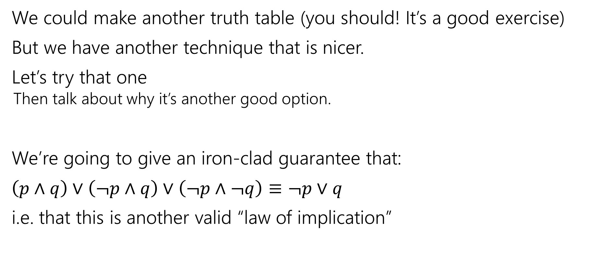
Our First Proof
We could make another truth table (you should! It’s a good exercise)
But we have another technique that is nicer.
Let’s try that one
  Then talk about why it’s another good option.
We’re going to give an iron-clad guarantee that:
$\left(p∧q\right)∨\left(¬p∧q\right)∨\left(¬p∧¬q\right)≡¬p∨q$
i.e. that this is another valid “law of implication”

Slide 17
Our First Proof
How do we write a proof?
It’s not always plug-and-chug…we’ll be highlighting strategies throughout the quarter.
To start with:
Make sure we know what we want to show…

Slide 18



Our First Proof
$\left(p∧q\right)∨\left(¬p∧q\right)∨(¬p∧¬q)$
$≡\left(p∧q\right)∨[\left(¬p∧q\right)∨\left(¬p∧¬q\right)]$
$≡\left(p∧q\right)∨\left[¬p∧\left(q∨¬q\right)\right]$
$≡\left(p∧q\right)∨[¬p∧T]$
$≡\left(p∧q\right)∨[¬p]$
$≡\left[¬p\right]∨(p∧q)$
$≡\left(¬p∨p\right)∧\left(¬p∨q\right)$
$≡T∧\left(¬p∨q\right)$
$≡$ $\left(¬p∨q\right)∧T$
$≡(¬p∨q)$
None of the rules look like this
Practice of Proof-Writing:
Big Picture…WHY do we think this might be true?
The last two “pieces” came from the vacuous proof lines…maybe the “$¬p$” came from there? Maybe that simplifies down to $¬p$

Slide 19

Let’s apply a rule
$\left(¬p∧q\right)∨(¬p∧¬q)$
The law says:
$p∧\left(q∨r\right)≡\left(p∧q\right)∨(p∧r)$
$\left(¬p∧q\right)∨\left(¬p∧¬q\right)≡¬p∧(q∨¬q)$

Slide 20
Our First Proof
$\left(p∧q\right)∨\left(¬p∧q\right)∨(¬p∧¬q)$
$≡\left(p∧q\right)∨[\left(¬p∧q\right)∨\left(¬p∧¬q\right)]$
$≡\left(p∧q\right)∨\left[¬p∧\left(q∨¬q\right)\right]$
$≡\left(p∧q\right)∨[¬p∧T]$
$≡\left(p∧q\right)∨[¬p]$
$≡\left[¬p\right]∨(p∧q)$
$≡\left(¬p∨p\right)∧\left(¬p∨q\right)$
$≡T∧\left(¬p∨q\right)$
$≡$ $\left(¬p∨q\right)∧T$
$≡(¬p∨q)$
None of the rules look like this
Practice of Proof-Writing:
Big Picture…WHY do we think this might be true?
The last two “pieces” came from the vacuous proof lines…maybe the “$¬p$” came from there? Maybe that simplifies down to $¬p$

Slide 21

Our First Proof
$\left(p∧q\right)∨\left(¬p∧q\right)∨(¬p∧¬q)$
$≡\left(p∧q\right)∨[\left(¬p∧q\right)∨\left(¬p∧¬q\right)]$
$≡\left[¬p\right]∨(p∧q)$
$≡\left(\begin{aligned}¬p \\ \\ \\ \\ ∨p\end{aligned}\right)∧\left(¬p∨q\right)$
$≡T∧\left(¬p∨q\right)$
$≡$ $\left(¬p∨q\right)∧T$
$≡(¬p∨q)$
Set ourselves an intermediate goal.
Let’s try to simplify those last two pieces
Associative law
Connect up the things we’re working on.

Slide 22


Our First Proof
$\left(p∧q\right)∨\left(¬p∧q\right)∨(¬p∧¬q)$
$≡\left(p∧q\right)∨[\left(¬p∧q\right)∨\left(¬p∧¬q\right)]$
$≡\left(p∧q\right)∨\left[¬p∧\left(q∨¬q\right)\right]$
$≡\left[¬p\right]∨(p∧q)$
$≡\left(¬p∨p\right)∧\left(¬p∨q\right)$
$≡T∧\left(¬p∨q\right)$
$≡$ $\left(¬p∨q\right)∧T$
$≡(¬p∨q)$
Set ourselves an intermediate goal.
Let’s try to simplify those last two pieces
Distributive law
We think $¬p$ is important, let’s isolate it.

Slide 23

Our First Proof
$\left(p∧q\right)∨\left(¬p∧q\right)∨(¬p∧¬q)$
$≡\left(p∧q\right)∨[\left(¬p∧q\right)∨\left(¬p∧¬q\right)]$
$≡\left(p∧q\right)∨\left[¬p∧\left(q∨¬q\right)\right]$
$≡\left(p∧q\right)∨[¬p∧T]$
$≡\left[¬p\right]∨(p∧q)$
$≡\left(¬p∨p\right)∧\left(¬p∨q\right)$
$≡T∧\left(¬p∨q\right)$
$≡$ $\left(¬p∨q\right)∧T$
$≡(¬p∨q)$
Set ourselves an intermediate goal.
Let’s try to simplify those last two pieces
Negation
Should make things simpler.

Slide 24
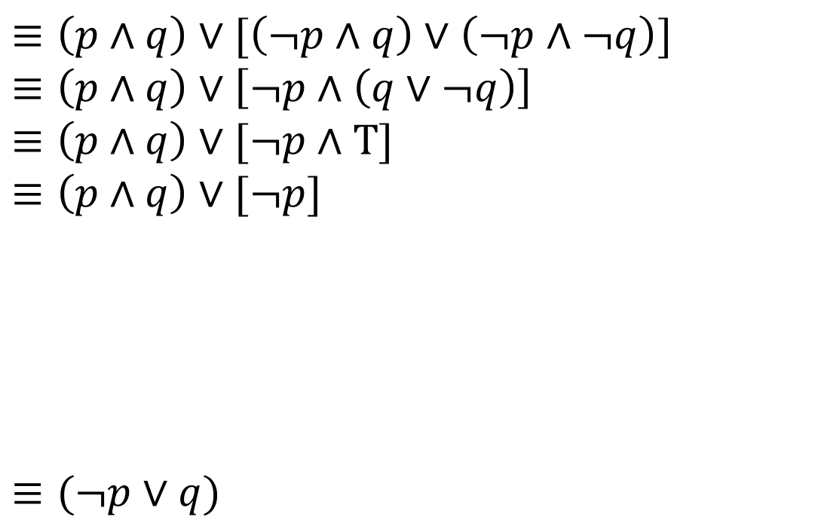
Our First Proof
$\left(p∧q\right)∨\left(¬p∧q\right)∨(¬p∧¬q)$
$≡\left(p∧q\right)∨[\left(¬p∧q\right)∨\left(¬p∧¬q\right)]$
$≡\left(p∧q\right)∨\left[¬p∧\left(q∨¬q\right)\right]$
$≡\left(p∧q\right)∨[¬p∧T]$
$≡\left(p∧q\right)∨[¬p]$
$≡\left[¬p\right]∨(p∧q)$
$≡\left(\begin{aligned}¬p \\ ∨p\end{aligned}\right)∧\left(¬p∨q\right)$
$≡T∧\left(¬p∨q\right)$
$≡$ $\left(¬p∨q\right)∧T$
$≡(¬p∨q)$
Set ourselves an intermediate goal.
Let’s try to simplify those last two pieces
Identity
Should make things simpler.

Slide 25
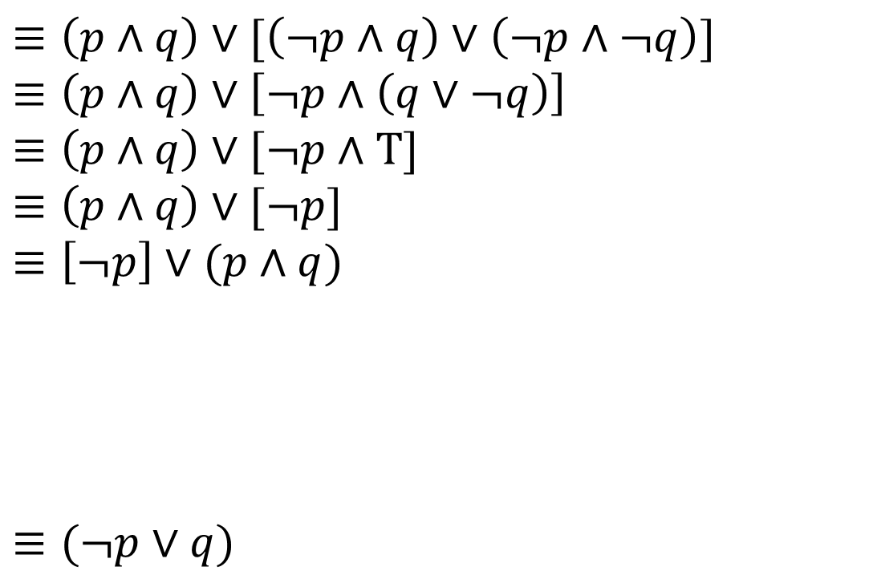

Our First Proof
$\left(p∧q\right)∨\left(¬p∧q\right)∨(¬p∧¬q)$
$≡\left(p∧q\right)∨[\left(¬p∧q\right)∨\left(¬p∧¬q\right)]$
$≡\left(p∧q\right)∨\left[¬p∧\left(q∨¬q\right)\right]$
$≡\left(p∧q\right)∨[¬p∧T]$
$≡\left(p∧q\right)∨[¬p]$
$≡\left[¬p\right]∨(p∧q)$
$≡(¬p∨q)$
Stay on target:
We met our intermediate goal.
Don‘t forget the final goal!
We want to end up at $\left(¬p∨q\right)$
If we apply the distribution rule,
We’d get a $(¬p∨q)$

Slide 26
Our First Proof
$\left(p∧q\right)∨\left(¬p∧q\right)∨(¬p∧¬q)$
$≡\left(p∧q\right)∨[\left(¬p∧q\right)∨\left(¬p∧¬q\right)]$
$≡\left(p∧q\right)∨\left[¬p∧\left(q∨¬q\right)\right]$
$≡\left(p∧q\right)∨[¬p∧T]$
$≡\left(p∧q\right)∨[¬p]$
$≡\left[¬p\right]∨(p∧q)$
$≡(¬p∨q)$
Stay on target:
We met our intermediate goal.
Don‘t forget the final goal!
We want to end up at $\left(¬p∨q\right)$
If we apply the distribution rule,
We’d get a $(¬p∨q)$
Commutative
Make the expression look exactly like the law (more on this later)

Slide 27
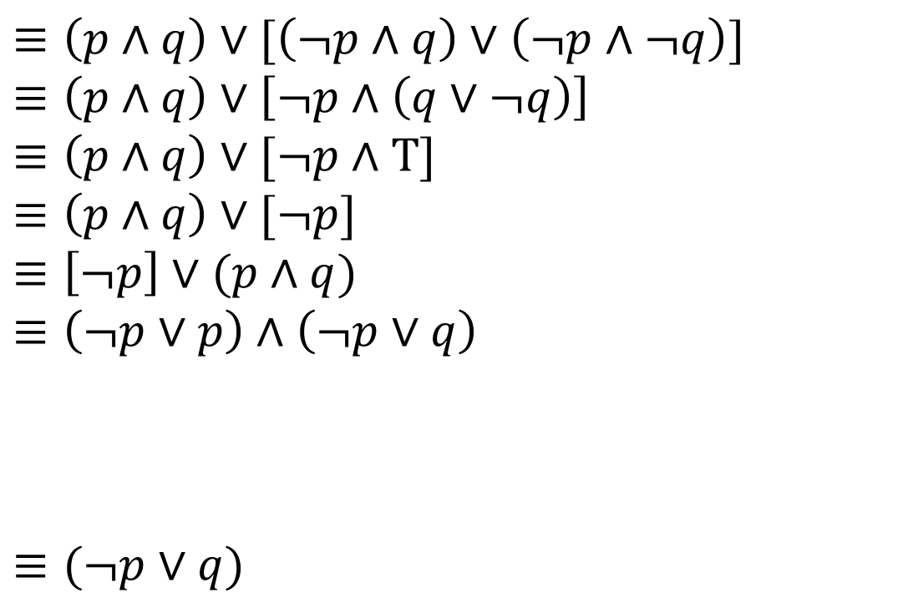

Our First Proof
$\left(p∧q\right)∨\left(¬p∧q\right)∨(¬p∧¬q)$
$≡\left(p∧q\right)∨[\left(¬p∧q\right)∨\left(¬p∧¬q\right)]$
$≡\left(p∧q\right)∨\left[¬p∧\left(q∨¬q\right)\right]$
$≡\left(p∧q\right)∨[¬p∧T]$
$≡\left(p∧q\right)∨[¬p]$
$≡\left[¬p\right]∨(p∧q)$
$≡\left(¬p∨p\right)∧\left(¬p∨q\right)$
$≡(¬p∨q)$
Stay on target:
We met our intermediate goal.
Don‘t forget the final goal!
We want to end up at $\left(¬p∨q\right)$
If we apply the distribution rule,
We’d get a $(¬p∨q)$
Distributive
Creates the $(¬p∨q)$ we were hoping for.

Slide 28
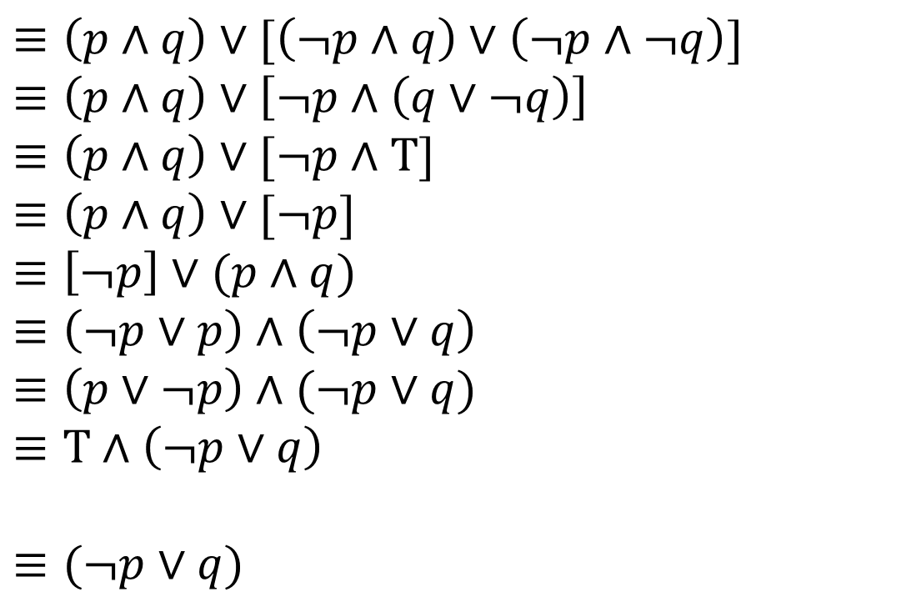
Our First Proof
$\left(p∧q\right)∨\left(¬p∧q\right)∨(¬p∧¬q)$
$≡\left(p∧q\right)∨[\left(¬p∧q\right)∨\left(¬p∧¬q\right)]$
$≡\left(p∧q\right)∨\left[¬p∧\left(q∨¬q\right)\right]$
$≡\left(p∧q\right)∨[¬p∧T]$
$≡\left(p∧q\right)∨[¬p]$
$≡\left[¬p\right]∨(p∧q)$
$≡\left(¬p∨p\right)∧\left(¬p∨q\right)$
$≡\left(p∨¬p\right)∧(¬p∨q)$
$≡T∧\left(¬p∨q\right)$
$≡(¬p∨q)$
Stay on target:
We met our intermediate goal.
Don‘t forget the final goal!
We want to end up at $\left(¬p∨q\right)$
If we apply the distribution rule,
We’d get a $(¬p∨q)$
Commutative
Make the expression look exactly like the law (more on this later)
Identity
Simplifies the part we want to disappear.

Slide 29

Simplify T$∧(¬p∨q)$ to $(¬p∨q)$
For every propositions $p,q,r$ the following hold:

Slide 30
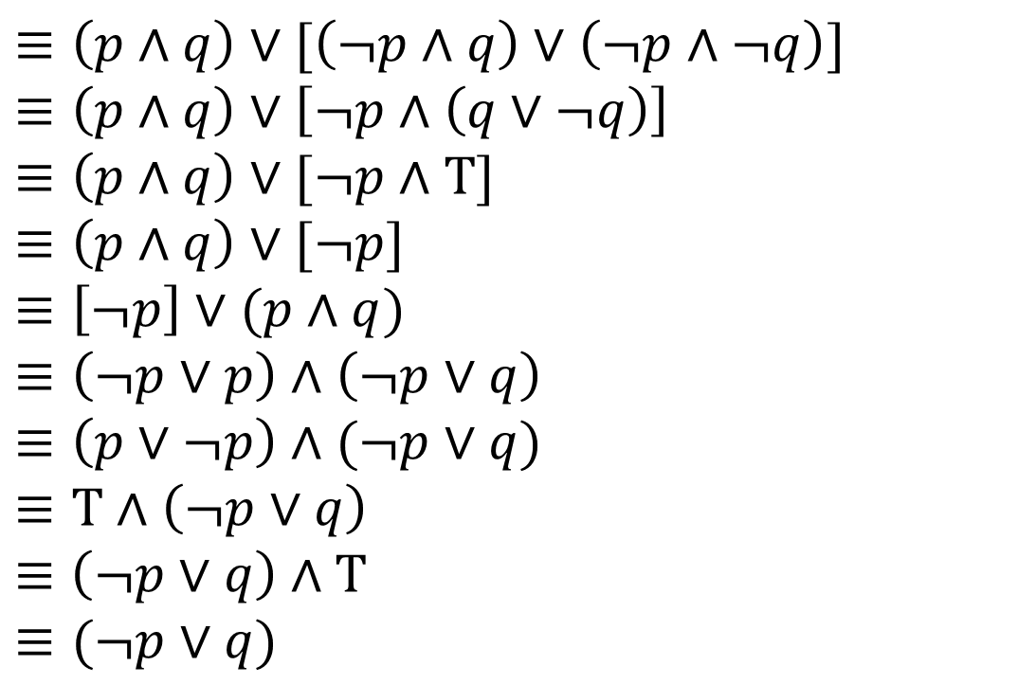
Our First Proof
$\left(p∧q\right)∨\left(¬p∧q\right)∨(¬p∧¬q)$
$≡\left(p∧q\right)∨[\left(¬p∧q\right)∨\left(¬p∧¬q\right)]$
$≡\left(p∧q\right)∨\left[¬p∧\left(q∨¬q\right)\right]$
$≡\left(p∧q\right)∨[¬p∧T]$
$≡\left(p∧q\right)∨[¬p]$
$≡\left[¬p\right]∨(p∧q)$
$≡\left(¬p∨p\right)∧\left(¬p∨q\right)$
$≡\left(p∨¬p\right)∧(¬p∨q)$
$≡T∧\left(¬p∨q\right)$
$≡$ $\left(¬p∨q\right)∧T$
$≡(¬p∨q)$
Stay on target:
We met our intermediate goal.
Don‘t forget the final goal!
We want to end up at $\left(¬p∨q\right)$
If we apply the distribution rule,
We’d get a $(¬p∨q)$
Commutative followed by Identity
Look exactly like the law, then apply it.
We’re done!!!

Slide 31
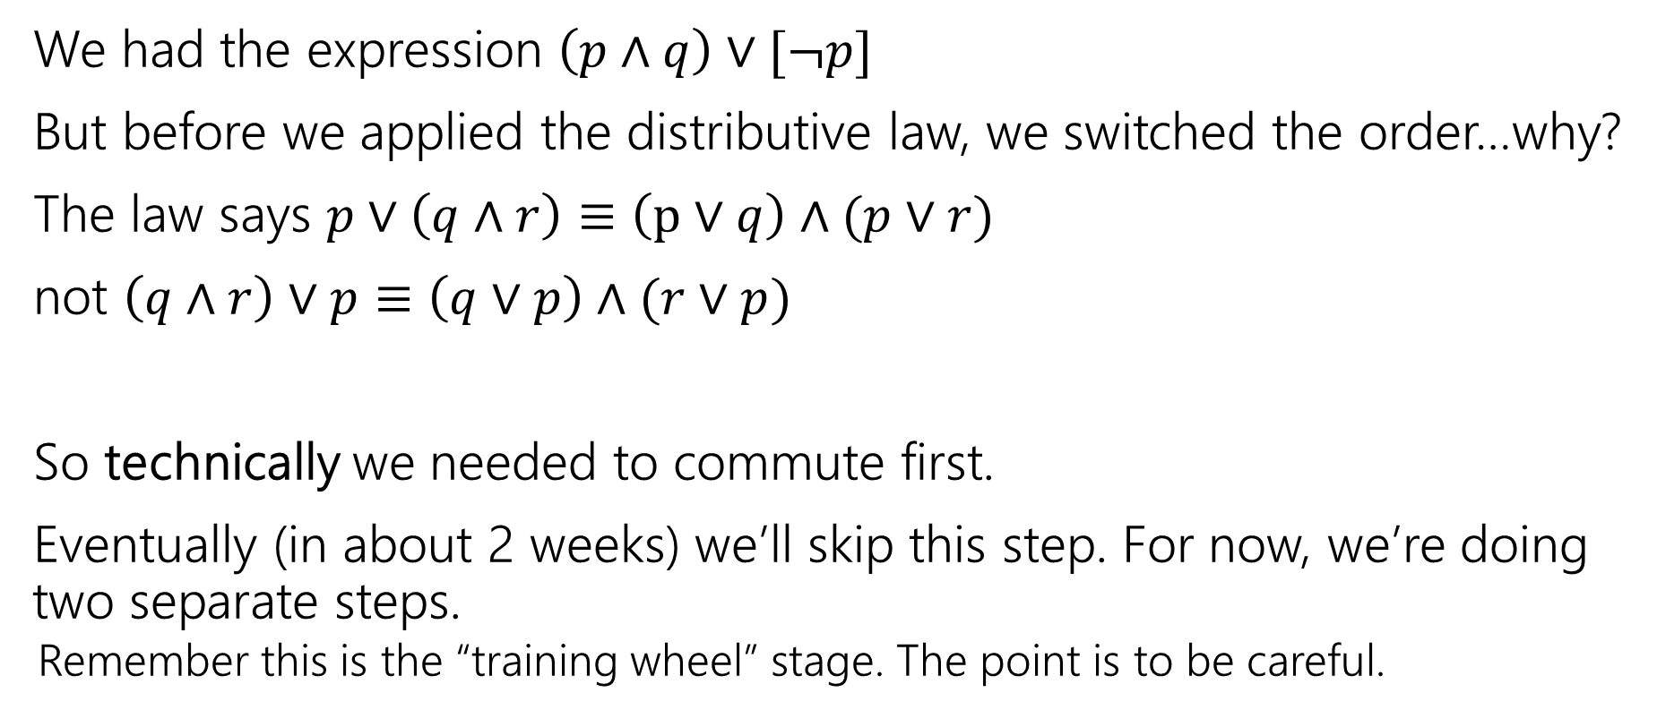
Commutativity
We had the expression $\left(p∧q\right)∨[¬p]$
But before we applied the distributive law, we switched the order…why?
The law says $p∨\left(q∧r\right)≡\left(p∨q\right)∧(p∨r)$
not $\left(q∧r\right)∨p≡\left(q∨p\right)∧(r∨p)$
So technically we needed to commute first.
Eventually (in about 2 weeks) we’ll skip this step. For now, we’re doing two separate steps.
  Remember this is the “training wheel” stage. The point is to be careful.

Slide 32
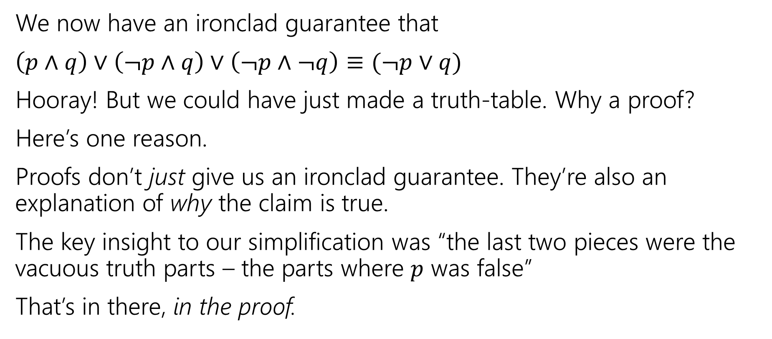
More on Our First Proof
We now have an ironclad guarantee that
$\left(p∧q\right)∨\left(¬p∧q\right)∨\left(¬p∧¬q\right)≡(¬p∨q)$
Hooray! But we could have just made a truth-table. Why a proof?
Here’s one reason.
Proofs don’t just give us an ironclad guarantee. They’re also an explanation of why the claim is true.
The key insight to our simplification was “the last two pieces were the vacuous truth parts – the parts where $p$ was false”
That’s in there, in the proof.

Slide 33
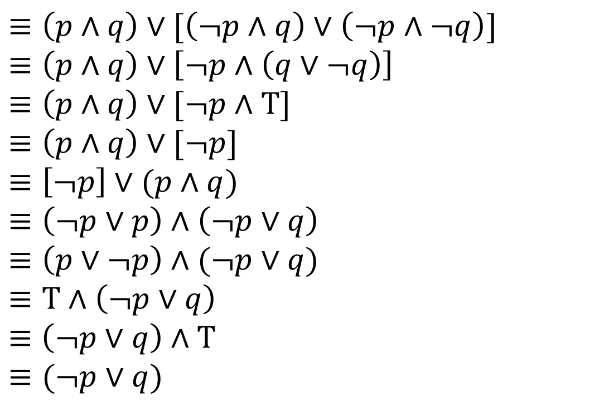

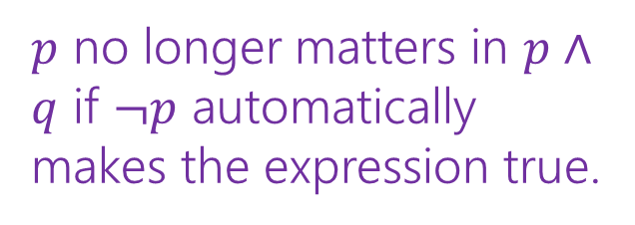
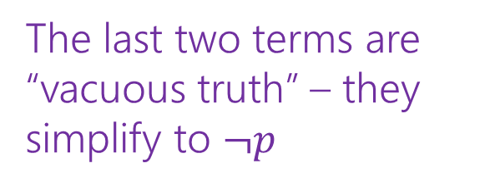
Our First Proof
$\left(p∧q\right)∨\left(¬p∧q\right)∨(¬p∧¬q)$
$≡\left(p∧q\right)∨[\left(¬p∧q\right)∨\left(¬p∧¬q\right)]$
$≡\left(p∧q\right)∨\left[¬p∧\left(q∨¬q\right)\right]$
$≡\left(p∧q\right)∨[¬p∧T]$
$≡\left(p∧q\right)∨[¬p]$
$≡\left[¬p\right]∨(p∧q)$
$≡\left(¬p∨p\right)∧\left(¬p∨q\right)$
$≡\left(p∨¬p\right)∧(¬p∨q)$
$≡T∧\left(¬p∨q\right)$
$≡$ $\left(¬p∨q\right)∧T$
$≡(¬p∨q)$
Associative
Distributive
Negation
Identity
Commutative
Distributive
Commutative
Negation
Commutative
Identity
The last two terms are “vacuous truth” – they simplify to $¬p$
$p$ no longer matters in $p∧q$ if $¬p$ automatically makes the expression true.

Slide 34
More on Our First Proof
With practice (and quite a bit of squinting) you can see not just the ironclad guarantee, but also the reason why something is true.
That’s not easy with a truth table.
Proofs can also communicate intuition about why a statement is true.
  We’ll practice extracting intuition from proofs more this quarter.

Slide 35
Modifying Implications

Slide 36
Converse, Contrapositive
Implication:
p → q
Converse:
q → p
Contrapositive:
¬q → ¬p
Inverse:
¬p → ¬q
If it’s raining, then I have my umbrella.
If I don’t have my umbrella, then it is not raining.
If I have my umbrella, then it is raining.
If it is not raining, then I don’t have my umbrella.
How do these relate to each other?
p | q | p → q | q → p | ¬p | ¬q | ¬p → ¬q | ¬q → ¬p
T | T
T | F
F | T
F | F

Slide 37
Converse, Contrapositive
Implication:
p → q
Converse:
q → p
Contrapositive:
¬q → ¬p
Inverse:
¬p → ¬q
An implication and its contrapositive have the same truth value!
p | q | p → q | q → p | ¬p | ¬q | ¬p → ¬q | ¬q → ¬p
T | T | T | T | F | F | T | T
T | F | F | T | F | T | T | F
F | T | T | F | T | F | F | T
F | F | T | T | T | T | T | T

Slide 38
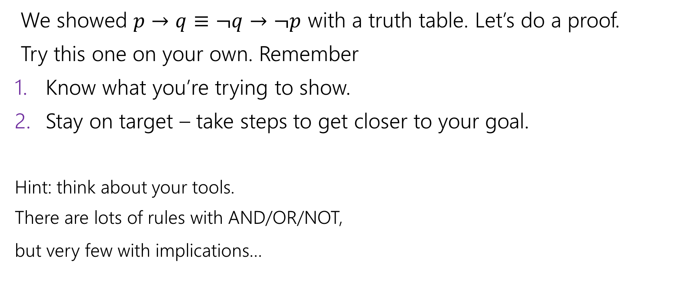
Contrapositive
We showed $p→q≡¬q→¬p$ with a truth table. Let’s do a proof.
Try this one on your own. Remember
Know what you’re trying to show.
Stay on target – take steps to get closer to your goal.
Hint: think about your tools.
There are lots of rules with AND/OR/NOT,
but very few with implications…
pollev.com/uwcse311
Help me adjust my explanation!

Slide 39
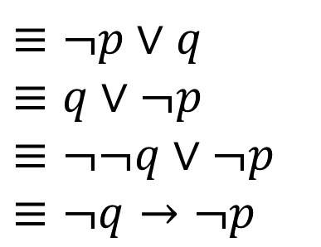

Contrapositive
$p→q$
$≡¬p∨q$
$≡q∨¬p$
$≡¬¬q∨¬p$
$≡¬q→¬p$
Law of Implication
Commutativity
Double Negation
Law of Implication
All of our rules deal with ORs and ANDs, let’s switch the implication to just use AND/NOT/OR.
And do the same with our target
It’s ok to work from both ends. In fact it’s a very common strategy!
Now how do we get the top to look like the bottom?
Just a few more rules and we’re done!

Slide 40
Work from both ends, but…
…make sure at the end, if you read from top-to-bottom, every step makes sense.
When proving an equivalence you must:
1. Start with the left side (or right side)
2. Modify what you had in the last step (using an equivalence)
3. Derive the right side (or left side if you started with the right)
You may not start with the equivalence you’re trying to show, and simplify to something “obviously true.”
  More on why later in the quarter, but tl;dr for now is you can’t use your goal as a starting assumption (it’s what you’re trying to show! If you knew it, no need to write a proof).

Slide 41
Digital Logic

Slide 42
Digital Circuits
Computing With Logic
  T corresponds to 1 or “high” voltage
  F corresponds to 0 or “low” voltage
Gates
  Take inputs and produce outputs (functions)
  Several kinds of gates
  Correspond to propositional connectives (most of them)

Slide 43

And Gate
AND Connective
vs.
AND Gate
p ∧ q
p
AND
OUT
q
p | q | p ∧ q
T | T | T
T | F | F
F | T | F
F | F | F
p | q | OUT
1 | 1 | 1
1 | 0 | 0
0 | 1 | 0
0 | 0 | 0
p
q
AND
OUT
“block looks like D of AND”

Slide 44

Or Gate
OR Connective
vs.
OR Gate
p ∨ q
p
OR
OUT
q
p | q | p ∨ q
T | T | T
T | F | T
F | T | T
F | F | F
p | q | OUT
1 | 1 | 1
1 | 0 | 1
0 | 1 | 1
0 | 0 | 0
p
OR
OUT
q
“arrowhead block looks like V”

Slide 45

Not Gates
NOT Connective
vs.
NOT Gate
¬p
p
NOT
OUT
Also called
inverter
p | ¬ p
T | F
F | T
p | OUT
1 | 0
0 | 1
p
NOT
OUT

Slide 46
Blobs are Okay!
You may write gates using blobs instead of shapes!
p
q
AND
OUT
p
q
OR
OUT
p
NOT
OUT

Slide 47
Combinational Logic Circuits
p
NOT
AND
OUT
q
NOT
AND
r
s
OR
Values get sent along wires connecting gates

Slide 48

Combinational Logic Circuits
p
NOT
AND
OUT
q
NOT
AND
r
s
OR
Values get sent along wires connecting gates

Slide 49
Combinational Logic Circuits
p
AND
q
NOT
OR
OUT
r
AND
Wires can send one value to multiple gates!

Slide 50


Combinational Logic Circuits
p
AND
q
NOT
OR
OUT
r
AND
Wires can send one value to multiple gates!
$$\left(p∧¬q \right)∨(¬q∧r)$$

Slide 51
More Vocabulary

Slide 52






Vocabulary!
Tautology if it is always true.
Contradiction if it is always false.
Contingency if it can be both true and false.
A proposition is a….
$$p∨¬p$$
Tautology
If $p$ is true, $p∨¬p$ is true; if $p$ is false, $p∨¬p$is true.
$$p⊕p$$
Contradiction
If $p$ is true, $p⊕p$ is false; if $p$ is false, $p⊕p$is false.
$$\left(p→q\right)∧p$$
Contingency If $p$ is true and $q$ is true, $\left(p→q\right)∧p$is true;
If $p$ is true and $q$ is false, $\left(p→q\right)∧p$is false.

Slide 53

Another Proof
Let’s prove that$\left(p∧q\right)→(q∨p)$ is a tautology.
Alright, what are we trying to show?

Slide 54






Another Proof
$\left(p∧q\right)→(q∨p)$
$≡¬\left(p∧q\right)∨\left(q∨p\right)$
$≡\left(¬p∨¬q\right)∨(q∨p)$
$≡¬p∨(¬q∨\left(q∨p\right))$
$≡¬p∨\left(\left(¬q∨q\right)∨p\right)$
$≡¬p∨(\left(q∨¬q\right)∨p)$
$≡¬p∨(T∨p)$
$≡¬p∨(p∨T)$
$≡¬p∨p$
$≡p∨¬p$
$≡T$
Proof-writing tip:
Take a step back.
Pause and carefully look at what you have. You might see where to go next…
Law of Implication
It’s easier if everything is AND/OR/NOT
DeMorgan’s Law
Gets rid of some parentheses/just a gut feeling.
Associative (twice)
Put $q,¬q$ next to each other.
Commutative, Negation
Simplify out the $q,¬q$.
Commutative, Domination
Simplify out the $T$.
Commutative, Negation
Simplify out the $p,¬p$.
We’re done!

Slide 55
Another Proof
$\left(p∧q\right)→(q∨p)$
$≡¬\left(p∧q\right)∨\left(q∨p\right)$
$≡\left(¬p∨¬q\right)∨(q∨p)$
$≡¬p∨(¬q∨\left(q∨p\right))$
$≡¬p∨\left(\left(¬q∨q\right)∨p\right)$
$≡¬p∨(\left(q∨¬q\right)∨p)$
$≡¬p∨(T∨p)$
$≡¬p∨(p∨T)$
$≡¬p∨p$
$≡p∨¬p$
$≡T$
Law of implication
DeMorgan’s Law
Associative
Associative
Commutative
Negation
Commutative
Domination
Commutative
Negation

Slide 56
Computing Equivalence
Given two propositions, can we write an algorithm to determine if they are equivalent?
What is the runtime of our algorithm?

Slide 57
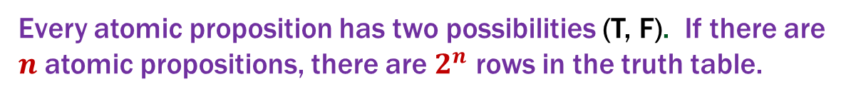
Computing Equivalence
Given two propositions, can we write an algorithm to determine if they are equivalent?
Yes! Generate the truth tables for both propositions and check if they are the same for every entry.
What is the runtime of our algorithm?
Every atomic proposition has two possibilities (T, F). If there are $n$ atomic propositions, there are $2^{n}$ rows in the truth table.

