Slide 1
More Logic, Equivalences, Symbolic Proofs
CSE 311 Winter 2021
Lecture 2

Slide 2
Announcements
Lecture recordings on “panopto” – link is posted on ed.
Section walkthroughs will go there as well.
Your section links will be posted on the pinned thread on Ed.
HW1 comes out tonight – on the assignments tab on the webpage
Due (a-week-from-today) Wednesday evening.
You’ll submit to gradescope (more information coming).
OH start on Thursday (will be posted on the calendar) – this week all are on zoom.

Slide 3
Consider enrolling in 390Z
There’s still space!
Alice (one of your TAs, who took 390Z when she took 311), said:
“It’s a good course to take if you feel that the course material is going by too quickly or if you want to work with other people!“
More info on the 390z course webpage

Slide 4
Today
More on implications
Simplification Rules
Our first proof (maybe)!

Slide 5

Implication ($p→q)$
“If it’s raining, then I have my umbrella”
It’s useful to think of implications as promises. An implication is false exactly when you can demonstrate I’m lying.
p | q | p → q
T | T | T
T | F | F
F | T | T
F | F | T
 | It’s raining | It’s not raining
I have my umbrella | No lie. True | No lie. True
I do not have my umbrella | LIE! False | No lie. True

Slide 6
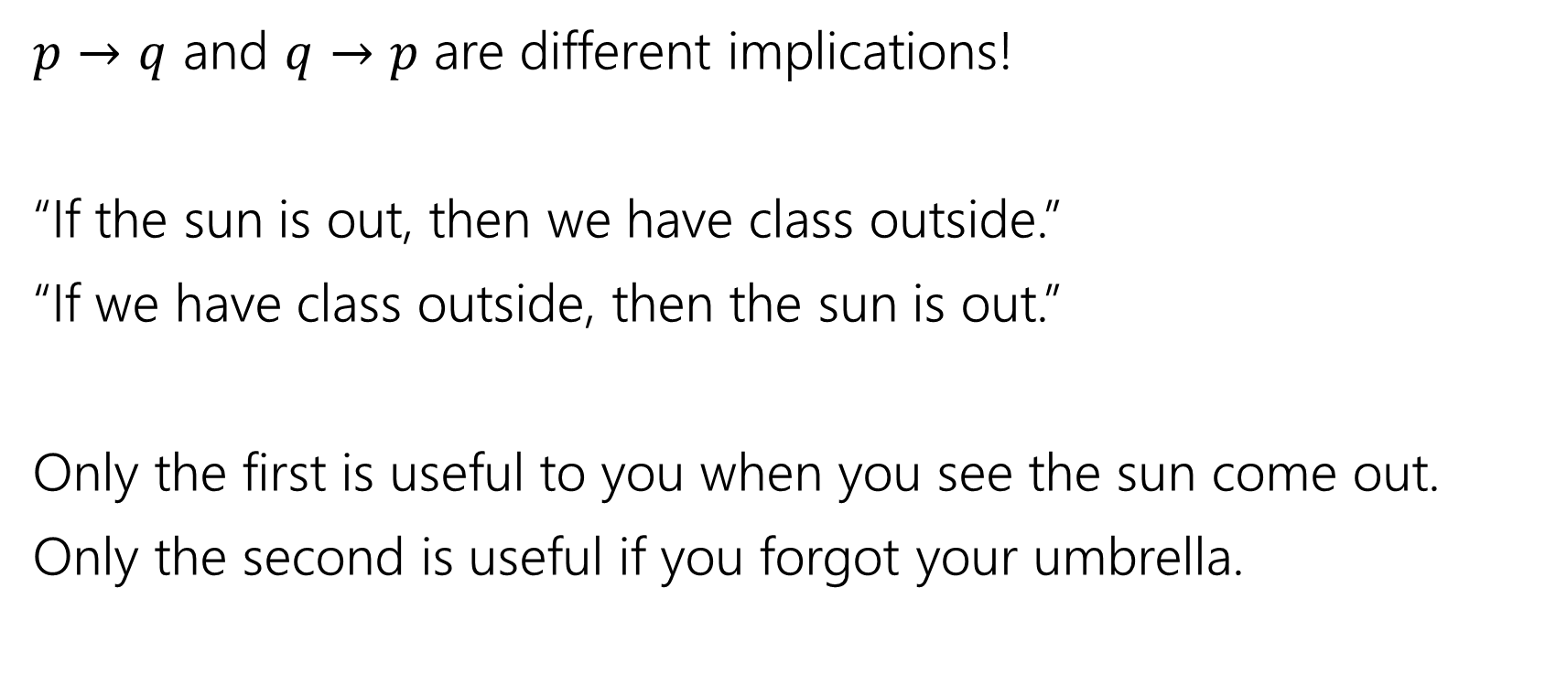
$$p → q$$
$p→q$ and $q→p$ are different implications!
“If the sun is out, then we have class outside.”
“If we have class outside, then the sun is out.”
Only the first is useful to you when you see the sun come out.
Only the second is useful if you forgot your umbrella.

Slide 7
$$p → q$$
p | q | p → q
T | T | T
T | F | F
F | T | T
F | F | T
Implication:
  p implies q
  whenever p is true q must be true
  if p then q
  q if p
  p is sufficient for q
  p only if q
  q is necessary for p
Implications are super useful, so there are LOTS of translations.
You’ll learn these in detail in section.

Slide 8
More Connectives

Slide 9
A More Complicated Statement
“Robbie knows the Pythagorean Theorem if he is a mathematician and took geometry, and he is a mathematician or did not take geometry.”
Is this a proposition?
We’d like to understand what this proposition means.
In particular, is it true?

Slide 10
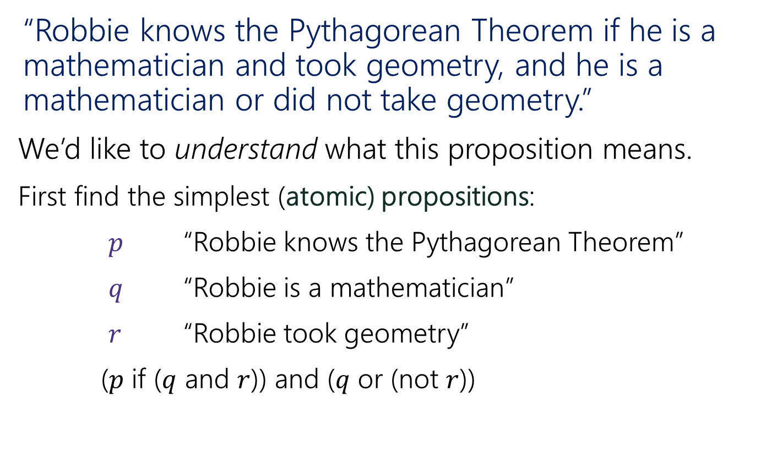
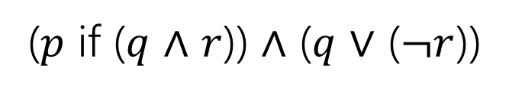
A Compound Proposition
“Robbie knows the Pythagorean Theorem if he is a mathematician and took geometry, and he is a mathematician or did not take geometry.”
We’d like to understand what this proposition means.
First find the simplest (atomic) propositions:
$p$ “Robbie knows the Pythagorean Theorem”
$q$ “Robbie is a mathematician”
$r$ “Robbie took geometry”
($p$ if ($q$ and $r$)) and ($q$ or (not $r$))
($p$ if ($q$ $∧$ $r$)) $∧$ ($q$ $∨$ ($¬r$))

Slide 11
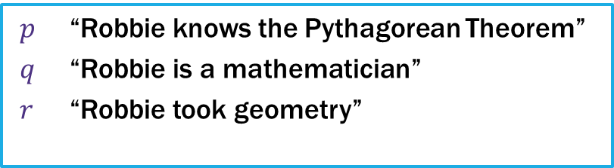
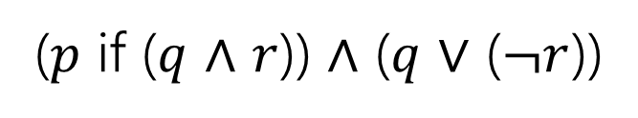
Parentheses…
“Robbie knows the Pythagorean Theorem if he is a mathematician and took geometry, and he is a mathematician or did not take geometry.”
$p$ “Robbie knows the Pythagorean Theorem”
$q$ “Robbie is a mathematician”
$r$ “Robbie took geometry”
($p$ if ($q$ $∧$ $r$)) $∧$ ($q$ $∨$ ($¬r$))
How did we know where to put the parentheses?
Subtle English grammar choices (top-level parentheses are independent clauses).
Context/which parsing will make more sense.
Conventions
A reading on this is coming soon!

Slide 12
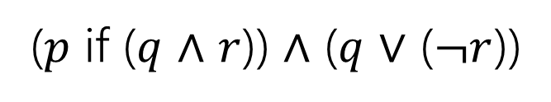
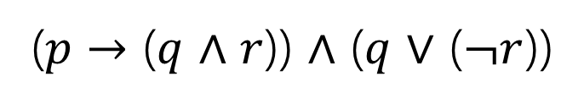
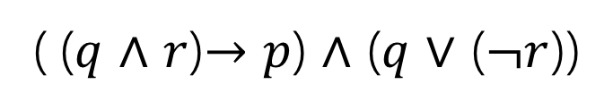
Back to the Compound Proposition…
“Robbie knows the Pythagorean Theorem if he is a mathematician and took geometry, and he is a mathematician or did not take geometry.”
($p$ if ($q$ $∧$ $r$)) $∧$ ($q$ $∨$ ($¬r$))
$p$ “Robbie knows the Pythagorean Theorem”
$q$ “Robbie is a mathematician”
$r$ “Robbie took geometry”
What promise am I making?
( ($q$ $∧$ $r$)$→p$) $∧$ ($q$ $∨$ ($¬r$))
($p$ $→$ ($q$ $∧$ $r$)) $∧$ ($q$ $∨$ ($¬r$))
The first one! Being a mathematician and taking geometry is the condition. Knowing the Pythagorean Theorem is the promise.

Slide 13
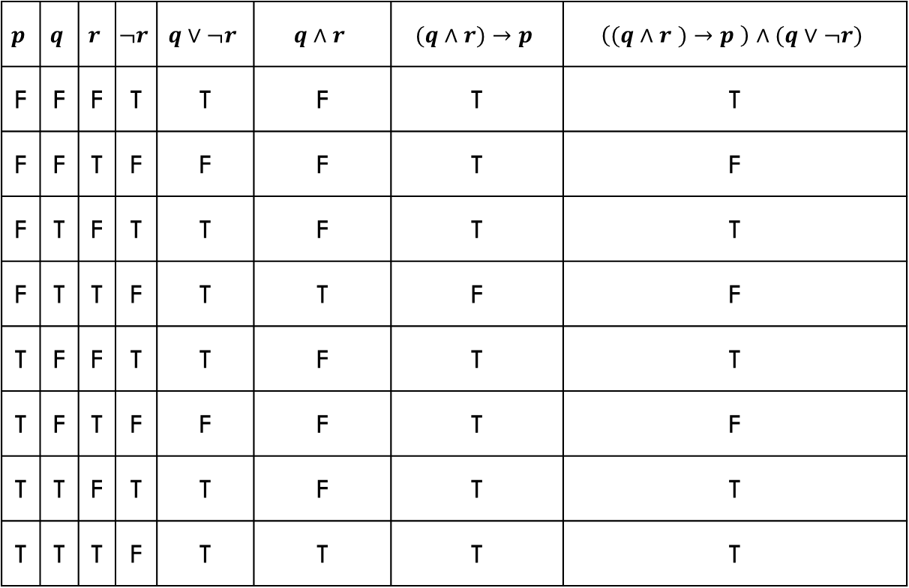
Analyzing the Sentence with a Truth Table
$$p$$ | $$q$$ | $$r$$ | $$¬r$$ | $$q∨¬r$$ | $$q∧r$$ | $$(q∧r)→p$$ | $$\left((q∧r )→p \right)∧(q∨¬r)$$
F | F | F | T | T | F | T | T
F | F | T | F | F | F | T | F
F | T | F | T | T | F | T | T
F | T | T | F | T | T | F | F
T | F | F | T | T | F | T | T
T | F | T | F | F | F | T | F
T | T | F | T | T | F | T | T
T | T | T | F | T | T | T | T

Slide 14
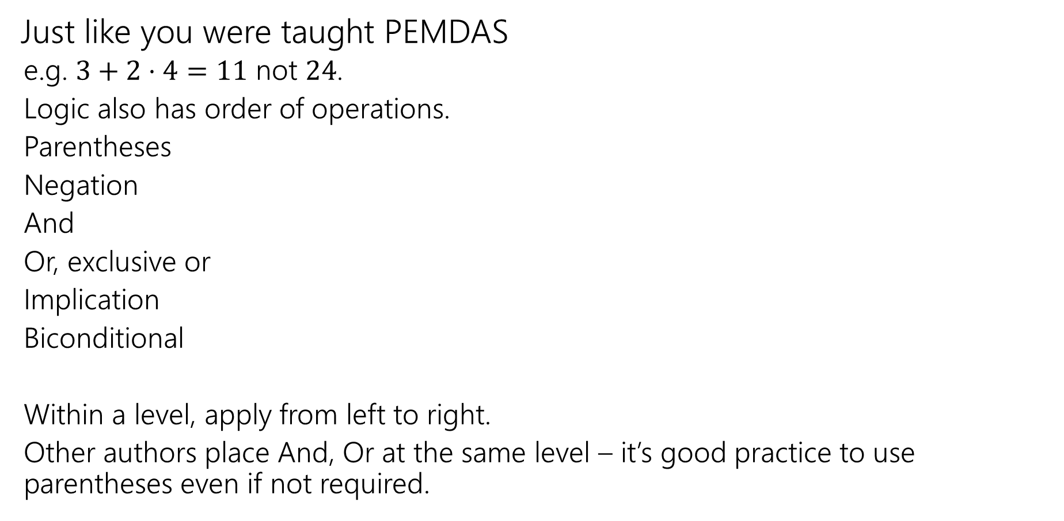
Order of Operations
Just like you were taught PEMDAS
  e.g. $3+2⋅4=11$ not $24$.
  Logic also has order of operations.
  Parentheses
  Negation
  And
  Or, exclusive or
  Implication
  Biconditional
  Within a level, apply from left to right.
  Other authors place And, Or at the same level – it’s good practice to use parentheses even if not required.
For this class: each of these is it’s own level!
e.g. “and”s have precedence over “or”s

Slide 15
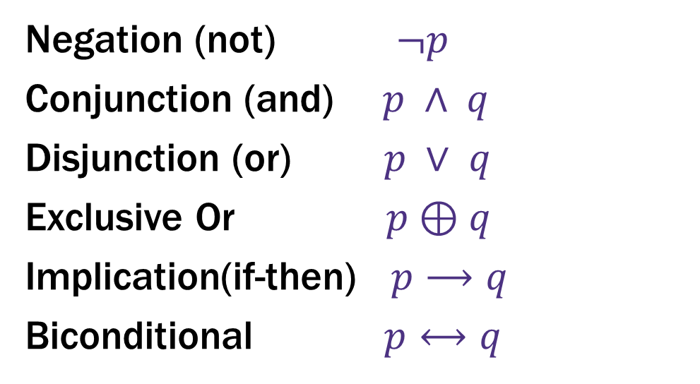
Logical Connectives
Negation (not) $¬p$
Conjunction (and) $p ∧ q$
Disjunction (or) $p ∨ q$
Exclusive Or $p⊕q$
Implication(if-then) $p⟶q$
Biconditional $p⟷q$
These ideas have been around for so long most have at least two names.
Two more connectives to discuss!

Slide 16
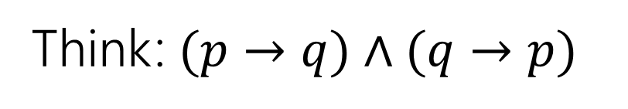

Biconditional: $p ↔ q$
Think: $(p→q)∧(q→p)$
p if and only if q
p iff q
p is equivalent to q
p implies q and q implies p
p is necessary and sufficient for q
p | q | p ↔ q

Slide 17
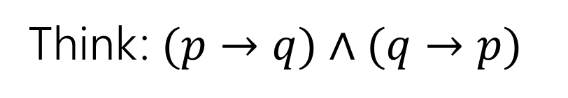
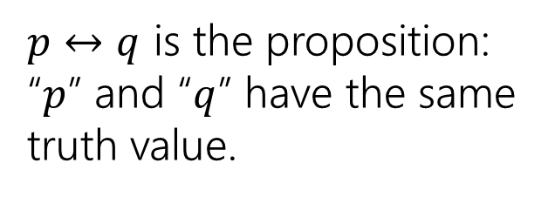
Biconditional: $p ↔ q$
Think: $(p→q)∧(q→p)$
p if and only if q
p iff q
p is equivalent to q
p implies q and q implies p
p is necessary and sufficient for q
p | q | p ↔ q
T | T | T
T | F | F
F | T | F
F | F | T
$p↔q$ is the proposition: “$p$” and “$q$” have the same truth value.

Slide 18
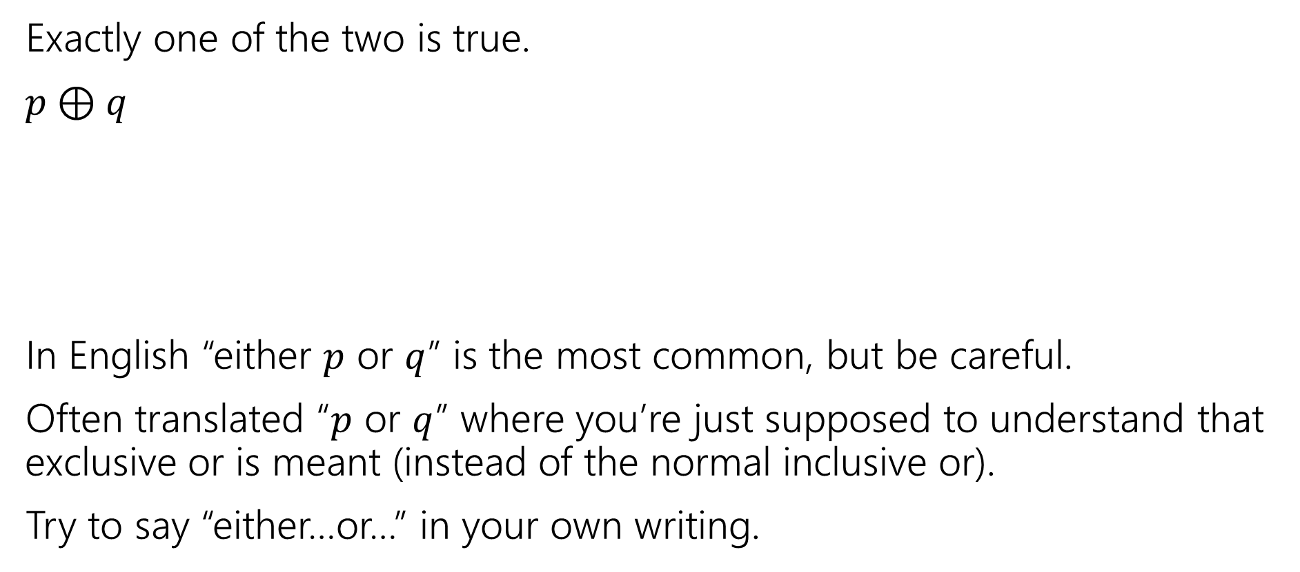
Exclusive Or
Exactly one of the two is true.
$p⊕q$
In English “either $p$ or $q$” is the most common, but be careful.
Often translated “$p$ or $q$” where you’re just supposed to understand that exclusive or is meant (instead of the normal inclusive or).
Try to say “either…or…” in your own writing.
p | q | p ⊕ q

Slide 19
Exclusive Or
Exactly one of the two is true.
$p⊕q$
In English “either $p$ or $q$” is the most common, but be careful.
Often translated “$p$ or $q$” where you’re just supposed to understand that exclusive or is meant (instead of the normal inclusive or).
Try to say “either…or…” in your own writing.
p | q | p ⊕ q
T | T | F
T | F | T
F | T | T
F | F | F

Slide 20
Today
A proof!
We want to be able to make iron-clad guarantees that something is true.
And convince others that we really have ironclad guarantees.
But first, some notation.

Slide 21
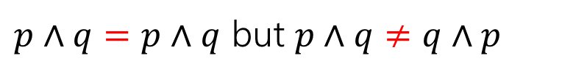
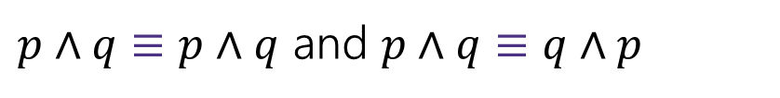
Logical Equivalence
We will want to talk about whether two propositions are “the same.”
Two propositions are “equal” ($=$) if they are character-for-character identical.
$p∧q=p∧q$ but $p∧q≠q∧p$
We almost never ask whether propositions are equal. It’s not an interesting question.
Two propositions are “equivalent” ($≡$) if they always have the same truth value.
$p∧q≡p∧q$ and $p∧q≡q∧p$
But $p∧q≢p∨q$
When $p$ is true and $q$ is false: $p∧q$ is false, but $p∨q$ is true.

Slide 22
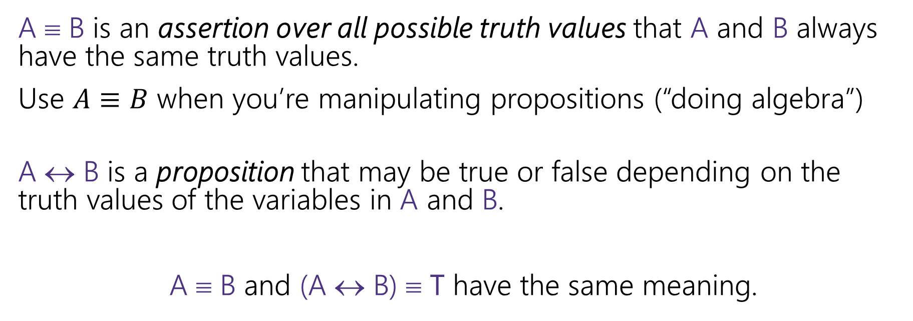
A ↔ B vs. A ≡ B
A ≡ B is an assertion over all possible truth values that A and B always have the same truth values.
Use $A≡B$ when you’re manipulating propositions (“doing algebra”)
A ↔ B is a proposition that may be true or false depending on the truth values of the variables in A and B.
A ≡ B and (A ↔ B) ≡ T have the same meaning.

Slide 23
Simplification and Proofs

Slide 24
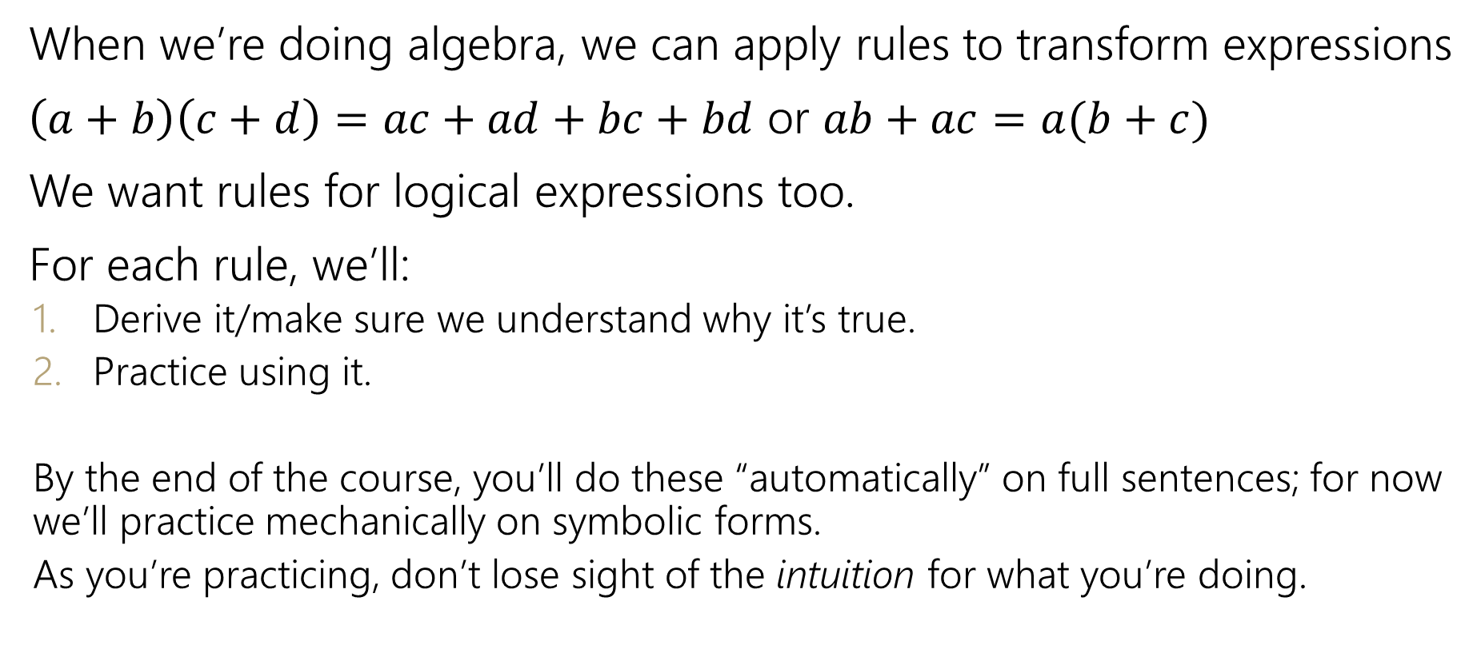
Manipulating Expressions
When we’re doing algebra, we can apply rules to transform expressions
$\left(a+b\right)\left(c+d\right)=ac+ad+bc+bd$ or $ab+ac=a(b+c)$
We want rules for logical expressions too.
For each rule, we’ll:
  Derive it/make sure we understand why it’s true.
  Practice using it.
  By the end of the course, you’ll do these “automatically” on full sentences; for now we’ll practice mechanically on symbolic forms.
  As you’re practicing, don’t lose sight of the intuition for what you’re doing.

Slide 25
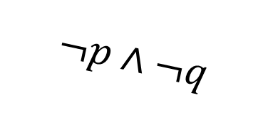
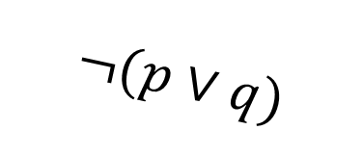
De Morgan’s Laws
Negate the statement
“my code compiles or there is a bug.”
i.e. find a natural English sentence that says
“the following is not true: my code compiles or there is a bug”
Hint: when it the original sentence false?
$$¬(p∨q)$$
‘or’ means ‘at least one is true’ so to negate, we need to say ‘neither is true’ or equivalently ‘both are false’
“my code does not compile and there is not a bug”
$$¬p∧¬q$$

Slide 26



De Morgan’s Laws
$¬\left(p∨q\right)≡¬p∧¬q$
is a general rule. It’s always true for any propositions $p$ and $q$.
This is one of De Morgan’s Laws.
The other is:
$¬\left(p∧q\right)≡¬p∨¬q$

Slide 27

De Morgan’s Laws
Example: $¬\left(p∧q\right)≡¬p∨¬q$
p | q | ¬p | ¬q | ¬p ∨ ¬q | p ∧ q | ¬(p ∧ q) | ¬(p ∧ q) ↔ (¬p ∨ ¬q)
T | T | F | F | F | T | F | T
T | F | F | T | T | F | T | T
F | T | T | F | T | F | T | T
F | F | T | T | T | F | T | T

Slide 28
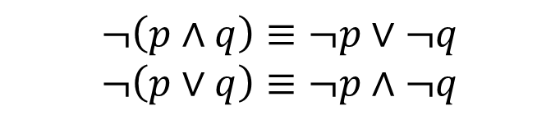
De Morgan’s Laws
$$¬\left(p∧q\right)≡¬p∨¬q$$
$$¬\left(p∨q\right)≡¬p∧¬q$$
if (!(front != null && value > front.data))
front = new ListNode(value, front);
else {
ListNode current = front;
while (current.next != null && current.next.data < value))
current = current.next;
current.next = new ListNode(value, current.next);
}

Slide 29

De Morgan’s Laws
$$¬\left(p∧q\right)≡¬p∨¬q$$
$$¬\left(p∨q\right)≡¬p∧¬q$$
!(front != null && value > front.data)
$$$$
front == null || value <= front.data
You’ve been using these for a while!

Slide 30
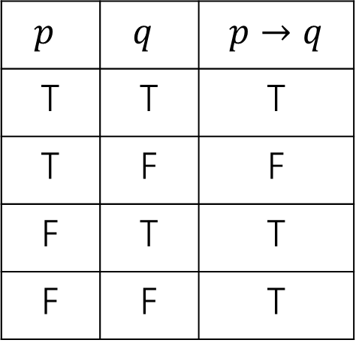
Law of Implication
Implications are hard.
AND/OR/NOT make more intuitive sense to me…
can we rewrite implications using just ANDs ORs and NOTs?
$p$ | $q$ | $$p→q$$
T | T | T
T | F | F
F | T | T
F | F | T
One approach: think “when is this implication false?” then negate it (you might want one of DeMorgan’s Laws!

Slide 31

Law of Implication
Implications are hard.
AND/OR/NOT make more intuitive sense to me…
can we rewrite implications using just ANDs ORs and NOTs?
$p$ | $q$ | $$p→q$$
T | T | T
T | F | F
F | T | T
F | F | T
Seems like we might want $¬(p∧¬q)$
$$¬p∨q$$
Seems like a reasonable guess.
So is it true? Is $¬p∨q≡p→q$?

Slide 32

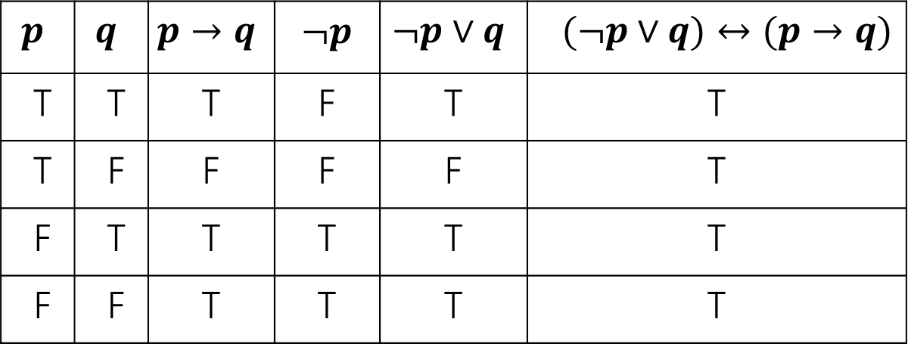
Law of Implication
$$¬p∨q≡p→q$$
$$p$$ | $$q$$ | $$p→q$$ | $¬p$ | $$¬p∨q$$ | $(¬p∨q)↔(p→q)$
T | T | T | F | T | T
T | F | F | F | F | T
F | T | T | T | T | T
F | F | T | T | T | T

Slide 33
Properties of Logical Connectives
We’ve derived two facts about logical connectives.
There’s a lot more. A LOT more.
The next slide is a list of a bunch of them…
  Most of these are much less complicated than the last two, so we won’t go through them in detail.
  DO NOT freak out about how many there are. We will always provide you the list on the next slide (no need to memorize).

Slide 34
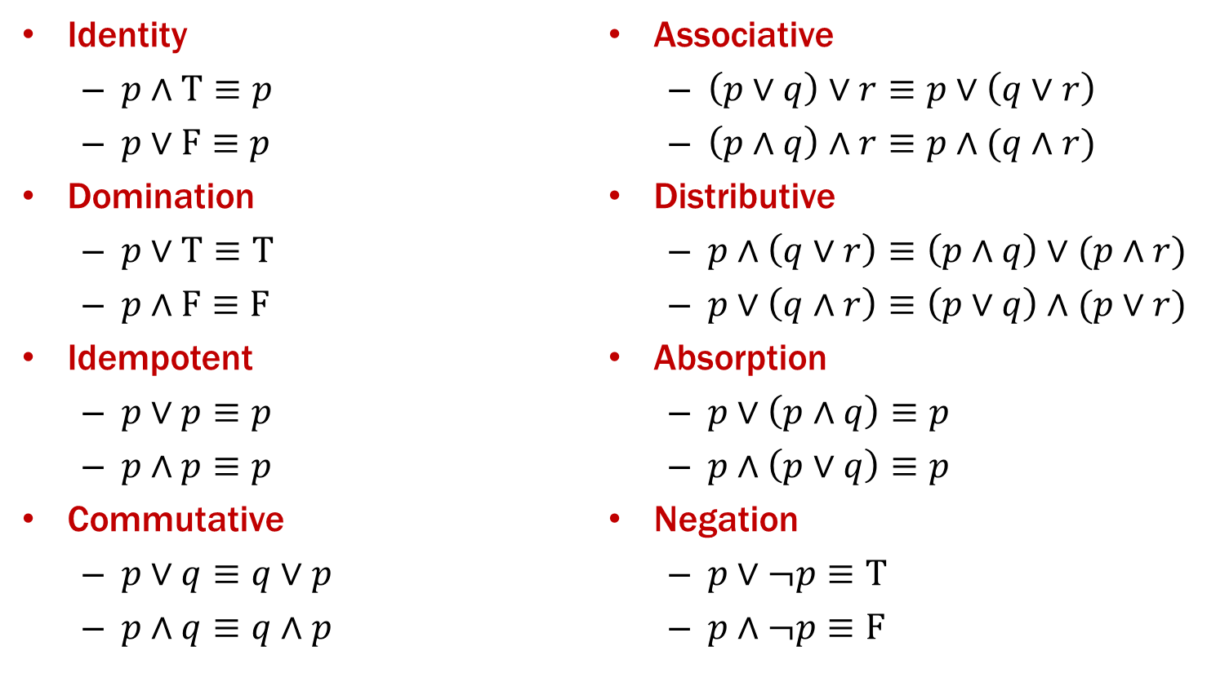
Properties of Logical Connectives
We will always give you this list!
For every propositions $p,q,r$ the following hold:

Slide 35
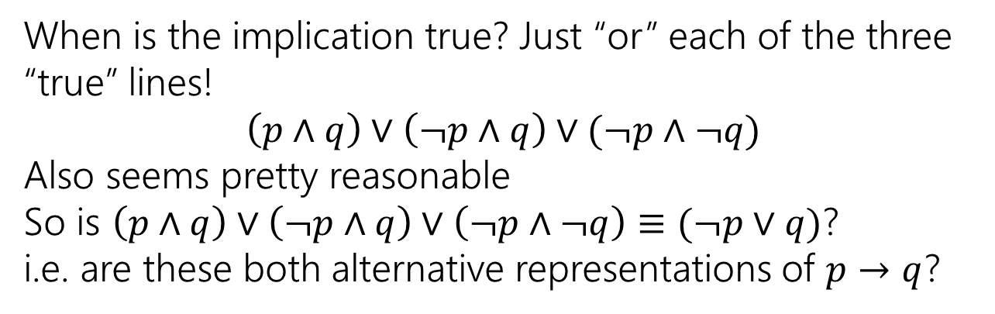
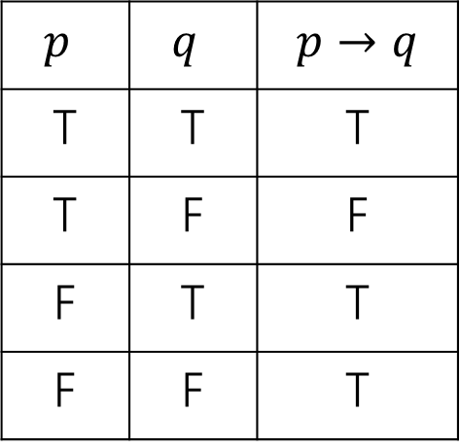
Using Our Rules
WOW that was a lot of rules.
Why do we need them? Simplification!
Let’s go back to the “law of implication” example.
$p$ | $q$ | $$p→q$$
T | T | T
T | F | F
F | T | T
F | F | T
When is the implication true? Just “or” each of the three “true” lines!
$$\left(p∧q\right)∨\left(¬p∧q\right)∨(¬p∧¬q)$$
Also seems pretty reasonable
So is $\left(p∧q\right)∨\left(¬p∧q\right)∨\left(¬p∧¬q\right)≡(¬p∨q)$?
i.e. are these both alternative representations of $p→q$?

Slide 36
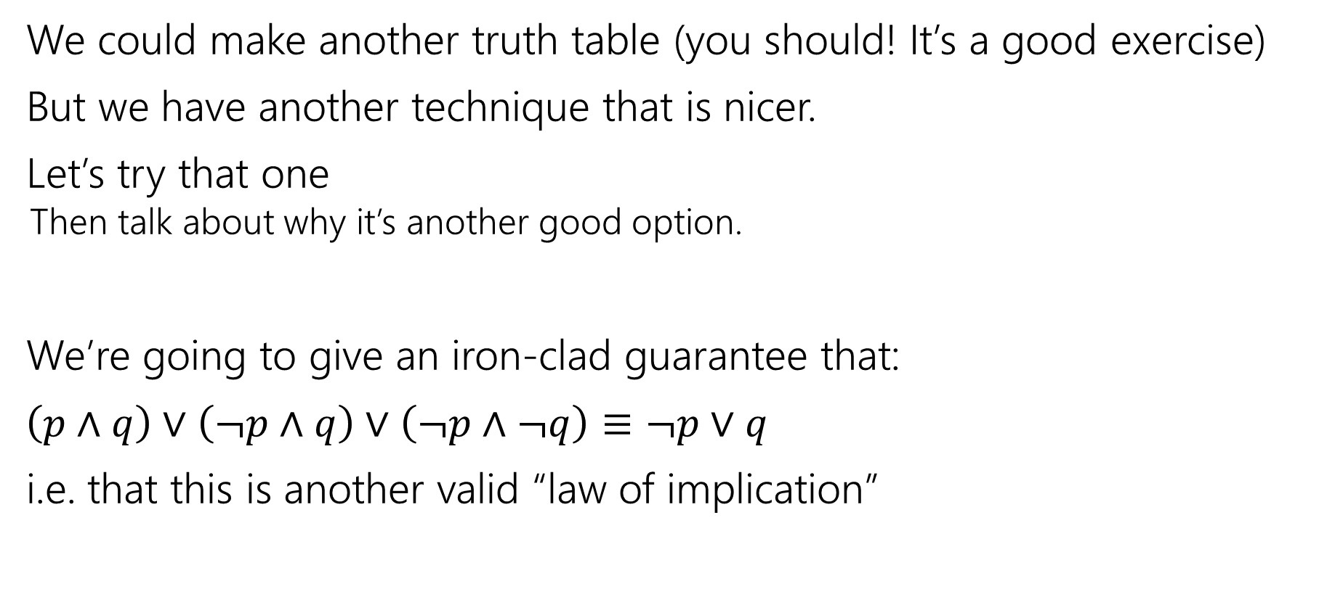
Our First Proof
We could make another truth table (you should! It’s a good exercise)
But we have another technique that is nicer.
Let’s try that one
  Then talk about why it’s another good option.
We’re going to give an iron-clad guarantee that:
$\left(p∧q\right)∨\left(¬p∧q\right)∨\left(¬p∧¬q\right)≡¬p∨q$
i.e. that this is another valid “law of implication”

Slide 37
Our First Proof
How do we write a proof?
It’s not always plug-and-chug…we’ll be highlighting strategies throughout the quarter.
To start with:
Make sure we know what we want to show…

Slide 38



Our First Proof
$\left(p∧q\right)∨\left(¬p∧q\right)∨(¬p∧¬q)$
$≡\left(p∧q\right)∨[\left(¬p∧q\right)∨\left(¬p∧¬q\right)]$
$≡\left(p∧q\right)∨\left[¬p∧\left(q∨¬q\right)\right]$
$≡\left(p∧q\right)∨[¬p∧T]$
$≡\left(p∧q\right)∨[¬p]$
$≡\left[¬p\right]∨(p∧q)$
$≡\left(¬p∨p\right)∧\left(¬p∨q\right)$
$≡T∧\left(¬p∨q\right)$
$≡$ $\left(¬p∨q\right)∧T$
$≡(¬p∨q)$
None of the rules look like this
Practice of Proof-Writing:
Big Picture…WHY do we think this might be true?
The last two “pieces” came from the vacuous proof lines…maybe the “$¬p$” came from there? Maybe that simplifies down to $¬p$

Slide 39


Our First Proof
$\left(p∧q\right)∨\left(¬p∧q\right)∨(¬p∧¬q)$
$≡\left(p∧q\right)∨[\left(¬p∧q\right)∨\left(¬p∧¬q\right)]$
$≡\left(p∧q\right)∨\left[¬p∧\left(q∨¬q\right)\right]$
$≡\left(p∧q\right)∨[¬p∧T]$
$≡\left(p∧q\right)∨[¬p]$
$≡\left[¬p\right]∨(p∧q)$
$≡\left(¬p∨p\right)∧\left(¬p∨q\right)$
$≡T∧\left(¬p∨q\right)$
$≡$ $\left(¬p∨q\right)∧T$
$≡(¬p∨q)$
Set ourselves an intermediate goal.
Let’s try to simplify those last two pieces
Associative law
Connect up the things we’re working on.
Distributive law
We think $¬p$ is important, let’s isolate it.
Negation
Should make things simpler.
Domination
Should make things simpler.

Slide 40
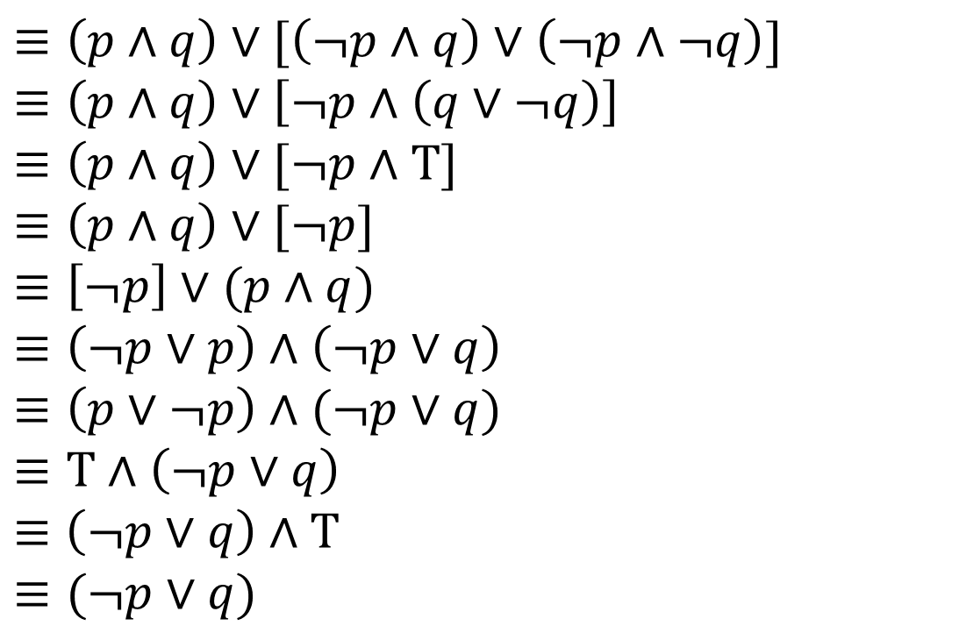


Our First Proof
$\left(p∧q\right)∨\left(¬p∧q\right)∨(¬p∧¬q)$
$≡\left(p∧q\right)∨[\left(¬p∧q\right)∨\left(¬p∧¬q\right)]$
$≡\left(p∧q\right)∨\left[¬p∧\left(q∨¬q\right)\right]$
$≡\left(p∧q\right)∨[¬p∧T]$
$≡\left(p∧q\right)∨[¬p]$
$≡\left[¬p\right]∨(p∧q)$
$≡\left(¬p∨p\right)∧\left(¬p∨q\right)$
$≡\left(p∨¬p\right)∧(¬p∨q)$
$≡T∧\left(¬p∨q\right)$
$≡$ $\left(¬p∨q\right)∧T$
$≡(¬p∨q)$
Stay on target:
We met our intermediate goal.
Don‘t forget the final goal!
We want to end up at $\left(¬p∨q\right)$
If we apply the distribution rule,
We’d get a $(¬p∨q)$
Commutative
Make the expression look exactly like the law (more on this later)
Distributive
Creates the $(¬p∨q)$ we were hoping for.
Commutative
Make the expression look exactly like the law (more on this later)
Negation
Simplifies the part we want to disappear.
Commutative followed by Domination
Look exactly like the law, then apply it.
We’re done!!!

Slide 41
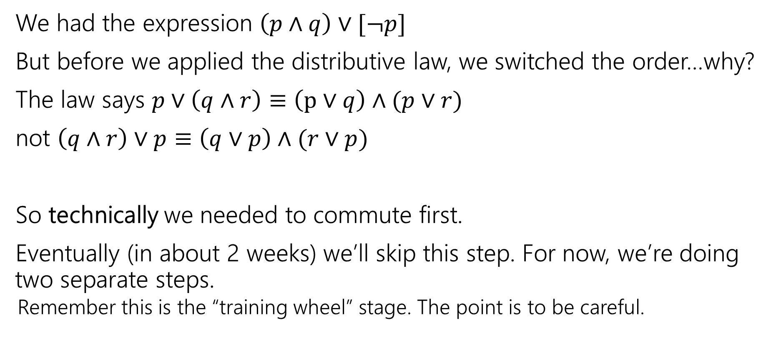
Commutativity
We had the expression $\left(p∧q\right)∨[¬p]$
But before we applied the distributive law, we switched the order…why?
The law says $p∨\left(q∧r\right)≡\left(p∨q\right)∧(p∨r)$
not $\left(q∧r\right)∨p≡\left(q∨p\right)∧(r∨p)$
So technically we needed to commute first.
Eventually (in about 2 weeks) we’ll skip this step. For now, we’re doing two separate steps.
  Remember this is the “training wheel” stage. The point is to be careful.

Slide 42
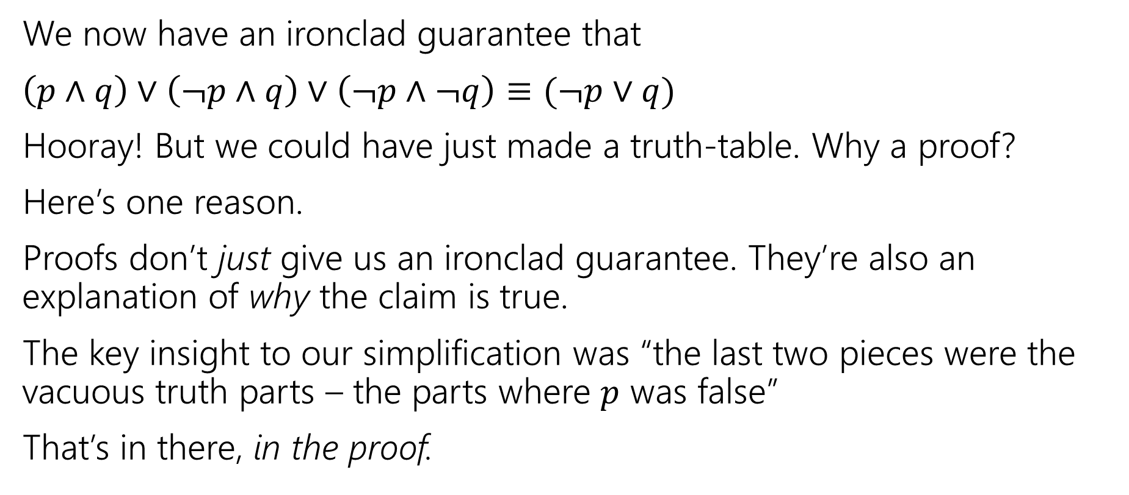
More on Our First Proof
We now have an ironclad guarantee that
$\left(p∧q\right)∨\left(¬p∧q\right)∨\left(¬p∧¬q\right)≡(¬p∨q)$
Hooray! But we could have just made a truth-table. Why a proof?
Here’s one reason.
Proofs don’t just give us an ironclad guarantee. They’re also an explanation of why the claim is true.
The key insight to our simplification was “the last two pieces were the vacuous truth parts – the parts where $p$ was false”
That’s in there, in the proof.

Slide 43
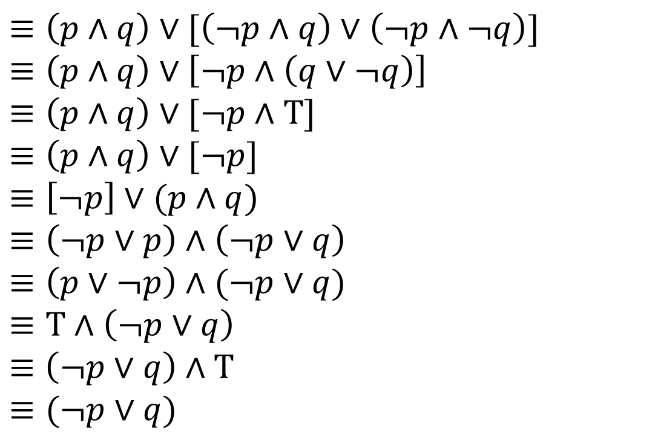

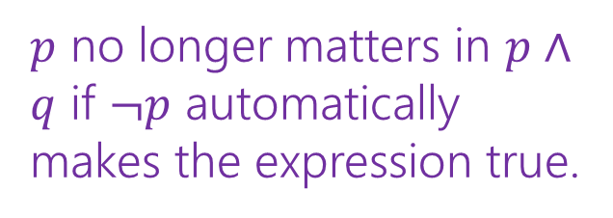
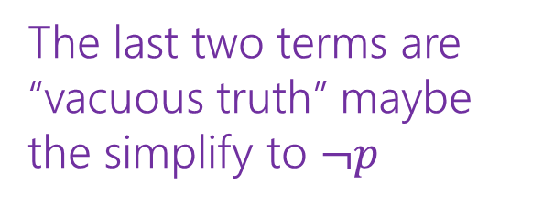
Our First Proof
$\left(p∧q\right)∨\left(¬p∧q\right)∨(¬p∧¬q)$
$≡\left(p∧q\right)∨[\left(¬p∧q\right)∨\left(¬p∧¬q\right)]$
$≡\left(p∧q\right)∨\left[¬p∧\left(q∨¬q\right)\right]$
$≡\left(p∧q\right)∨[¬p∧T]$
$≡\left(p∧q\right)∨[¬p]$
$≡\left[¬p\right]∨(p∧q)$
$≡\left(¬p∨p\right)∧\left(¬p∨q\right)$
$≡\left(p∨¬p\right)∧(¬p∨q)$
$≡T∧\left(¬p∨q\right)$
$≡$ $\left(¬p∨q\right)∧T$
$≡(¬p∨q)$
Associative
Distributive
Negation
Domination
Commutative
Distributive
Commutative
Negation
Commutative
Domination
The last two terms are “vacuous truth” maybe the simplify to $¬p$
$p$ no longer matters in $p∧q$ if $¬p$ automatically makes the expression true.

Slide 44
More on Our First Proof
With practice (and quite a bit of squinting) you can see not just the ironclad guarantee, but also the reason why something is true.
That’s not easy with a truth table.
Proofs can also communicate intuition about why a statement is true.
  We’ll practice extracting intuition from proofs more this quarter.

