Slide 1
Here Early?
Here for CSE 311?
Welcome! You’re early!
Want a copy of these slides to take notes?
  You can download them from the webpage cs.uw.edu/311
  Want to be ready for the end of the lecture?
  Download the Activity slide from the same place

Slide 2
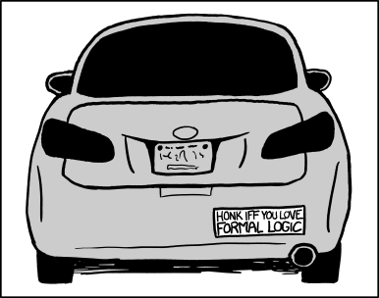
Logistics and
Propositional Logic
CSE 311: Foundations of Computing I
Lecture 1

Slide 3
Outline
Course logistics (e.g. how are we doing this online?)
What is the goal of this course?
Start of Propositional Logic

Slide 4

Zoom Logistics
We’ll always have a TA watching chat – if you have a question, ask it there (either general or direct to the TA).
  Don’t send direct to me, I won’t see it
TA may answer directly, interrupt me, or wait a few minutes and have me answer at a good stopping point.
If you’re comfortable (and have the wifi) to turn on your video please do
  Nodding/confused looks/glazed over eyes help me know if I said something super confusing.
  We will put recordings of lecture on panopto.

Slide 5

Staff
TAs
Anjali Agarwal
Sandy Chien
Ben Lambert
Kasper Lindberg
Allie Pfleger
David Shiroma
Alicia Stepin
Alice Wang
Ben Zhang
Muru Zhang
Instructor: Robbie Weber
Ph.D. from UW CSE in theory
Second year as teaching faculty
Second time teaching 311
Office: CSE2 311
Email: rtweber2@cs.washington.edu

Slide 6
This is where syllabus information would go
If we had time…
Since it’s Winter, we have fewer lectures than normal.
So detailed information is in an extra recording on panopto. Part of HW1 is watching that video.

Slide 7
What you need to know right now
We’re zoom-only until UW says we’re safe to resume in-person.
  Lectures and Sections this week will be over zoom.
  Zoom links will be on Ed.
There’s no required attendance for regular lectures or sections.
  Lectures are recorded. Sections won’t be recorded, but we’ll post “recap” videos walking through the covered problems.
We’ll have a take-home “mini-midterm”
I wrote the syllabus assuming things will be “mostly like Fall” in a few weeks.
  If things aren’t back to “mostly like Fall” then we’ll switch the final to take-home (more in the syllabus).

Slide 8
We’re in a pandemic…
I’ve put as much into the syllabus as I can, but fundamentally ¯\_(ツ)_/¯
Now is a great time to:
Ask DRS for accommodations if you think you might need formal ones.
Ensure your travel plans are consistent with either in-person or remote finals week.
Start looking for a study group!

Slide 9
CSE 390Z
390Z is:
Practice with concepts
Lessons on study skills
Place to find study groups
390Z is NOT:
Extra office hours
Homework help
CSE 390Z is a workshop designed to provide academic support to students enrolled concurrently in CSE 311. During each 2-hour workshop, students will reinforce concepts through:
collaborative problem solving
practice study skills and effective learning habits
build community for peer support
All students enrolled in CSE 311 are welcome to register for this class.
Contact Omar Ibrahim for more information

Slide 10
What is this course?

Slide 11
What is this course?
In this course, you will learn how to make and communicate rigorous and formal arguments.
Why? Because you’ll have to do technical communication in real life.
  If you become a PM – you’ll have to convert non-technical requirements from experts into clear, unambiguous statements of what is needed.
  If you become an engineer – you’ll have to justify to others exactly why your code works, and interpret precise requirements from your PM.
  If you become an academic – to explain to other academics how your algorithms and ideas improve on everyone else’s.

Slide 12
What is this course?
In this course, you will learn how to make and communicate rigorous and formal arguments.
Two verbs
Make arguments – what kind of reasoning is allowed and what kind of reasoning can lead to errors?
Communicate arguments – using one of the common languages of computer scientists (no one is going to use your code if you can’t tell them what it does or convince them it’s functional)

Slide 13
Course Outline
Symbolic Logic (training wheels; lectures 1-7)
  Just make arguments in mechanical ways.
    Using notation and rules a computer could understand.
  Understand the rules that are allowed, without worrying about pretty words.
Set Theory/Arithmetic (bike in your backyard; lectures 8-19)
  Make arguments, and communicate them to humans
  Arguments about numbers and sets, objects you already know
Models of computation (biking in your neighborhood; lectures 20-28)
  Still make and communicate rigorous arguments
  But now with objects you haven’t used before.
    A first taste of how we can argue rigorously about computers.

Slide 14
Some Perspective
Computer Science
and Engineering
Programming
Theory
CSE 14x
Hardware
CSE 311

Slide 15
Symbolic Logic

Slide 16
What is symbolic logic and why do we need it?
Symbolic Logic is a language, like English or Java, with its own
words and rules for combining words into sentences (syntax)
ways to assign meaning to words and sentences (semantics)
Symbolic Logic will let us mechanically simplify expressions and make arguments.
The new language will let us focus on the (sometimes familiar, sometimes unfamiliar) rules of logic.
Once we have those rules down, we’ll be able to apply them “intuitively” and won’t need the symbolic representation as often
but we’ll still go back to it when things get complicated.

Slide 17
Propositions: building blocks of logic
  Propositions are the basic building blocks in symbolic logic.
  Here are two propositions.
All cats are mammals
  True, (and a proposition)
All mammals are cats
  False, but is well-formed and has a truth value, so still a proposition.
A statement that has a truth value (i.e. is true or false) and is “well-formed”
Proposition

Slide 18
Analogy
In 142/143 you talked about a variable type that could be either true or false.
You called it a “Boolean”
Boolean variables are a useful analogy for propositions.
  They aren’t identical, but they’re very similar.

Slide 19
Are These Propositions?
2 + 2 = 5
x + 2 = 5
Akjsdf!
Who are you?
There is life on Mars.

Slide 20
Are These Propositions?
2 + 2 = 5
This is a proposition. It’s okay for propositions to be false.
x + 2 = 5
Not a proposition. Doesn’t have a fixed truth value
Akjsdf!
Not a proposition because it’s gibberish.
Who are you?
This is a question which means it doesn’t have a truth value.
There is life on Mars.
This is a proposition. We don’t know if it’s true or false, but we know it’s one of them!

Slide 21
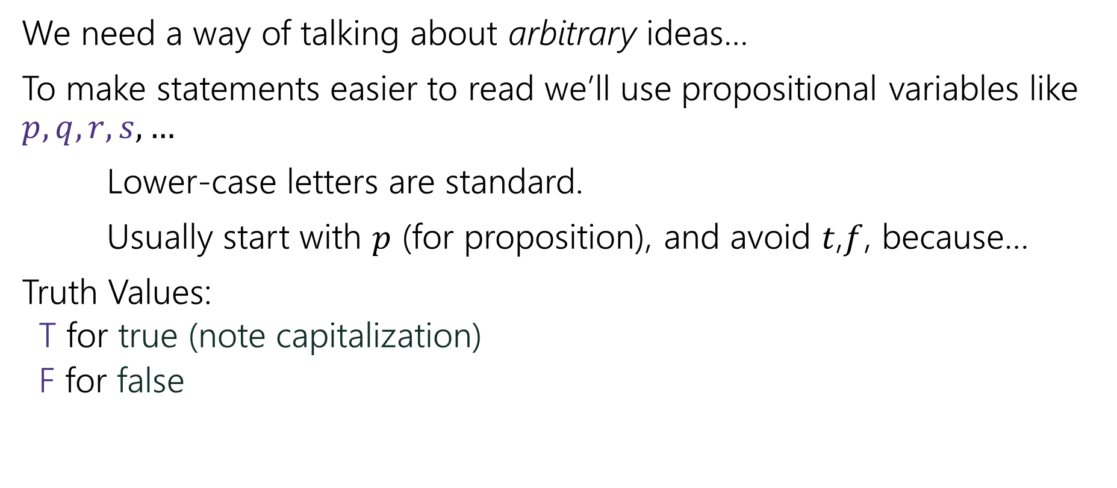
Propositions
We need a way of talking about arbitrary ideas…
To make statements easier to read we’ll use propositional variables like $p, q, r, s,…$
Lower-case letters are standard.
Usually start with $p$ (for proposition), and avoid $t$,$f$, because…
Truth Values:
  T for true (note capitalization)
  F for false

Slide 22
Analogy
We said propositions were a lot like Booleans…
How did you connect Booleans in code?
&&
||
!

Slide 23
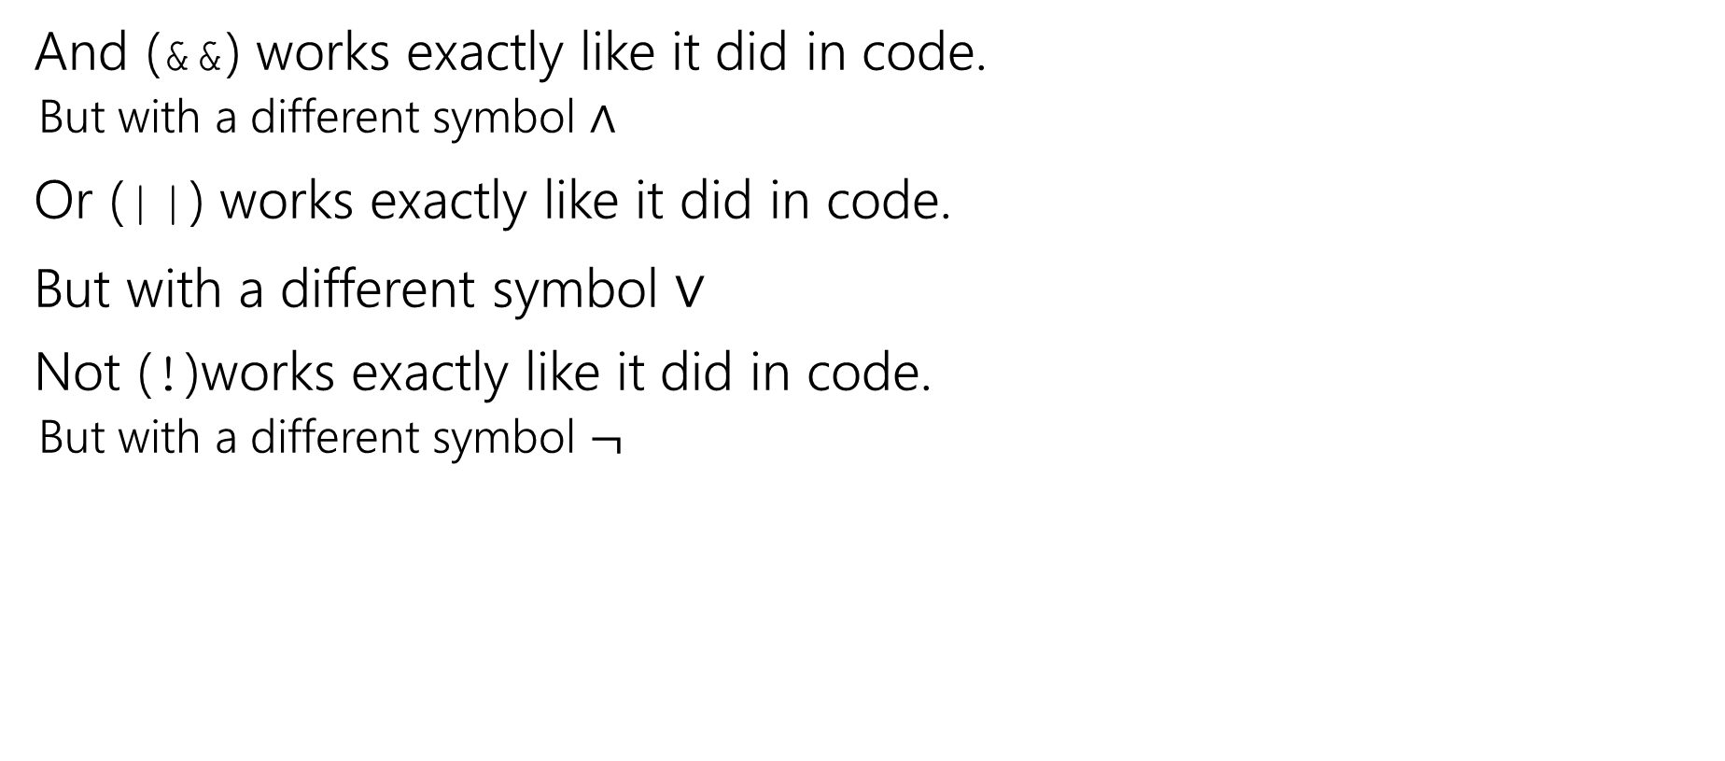
Logical Connectives
And (&&) works exactly like it did in code.
  But with a different symbol $∧$
Or (||) works exactly like it did in code.
But with a different symbol $∨$
Not (!)works exactly like it did in code.
  But with a different symbol $¬$

Slide 24
Some Truth Tables
p | ¬p
p | q | p ∧ q
p | q | p ∨ q
Truth tables are the simplest way to describe how logical connectives operate.

Slide 25
Some Truth Tables
p | ¬p
T | F
F | T
p | q | p ∧ q
T | T | T
T | F | F
F | T | F
F | F | F
p | q | p ∨ q
T | T | T
T | F | T
F | T | T
F | F | F
Truth tables are the simplest way to describe how logical connectives operate.

Slide 26

Implication
Another way to connect propositions
If $p$ then $q$.
“If it is raining, then I have my umbrella.”
$p→q$
Think of an implication as a promise.

Slide 27
Implication
p | q | p → q
T | T | T
T | F | F
F | T | T
F | F | T
The first two lines should match your intuition.
The last two lines are called “vacuous truth.” For now, they’re the definition. We’ll explain why in a few lectures.
This is the definition of implication.
When you write “if…then…” in a piece of mathematical English, this is how you will be interpreted.

Slide 28

Implication ($p→q)$
“If it’s raining, then I have my umbrella”
It’s useful to think of implications as promises. An implication is false exactly when you can demonstrate I’m lying.
p | q | p → q
T | T | T
T | F | F
F | T | T
F | F | T
 | It’s raining | It’s not raining
I have my umbrella
I do not have my umbrella

Slide 29
Implication ($p→q)$
“If it’s raining, then I have my umbrella”
It’s useful to think of implications as promises. An implication is false exactly when you can demonstrate I’m lying.
p | q | p → q
T | T | T
T | F | F
F | T | T
F | F | T
 | It’s raining | It’s not raining
I have my umbrella | No lie. True | No lie. True
I do not have my umbrella | LIE! False | No lie. True

Slide 30
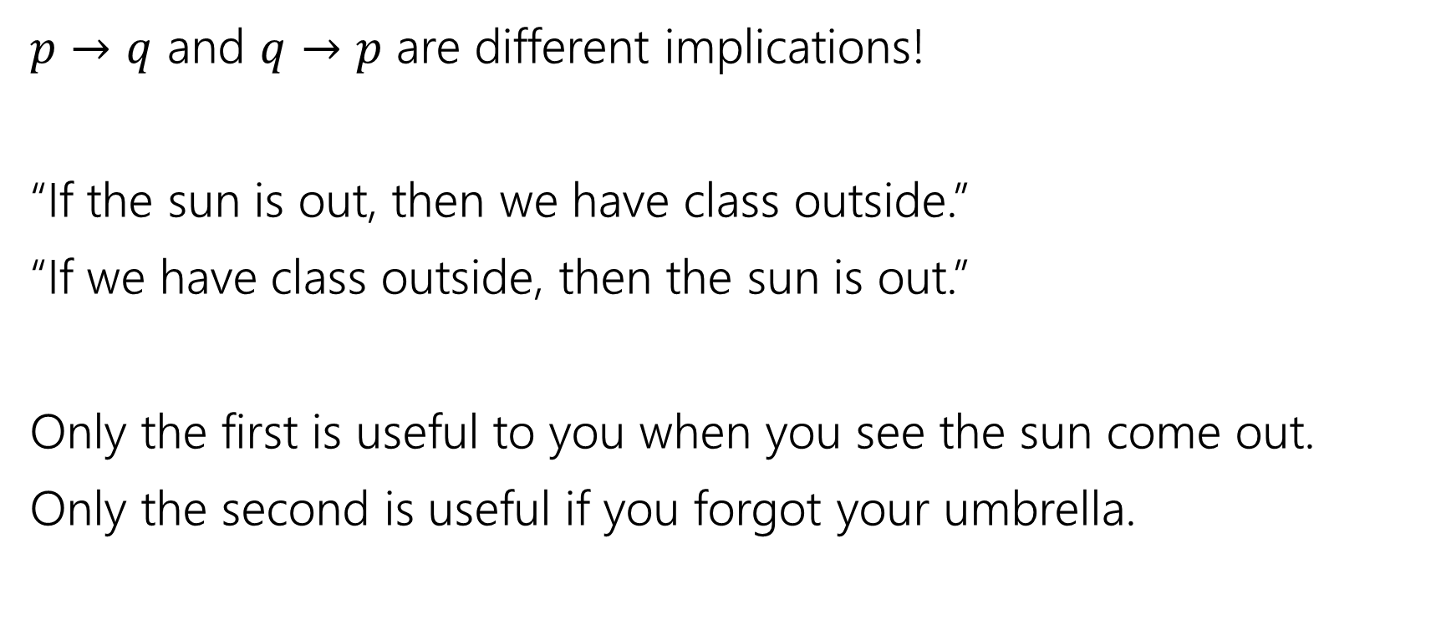
$$p → q$$
$p→q$ and $q→p$ are different implications!
“If the sun is out, then we have class outside.”
“If we have class outside, then the sun is out.”
Only the first is useful to you when you see the sun come out.
Only the second is useful if you forgot your umbrella.

Slide 31
$$p → q$$
p | q | p → q
T | T | T
T | F | F
F | T | T
F | F | T
Implication:
  p implies q
  whenever p is true q must be true
  if p then q
  q if p
  p is sufficient for q
  p only if q
  q is necessary for p
Implications are super useful, so there are LOTS of translations.
You’ll learn these in detail in section.

Slide 32
A More Complicated Statement
“Robbie knows the Pythagorean Theorem if he is a mathematician and took geometry, and he is a mathematician or did not take geometry.”
Is this a proposition?
We’d like to understand what this proposition means.
In particular, is it true?

Slide 33
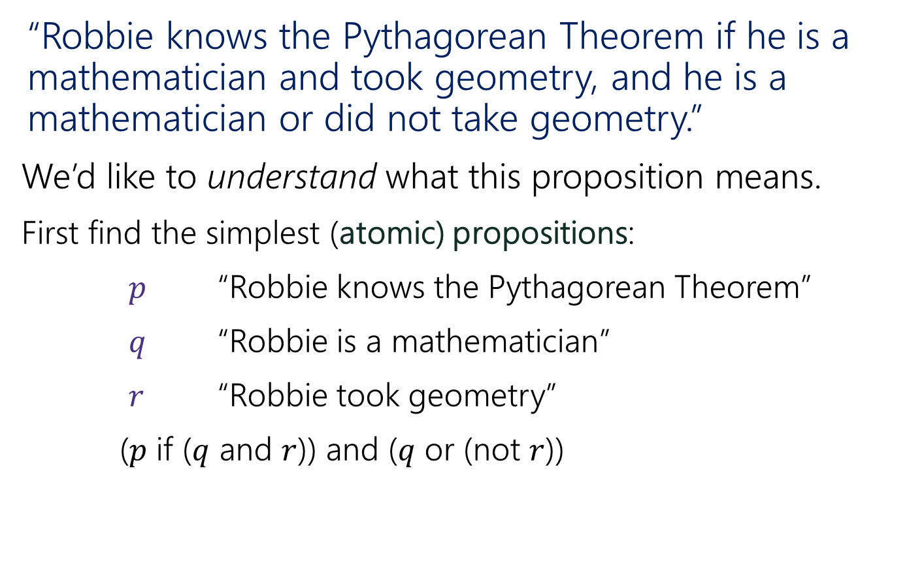
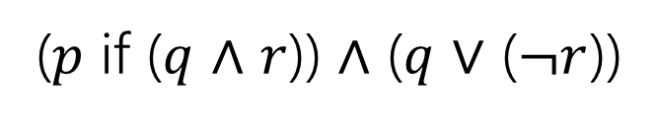
A Compound Proposition
“Robbie knows the Pythagorean Theorem if he is a mathematician and took geometry, and he is a mathematician or did not take geometry.”
We’d like to understand what this proposition means.
First find the simplest (atomic) propositions:
$p$ “Robbie knows the Pythagorean Theorem”
$q$ “Robbie is a mathematician”
$r$ “Robbie took geometry”
($p$ if ($q$ and $r$)) and ($q$ or (not $r$))
($p$ if ($q$ $∧$ $r$)) $∧$ ($q$ $∨$ ($¬r$))

Slide 34
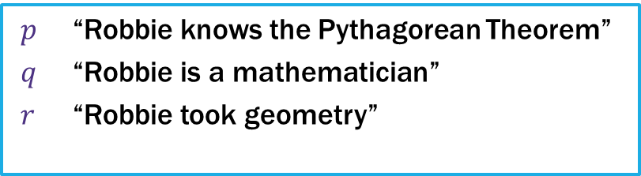
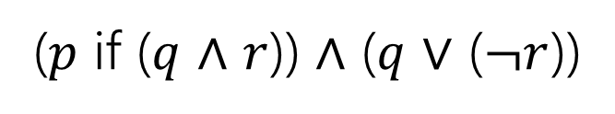
A Compound Proposition
“Robbie knows the Pythagorean Theorem if he is a mathematician and took geometry, and he is a mathematician or did not take geometry.”
$p$ “Robbie knows the Pythagorean Theorem”
$q$ “Robbie is a mathematician”
$r$ “Robbie took geometry”
($p$ if ($q$ $∧$ $r$)) $∧$ ($q$ $∨$ ($¬r$))
How did we know where to put the parentheses?
Subtle English grammar choices (top-level parentheses are independent clauses).
Context/which parsing will make more sense.
Conventions
A reading on this is coming soon!

Slide 35
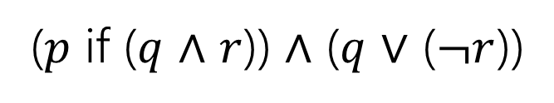
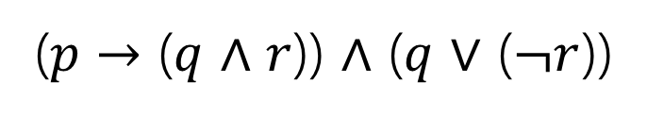
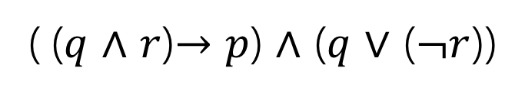
Back to the Compound Proposition…
“Robbie knows the Pythagorean Theorem if he is a mathematician and took geometry, and he is a mathematician or did not take geometry.”
($p$ if ($q$ $∧$ $r$)) $∧$ ($q$ $∨$ ($¬r$))
$p$ “Robbie knows the Pythagorean Theorem”
$q$ “Robbie is a mathematician”
$r$ “Robbie took geometry”
What promise am I making?
( ($q$ $∧$ $r$)$→p$) $∧$ ($q$ $∨$ ($¬r$))
($p$ $→$ ($q$ $∧$ $r$)) $∧$ ($q$ $∨$ ($¬r$))
The first one! Being a mathematician and taking geometry goes with the “if.” Knowing the Pythagorean Theorem is the consequence.

Slide 36
A Compound Proposition
“Robbie knows the Pythagorean Theorem if he is a mathematician and took geometry, and he is a mathematician or did not take geometry.”
We’d like to understand what this proposition means.
First find the simplest (atomic) propositions:
$p$ “Robbie knows the Pythagorean Theorem”
$q$ “Robbie is a mathematician”
$r$ “Robbie took geometry”
($p$ if ($q$ and $r$)) and ($q$ or (not $r$))
($p$ if ($q$ $∧$ $r$)) $∧$ ($q$ $∨$ ($¬r$))

Slide 37
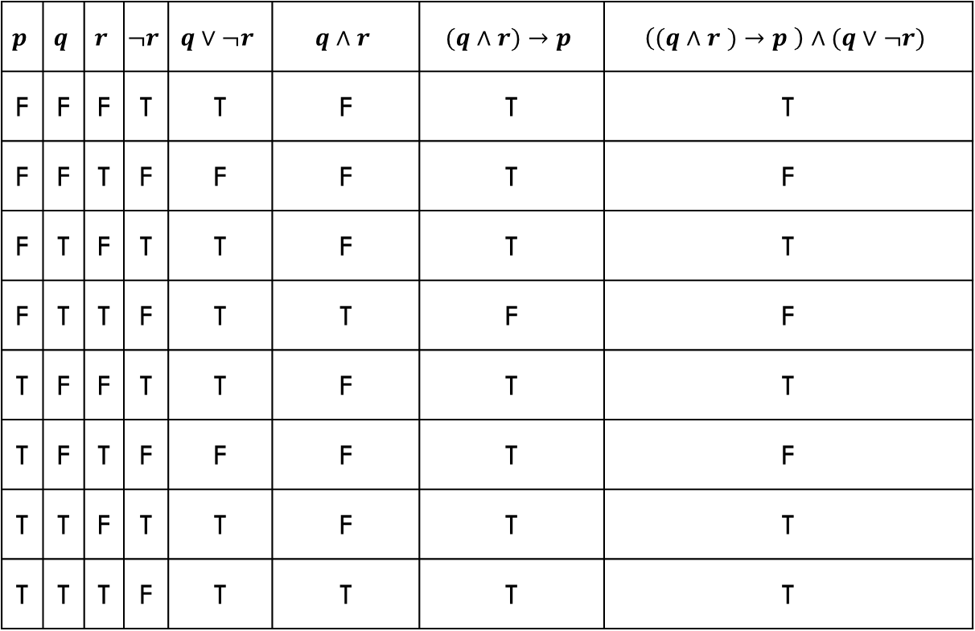
Analyzing the Sentence with a Truth Table
$$p$$ | $$q$$ | $$r$$ | $$¬r$$ | $$q∨¬r$$ | $$q∧r$$ | $$(q∧r)→p$$ | $$\left((q∧r )→p \right)∧(q∨¬r)$$
F | F | F | T | T | F | T | T
F | F | T | F | F | F | T | F
F | T | F | T | T | F | T | T
F | T | T | F | T | T | F | F
T | F | F | T | T | F | T | T
T | F | T | F | F | F | T | F
T | T | F | T | T | F | T | T
T | T | T | F | T | T | T | T

Slide 38
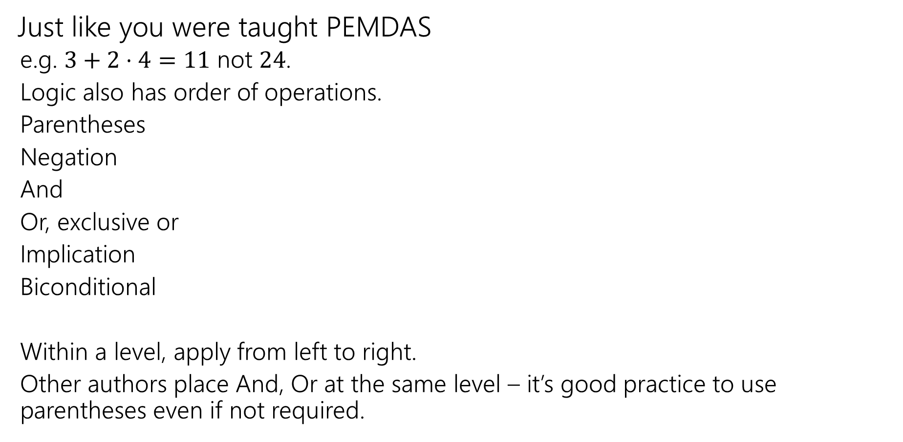
Order of Operations
Just like you were taught PEMDAS
  e.g. $3+2⋅4=11$ not $24$.
  Logic also has order of operations.
  Parentheses
  Negation
  And
  Or, exclusive or
  Implication
  Biconditional
  Within a level, apply from left to right.
  Other authors place And, Or at the same level – it’s good practice to use parentheses even if not required.
For this class: each of these is it’s own level!
e.g. “and”s have precedence over “or”s

Slide 39
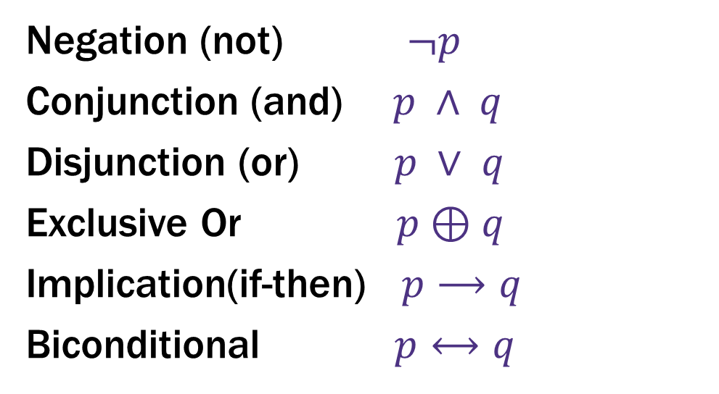
Logical Connectives
Negation (not) $¬p$
Conjunction (and) $p ∧ q$
Disjunction (or) $p ∨ q$
Exclusive Or $p⊕q$
Implication(if-then) $p⟶q$
Biconditional $p⟷q$
These ideas have been around for so long most have at least two names.
Two more connectives to discuss!

Slide 40
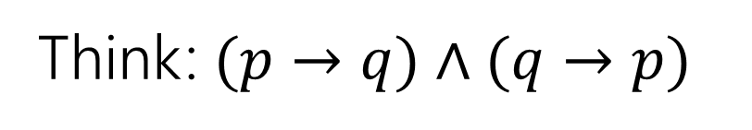

Biconditional: $p ↔ q$
Think: $(p→q)∧(q→p)$
p if and only if q
p iff q
p is equivalent to q
p implies q and q implies p
p is necessary and sufficient for q
p | q | p ↔ q

Slide 41
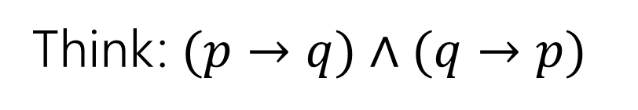
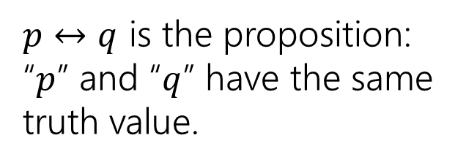
Biconditional: $p ↔ q$
Think: $(p→q)∧(q→p)$
p if and only if q
p iff q
p is equivalent to q
p implies q and q implies p
p is necessary and sufficient for q
p | q | p ↔ q
T | T | T
T | F | F
F | T | F
F | F | T
$p↔q$ is the proposition: “$p$” and “$q$” have the same truth value.

Slide 42
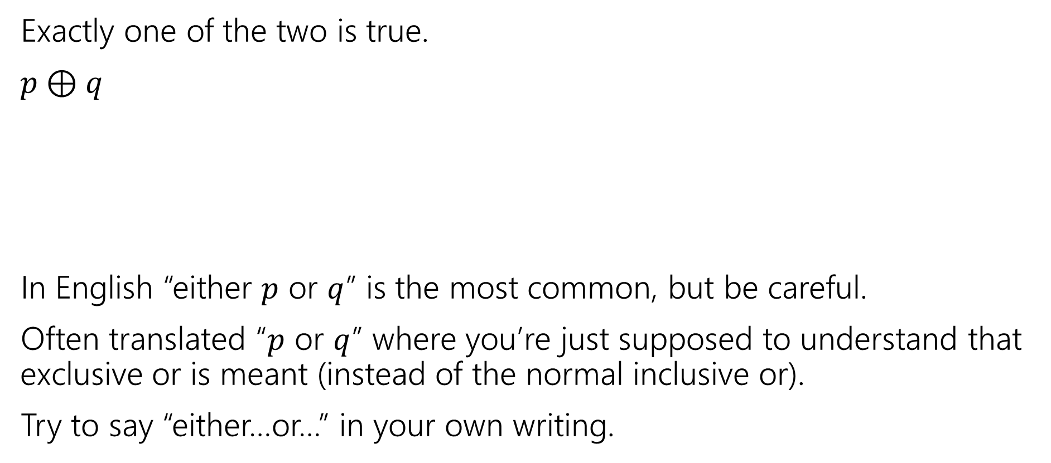
Exclusive Or
Exactly one of the two is true.
$p⊕q$
In English “either $p$ or $q$” is the most common, but be careful.
Often translated “$p$ or $q$” where you’re just supposed to understand that exclusive or is meant (instead of the normal inclusive or).
Try to say “either…or…” in your own writing.
p | q | p ⊕ q

Slide 43
Exclusive Or
Exactly one of the two is true.
$p⊕q$
In English “either $p$ or $q$” is the most common, but be careful.
Often translated “$p$ or $q$” where you’re just supposed to understand that exclusive or is meant (instead of the normal inclusive or).
Try to say “either…or…” in your own writing.
p | q | p ⊕ q
T | T | F
T | F | T
F | T | T
F | F | F

Slide 44
Active learning!
We’ll use breakout rooms to give you a chance to try problems with other students.
Why? It works!
  https://www.pnas.org/content/111/23/8410 a meta-analysis of 225 studies.
  Just listening to me isn’t as good for you as listening to me then trying problems on your own and with each other.

Slide 45
Breakout Rooms
In-person, you’ll talk to those around you.
This week, we’ll use breakouts.
Directions are in Activity pdf
  Go to cs.uw.edu/311 and get that pdf!

Slide 46
Lecture 1 Activity
Go to pollev.com/cse311
You don’t have to be logged in (though you can be) – no “points” are associated, but helps me adjust explanation.
Introduce yourselves!
  If you can turn your video on, please do.
  If you can’t, please unmute and say hi.
  If you can’t do either, say “hi” in chat.
  Choose someone to share screen, showing this pdf.
  Answer these “get to know you” questions until you’re pulled back to the main room.
  What is your favorite socially-distanced activity?
  What class are you most excited about this quarter?
  And why is it 311?
  Found a new friend? A new study group? Share your emails!

Slide 47
What’s next?
A proof!
We want to be able to make iron-clad guarantees that something is true.
And convince others that we really have ironclad guarantees.

Slide 48
Todo
Tonight:
Make sure you can access the Ed discussion board.
Wednesday (and Friday):
Lectures on zoom.
Thursday:
Go to section on zoom! Zoom links will go on the Ed board
Soon:
Form a study group! Threads to organize on the Ed board.

