Slide 1
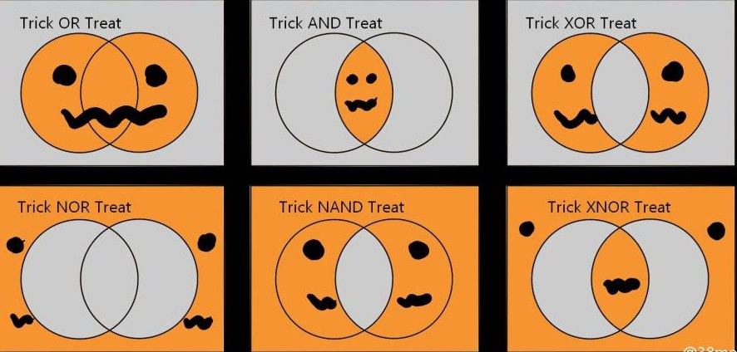
More Number Theory
CSE 311 Autumn 20
Lecture 12

Slide 2
Warm up
Let $a∈ℤ, b∈ℤ, n∈ℤ$ and $n>0$.
We say $a≡b (mod n)$ if and only if $n|(b−a)$
Equivalence in modular arithmetic
Show that $a≡b \left(mod n\right)$ if and only if $b≡a(mod n)$
Show that $a\%n$=($a−n)\%n$ Where $b\%c$ is the unique $r$ such that $b=kc+r$ for some integer $k$.
For every $a∈ℤ$, $d∈ℤ$ with $d>0$
There exist unique integers $q,r$ with $0≤r<d$ Such that $a=dq+r$
The Division Theorem

Slide 3
Warm up
Show that $a≡b \left(mod n\right)$ if and only if $b≡a(mod n)$
$a≡b\left(mod n\right)↔n|(b−a)↔nk=b−a\left(for k∈ℤ\right)↔$
$n(−k)=a−b(for −k∈ℤ)↔n|\left(a−b\right)↔b≡a(mod n)$
Show that $a\%n$=($a−n)\%n$ Where $b\%c$ is the unique $r$ such that $b=kc+r$ for some integer $k$.
By definition of %, $a=qn+(a\%n)$ for some integer $q$. Subtracting $n$,
$a−n=\left(q−1\right)n+(a\%n)$. Observe that $q−1$ is an integer, and that this is the form of the division theorem for $\left(a−n\right)\%n.$ Since the division theorem guarantees a unique integer, $\left(a−n\right)\%n=(a\%n)$

Slide 4
Modular arithmetic so far
For all integers $a,b,c,d,n$where $n>0$:
If $a≡b(mod n)$ then $a+c≡a+c(mod n)$.
If $a≡b(mod n)$ then $ac≡bc (mod n)$.
$a≡b(mod n)$ if and only if $b≡a (mod n)$.
$a\%n=\left(a−n\right)\%n$.

Slide 5
% and Mod
Other resources use $mod$ to mean an operation (takes in an integer, outputs an integer). We will not in this course. $mod$ only describes $≡$. It’s not “just on the right hand side”
Define $a\%b$ to be “the $r$ you get from the division theorem” i.e. the integer $r$ such that $0≤r<d$ and $a=bq+r$ for some integer $q$.
This is the “mod function”
I claim $a\%n=b\%n$ if and only if $a≡b(mod n)$.
How do we show and if-and-only-if?

Slide 6
$a\%n=b\%n$ if and only if $a≡b(mod n)$
Backward direction:
Suppose $a≡b(mod n)$
$a\%n=\left(b−nk\right)\%n=b\%n$

Slide 7
$a\%n=b\%n$ if and only if $a≡b(mod n)$
Backward direction:
Suppose $a≡b(mod n)$
$n|b−a$ so $nk=b−a$ for some integer $k$. (by definitions of mod and divides).
So $a=b−nk$
Taking each side $\%n$ we get:
$a\%n=\left(b−nk\right)\%n=b\%n$
Where the last equality follows from $k$ being an integer and doing $k$ applications of the identity we proved in the warm-up.

Slide 8
$a\%n=b\%n$ if and only if $a≡b(mod n)$
Show the forward direction:
If $a\%n=b\%n$ then $a≡b(mod n)$.
This proof is a bit different than the other direction.
Remember to work from top and bottom!!
Let $a∈ℤ, b∈ℤ, n∈ℤ$ and $n>0$.
We say $a≡b (mod n)$ if and only if $n|(b−a)$
Equivalence in modular arithmetic
Fill out the poll everywhere for Activity Credit!
Go to pollev.com/cse311 and login with your UW identity
Or text cse311 to 22333
For every $a∈ℤ$, $d∈ℤ$ with $d>0$
There exist unique integers $q,r$ with $0≤r<d$ Such that $a=dq+r$
The Division Theorem

Slide 9
$a\%n=b\%n$ if and only if $a≡b(mod n)$
Forward direction:
Suppose $a\%n=b\%n$.
By definition of $\%, a=kn+(a\%n)$ and $b=jn+\left(b\%n\right)$ for integers $k,j$
Isolating $a\%n$ we have $a\%n=a−kn$. Since $a\%n=b\%n$, we can plug into the second equation to get: $b=jn+(a−kn)$
Rearranging, we have $b−a=\left(j−k\right)n$. Since $k,j$ are integers we have $n|(b−a)$.
By definition of mod we have $a≡b(mod n)$.

Slide 10
More proofs
Show that if $a≡b\left(mod n\right)$ and $c≡d (mod n)$ then $ac≡bd (mod n)$.
Step 1: What do the words mean?
Step 2: What does the statement as a whole say?
Step 3: Where do we start?
Step 4: What’s our target?
Step 5: Now prove it.

Slide 11
Another Proof
Show that if $a≡b\left(mod n\right)$ and $c≡d (mod n)$ then $ac≡bd (mod n)$.
Let $a,b,c,d,n∈ℤ, n≥0$ and suppose $a≡b\left(mod n\right)$ and $c≡d (mod n)$.
$ac≡bd(mod n)$

Slide 12
Another Proof
Show that if $a≡b\left(mod n\right)$ and $c≡d (mod n)$ then $ac≡bd (mod n)$.
Let $a,b,c,d,n∈ℤ, n≥0$ and suppose $a≡b\left(mod n\right)$ and $c≡d (mod n)$.
$n|(b−a)$ and $n|(d−c)$ by definition of mod.
$nk=(b−a)$ and $nj=(d−c)$ for integers $j,k$ by definition of divides.
$n??=bd−ac$
$n|(bd−ac)$
$ac≡bd(mod n)$

Slide 13
Another Proof
Show that if $a≡b\left(mod n\right)$ and $c≡d (mod n)$ then $ac≡bd (mod n)$.
Let $a,b,c,d,n∈ℤ, n≥0$ and suppose $a≡b\left(mod n\right)$ and $c≡d (mod n)$.
$n|(b−a)$ and $n|(d−c)$ by definition of mod.
$nk=(b−a)$ and $nj=(d−c)$ for integers $j,k$ by definition of divides.
$nknj=(d−c)(b−a)$ by multiplying the two equations
$nknj=(bd−bc−ad+ac)$
…
$n??=bd−ac$
$n|(bd−ac)$
$ac≡bd(mod n)$

Slide 14
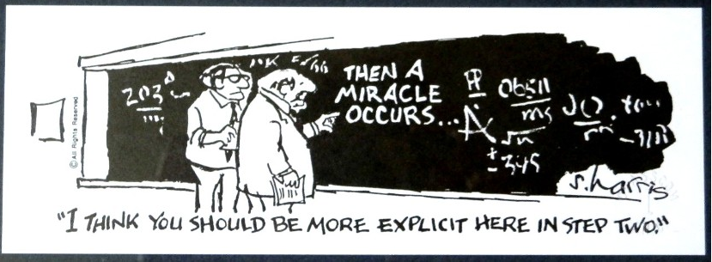
Another Proof
Show that if $a≡b\left(mod n\right)$ and $c≡d (mod n)$ then $ac≡bd (mod n)$.
Let $a,b,c,d,n∈ℤ, n≥0$ and suppose $a≡b\left(mod n\right)$ and $c≡d (mod n)$.
$n|(b−a)$ and $n|(d−c)$ by definition of mod.
$nk=(b−a)$ and $nj=(d−c)$ for integers $j,k$ by definition of divides.
$nknj=(d−c)(b−a)$ by multiplying the two equations
$nknj=(bd−bc−ad+ac)$
And then a miracle occurs
$n??=bd−ac$
$n|(bd−ac)$
$ac≡bd(mod n)$

Slide 15
Uh-Oh
We hit a dead end.
But how did I know we hit a dead end? Because I knew exactly where we needed to go. If you didn’t, you’d have been staring at that for ages trying to figure out the magic step.
(or worse, assumed you lost a minus sign somewhere, and just “fixed” it….)
Let’s try again. This time, let’s separate $b$ from $a$ and $d$ from $c$ before combining.

Slide 16
Another Approach
Show that if $a≡b\left(mod n\right)$ and $c≡d (mod n)$ then $ac≡bd (mod n)$.
Let $a,b,c,d,n∈ℤ, n≥0$ and suppose $a≡b\left(mod n\right)$ and $c≡d (mod n)$.
$n|(b−a)$ and $n|(d−c)$ by definition of mod.
$nk=(b−a)$ and $nj=(d−c)$ for integers $j,k$ by definition of divides.
$b=nk+a, d=nj+c$
$n??=bd−ac$
$n|(bd−ac)$
$ac≡bd(mod n)$

Slide 17
Another Approach
Show that if $a≡b\left(mod n\right)$ and $c≡d (mod n)$ then $ac≡bd (mod n)$.
Let $a,b,c,d,n∈ℤ, n≥0$ and suppose $a≡b\left(mod n\right)$ and $c≡d (mod n)$.
$n|(b−a)$ and $n|(d−c)$ by definition of mod.
$nk=(b−a)$ and $nj=(d−c)$ for integers $j,k$ by definition of divides.
$b=nk+a, d=nj+c$,
$bd=\left(nk+a\right)\left(nj+c\right)=n^{2}kj+anj+cnk+ac$
$bd−ac=n^{2}kj+anj+cnk=n(nkj+aj+ck)$
$n??=bd−ac$
$n|(bd−ac)$
$ac≡bd(mod n)$

Slide 18
Another Approach
Show that if $a≡b\left(mod n\right)$ and $c≡d (mod n)$ then $ac≡bd (mod n)$.
Let $a,b,c,d,n∈ℤ, n≥0$ and suppose $a≡b\left(mod n\right)$ and $c≡d (mod n)$.
$n|(b−a)$ and $n|(d−c)$ by definition of mod.
$nk=(b−a)$ and $nj=(d−c)$ for integers $j,k$ by definition of divides.
Isolating,$b$ and $d,$ we have: $b=nk+a, d=nj+c$
Muliplying the equations, and factoring, $bd=\left(nk+a\right)\left(nj+c\right)=n^{2}kj+anj+cnk+ac$
Rearranging, and facoring out $n: bd−ac=n^{2}kj+anj+cnk=n(nkj+aj+ck)$
Since all of $n,j,k,a,$ and $c$ are integers, we have that $bd−ac$ is $n$ times an integer, so
$n|(bd−ac)$, and by definition of mod
$ac≡bd(mod n)$

Slide 19
Logical Ordering
When doing a proof, we often work from both sides…
But we have to be careful!
When you read from top to bottom, every step has to follow only from what’s before it, not after it.
Suppose our target is $q$ and I know $q→p$ and $r→q$.
What can I put as a “new target?”

Slide 20
Logical Ordering
So why have all our prior steps been ok backward?
They’ve all been either:
A definition (which is always an “if and only if”)
An algebra step that is an “if and only if”
Even if your steps are “if and only if” you still have to put everything in order – start from your assumptions, and only assert something once it can be shown.

Slide 21
A bad proof
Claim: i$f x$ is positive then $x+5=−x−5$.
$x+5=−x−5$
$\left|x+5\right|=\left|−x−5\right|$
$|x+5|=|−(x+5)|$
$\left|x+5\right|=|x+5|$
$0=0$
This claim is false – if you’re trying to do algebra, you need to start with an equation you know (say $x=x$ or $2=2$ or $0=0$) and expand to the equation you want.

Slide 22
Another Proof
For all integers, $a,b,c:$Show that if $a∤(bc)$ then $a∤b$ or $a∤c$.
Proof:
Let $a,b,c$be arbitrary integers, and suppose $a∤\left(bc\right).$
Then there is not an integer $z$ such that $az=bc$
…
So $a∤b$ or $a∤c$

Slide 23
Another Proof
For all integers, $a,b,c:$Show that if $a∤(bc)$ then $a∤b$ or $a∤c$.
Proof:
Let $a,b,c$be arbitrary integers, and suppose $a∤\left(bc\right).$
Then there is not an integer $z$ such that $az=bc$
…
So $a∤b$ or $a∤c$
There has to be a better way!

Slide 24
Another Proof
For all integers, $a,b,c:$Show that if $a∤(bc)$ then $a∤b$ or $a∤c$.
There has to be a better way!
If only there were some equivalent implication…
One where we could negate everything…
Take the contrapositive of the statement:
For all integers, $a,b,c:$ Show if $a|b$ and $a|c$ then $a|(bc)$.

Slide 25
By contrapositive
Claim: For all integers, $a,b,c:$Show that if $a∤(bc)$ then $a∤b$ or $a∤c$.
We argue by contrapositive.
Let $a,b,c$be arbitrary integers, and suppose $a|b$ and $a|c$.
Therefore $a|bc$

Slide 26
By contrapositive
Claim: For all integers, $a,b,c:$Show that if $a∤(bc)$ then $a∤b$ or $a∤c$.
We argue by contrapositive.
Let $a,b,c$be arbitrary integers, and suppose $a|b$ and $a|c$.
By definition of divides, $ax=b$ and $ay=c$ for integers $x$ and $y$.
Multiplying the two equations, we get $axay=bc$
Since $a,x,y$ are all integers, $xay$ is an integer. Applying the definition of divides, we have $a|bc$.

Slide 27
Facts about modular arithmetic
For all integers $a,b,c,d,n$where $n>0$:
If $a≡b(mod n)$ and $c≡d\left(mod n\right)$ then $a+c≡b+d(mod n)$.
If $a≡b(mod n)$ and $c≡d(mod n)$ then $ac≡bd (mod n)$.
$a≡b(mod n)$ if and only if $b≡a (mod n)$.
$a\%n=\left(a−n\right)\%n$.
We didn’t prove the first, it’s a good exercise! You can use it as a fact as though we had proven it in class.

Slide 28
Divisors and Primes

Slide 29
Primes and FTA
An integer $p>1$ is prime iff its only positive divisors are $1$ and $p.$ Otherwise it is “composite”
Prime
Every positive integer greater than 1 has a unique
prime factorization.
Fundamental Theorem of Arithmetic

Slide 30
GCD and LCM
The Greatest Common Divisor of $a$ and $b$ (gcd(a,b)) is the largest integer $c$ such that $c|a$ and $c|b$
Greatest Common Divisor
The Least Common Multiple of $a$ and $b$ (lcm(a,b)) is the smallest positive integer $c$ such that $a|c$ and $b|c$.
Least Common Multiple

Slide 31
public int Mystery(int m, int n){
if(m<n){
int temp = m;
m=n;
n=temp;
}
while(n != 0) {
int rem = m % n;
m=n;
n=temp;
}
return m;
}

Slide 32
Try a few values…
gcd(100,125)
gcd(17,49)
gcd(17,34)
gcd(13,0)
lcm(7,11)
lcm(6,10)

Slide 33
How do you calculate a gcd?
You could:
Find the prime factorization of each
Take all the common ones. E.g.
gcd(24,20)=gcd($2^{3}⋅3, 2^{2}⋅5)=2^\{min⁡(2,3)\}=2^2=4$.
(lcm has a similar algorithm – take the maximum number of copies of everything)
But that’s….really expensive. Mystery from a few slides ago find gcd.

Slide 34
GCD fact
If $a$ and $b$ are positive integers, then gcd(a,b) = gcd(b, a % b)
How do you show two gcds are equal?
Call $a=\gcd\left(w,x\right),b=\gcd{(y,z)}$
If $b|w$ and $b|x$ then $b$ is a common divisor of $w,x$ so $b≤a$
If $a|y$ and $a|z$ then $a$ is a common divisor of $y,z,$ so $a≤b$
If $a≤b$ and $b≤a$ then $a=b$

Slide 35
gcd(a,b) = gcd(b, a % b)
Let $x=gcd⁡(a,b)$ and $y=gcd⁡(b,a\%b)$.
We show that $y$ is a common divisor of $a$ and $b$.
By definition of gcd, $y|b$ and $y|(a\%b)$. So it is enough to show that $y|a$.
Applying the definition of divides we get $b=yk$ for an integer $k,$ and $\left(a\%b\right)=yj$ for an integer $j.$
By definition of mod, $a\%b$ is $a=qb+\left(a\%b\right)$ for an integer $q$.
Plugging in both of our other equations:
$a=qyk+yj=y\left(qk+j\right).$Since $q,k,$ and $j$are integers, $y|a$. Thus $y$ is a common divisor of $a,b$ and thus $y≤x$.

Slide 36
gcd(a,b) = gcd(b, a % b)
Let $x=gcd⁡(a,b)$ and $y=gcd⁡(b,a\%b)$.
We show that $x$ is a common divisor of $b$ and $a\%b$.
By definition of gcd, $x|b$ and $x|a$. So it is enough to show that $x|(a\%b)$.
Applying the definition of divides we get $b=xk′$ for an integer $k′,$ and $a=xj′$ for an integer $j′.$
By definition of mod, $a\%b$ is $a=qb+\left(a\%b\right)$ for an integer $q$
Plugging in both of our other equations:
$xj^{′}=qxk^{′}+a\%b.$ Solving for $a\%b,$ we have $a\%b=xj^{′}−qxk^{′}=x\left(j^{′}−qk^{′}\right).$ So $x|(a\%b)$. Thus $x$ is a common divisor of $b,a\%b$ and thus $x≤y$.

Slide 37
gcd(a,b) = gcd(b, a % b)
Let $x=gcd⁡(a,b)$ and $y=gcd⁡(b,a\%b)$.
We show that $x$ is a common divisor of $b$ and $a\%b$.
We have shown $x≤y$ and $y≤x$.
Thus $x=y,$ and $\gcd\left(a,b\right)=\gcd\left(b,a\%b\right).$

