Slide 1
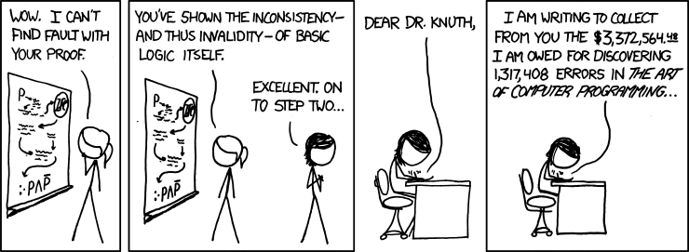
Inference Proofs With Quantifiers
xkcd.com/816/

Slide 2
Announcements
HW1 came back yesterday.
Do take a look today, so you don’t repeat mistakes from HW1 to HW2.
HW1 5c (the label the proof with your intuition part) did not go as I planned.
About 15% of the class interpreted that part as saying “label the individual step with rule names”
This was the first time a 311 course has asked for this kind of thing – we didn’t find clear wording; that’s on me.
We did model the type of question in lecture, and got questions on Ed clarifying what was meant. – I think there were enough resources that everyone should have been able to understand.

Slide 3
Announcements
About 15% of you didn’t even try the problem (because you didn’t think there was anything to do)
That means you didn’t learn. Which is the opposite of what I want.
HW3 has two more “give us a summary” questions. (doing “5c” again on different proofs). Of the three parts, we’ll drop the lowest score.
More resources on domain restriction coming soon!

Slide 4
Given: (($p→q)∧(q→r))$ Show: $(p→r)$
Here’s a corrected version of the proof.
$\left(p→q\right)∧\left(q→r\right)$
$p→q$
$q→r$
4.1 $p$
4.2 $q$
4.3 $r$
$p→r$
Given
Eliminate $∧$ 1
Eliminate $∧$ 1
Assumption
Modus Ponens 4.1,2
Modus Ponens 4.2,3
Direct Proof Rule
When introducing an assumption to prove an implication:
Indent, and change numbering.
When reached your conclusion, use the Direct Proof Rule to observe the implication is a fact.
The conclusion is an unconditional fact (doesn’t depend on $p$) so it goes back up a level

Slide 5
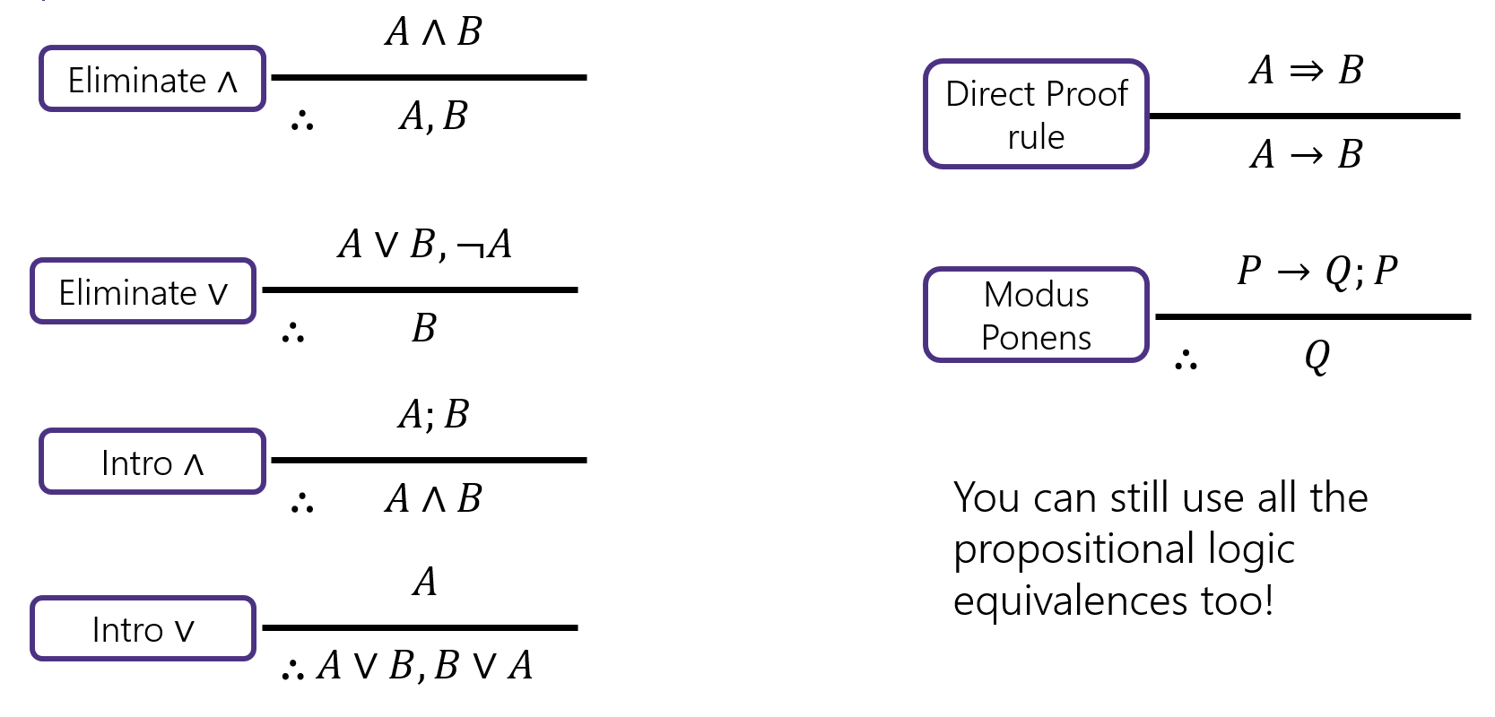
Try it!
Given: $p∨q$, $\left(r∧s\right)→¬q$, $r$. Show: $s→p$

Slide 6
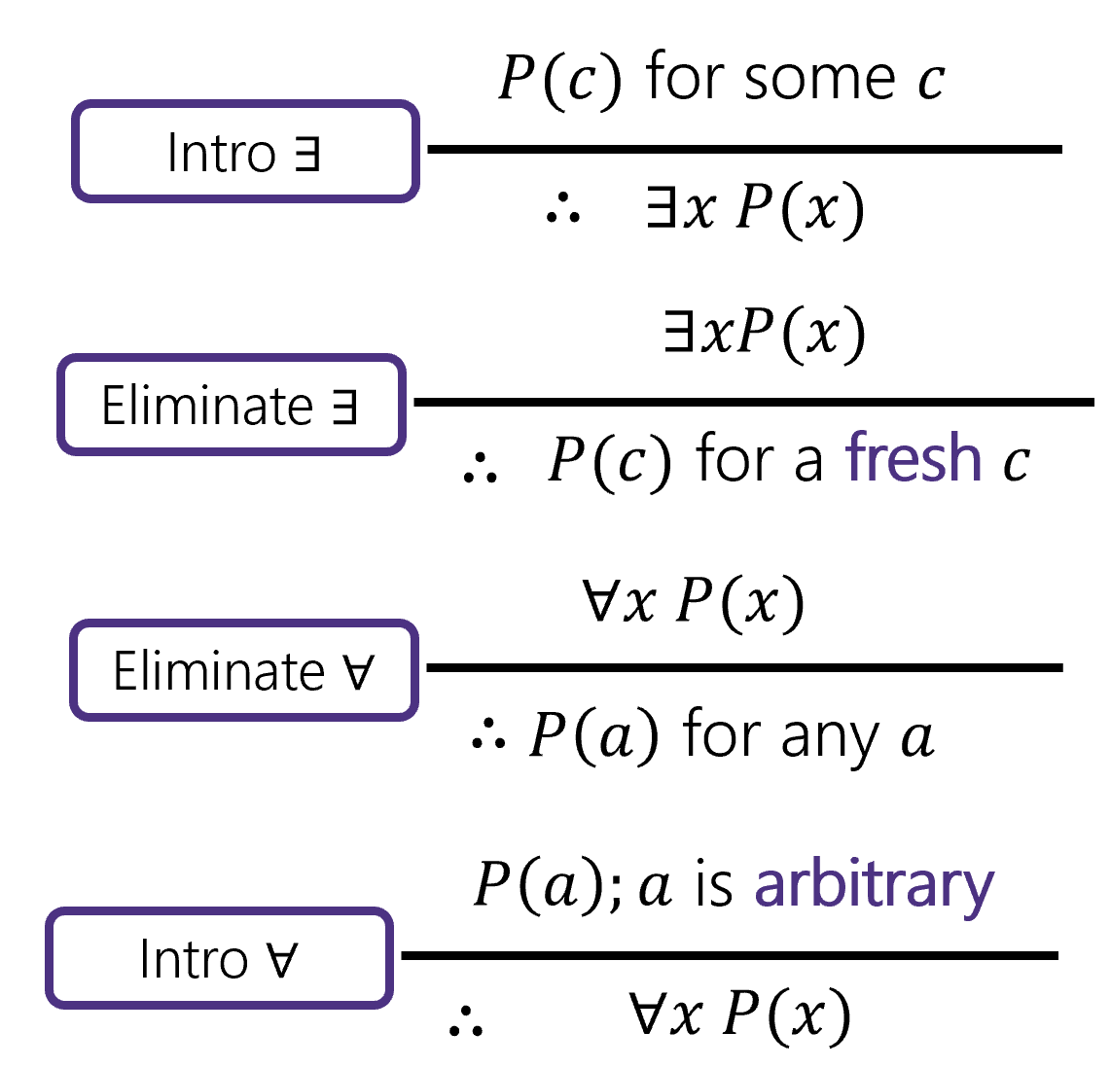
Inference Rules
DeMorgan’s (Quantifiers)
$$∴$$
$$A∨¬A$$

Slide 7
Try it!
Given: $p∨q$, $\left(r∧s\right)→¬q$, $r$. Show: $s→p$
$p∨q$
$\left(r∧s\right)→¬q$
$r$
4.1 $s$
4.2 $r∧s$
4.3 $¬q$
4.4 $q∨p$
4.5 $p$
$s→p$
Given
Given
Given
Assumption
Intro $∧$(3,4.1)
Modus Ponens (2, 4.2)
Commutativity (1)
Eliminate $∨$ (4.4, 4.3)
Direct Proof Rule

Slide 8
Try it!
Given: $p∨q$, $\left(r∧s\right)→¬q$, $r$. Show: $s→p$
$p∨q$
$\left(r∧s\right)→¬q$
$r$
4.1 $s$
4.2 $r∧s$
4.3 $¬q$
4.4 $q∨p$
4.5 $p$
$s→p$
Given
Given
Given
Assumption
Intro $∧$(3,4.1)
Modus Ponens (2, 4.2)
Commutativity (1)
Eliminate $∨$ (4.4, 4.3)
Direct Proof Rule

Slide 9
Proofs with Quantifiers
We’ve done symbolic proofs with propositional logic.
To include predicate logic, we’ll need some rules about how to use quantifiers.
$$∀x P(x)$$
$P(c)$ for some $c$
Eliminate $∀$
Intro $∃$
$$∴$$
$$∴$$
$P\left(a\right)$ for any $a$
$$∃x P(x)$$
$P\left(a\right);a$ is arbitrary
$$∃xP(x)$$
Intro $∀$
Eliminate $∃$
$$∴$$
$$∴$$
$P(c)$ for a fresh $c$
$$∀x P(x)$$
Let’s see a good example, then come back to those “arbitrary” and “fresh” conditions.

Slide 10
Proof Using Quantifiers
Suppose we know $∃xP(x)$ and $∀y[ P\left(y\right)→Q\left(y\right)]$. Conclude $∃xQ(x)$.
$$∀x P(x)$$
$P(c)$ for some $c$
Eliminate $∀$
Intro $∃$
$$∴$$
$$∴$$
$P\left(a\right)$ for any $a$
$$∃x P(x)$$
$P\left(a\right);a$ is arbitrary
$$∃xP(x)$$
Intro $∀$
Eliminate $∃$
$$∴$$
$$∴$$
$P(c)$ for a fresh $c$
$$∀x P(x)$$
Notes:
Have a good example here.

Slide 11
Proof Using Quantifiers
Suppose we know $∃xP(x)$ and $∀y[ P\left(y\right)→Q\left(y\right)]$. Conclude $∃xQ(x)$.
$P(c)$ for some $c$
Intro $∃$
$$∴$$
$$∃x P(x)$$
$$∃xP(x)$$
Eliminate $∃$
$$∴$$
$P(c)$ for a fresh $c$
$$∀x P(x)$$
Eliminate $∀$
$$∴$$
$P\left(a\right)$ for any $a$
$P\left(a\right);a$ is arbitrary
Intro $∀$
$$∴$$
$$∀x P(x)$$
Notes:
Have a good example here.

Slide 12
Proof Using Quantifiers
Suppose we know $∃xP(x)$ and $∀y[ P\left(y\right)→Q\left(y\right)]$. Conclude $∃xQ(x)$.
$P(c)$ for some $c$
$∃xP(x)$
$P(a)$
$∀y[P\left(y\right)→Q\left(y\right)]$
$P\left(a\right)→Q(a)$
$Q(a)$
$∃xQ(x)$
Given
Eliminate $∃$ 1
Given
Eliminate $∀$ 3
Modus Ponens 2,4
Intro $∃$ 5
Intro $∃$
$$∴$$
$$∃x P(x)$$
$$∃xP(x)$$
Eliminate $∃$
$$∴$$
$P(c)$ for a fresh $c$
$$∀x P(x)$$
Eliminate $∀$
$$∴$$
$P\left(a\right)$ for any $a$
$P\left(a\right);a$ is arbitrary
Intro $∀$
$$∴$$
$$∀x P(x)$$
Notes:
Have a good example here.

Slide 13
Proofs with Quantifiers
We’ve done symbolic proofs with propositional logic.
To include predicate logic, we’ll need some rules about how to use quantifiers.
$$∀x P(x)$$
$P(c)$ for some $c$
Eliminate $∀$
Intro $∃$
$$∴$$
$$∴$$
$P\left(a\right)$ for any $a$
$$∃x P(x)$$
$P\left(a\right);a$ is arbitrary
$$∃xP(x)$$
Intro $∀$
Eliminate $∃$
$$∴$$
$$∴$$
$P(c)$ for a fresh $c$
$$∀x P(x)$$
“arbitrary” means $a$ is “just” a variable in our domain.
It doesn’t depend on any other variables and wasn’t introduced with other information.

Slide 14
Proofs with Quantifiers
We’ve done symbolic proofs with propositional logic.
To include predicate logic, we’ll need some rules about how to use quantifiers.
$$∀x P(x)$$
$P(c)$ for some $c$
Eliminate $∀$
Intro $∃$
$$∴$$
$$∴$$
$P\left(a\right)$ for any $a$
$$∃x P(x)$$
$P\left(a\right);a$ is arbitrary
$$∃xP(x)$$
Intro $∀$
Eliminate $∃$
$$∴$$
$$∴$$
$P(c)$ for a fresh $c$
$$∀x P(x)$$
“fresh” means $c$ is a new symbol (there isn’t another $c$ somewhere else in our proof).

Slide 15
Fresh and Arbitrary
Suppose we know $∃xP\left(x\right)$. Can we conclude $∀xP\left(x\right)$?
$P(c)$ for some $c$
$∃x P\left(x\right)$
$P(a)$
$∀x P(x)$
Given
Eliminate $∃$ (1)
Intro $∀$ (2)
Intro $∃$
$$∴$$
$$∃x P(x)$$
$$∃xP(x)$$
Eliminate $∃$
$$∴$$
$P(c)$ for a fresh $c$
This proof is definitely wrong.
(take $P(x)$ to be “is a prime number”)
$$∀x P(x)$$
Eliminate $∀$
$$∴$$
$P\left(a\right)$ for any $a$
$a$ wasn’t arbitrary. We knew something about it – it’s the $x$ that exists to make $P\left(x\right)$ true.
$P\left(a\right);a$ is arbitrary
Intro $∀$
$$∴$$
$$∀x P(x)$$

Slide 16
Fresh and Arbitrary
$P\left(a\right);a$ is arbitrary
$$∃xP(x)$$
Intro $∀$
Eliminate $∃$
$$∴$$
$$∴$$
$P(c)$ for a fresh $c$
$$∀x P(x)$$
You can trust a variable to be arbitrary if you introduce it as such.
If you eliminated a $∀$ to create a variable, that variable is arbitrary. Otherwise it’s not arbitrary – it depends on something.
You can trust a variable to be fresh if the variable doesn’t appear anywhere else (i.e. just use a new letter)

Slide 17
Fresh and Arbitrary
$$∀x P(x)$$
$P(c)$ for some $c$
Eliminate $∀$
Intro $∃$
$$∴$$
$$∴$$
$P\left(a\right)$ for any $a$
$$∃x P(x)$$
There are no similar concerns with these two rules.
Want to reuse a variable when you eliminate $∀?$ Go ahead.
Have a $c$ that depends on many other variables, and want to intro $∃$?
Also not a problem.

Slide 18
Arbitrary
In section yesterday, you said: $\left[∃y∀x P\left(x,y\right)\right]→[∀x∃y P\left(x,y\right)]$. Let’s prove it!!

Slide 19
Arbitrary
In section yesterday, you said: $\left[∃y∀x P\left(x,y\right)\right]→[∀x∃y P\left(x,y\right)]$. Let’s prove it!!
1.1 $∃y∀x P\left(x,y\right)$
1.2 $∀x P\left(x,c\right)$
1.3 Let $a$ be arbitrary.
1.4 $P(a,c)$
1.5 $∃y P\left(a,y\right)$
1.6 $∀x∃y P(x,y)$
2. $\left[∃y∀x P\left(x,y\right)\right]→[∀x∃y P(x,y)]$
Assumption
Elim $∃$ (1.1)
--
Elim $∀$ (1.2)
Intro $∃$ (1.4)
Intro $∀$ (1.5)
Direct Proof Rule

Slide 20
Arbitrary
In section yesterday, you said: $\left[∃y∀x P\left(x,y\right)\right]→[∀x∃y P\left(x,y\right)]$. Let’s prove it!!
1.1 $∃y∀x P\left(x,y\right)$
1.2 $∀x P\left(x,c\right)$
1.4 $P(a,c)$
1.5 $∃y P\left(a,y\right)$
1.6 $∀x∃y P(x,y)$
2. $\left[∃y∀x P\left(x,y\right)\right]→[∀x∃y P(x,y)]$
Assumption
Elim $∃$ (1.1)
Elim $∀$ (1.2)
Intro $∃$ (1.4)
Intro $∀$ (1.5)
Direct Proof Rule

Slide 21
Find The Bug
Let your domain of discourse be integers.
We claim that given $∀x∃y$ Greater$\left(y,x\right),$ we can conclude $∃y∀x$ Greater($y,x)$
Where Greater$(y,x)$ means $y>x$
$∀x∃y$Greater$\left(y,x\right)$
Let $a$ be an arbitrary integer
$∃y$ Greater$(y,a)$
$b≥a$
$∀x$Greater$(b,x)$
$∃y∀x$Greater$(y,x)$
Given
--
Elim $∀$ (1)
Elim $∃$ (2)
Intro $∀$ (4)
Intro $∃$ (5)

Slide 22
Find The Bug
$∀x∃y$Greater$\left(y,x\right)$
Let $a$ be an arbitrary integer
$∃y$ Greater$(y,a)$
$b≥a$
$∀x$Greater$(b,x)$
$∃y∀x$Greater$(y,x)$
Given
--
Elim $∀$ (1)
Elim $∃$ (2)
Intro $∀$ (4)
Intro $∃$ (5)
$b$ is not arbitrary. The variable $b$ depends on $a.$ Even though $a$ is arbitrary, $b$ is not!

Slide 23
Bug Found
There’s one other “hidden” requirement to introduce $∀$.
“No other variable in the statement can depend on the variable to be generalized”
Think of it like this -- $b$ was probably $a+1$in that example.
You wouldn’t have generalized from Greater$(a+1,a)$
To $∀x$ Greater$(a+1, x)$. There’s still an $a,$you’d have replaced all the $a$’s.
$x$ depends on $y$ if $y$ is in a statement when $x$ is introduced.
This issue is much clearer in English proofs, which we’ll start next time.

