Slide 1
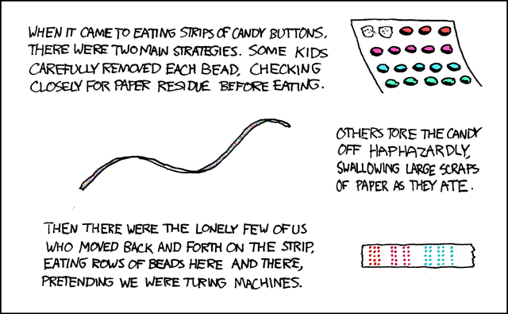
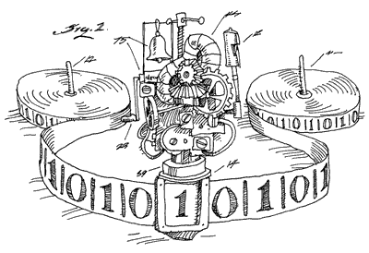
CSE 311: Foundations of Computing
Fall 2014
Lecture 29: Turing machines and more decidability

Slide 2
Proving that problem/set S is undecidable
The main part is a programming task!
Figure out how you could use a subroutine that decided S to build a program to decide one of the problems you already know is undecidable.
You also need to show that your program would really solve the known problem
The slides last class mostly focused on how to build that program but not on the correctness argument.
The need to show correctness should guide your programming solution

Slide 3
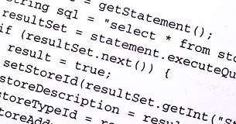
Showing there is no program solving HaltsNoInput
Suppose that hypothetical program A solves HaltsNoInput problem. Combine with Hardcoder:
H’ outputs true on inputs
CODE(P) and x
iff A outputs true
on input CODE(Q) by diagram
iff Q() reads no input
and (always) halts by property of A
iff P(x) halts by definition of Hardcoder
CODE(P)
x
Hardcoder
CODE(Q)
H’
A
true
false
If A existed then H’ would solve the
Halting Problem: Impossible

Slide 4
Showing EQUIV is Undecidable
Consider the set:
EQUIV = {(CODE(P), CODE(R)): P, R are programs, P(x) = R(x) for all inputs x}
Question: Does Q() halt?
CODE(Q)
Step 1: Construct P:
public static boolean P() {return true;}
Step 2: Construct R:
Step a: Replace return type of Q with boolean
Step b: Replace all return values with true
Step c: Add “return true;” to the end of the program
Call this program R
(CODE(P),CODE(R))
Question: Are P and R Equivalent?
Combined program outputs true
iff P and R are equivalent by diagram
iff R always returns true by defn of P
iff Q halts by construction of R from Q
EQUIV
Answering with ANS
would solve HaltsNoInput!
>>> ANS

Slide 5
Proving set S is undecidable
Assume that there is some (hypothetical) program that decides S
Choose some known undecidable set K
Show how to build a program to decide K that uses the program for S as a subroutine
Often you only need one call to S and can return the same answer
Prove that your algorithm outputs true on its input if and only if that input is in K, using the correctness of the hypothetical program for S
If you made one call and returned the same answer you just need to show that the input to the program is in K iff the value in the call to the subroutine is in S.
“Since K is undecidable, the program deciding S can’t exist. Therefore S is undecidable.”

Slide 6
Checking Division By Zero is undecidable
DivBy0={ (CODE(Q),x): Q executes a divide by 0 when run on input x}
Use Halts={(CODE(P),x): P halts on input x}
Let’s try this with one call using same answer
Want to transform CODE(P) into CODE(Q) s.t. - Q does a divide by 0 on input x iff P halts on input x
CODE(P)
x
Transform
CODE(Q)
DivBy0
>>> ANS

Slide 7
Checking Division By Zero is undecidable
Want Q does a divide by 0 on input x iff P halts on input x
Ideas for transformation from P to Q:
Put a divide by 0 in place of each return statement of P and at the end of P
ensures that if P halts there will be a divide by 0 in Q
Add a test before each original division in P to make sure that the divisor is not 0. If the divisor is 0 then don’t do the division, print “error” and halt.
ensures that the only divide by 0 in Q occurs when P halts

Slide 8
Computers and algorithms: Programs and People
Does Java (or any programming language) cover all possible computation? Every possible algorithm?
There was a time when computers were people who did calculations on sheets paper to solve computational problems
Computers as we known them arose from trying to understand everything these people could do

Slide 9
Recall: A brief history of reasoning
1900
Hilbert's famous speech outlines goal: mechanize all of mathematics 23 problems
1930’s
Gödel, Turing show that Hilbert’s program is impossible.
Gödel’s Incompleteness Theorem
Undecidability of the Halting Problem
Both use ideas from Cantor’s proof about reals & rationals

Slide 10
before Java…more from our brief history of reasoning
1930’s
How can we formalize what algorithms are possible?
Turing machines (Turing, Post)
basis of modern computers
Lambda Calculus (Church)
basis for functional programming
μ-recursive functions (Kleene)
alternative functional programming basis
All
are
equivalent!

Slide 11
turing machines
Church-Turing Thesis
Any reasonable model of computation that includes all possible algorithms is equivalent in power to a Turing machine
Evidence
Intuitive justification
Huge numbers of equivalent models to TM’s based on radically different ideas

Slide 12
components of Turing’s intuitive model of computation
Finite Control
Brain/CPU that has only a finite # of possible “states of mind”
Recording medium
An unlimited supply of blank “scratch paper” on which to write & read symbols, each chosen from a finite set of possibilities
Input also supplied on the scratch paper
Focus of attention
Finite control can only focus on a small portion of the recording medium at once
Focus of attention can only shift a small amount at a time

Slide 13
Some quotes from Turing’s original paper
Computing is normally done by writing certain symbols on paper. We may suppose this paper is divided into squares like a child’s arithmetic book. In elementary arithmetic the two-dimensional character of the paper is sometimes used. But such a use is always avoidable … the two-dimensional character of paper is no essential of computation. I assume then that the computation is carried out on one-dimensional paper, i.e. on a tape divided into squares.
I shall also suppose that the number of symbols which may be printed is finite. If we were to allow an infinity of symbols, then there would be symbols differing to an arbitrarily small extent. The effect of this restriction of the number of symbols is not very serious. It is always possible to use sequences of symbols in place of single symbols. The differences from our point of view between the single and compound symbols is that the compound symbols, if they are too lengthy, cannot be observed at one glance. This is in accordance with experience. We cannot tell at a glance whether 9999999999999999 and 999999999999999 are the same.
The behavior of the computer at any moment is determined by the symbols which he is observing, and his "state of mind“ at that moment. We may suppose that there is a bound B to the number of symbols or squares which the computer can observe at one moment. If he wishes to observe more, he must use successive observations. We will also suppose that the number of states of mind which need be taken into account is finite. The reasons for this are of the same character as those which restrict the number of symbols. If we admitted an infinity of states of mind, some of them will be "arbitrarily close“ and will be confused. Again, the restriction is not one which seriously affects computation, since the use of more complicated states.
[He then discusses simple operations that allow the computer to change one of the observed squares]
…. the simple operations must include changes of distribution of observed squares. The new observed squares must be immediately recognisable by the computer. I think it is reasonable to suppose that they can only be squares whose distance from the closest of the immediately previously observed squares does not exceed a certain fixed amount. Let us say at each of the new observed squares is within L squares of an immediately previously observed square.

Slide 14
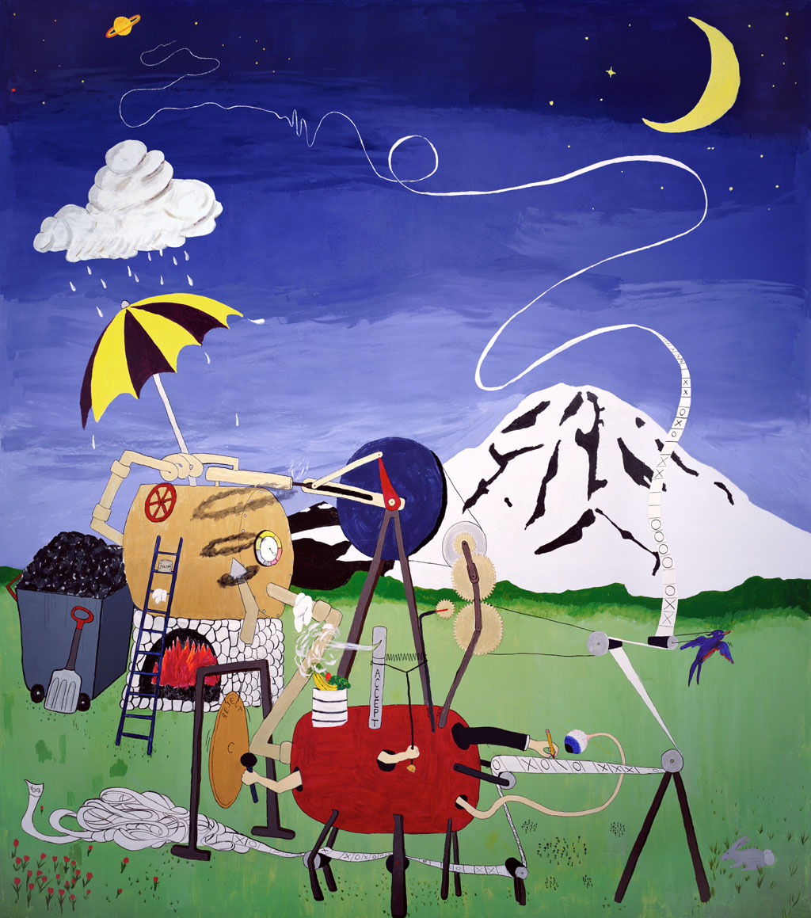
what is a Turing machine?

Slide 15
what is a Turing machine?
Recording medium
An infinite read/write “tape” marked off into cells
Each cell can store one symbol or be “blank”
Tape is initially all blank except a few cells of the tape containing the input string
Read/write head can scan one cell of the tape - starts on input
In each step, a Turing machine
Reads the currently scanned symbol
Based on state of mind and scanned symbol
Overwrites symbol in scanned cell
Moves read/write head left or right one cell
Changes to a new state
Each Turing Machine is specified by its finite set of rules

Slide 16
sample Turing machine
 | _ | 0 | 1
s₁ | (1,s₃) | (1,s₂) | (0,s₂)
s₂ | (H,s₃) | (R,s₁) | (R,s₁)
s₃ | (H,s₃) | (R,s₃) | (R,s₃)
_ | _ | 1 | 1 | 0 | 1 | 1 | _ | _

Slide 17
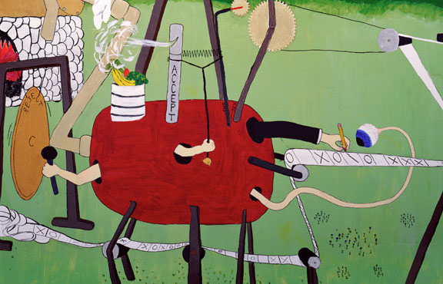
what is a Turing machine?

Slide 18
turing machine ≡ ideal Java/C program
Ideal Java/C programs
Just like the Java/C you’re used to programming with, except you never run out of memory
Constructor methods always succeed
malloc in C never fails
Equivalent to Turing machines except a lot easier to program !
Turing machine definition is useful for breaking computation down into simplest steps
We only care about high level so we use programs

Slide 19
Turing’s big idea: machines as data
Original Turing machine definition
A different “machine” M for each task
Each machine M is defined by a finite set of possible operations on finite set of symbols
M has a finite description as a sequence of symbols, its “code” denoted <M>
You already are used to this idea with the notion of the program code or text but this was a new idea in Turing’s time.

Slide 20
Turing’s idea: a Universal Turing Machine
A Turing machine interpreter U
On input <M> and its input x, U outputs the same thing as M does on input x
At each step it decodes which operation M would have performed and simulates it.
One Turing machine is enough
Basis for modern stored-program computer
Von Neumann studied Turing’s UTM design
input
output
x
output
x
M
U
M(x)
M(x)
<M>

Slide 21
General phenomenon: can’t tell a book by its cover
and you can’t tell what a program does just by its code...
Rice’s Theorem: In general there is no way to tell
anything about the input/output (I/O) behavior of a
program P just given it code!
Note: The statement above is not precise, and we didn’t prove it, so this
isn’t something you can use on homework or exams

Slide 22
Even harder problems
With the halting problem, by using the Universal machine (a program interpreter) we can simulate P and input x and always get the true answers correct
we can’t be sure about answering false
For other problems we can always answer false correctly but maybe not the true answers
There are natural problems where you can’t even do that!
The EQUIV problem is an example of this kind of even harder problem

Slide 23
Quick lessons
Don’t rely on the idea of improved compilers and programming languages to eliminate major programming errors
truly safe languages can’t possibly do general computation
Document your code!!!!
there is no way you can expect someone else to figure out what your program does with just your code ....since....in general it is provably impossible to do this!

