Slide 1
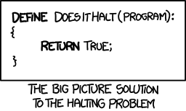
CSE 311: Foundations of Computing
Fall 2014
Lecture 26: Pattern matching, Halting problem

Slide 2
highlights
DFAs ≡ Regular Expressions
  No need to know details of NFAs→RegExpressions
Method for proving no DFAs for languages
  e.g. {0^{n}1^{n} : n ≥ 0},
    {Binary palindromes}

Slide 3
pattern matching
Given
  a string, s, of n characters
  a pattern, p, of m characters
  usually m<<n
Find
  all occurrences of the pattern p in the string s
Obvious algorithm:
  try to see if p matches at each of the positions in s
    stop at a failed match and try the next position

Slide 4
string s = x y x x y x y x y y x y x y x y y x y x y x x
pattern p = x y x y y x y x y x x

Slide 5
string s = x y x x y x y x y y x y x y x y y x y x y x x
x y x y y x y x y x x

Slide 6
string s = x y x x y x y x y y x y x y x y y x y x y x x
x y x y
x y x y y x y x y x x

Slide 7
string s = x y x x y x y x y y x y x y x y y x y x y x x
x y x y
x
x y x y y x y x y x x

Slide 8
string s = x y x x y x y x y y x y x y x y y x y x y x x
x y x y
x
x y
x y x y y x y x y x x

Slide 9
string s = x y x x y x y x y y x y x y x y y x y x y x x
x y x y
x
x y
x y x y y
x y x y y x y x y x x

Slide 10
string s = x y x x y x y x y y x y x y x y y x y x y x x
x y x y
x
x y
x y x y y
x
x y x y y x y x y x x

Slide 11
string s = x y x x y x y x y y x y x y x y y x y x y x x
x y x y
x
x y
x y x y y
x
x y x y y x y x y x x
x y x y y x y x y x x

Slide 12
string s = x y x x y x y x y y x y x y x y y x y x y x x
x y x y
x
x y
x y x y y
x
x y x y y x y x y x x
x
x y x y y x y x y x x

Slide 13
string s = x y x x y x y x y y x y x y x y y x y x y x x
x y x y
x
x y
x y x y y
x
x y x y y x y x y x x
x
x y x
x y x y y x y x y x x

Slide 14
string s = x y x x y x y x y y x y x y x y y x y x y x x
x y x y
x
x y
x y x y y
x
x y x y y x y x y x x
x
x y x
x
x y x y y x y x y x x

Slide 15
string s = x y x x y x y x y y x y x y x y y x y x y x x
x y x y
x
x y
x y x y y
x
x y x y y x y x y x x
x
x y x
x
x
x y x y y x y x y x x

Slide 16
string s = x y x x y x y x y y x y x y x y y x y x y x x
x y x y
x
x y
x y x y y
x
x y x y y x y x y x x
x
x y x
x
x
x y x y y
x y x y y x y x y x x

Slide 17
string s = x y x x y x y x y y x y x y x y y x y x y x x
x y x y
x
x y
x y x y y
x
x y x y y x y x y x x
x
Worst-case time
O(mn)
x y x
x
x
x y x y y
x
x y x y y x y x y x x

Slide 18
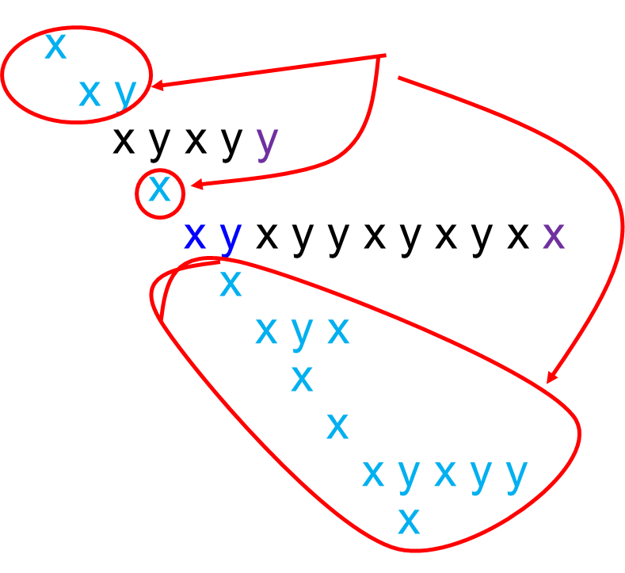
string s = x y x x y x y x y y x y x y x y y x y x y x x
x y x y
Lots of wasted work
x y x y y x y x y x x

Slide 19
better pattern matching via finite automata
Build a DFA for the pattern (preprocessing) of size O(m)
  Keep track of the ‘longest match currently active’
  The DFA will have only m+1 states
Run the DFA on the string n steps
Obvious construction method for DFA will be O(m²) but can be done in O(m) time.
Total O(m+n) time

Slide 20
building a DFA for the pattern
pattern p=x y x y y x y x y x x

Slide 21
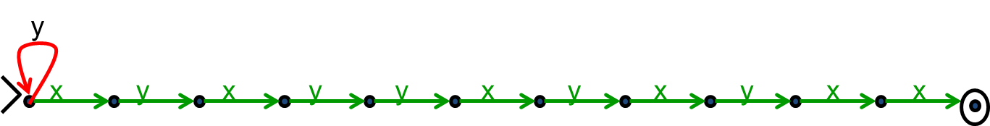
preprocessing the pattern
pattern p=x y x y y x y x y x x

Slide 22
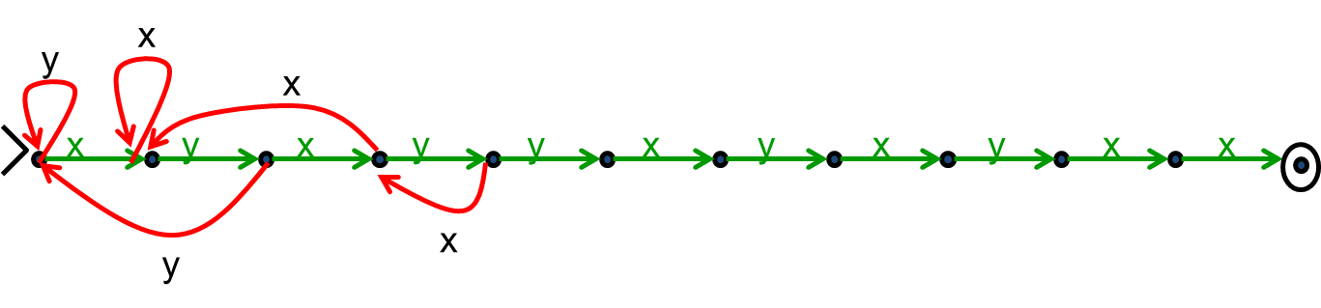
preprocessing the pattern
pattern p=x y x y y x y x y x x

Slide 23
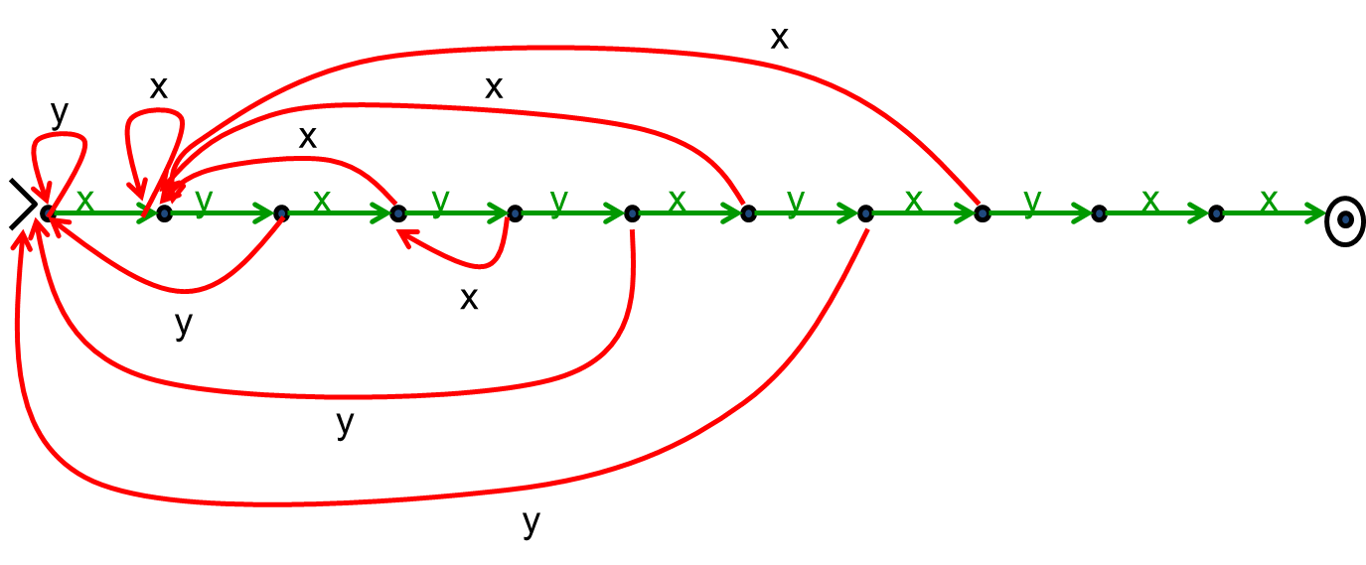
preprocessing the pattern
pattern p=x y x y y x y x y x x

Slide 24
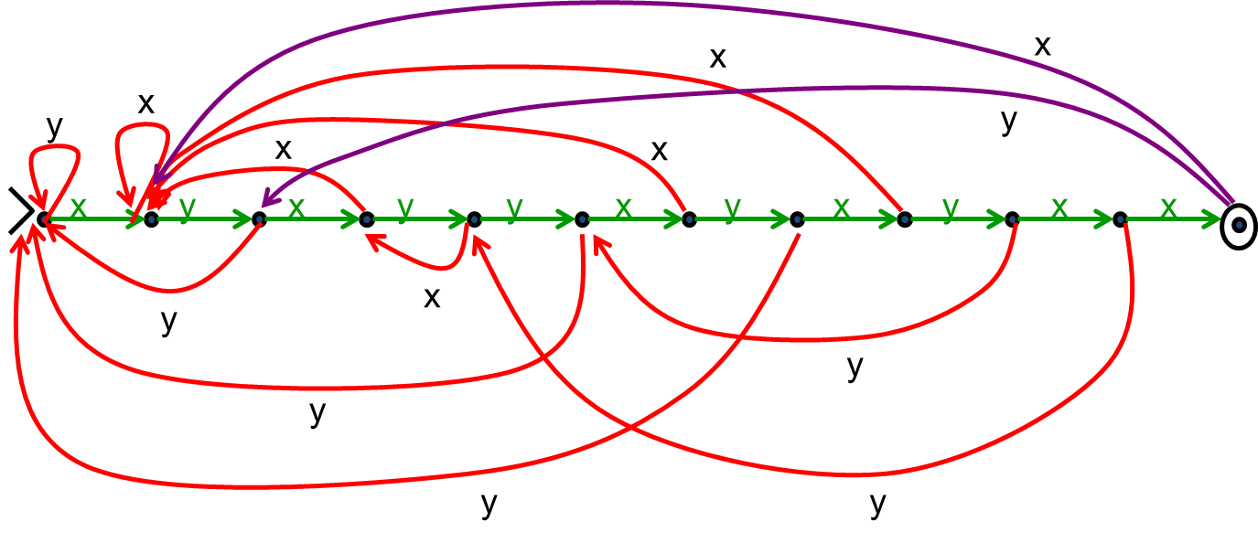
preprocessing the pattern
pattern p=x y x y y x y x y x x

Slide 25
generalizing
Can search for arbitrary combinations of patterns
  Not just a single pattern
  Build NFA for pattern then convert to DFA ‘on the fly’.
    Compare DFA constructed above with subset construction for the obvious NFA.

Slide 26
Languages and Machines!
All
Are there things Java can’t do?
Java
Context-Free
Binary Palindromes
Regular
DFA
NFA
Regex
0*
Finite
{001, 10, 12}

Slide 27
An Assignment Too Simple for 142.
Students should write a Java program that…
  Prints “Hello” to the console
  Eventually exits
GradeIt, PracticeIt, etc. need to grade the students.
How do we write that grading program?

Slide 28
Follow Up Question
What does this program do?
_(__,___,____){___/__<=1?_(__,___+1,___ _):!(___%__)?_(__,___+1,0):___%__==___ / __&&!____?(printf("%d\t",___/__),_(__,_ __+1,0)):___%__>1&&___%__<___/__?_( __,1+ ___,____+!(___/__%(___%__))):___<__*__ ?_(__,___+1,____):0;}main(){_(100,0,0);}

Slide 29
Follow Up Question
public static void collatz(n) {
if (n == 1) {
return 1;
}
if (n % 2 == 0) {
return collatz(n/2)
}
else {
return collatz(3n + 1)
}
}
What does this program do?
…on n=5?
…on n=10000000000000000001?

Slide 30
Sneak Peak
It turns out the simple autograder is impossible to write…
And we’ll prove it!

Slide 31
Some Notation and Starting Ideas
We’re going to be talking about Java code a lot.
CODE(P) will mean “the code of the program P”
So, consider the following function:
public String P(String x) {
return new String(Arrays.sort(x.toCharArray());
}
What is P(CODE(P))?
“((()))..;AACPSSaaabceeggghiiiilnnnnnooprrrrrrrrrrrsssttttttuuwxxyy{}”

Slide 32
The Halting Problem
Given: - CODE(P) for any program P
- input x
Output: true if P halts on input x
false if P does not halt on input x

Slide 33
The Halting Problem
Given: - CODE(P) for any program P
- input x
Output: true if P halts on input x
false if P does not halt on input x
It turns out that it isn’t possible to write a program that solves the Halting Problem.

Slide 34
Proof by contradiction
Suppose that H is a Java program that solves the Halting problem. Then we can write this program:
  public static void D(x) {
  if (H(x,x) == true) {
  while (true); /* don’t halt */
      }
      else {
      return; /* halt */
      }
    }
Does D(CODE(D)) halt?

Slide 35
public static void D(x) {
  if (H(x,x) == true) {
  while (true); /* don’t halt */
  }
  else {
  return; /* halt */
  }
}
Does D(CODE(D)) halt?
H solves the halting problem implies that H(CODE(D),x) is true iff D(x) halts, H(CODE(D),x) is false iff not
Suppose D(CODE(D)) halts.
Then, we must be in the second case of the if.
So, H(CODE(D), CODE(D)) is false
Which means D(CODE(D)) doesn’t halt
Suppose D(CODE(D)) doesn’t halt.
Then, we must be in the first case of the if.
So, H(CODE(D), CODE(D)) is true.
Which means D(CODE(D)) halts.

Slide 36
public static void D(x) {
  if (H(x,x) == true) {
  while (true); /* don’t halt */
  }
  else {
  return; /* halt */
  }
}
Does D(CODE(D)) halt?
H solves the halting problem implies that H(CODE(D),x) is true iff D(x) halts, H(CODE(D),x) is false iff not
Suppose D(CODE(D)) halts.
Then, we must be in the second case of the if.
So, H(CODE(D), CODE(D)) is false
Which means D(CODE(D)) doesn’t halt
Suppose D(CODE(D)) doesn’t halt.
Then, we must be in the first case of the if.
So, H(CODE(D), CODE(D)) is true.
Which means D(CODE(D)) halts.

Slide 37
public static void D(x) {
  if (H(x,x) == true) {
  while (true); /* don’t halt */
  }
  else {
  return; /* halt */
  }
}
Does D(CODE(D)) halt?
H solves the halting problem implies that H(CODE(D),x) is true iff D(x) halts, H(CODE(D),x) is false iff not
Suppose D(CODE(D)) halts.
Then, we must be in the second case of the if.
So, H(CODE(D), CODE(D)) is false
Which means D(CODE(D)) doesn’t halt
Suppose D(CODE(D)) doesn’t halt.
Then, we must be in the first case of the if.
So, H(CODE(D), CODE(D)) is true.
Which means D(CODE(D)) halts.

Slide 38
public static void D(x) {
  if (H(x,x) == true) {
  while (true); /* don’t halt */
  }
  else {
  return; /* halt */
  }
}
Does D(CODE(D)) halt?
H solves the halting problem implies that H(CODE(D),x) is true iff D(x) halts, H(CODE(D),x) is false iff not
Suppose D(CODE(D)) halts.
Then, we must be in the second case of the if.
So, H(CODE(D), CODE(D)) is false
Which means D(CODE(D)) doesn’t halt
Suppose D(CODE(D)) doesn’t halt.
Then, we must be in the first case of the if.
So, H(CODE(D), CODE(D)) is true.
Which means D(CODE(D)) halts.
Contradiction!

Slide 39
That’s it!
We proved that there is no computer program that can solve the Halting Problem.
  There was nothing special about Java
This tells us that there is no compiler that can check our programs and guarantee to find any infinite loops they might have.

Slide 40
What’s next?
We showed: If some “hypothetical” subroutine H existed that solved the Halting Problem then it would let us build a program D that cannot possibly exist
  We will use the same idea to show that programs solving other problems are impossible, but we now will be able to use that H cannot exist
A key piece of the proof was considering what a program does when given its own code as input
  This was inspired by a method to compare the sizes of infinite sets call diagonalization that we will study next class

