Slide 1
CSE 311 Foundations of Computing I
Lecture 23
Finite State Machines
Autumn 2012

Slide 2
Announcements
Reading assignments
7th Edition, Sections 13.3 and 13.4
6th Edition, Section 12.3 and 12.4
5th Edition, Section 11.3 and 11.4

Slide 3
Lecture highlights: Database and relations
TAKES
STUDENT
ID_Number | Course
328012098 | CSE311
328012098 | CSE351
481080220 | CSE311
238082388 | CSE312
238082388 | CSE344
238082388 | CSE351
1727017 | CSE312
348882811 | CSE311
348882811 | CSE312
348882811 | CSE344
348882811 | CSE351
2921938 | CSE351
Student_Name | ID_Number | Office | GPA
Knuth | 328012098 | 022 | 4.00
Von Neuman | 481080220 | 555 | 3.78
Russell | 238082388 | 022 | 3.85
Einstein | 238001920 | 022 | 2.11
Newton | 1727017 | 333 | 3.61
Karp | 348882811 | 022 | 3.98
Bernoulli | 2921938 | 022 | 3.21
Databases consist of collection of n-ary relations
Relational algebra: $⋈, Π, σ$

Slide 4
Relational Databases: Keys
An attribute is a key if all its values in the database are always distinct
Student_Name | ID_Number | Office | GPA
Knuth | 328012098 | 022 | 4.00
Von Neuman | 481080220 | 555 | 3.78
Russell | 238082388 | 022 | 3.85
Einstein | 238001920 | 022 | 2.11
Newton | 1727017 | 333 | 3.61
Karp | 348882811 | 022 | 3.98
Bernoulli | 2921938 | 022 | 3.21
Which attribute is the key?
Why is Student_Name not a key?

Slide 5
Relational Databases: Relationships
STUDENT
Student_Name | ID_Number | Office
Knuth | 328012098 | 022
Von Neuman | 481080220 | 555
Russell | 238082388 | 022
Einstein | 238001920 | 022
Newton | 1727017 | 333
Karp | 348882811 | 022
Bernoulli | 2921938 | 022
PROJECT
PRJ_ID | Project_Name | Due_date
P331 | “Flying cyphers” | 11/2012
P004 | “Virtual induction” | 12/2012
P901 | “Binary bots” | 12/2012
ID_Number | PRJ_ID
2921938 | P004
2921938 | P901
1727017 | P901
WORKS_ON is a relationship between students and project
Who works on what?

Slide 6
Types of Relationships in Relational Databases
one-one:
many-one
many-many
1
2
3
a
b
c
d
What type is WORKS_ON?
ID_Number | PRJ_ID
2921938 | P004
2921938 | P901
1727017 | P901
1
2
3
a
b
c
d
1
2
3
a
b
c
d

Slide 7
Finite state machines
States
Transitions on inputs
Start state and final states
The language recognized by a machine is the set of strings that reach a final state
State | 0 | 1
s₀ | s₀ | s₁
s₁ | s₀ | s₂
s₂ | s₀ | s₃
s₃ | s₃ | s₃
0
0
s₀
1
s₁
1
s₂
1
s₃
0
0,1

Slide 8
Applications of Finite State Machines (a.k.a. Finite Automata)
Implementation of regular expression matching in programs like grep
Control structures for sequential logic in digital circuits
Algorithms for communication and cache-coherence protocols
Each agent runs its own FSM
Design specifications for reactive systems
Components are communicating FSMs

Slide 9
Applications of Finite State Machines (a.k.a. Finite Automata)
Formal verification of systems
Is an unsafe state reachable?
Computer games
FSMs provide worlds to explore
Minimization algorithms for FSMs can be extended to more general models used in
Text prediction
Speech recognition

Slide 10
What language does this machine recognize?
1
s₀
s₁
1
0
0
0
0
1
s₂
s₃
1

Slide 11
3 Bit Shift register
001
1
011
1
0
1
1
1
0
000
1
010
101
0
111
1
0
0
1
0
0
100
0
110

Slide 12
0
1
0
1
0
1
0
1
00
01
10
11
1
1
1
0
0
0
0
1
001
1
011
1
0
1
1
1
0
0
000
1
010
101
111
1
0
0
1
0
0
100
0
110

Slide 13
Design a DFA that accepts strings with a 1 three positions from the end

Slide 14
How does the size of a DFA to recognize “10th character is a 1” compare with the size of a DFA to recognize “10th character from the end is 1”?

Slide 15
Strings over {0, 1, 2}*
M₁: Strings with an even number of 2’s
M₂: Strings where the sum of digits mod 3 is 0
s₀
s₁
t₁
t₀
t₂

Slide 16
Recognize strings with an even number of 2’s and a mod 3 sum of 0
s₁t₀
s₀t₁
s₀t₀
s₁t₁
s₁t₂
s₀t₂

Slide 17
State machines with output
“Tug-of-war”
 | Input |  | Output
State | L | R
s₁ | s₁ | s₂ | Beep
s₂ | s₁ | s₃
s₃ | s₂ | s₄
s₄ | s₃ | s₄ | Beep
R
R
R
L
S₁
S₂
S₃
S₄
R
L
L
L

Slide 18
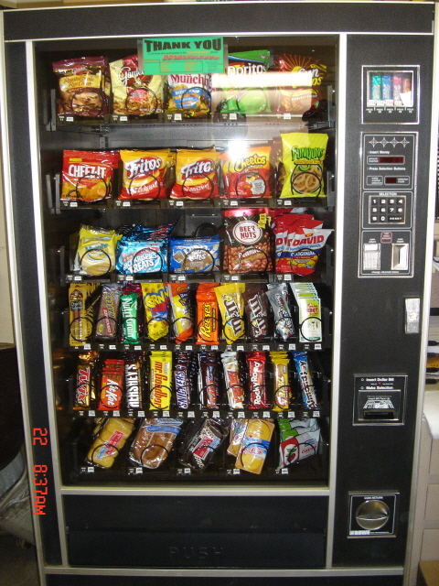
Vending Machine
Enter 15 cents in dimes or nickels
Press S or B for a candy bar

Slide 19
Vending Machine, Version 1
D
D
0
N
5
N
10
N, D
15
B, S
Basic transitions on N (nickel), D (dime), B (butterfinger), S (snickers)

Slide 20
Vending Machine, Version 2
0
D
N
15
D
D
B
0’ B
5
10
S
N
N
N
D
15’ N
B
S
N
D
0” S
Adding output to states: N – Nickel, S – Snickers, B – Butterfinger

Slide 21
Vending Machine, Final Version
B,S
0
D
N
15
B,S
B,S
B,S
D
D
B
D
0’ B
5
10
S
N
N
N
N
D
15’ N
B
N
B,S
S
D
N
D
0” S
N
B
15” D
S
D
Adding additional “unexpected” transitions

