Slide 1
CSE 311 Foundations of Computing I
Lecture 21
Relations
Autumn 2012

Slide 2
Announcements
Reading assignments
7th Edition, Section 9.1 and pp. 594-601
6th Edition, Section 8.1 and pp. 541-548
5th Edition, Section 7.1 and pp. 493-500
Upcoming topics
Relations
Finite State Machines

Slide 3
Definition of Relations
Let A and B be sets,
A binary relation from A to B is a subset of A × B
Let A be a set,
A binary relation on A is a subset of A × A

Slide 4
Relation Examples
R₁ = {(a, 1), (a, 2), (b, 1), (b, 3), (c, 3)}
R₂ = {(x, y) | x ≡ y (mod 5) }
R₃ = {(c₁, c₂) | c₁ is a prerequisite of c₂ }
R₄ = {(s, c) | student s had taken course c }

Slide 5
Properties of Relations
Let R be a relation on A
R is reflexive iff (a,a) ∈ R for every a ∈ A
R is symmetric iff (a,b) ∈ R implies (b, a)∈ R
R is antisymmetric iff (a,b) ∈ R and a ≠ b implies (b,a) ∈ R
/
R is transitive iff (a,b)∈ R and (b, c)∈ R implies (a, c) ∈ R

Slide 6
Combining Relations
Let R be a relation from A to B
Let S be a relation from B to C
The composite of R and S, S ° R is the relation
from A to C defined
S ° R = {(a, c) | ∃ b such that (a,b)∈ R and (b,c)∈ S}

Slide 7
Examples
(a,b)∈ Parent: b is a parent of a
(a,b)∈ Sister: b is a sister of a
What is Sister ° Parent?
What is Parent ° Sister?
S ° R = {(a, c) | ∃ b such that (a,b)∈ R and (b,c)∈ S}

Slide 8
Examples
Using the relations: Parent, Child, Brother, Sister, Sibling, Father, Mother, Husband, Wife express -
Uncle: b is an uncle of a
Cousin: b is a cousin of a

Slide 9
Powers of a Relation
R² = R ° R = {(a, c) | ∃ b such that (a,b)∈ R and (b,c)∈ R}
R⁰ = {(a,a) | a ∈ A}
R¹ = R
R^{n+1} = R^{n} ° R

Slide 10
Matrix representation
Relation R on A={a₁, … a_{p}}
{(1, 1), (1, 2), (1, 4), (2,1), (2,3), (3,2), (3, 3) (4,2) (4,3)}

Slide 11
Computing the Composite Relation with Matrix Multiplication
If S={(2,2),(2,3),(3,1)} and R={(1,2),(2,1),(1,3)} compute S ° R
M_{S} =
M_{R} =
M_{S°R} =

Slide 12
Directed graphs
G = (V, E)
V – vertices
E – edges, order pairs of vertices
Path: v₁, v₂, …, v_{k}, with (v_{i}, v_{i+1}) in E
Simple Path
Cycle
Simple Cycle

Slide 13
Representation of relations
Directed Graph Representation (Digraph)
{(a, b), (a, a), (b, a), (c, a), (c, d), (c, e) (d, e) }
b
c
a
d
e

Slide 14
Computing the Composite Relation using the Graph Representation
If S={(2,2),(2,3),(3,1)} and R={(1,2),(2,1),(1,3)} compute S ° R

Slide 15
Paths in relations
Let R be a relation on a set A. There is a path of length n from a to b if and only if (a,b) ∈R^{n}

Slide 16
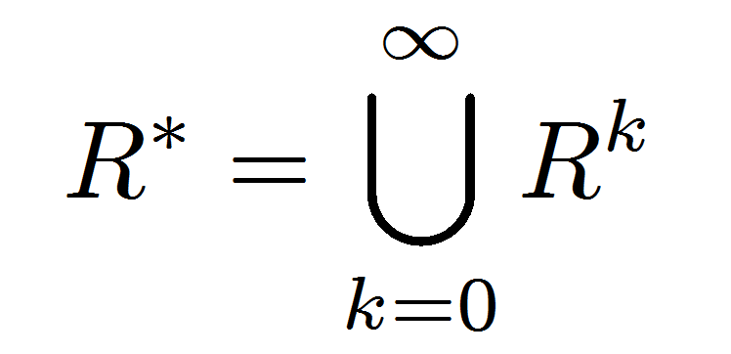
Connectivity relation
Let R be a relation on a set A. The connectivity relation R* consists of the pairs (a,b) such that there is a path from a to b in R.

Slide 17
Properties of Relations
Let R be a relation on A
R is reflexive iff (a,a) ∈ R for every a ∈ A
R is symmetric iff (a,b) ∈ R implies (b, a)∈ R
R is transitive iff (a,b)∈ R and (b, c)∈ R implies (a, c) ∈ R
/

Slide 18
Transitive-Reflexive Closure
Add the minimum possible number of edges to make the relation transitive and reflexive
The transitive-reflexive closure of a relation R is the connectivity relation R*

Slide 19
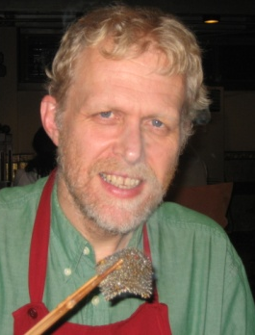
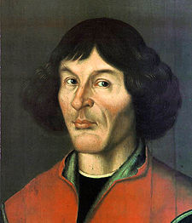
How is Anderson related to Bernoulli?
Copernicus
Anderson

Slide 20
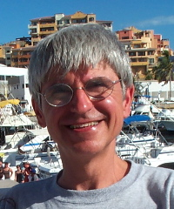
How is Anderson related to Bernoulli?
Suciu
Copernicus

Slide 21
http://genealogy.math.ndsu.nodak.edu/

Slide 22
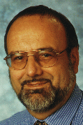
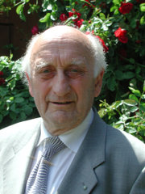
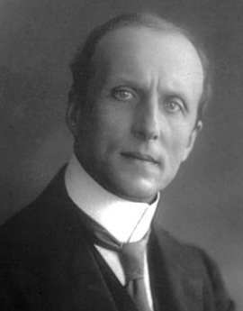
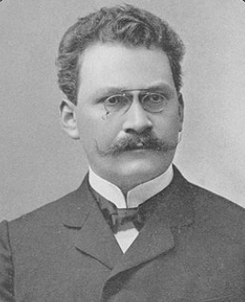
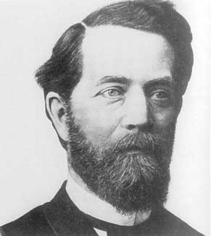
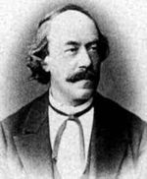
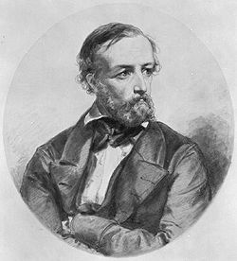
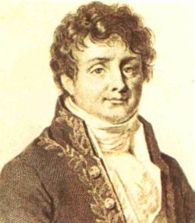
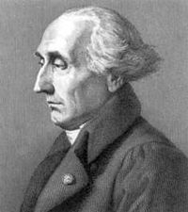
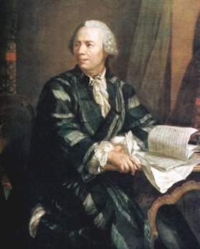
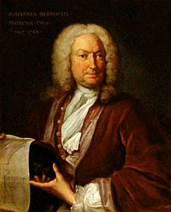
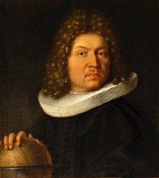
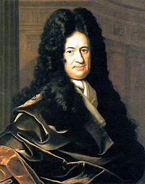
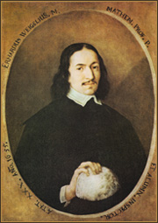
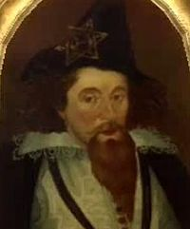
Anderson
Mayr
Bauer
Caratheodory
Minkowski
Klein
Lipschitz
Dirichlet
Fourier
Lagrange
Euler
Johann Bernoulli
Jacob Bernoulli
Leibniz
Weigel
Rheticus
Copernicus

Slide 23
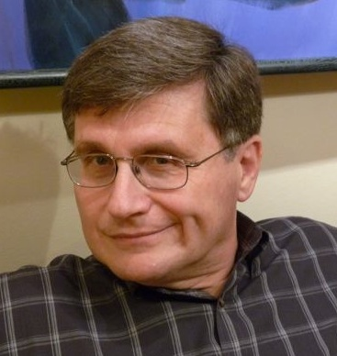
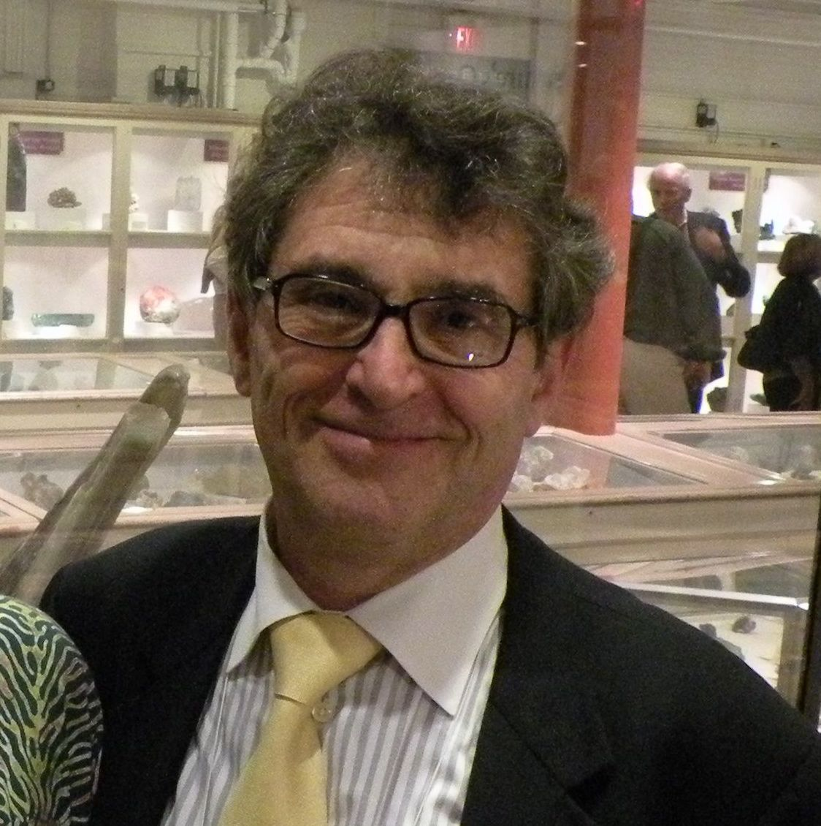
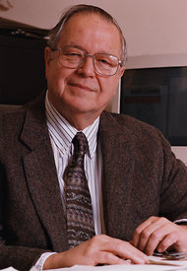
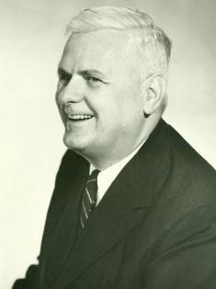
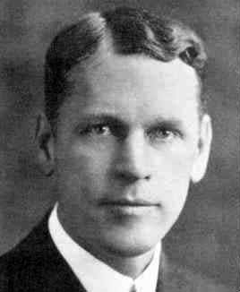
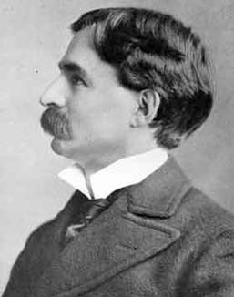
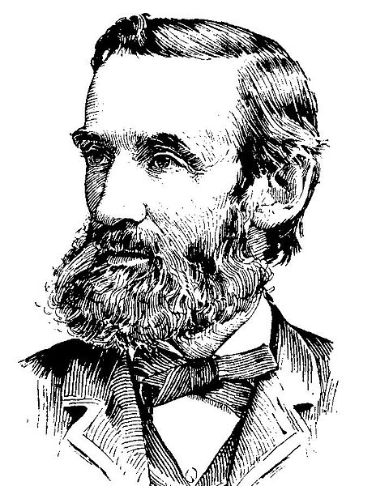
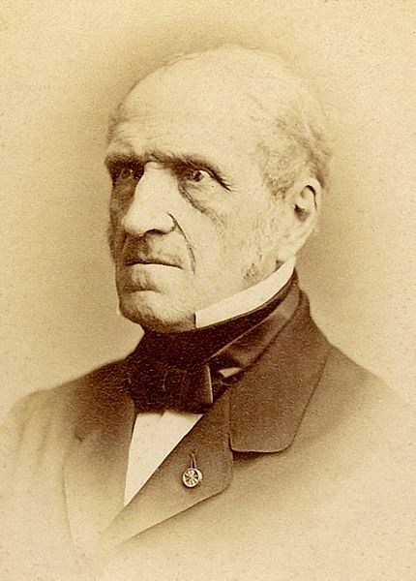
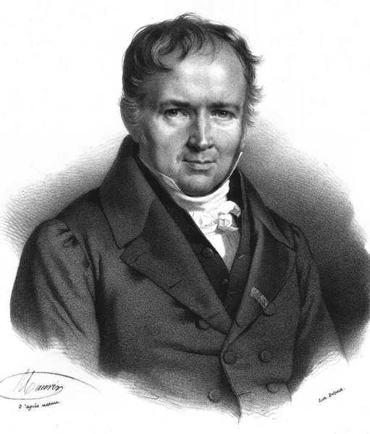
Suciu
Tannen
Meyer
Fischer
Rogers
Church
Veblen
Moore
H.A.Newton
Chasles
Poisson
Lagrange
Euler
Johann Bernoulli
Jacob Bernoulli

Slide 24
Nicolaus Copernicus
Georg Rheticus
Moritz Steinmetz
Christoph Meurer
Philipp Muller
Erhard Weigel
Gottfried Leibniz
Noclas Malebranache
Jacob Bernoulli
Johann Bernoulli
Leonhard Euler
Joseph Lagrange
Jean-Baptiste Fourier
Gustav Dirichlet
Rudolf Lipschitz
Felix Klein
C. L. Ferdinand Lindemann Herman Minkowski
Constantin Caratheodory Georg Aumann
Friedrich Bauer
Manfred Paul
Ernst Mayr Richard Anderson
Nicolaus Copernicus
Georg Rheticus
Moritz Steinmetz
Christoph Meurer
Philipp Muller
Erhard Weigel
Gottfried Leibniz
Noclas Malebranache
Jacob Bernoulli
Johann Bernoulli
Leonhard Euler
Joseph Lagrange
Michel Chasles
H. A. (Hubert Anson) Newton
E. H. (Eliakim Hastings) Moore
Oswald Veblen
Alonzo Church
Hartley Rogers, Jr.
Patrick Carl Fischer
Albert Ronald da Silva Meyer
Val Tannen
Dan Suciu

Slide 25
n-ary relations
Let A₁, A₂, …, A_{n} be sets. An n-ary relation on
these sets is a subset of A₁× A₂× . . . × A_{n}.

Slide 26
Relational databases
STUDENT
Student_Name | ID_Number | Office | GPA
Knuth | 328012098 | 022 | 4.00
Von Neuman | 481080220 | 555 | 3.78
Russell | 238082388 | 022 | 3.85
Einstein | 238001920 | 022 | 2.11
Newton | 1727017 | 333 | 3.61
Karp | 348882811 | 022 | 3.98
Bernoulli | 2921938 | 022 | 3.21

Slide 27
Relational databases
STUDENT
Student_Name | ID_Number | Office | GPA | Course
Knuth | 328012098 | 022 | 4.00 | CSE311
Knuth | 328012098 | 022 | 4.00 | CSE351
Von Neuman | 481080220 | 555 | 3.78 | CSE311
Russell | 238082388 | 022 | 3.85 | CSE312
Russell | 238082388 | 022 | 3.85 | CSE344
Russell | 238082388 | 022 | 3.85 | CSE351
Newton | 1727017 | 333 | 3.61 | CSE312
Karp | 348882811 | 022 | 3.98 | CSE311
Karp | 348882811 | 022 | 3.98 | CSE312
Karp | 348882811 | 022 | 3.98 | CSE344
Karp | 348882811 | 022 | 3.98 | CSE351
Bernoulli | 2921938 | 022 | 3.21 | CSE351
What wrong?
Notes:
What’s wrong:
Redundant data: we repeat all the GPAs and all the Office numbers
Missing data: we lost Einstein

Slide 28
Relational databases
TAKES
STUDENT
ID_Number | Course
328012098 | CSE311
328012098 | CSE351
481080220 | CSE311
238082388 | CSE312
238082388 | CSE344
238082388 | CSE351
1727017 | CSE312
348882811 | CSE311
348882811 | CSE312
348882811 | CSE344
348882811 | CSE351
2921938 | CSE351
Student_Name | ID_Number | Office | GPA
Knuth | 328012098 | 022 | 4.00
Von Neuman | 481080220 | 555 | 3.78
Russell | 238082388 | 022 | 3.85
Einstein | 238001920 | 022 | 2.11
Newton | 1727017 | 333 | 3.61
Karp | 348882811 | 022 | 3.98
Bernoulli | 2921938 | 022 | 3.21
Better

Slide 29
Database Operations: Projection
Office
022
555
333
Find all offices: Π_{Office}(STUDENT)
Office | GPA
022 | 4.00
555 | 3.78
022 | 3.85
022 | 2.11
333 | 3.61
022 | 3.98
022 | 3.21
Find offices and GPAs: Π_{Office,GPA}(STUDENT)

Slide 30
Database Operations: Selection
Find students with GPA > 3.9 : σ_{GPA>3.9}(STUDENT)
Student_Name | ID_Number | Office | GPA
Knuth | 328012098 | 022 | 4.00
Karp | 348882811 | 022 | 3.98
Retrieve the name and GPA for students with GPA > 3.9 : Π_{Student_Name,GPA}(σ_{GPA>3.9}(STUDENT))
Student_Name | GPA
Knuth | 4.00
Karp | 3.98

Slide 31
Database Operations: Natural Join
Student ⋈ Takes
Student_Name | ID_Number | Office | GPA | Course
Knuth | 328012098 | 022 | 4.00 | CSE311
Knuth | 328012098 | 022 | 4.00 | CSE351
Von Neuman | 481080220 | 555 | 3.78 | CSE311
Russell | 238082388 | 022 | 3.85 | CSE312
Russell | 238082388 | 022 | 3.85 | CSE344
Russell | 238082388 | 022 | 3.85 | CSE351
Newton | 1727017 | 333 | 3.61 | CSE312
Karp | 348882811 | 022 | 3.98 | CSE311
Karp | 348882811 | 022 | 3.98 | CSE312
Karp | 348882811 | 022 | 3.98 | CSE344
Karp | 348882811 | 022 | 3.98 | CSE351
Bernoulli | 2921938 | 022 | 3.21 | CSE351

