Slide 1
CSE 311 Foundations of Computing I
Lecture 15
Induction
Autumn 2012

Slide 2
Announcements
Reading assignments
Today:
5.2, 5.3 7th Edition
4.2, 4.3 6th Edition
3.3, 3.4 5th Edition
Monday: 5.3 (7th), 4.3 (6th), 3.4 (5th)
Midterm next Friday, Nov 2
Closed book, closed notes
Practice midterm questions available on the Web
Extra office hours Thursday (midterm review)
3:30 pm, Dan Suciu, Gowen 201
4:30 pm, Richard Anderson, Gowen 201

Slide 3
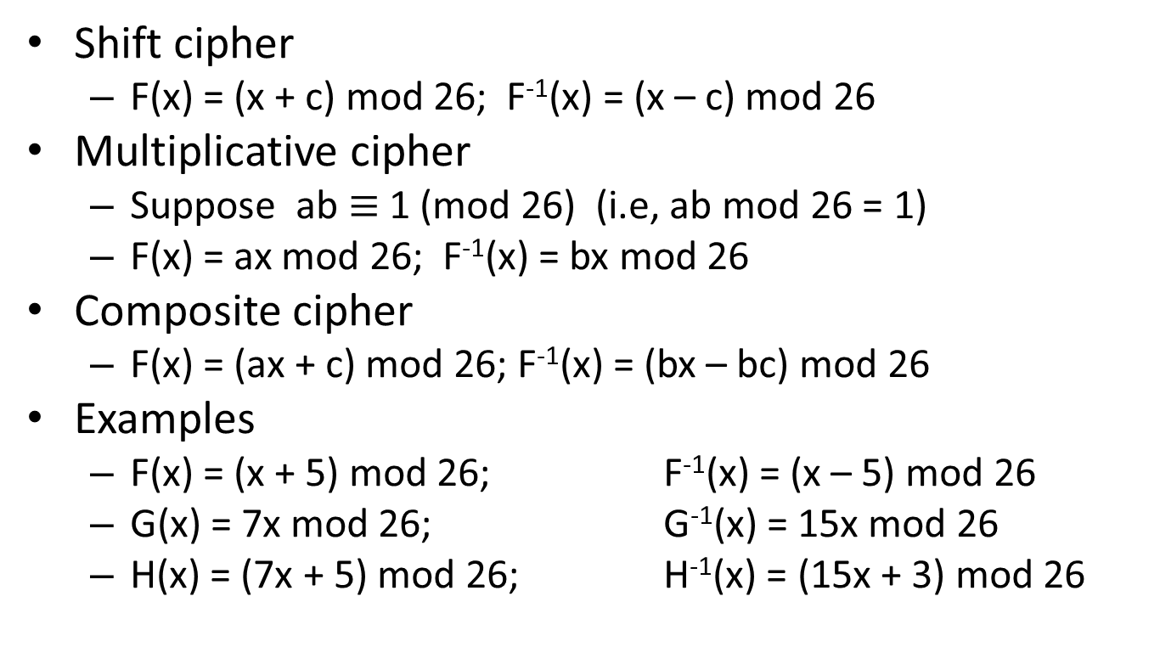
Highlights from last lecture
Shift cipher
F(x) = (x + c) mod 26; F⁻¹(x) = (x – c) mod 26
Multiplicative cipher
Suppose ab $≡$1 (mod 26) (i.e, ab mod 26 = 1)
F(x) = ax mod 26; F⁻¹(x) = bx mod 26
Composite cipher
F(x) = (ax + c) mod 26; F⁻¹(x) = (bx – bc) mod 26
Examples
F(x) = (x + 5) mod 26; F⁻¹(x) = (x – 5) mod 26
G(x) = 7x mod 26; G⁻¹(x) = 15x mod 26
H(x) = (7x + 5) mod 26; H⁻¹(x) = (15x + 3) mod 26

Slide 4
Induction Example
Prove 3 | 2^{2n} -1 for all n ≥ 0
n=0
n=1
n=2
n=3
...

Slide 5
Induction as a rule of Inference
Domain: integers ≥ 0
P(0)
∀ k (P(k) → P(k+1))
∴ ∀ n P(n)

Slide 6
How would we use the induction rule in a formal proof?
P(0)
∀ k (P(k) → P(k+1))
∴ ∀ n P(n)
1. Prove P(0)
Let k be an arbitrary integer ≥ 0
3. Assume that P(k) is true
4. ...
5. Prove P(k+1) is true
P(k) → P(k+1) Direct Proof Rule
7. ∀ k (P(k) → P(k+1)) Intro ∀ from 2-6
8. ∀ n P(n) Induction Rule 1&7

Slide 7
How would we use the induction rule in a formal proof?
P(0)
∀ k (P(k) → P(k+1))
∴ ∀ n P(n)
Base Case
1. Prove P(0)
Let k be an arbitrary integer ≥ 0
3. Assume that P(k) is true
4. ...
5. Prove P(k+1) is true
P(k) → P(k+1) Direct Proof Rule
7. ∀ k (P(k) → P(k+1)) Intro ∀ from 2-6
8. ∀ n P(n) Induction Rule 1&7
Inductive
Hypothesis
Inductive
Step
Conclusion

Slide 8
5 Steps to Inductive Proofs in English
Proof:
1. “By induction we will show that P(n) is true for every n≥0”
2. “Base Case:” Prove P(0)
3. “Inductive Hypothesis: Assume that P(k) is true for some arbitrary integer k ≥ 0”
4. “Inductive Step:” Want to prove that P(k+1) is true:
Use the goal to figure out what you need. Make sure you are using I.H. and point out where you are using it. (Don’t assume P(k+1)!)
5. “Conclusion: Result follows by induction”

Slide 9
Induction Example
Prove 3 | 2^{2n} -1 for all n ≥ 0

Slide 10
1 + 2 + 4 + … + 2^{n} = 2^{n+1} – 1 for all n ≥ 0

Slide 11
1+2+...+n = Σ i = n(n+1)/2 for all n≥1
^{n}
_{i=1}

Slide 12
Harmonic Numbers
for all 𝑛 ≥ 1

Slide 13
Cute Application: Checkerboard Tiling with Trinominos
Prove that a 2^{n} × 2^{n} checkerboard with one
square removed can be tiled with:

Slide 14
Strong Induction
P(0)
∀ k ((P(0) ∧ P(1) ∧ P(2) ∧ … ∧ P(k)) → P(k+1))
∴ ∀ n P(n)
Follows from ordinary induction applied to
Q(n) = P(0) ∧ P(1) ∧ P(2) ∧ … ∧ P(n)

Slide 15
Strong Induction English Proofs
By induction we will show that P(n) is true for every n≥0
Base Case: Prove P(0)
Inductive Hypothesis: Assume that for some arbitrary integer k ≥ 0, P(j) is true for every j from 0 to k
Inductive Step: Prove that P(k+1) is true using Inductive Hypothesis that P(j) is true for all values ≤ k
Conclusion: Result follows by induction

Slide 16
Every integer ≥ 2 is the product of primes

