Slide 1
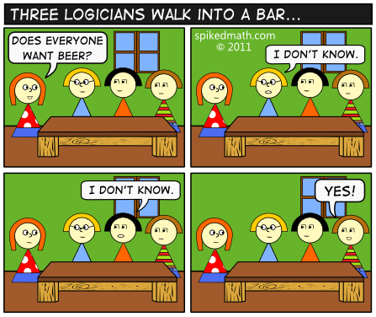
CSE 311 Foundations of Computing I
Autumn 2012, Lecture 3
Propositional Logic

Slide 2
Administrative
Course web: http://www.cs.washington.edu/311
Homework, Lecture slides, Office Hours ...
Homework:
Due Wednesday at the start of class

Slide 3
Highlights of week 1
Propositional calculus
Basic logical connectives
If pigs can whistle, then horses can fly

Slide 4
Combinational Logic Circuits
AND
OR
AND
Design a 3 input circuit to compute the majority of 3. Output 1 if at least two
inputs are 1, output 0 otherwise
What about a majority of 5 circuit?

Slide 5
Logical equivalence
Review
Terminology: A compound proposition is a
Tautology if it is always true
Contradiction if it is always false
Contingency if it can be either true or false
p ∨ ¬ p
p ⊕ p
(p → q) ∧ p
(p ∧ q) ∨ (p ∧ ¬ q) ∨ (¬ p ∧ q) ∨ (¬ p ∧ ¬ q)

Slide 6
Logical Equivalence
Review
p and q are logically equivalent iff p ↔ q is a tautology
i.e. p and q have the same truth table
The notation p ≡ q denotes p and q are logically equivalent
Example: p ≡ ¬ ¬ p
p | ¬ p | ¬ ¬ p | p ↔ ¬ ¬p

Slide 7
De Morgan’s Laws
Review
¬ (p ∧ q) ≡ ¬ p ∨ ¬ q
¬ (p ∨ q) ≡ ¬ p ∧ ¬ q
What are the negations of:
The Yankees and the Phillies will play in the World Series
It will rain today or it will snow on New Year’s Day

Slide 8
De Morgan’s Laws
Review
Example: ¬ (p ∧ q) ≡ (¬ p ∨ ¬ q)
p | q | ¬ p | ¬ q | ¬ p ∨ ¬q | p ∧ q | ¬(p ∧ q) | ¬(p ∧ q) ↔(¬ p ∨ ¬q)
T | T
T | F
F | T
F | F

Slide 9
Law of Implication
Example: (p → q) ≡ (¬ p ∨ q)
p | q | p → q | ¬ p | ¬ p ∨ q | (p → q) ↔ (¬ p ∨ q)

Slide 10
Understanding connectives
Reflect basic rules of reasoning and logic
Allow manipulation of logical formulas
Simplification
Testing for equivalence
Applications
Query optimization
Search optimization and caching
Artificial Intelligence
Program verification

Slide 11
Properties of logical connectives
Identity
Domination
Idempotent
Commutative
Associative
Distributive
Absorption
Negation
DeMorgan’s Laws
Double Negation
p ∧ T ≡ p
p ∧ F ≡ F
p ∧ p ≡ p
p ∧ q ≡ q ∧ p
(p ∧ q) ∧ r ≡ p ∧ (q ∧ r)
p ∧ (q ∨ r) ≡ (p∧ q) ∨ (p ∧ r)
p ∧ (p ∨ q) ≡ p
p ∧ ¬ p ≡ F
Textbook, 1.3, Table 6

Slide 12
Equivalences relating to implication
p → q ≡ ¬ p ∨ q
p → q ≡ ¬ q → ¬ p
p ∨ q ≡ ¬ p → q
p ∧ q ≡ ¬ (p → ¬ q)
p ↔ q ≡ (p→ q) ∧ (q → p)
p ↔ q ≡ ¬ p ↔ ¬ q
p ↔ q ≡ (p ∧ q) ∨ (¬ p ∧ ¬ q)
¬ (p ↔ q) ≡ p ↔ ¬ q

Slide 13
Logical Proofs
To show P is equivalent to Q
Apply a series of logical equivalences to subexpressions to convert P to Q
To show P is a tautology
Apply a series of logical equivalences to subexpressions to convert P to T

Slide 14
Show (p ∧ q) → (p ∨ q) is a tautology

Slide 15
Show (p → q) → r and r → (q → p) are not equivalent
All false works

