Slide 1
HW 2A in focus
anagram raga Man
computer science (&) engineering epic reticence ensuring gnome
notkin beard drank one bit
David Notkin  Autumn 2009  CSE303 Lecture 6

Slide 2
HW 2A
Understanding vs. doing – this is not a straightforward barrier to overcome, and it doesn’t happen all at once
Breaking down solutions into parts is crucial
Edsger W. Dijkstra, ACM Turing Lecture 1972, “The Humble Programmer”
Some amount of “finding things on your own” is essential; perhaps I expected too much of this for this assignment
sed and regular expressions
loops
…
Performance – not the high priority
Linear vs. quadratic (or worse) complexity of the script

Slide 3
Editors
To write and change your programs you should be using an editor – what’s the alternative?
The most common editors on Unix are pico, emacs and vi – pico is simple, emacs is (arbitrarily) complex, and vi is still loved by many old-time Unix users
You don’t need to become an expert in these, but it’s worth an investment to become capable

Slide 4
ed/sed
But you didn’t mention sed on the previous slide? Isn’t it a “stream editor”? Indeed it is.
It’s closely related to ed, a line editor from the first days of Unix
ed let you interactively edit lines, changing parts of specific lines – referred to by number and/or by content – inserting and deleting lines, etc.

Slide 5
Example ed session [Wikipedia]
a
ed is the standard Unix text editor.
This is line number two.
.
2i
.
%l
ed is the standard Unix text editor.$
$
This is line number two.$
3s/two/three/
,l
ed is the standard Unix text editor.$
$
This is line number three.$
w text
65
q
The end result is a simple text file containing the following text:
ed is the standard Unix text editor.
This is line number three.

Slide 6
sed: non-interactive ed
But sometimes you wanted to use ed-like features – in particular regular expression matching – non-interactively
That’s what sed is for – using ed-like commands on a string to do transformations that are hard or impossible to do with tr, etc.
A core feature is the use of regular expressions – these are powerful and found in other Unix tools, most noticeably grep

Slide 7
What is a regular expression?
"[a-zA-Z_\-]+@(([a-zA-Z_\-])+\.)+[a-zA-Z]{2,4}"
regular expression: a description of a pattern of text
can test whether a string matches the expression's pattern
can use a regex to search/replace characters in a string
regular expressions are powerful but can be tough to read
the above regular expression matches basic email addresses

Slide 8
Regular expressions
Appear throughout computer science, in tools, in theory, in practice
Powerful enough to be very useful; other kinds of matching require more powerful languages than regular expressions, but they are more complex
Lots of variations, but all have the same “power” – that is, they can match the same patterns, although the expressions themselves may be more or less complicated

Slide 9
egrep and regexes
egrep "[0-9]{3}-[0-9]{3}-[0-9]{4}"
command | description
egrep | extended grep; uses regexes in its search patterns; equivalent to grep -E

Slide 10
Basic regexes
The simplest regexes simply match a particular substring: "abc"
Matches any line containing "abc"
YES : "abc","abcdef","defabc",".=.abc.=.", ...
NO : "fedcba","ab c","AbC","Bash", ...

Slide 11
Wildcards and anchors
. (a dot) matches any character except \n
".oo.y" matches "Doocy", "goofy", "LooPy", ...
use \. to literally match a dot . character
^ matches the beginning of a line; $ the end
"^fi$" matches lines that consist entirely of "fi"
\< demands that pattern is the beginning of a word; \> demands that pattern is the end of a word
"\<for\>" matches lines that contain the word "for"
Notes:
egrep "\<C\>" ideas.txt
egrep "^ACT|^Scene" hamlet.txt

Slide 12
Special characters
| means or
"abc|def|g" matches lines with "abc", "def", or "g“
precedence of ^(Subject|Date): vs. ^Subject|Date:
There's no and symbol. Why not?
() are for grouping
"(Homer|Marge) Simpson" matches lines containing "Homer Simpson" or "Marge Simpson“
\ starts an escape sequence: many characters must be escaped to match them: /\$.[]()^*+?

Slide 13
Quantifiers: * + ?
* means 0 or more occurrences
"abc*" matches "ab","abc","abcc", "abccc", ...
"a(bc)*" matches "a", "abc", "abcbc", "abcbcbc", ...
"a.*a" matches "aa", "aba", "a8qa", "a!?_a", ...
+ means 1 or more occurrences
"a(bc)+" matches "abc", "abcbc", "abcbcbc", ...
"Goo+gle" matches "Google", "Gooogle", "Goooogle", ...
? means 0 or 1 occurrences
"Martina?" matches lines with "Martin", "Martina"
"Dan(iel)?" matches lines with "Dan" or "Daniel"
Notes:
egrep "\^_*\^" chat.txt

Slide 14
More quantifiers
{min,max} means between min and max occurrences
"a(bc){2,4}" matches "abcbc", "abcbcbc", or "abcbcbcbc"
min or max may be omitted to specify any number
"{2,}" means 2 or more
"{,6}" means up to 6
"{3}" means exactly 3

Slide 15
Character sets
[ ] group characters into a character set; will match any single character from the set
"[bcd]art" matches strings containing "bart", "cart", and "dart"
equivalent to "(b|c|d)art"
Notes:
egrep "[ABCDF][+\-]?" 143.txt

Slide 16
Character ranges
Specify a range of characters with -
"[a-z]" matches any lowercase letter
"[a-zA-Z0-9]" matches any lower- or uppercase letter or digit
an initial ^ inside a character set negates it
"[^abcd]" matches any character other than a, b, c, d
inside a character set, - must be escaped to be matched
"[+\-]?[0-9]+" matches optional + or -, followed by at least one digit
Notes:
egrep "[0-9]{3}-[0-9]{3}-[0-9]{4}" faculty.html

Slide 17
sed
command | description
sed | stream editor; performs regex-based replacements and alterations on input
Usage:
sed -r "s/REGEX/TEXT/g" filename
substitutes (replaces) occurrence(s) of regex with the given text
if filename is omitted, reads from standard input
sed has other uses, but most can be emulated with substitutions
Example (replaces all occurrences of 143 with 303):
sed -r "s/143/303/g" lecturenotes.txt

Slide 18
more about sed
sed is line-oriented; processes input a line at a time
-r option makes regexes work better
recognizes ( ) , [ ] , * , + the “right” way, etc.
g flag after last / matches all occurrences
special characters must be escaped to match them literally
sed -r "s/http:\/\//https:\/\//g" urls.txt
sed can use other delimiters besides / ... whatever follows s
find /usr | sed -r "s#/usr/bin#/home/billy#g"

Slide 19
Back-references
every span of text captured by () is given an internal number
you can use \number to use the captured text in the replacement
\0 is the overall pattern
\1 is the first parenthetical capture
...
Example: swap last names with first names
sed -r "s/([^ ]*), ([^ ]*)/\2 \1/g"
Notes:
sed -r "s/([0-9]{3})-([0-9]{3})-([0-9]{4})/(\1) \2.\3/g" facnames.txt

Slide 20
loops
while read line; do
echo $line
done

Slide 21
Debugging
“Debugging is important, especially since the shell is so sensitive to details. I recommend two things: (a) trying your commands individually in the command-line as you're trying to build your shell scripts; and (b) assigning and echoing ‘unnecessary’ variables in your scripts that can be used to help see what's happening step-by-step.”
When things don’t work, what do you do?

Slide 22
Performance
I'm not worried about performance (within a little bit of reason) on 2A. Bill Wulf, who served as president of the National Academy of Engineering for over a decade, once said something like: “More mistakes are made by premature optimization than for any other reason including sheer ignorance.”
OK, maybe it doesn’t work right, but at least it’s really fast.
Well, if it doesn’t have to work right, I can make it even faster!

Slide 23
Algorithmic complexity
When dealing with a lot of data, what is usually most important about performance is the underlying algorithmic complexity
Very roughly, how many times do you need to touch each data item
Examples
Finding a number in an unsorted list: linear search
Finding a number in a sorted list: linear or binary search
Sorting a list: O(N²) vs. O(N log N)
HW2: if you touch every entry in the dictionary many times for each input string, that might be a problem – there are 479,829 entries

Slide 24
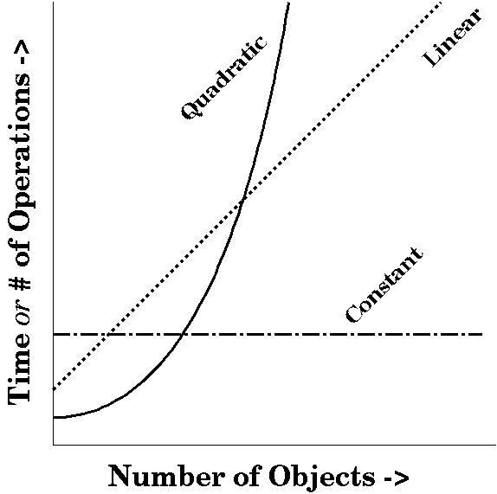
http://www.cs.bath.ac.uk/~jjb/here/CM10135/CM10135_Lecture3_2004.html

Slide 25
Wednesday
I’d like to spend about 15 minutes having about three students present their solution to 2A to the class
I’ll pick some varying approaches
Please send me email if you are willing to present your solution

Slide 26
Questions?

