Slide 1
The Invisible Trail: Third-Party Tracking on the Web
Franziska Roesner
Assistant Professor
Computer Science & Engineering
University of Washington

Slide 2
The Invisible Trail: Third-Party Tracking on the Web
Franziska Roesner
Assistant Professor
Computer Science & Engineering
University of Washington
+ many collaborators!

Slide 3
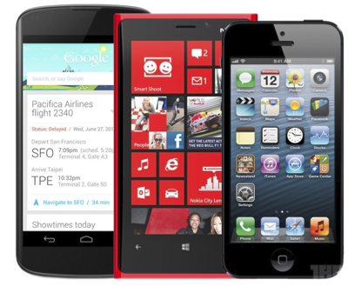
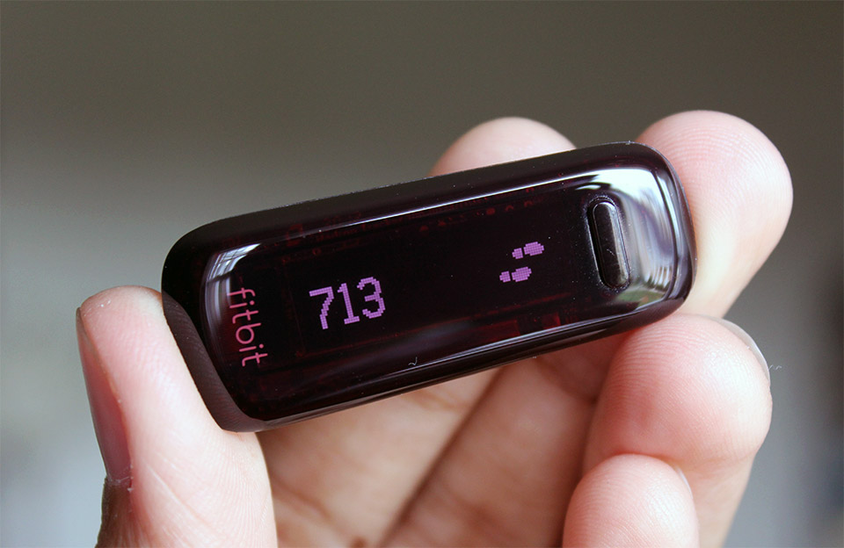
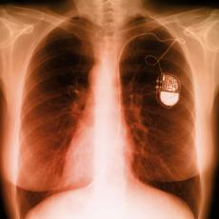
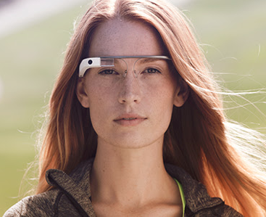
New technologies bring new benefits…
… but also new risks.

Slide 4
Security & Privacy Research
Goal: Improve security & privacy of technologies.
Security mindset: Challenge assumptions, think like an attacker.
Study existing technologies: attack and measure.
Design and build defenses and new technologies.

Slide 5
S&P Challenges Arise Everywhere
Today’s talk: web privacy
Who tracks you as you browse, and how?

Slide 6
Outline
Understanding web tracking
Measuring web tracking
Defenses

Slide 7
Outline
Understanding web tracking
Measuring web tracking
Defenses

Slide 8
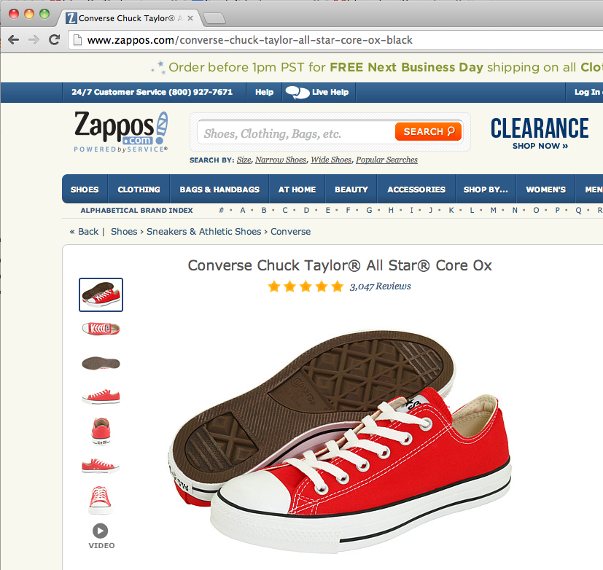
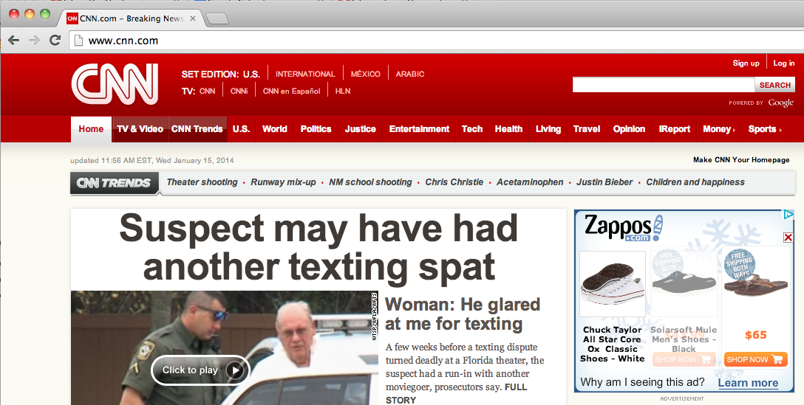
Ads That Follow You
Advertisers (and others) track your browsing behaviors for the purposes of targeted ads, website analytics, and personalized content.

Slide 9
Third-Party Web Tracking
Browsing profile for user 123:
cnn.com
theonion.com
adult-site.com
political-site.com
These ads allow criteo.com to link your visits between sites, even if you never click on the ads.

Slide 10
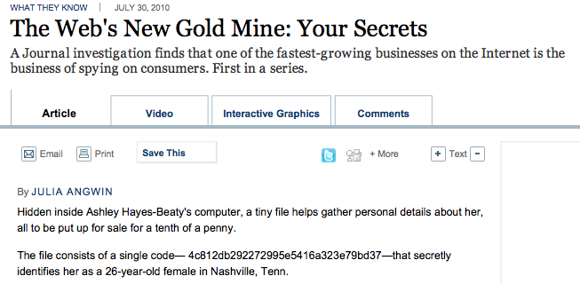
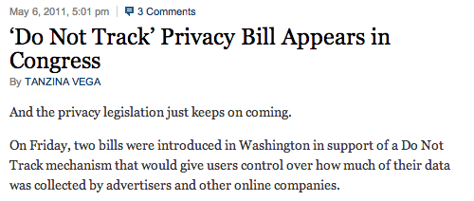
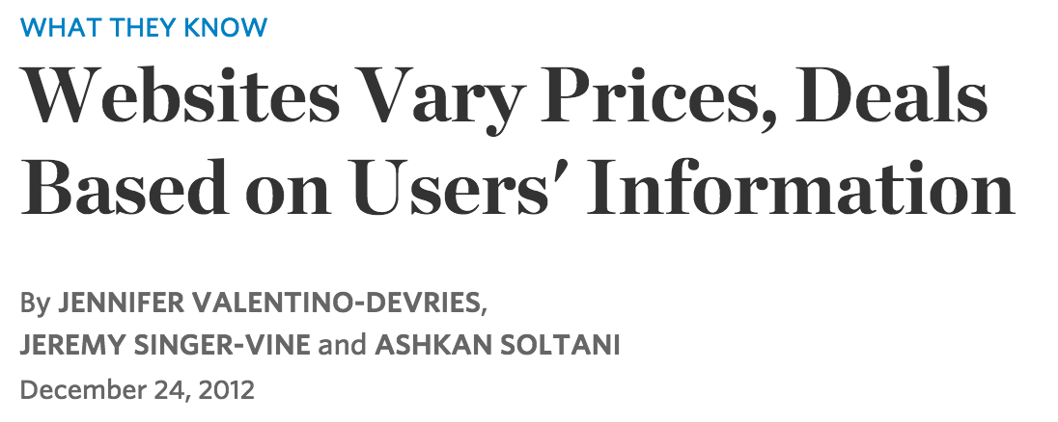
Concerns About Privacy

Slide 11
Understanding the Tracking Ecosystem
In 2011, much discussion about tracking, but limited understanding of how it actually works.
Our Goal: systematically study web tracking ecosystem to inform policy and defenses.
Challenges:
No agreement on definition of tracking.
No automated way to detect trackers. (State of the art: blacklists)

Slide 12
Our Approach
ANALYZE
Reverse-engineer trackers’ methods.
Develop tracking taxonomy.
MEASURE
(3) Build automated detection tool.
(4) Measure prevalence in the wild.
(5) Evaluate existing defenses.
BUILD
(6) Develop new defenses.

Slide 13
Web 101: Cookies
Websites store info in cookies in the browser.
Only accessible to the site that set them.
Automatically included with web requests.
cookie: id=123
theonion.com server
cookie: id=123
cookie: id=456
cnn.com server
cookie: id=456

Slide 14
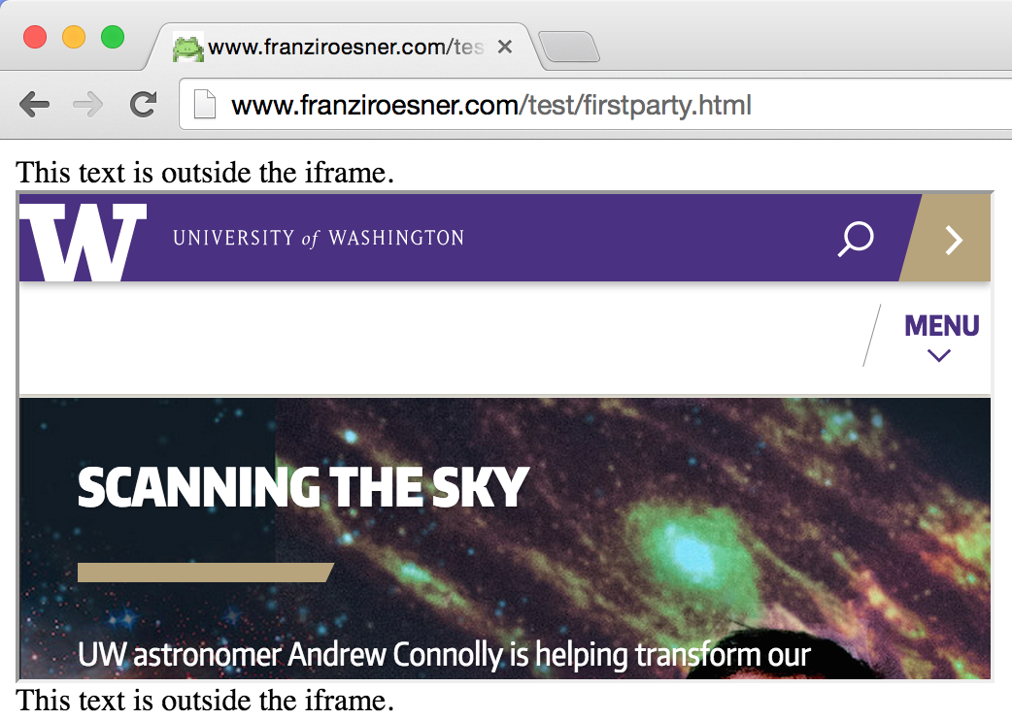
Web 101: First and Third Parties
Iframes allow one website to include another:
<iframe src=“www.washington.edu”> </iframe>
“first party”
“third party”

Slide 15
Anonymous Tracking
Trackers included in other sites use third-party cookies containing unique identifiers to create browsing profiles.
cookie: id=789
criteo.com
user 789:
theonion.com, cnn.com, adult-site.com, …
cookie: id=789

Slide 16
Basic Tracking Mechanisms
Tracking requires:
re-identifying a user.
communicating id + visited site back to tracker.

Slide 17
Our Tracking Taxonomy
[NSDI ’12]
In the wild, tracking is much more complicated.
(1) Trackers don’t just use cookies.
Flash cookies, HTML5 LocalStorage, etc.
(2) Trackers exhibit different behaviors.
Within-site vs. cross-site.
Anonymous vs. non-anonymous.
Specific behavior types: analytics, vanilla, forced, referred, personal.

Slide 18
Other Trackers?
“Personal” Trackers

Slide 19
Personal Tracking
cookie: id=franzi.roesner
cookie: id=franzi.roesner
facebook.com
user franzi.roesner:
theonion.com, cnn.com, adult-site.com, …
cookie: id=franzi.roesner
Tracking is not anonymous (linked to accounts).
Users directly visit tracker’s site → evades some defenses.

Slide 20
Outline
Understanding web tracking
Measuring web tracking
Defenses

Slide 21
Measurement Study
[NSDI ’12]
Questions:
How prevalent is tracking (of different types)?
How much of a user’s browsing history is captured?
How effective are defenses?
Approach: Build tool to automatically crawl web, detect and categorize trackers based on our taxonomy.
TrackingObserver: tracking detection platform
http://trackingobserver.cs.washington.edu

Slide 22
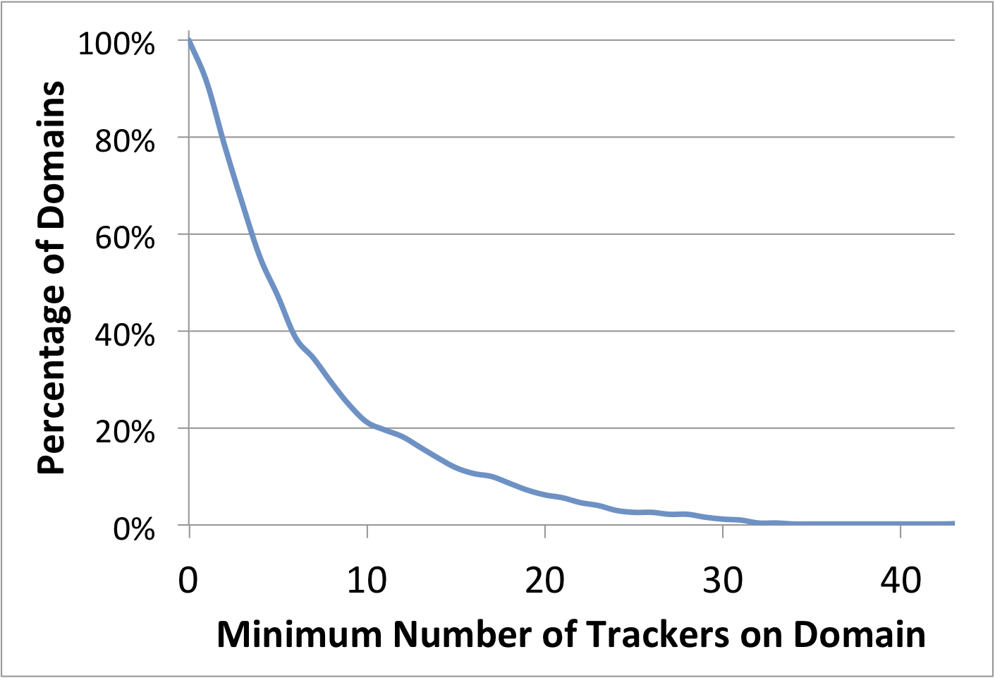
How prevalent is tracking?
524 unique trackers on Alexa top 500 websites (homepages + 4 links)
457 domains (91%) embed at least one tracker.
(97% of those include at least one cross-site tracker.)
50% of domains embed between 4 and 5 trackers.
One domain includes
43 trackers.

Slide 23
How prevalent is tracking?
524 unique trackers on Alexa top 500 websites (homepages + 4 links)
457 domains (91%) embed at least one tracker.
(97% of those include at least one cross-site tracker.)
Tracking is increasing!
Unique trackers on the top 500 websites (homepages only):
2011: 383
2013: 409
2015: 512
50% of domains embed between 4 and 5 trackers.
One domain includes
43 trackers.

Slide 24
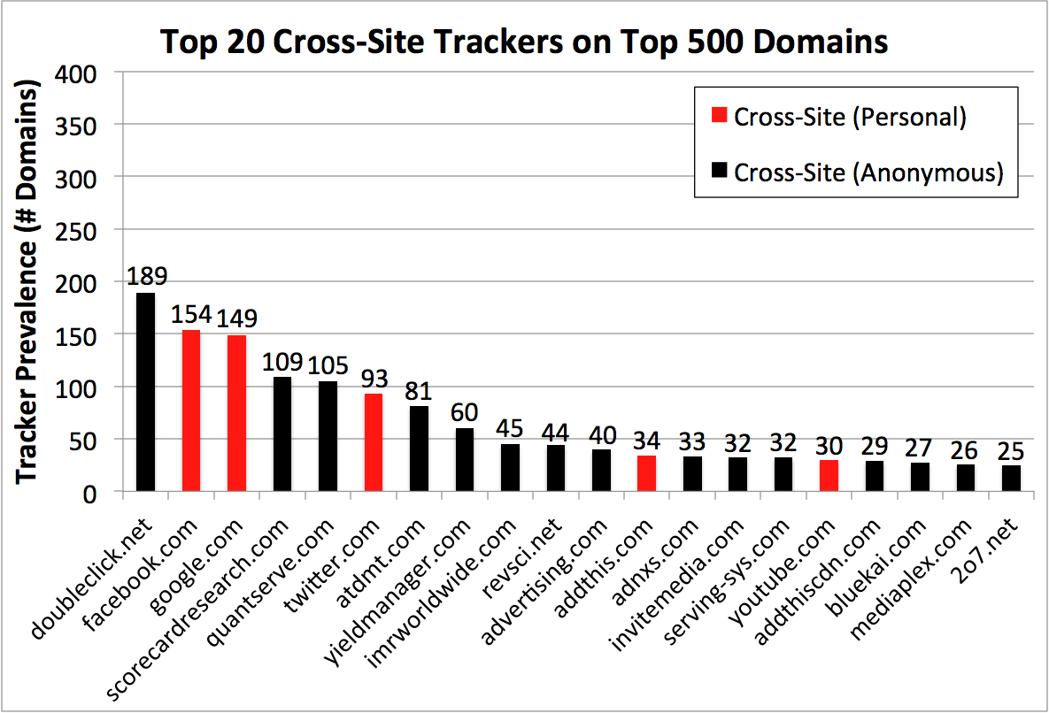
Who/what are the top trackers?
(“Vanilla” and others)

Slide 25
How are users affected?
Question: How much of a real user’s browsing history can top trackers capture?
Measurement challenges:
Privacy concerns.
Users may not browse realistically while monitored.
Insight: AOL search logs (released in 2006) represent real user behaviors.

Slide 26
How are users affected?
Idea: Use AOL search logs to create 30 hypothetical browsing histories.
300 unique queries per user → top search hits.
Trackers can capture a large fraction:
Doubleclick: Avg 39% (Max 66%)
Facebook: Avg 23% (Max 45%)
Google: Avg 21% (Max 61%)

Slide 27
How are users affected?
Idea: Use AOL search logs to create hypothetical browsing histories.
300 unique queries per user → top search hits.
Trackers can capture a large fraction:
Doubleclick: Avg 39% (Max 66%)
Facebook: Avg 23% (Max 45%)
Google: Avg 21% (Max 61%)

Slide 28
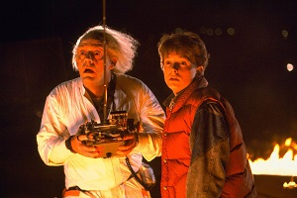
How has this changed over time?
[USENIX Security ’16]
The web has existed for a while now…
What about tracking before 2011? (our first study)
What about tracking before 2009? (first academic study)
Solution: time travel!

Slide 29
The Wayback Machine to the Rescue
Time travel for web tracking: http://trackingexcavator.cs.washington.edu

Slide 30
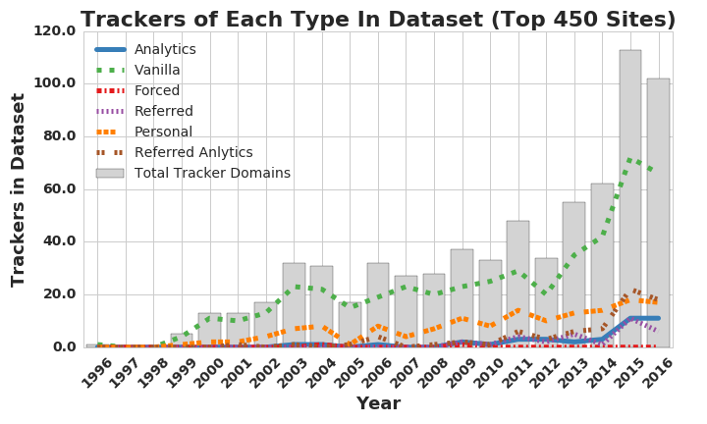
1996-2016: More & More Tracking
More trackers of more types

Slide 31
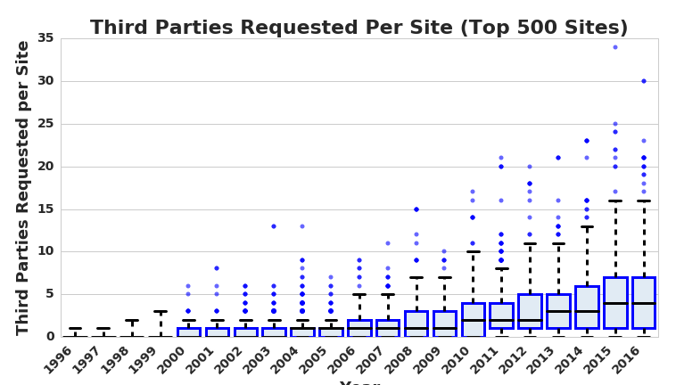
1996-2016: More & More Tracking
More trackers of more types, more per site

Slide 32
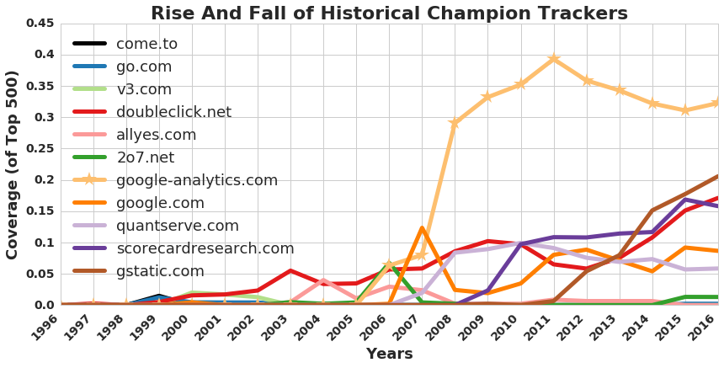
1996-2016: More & More Tracking
More trackers of more types, more per site, more coverage

Slide 33
Outline
Understanding web tracking
Measuring web tracking
Defenses

Slide 34
Defenses to Reduce Tracking
Do Not Track proposal?
Do Not Track is not a technical defense:
trackers must honor the request.

Slide 35
Defenses to Reduce Tracking
Do Not Track proposal?
Private browsing mode?
Private browsing mode protects against local, not network, attackers.

Slide 36
Defenses to Reduce Tracking
Do Not Track proposal?
Private browsing mode?
Third-party cookie blocking?
www.bar.com
Bar’s Server
www.bar.com’s
cookie (1st party)
www.foo.com
Foo’s Server
www.foo.com’s
cookie (3rd party)

Slide 37
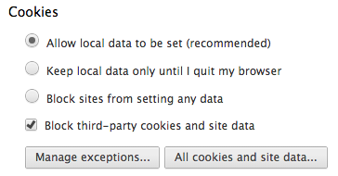
Quirks of 3rd Party Cookie Blocking
So if a third-party cookie is somehow set, it can be used.
How to get a cookie set?
One way: be a first party.
In some browsers, this option means third-party cookies cannot be set, but they CAN be sent.
etc.

Slide 38
What 3rd Party Cookie Blocking Misses

Slide 39
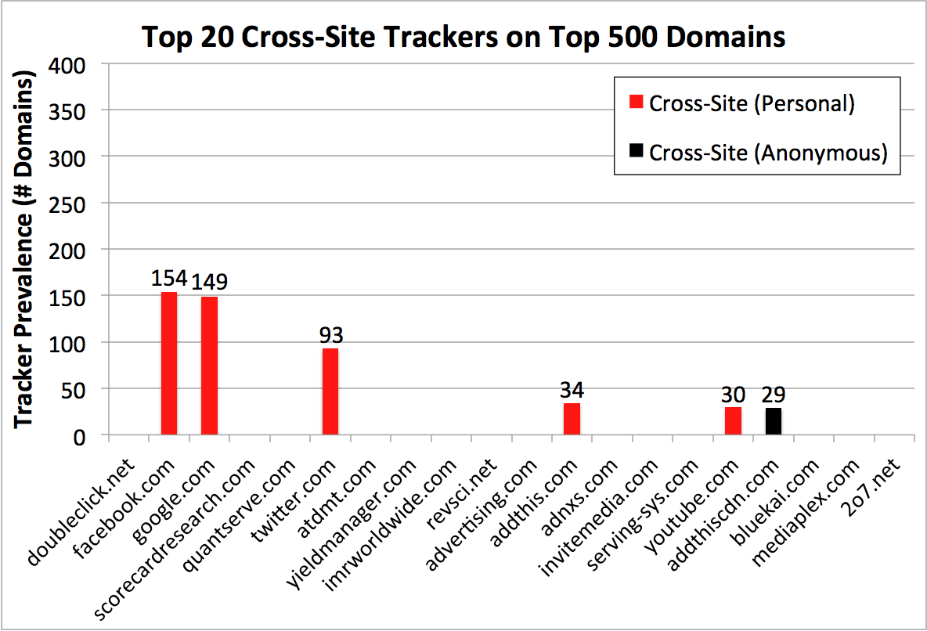
What 3rd Party Cookie Blocking Misses
Defenses for personal trackers (red bars) were inadequate.

Slide 40
Our Defense: ShareMeNot
Prior defenses for personal trackers: ineffective or completely removed social media buttons.
Our defense:
ShareMeNot (for Chrome/Firefox) protects against tracking without compromising button functionality.
Blocks requests to load buttons, replaces with local versions. On click, shares to social media as expected.
Techniques adopted by Ghostery and the EFF.
http://sharemenot.cs.washington.edu

Slide 41
Defenses to Reduce Tracking
Do Not Track proposal?
Private browsing mode?
Third-party cookie blocking?
Browser add-ons?
None are perfect, so use a combination:

Slide 42
Recommended Browser Add-ons
Privacy Badger (EFF) https://www.eff.org/privacybadger
https://www.mozilla.org/en-US/lightbeam/
https://www.ghostery.com/

Slide 43
Summary
Web tracking is complicated and ubiquitous.
We systematically developed a tracking taxonomy and performed an extensive measurement study.
Understanding the tracking ecosystem helps us design new tools and defenses.
Thanks to my collaborators! Yoshi Kohno, Ada Lerner, Chris Rovillos, Alisha Saxena, Anna Kornfeld Simpson, David Wetherall

Slide 44
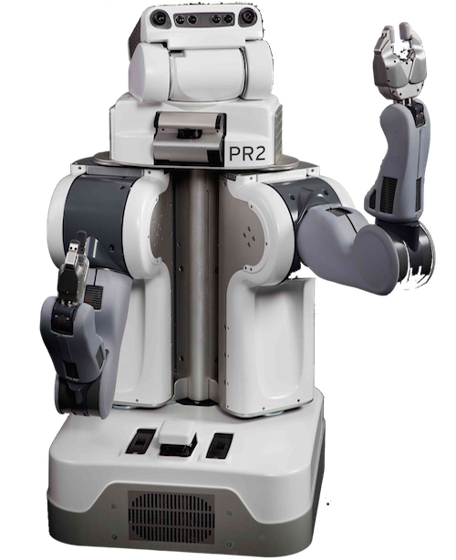
www.franziroesner.com
franzi@cs.washington.edu
Research Overview: Improving Security & Privacy
Analyze existing systems.
e.g.: web tracking, automobiles, QR codes.
Build new systems.
e.g.: web, OS, smartphones, UI toolkits, usable encrypted email.
Understand mental models.
e.g.: smartphone permissions,
social media, journalists, lawyers.
Anticipate future technologies.
e.g.: telerobotics, wearables, augmented reality, IoT.

