Slide 1



CSE 163
Inheritance
Adrian Salguero Spring 2026 💭Icebreaker (discuss with neighbors): ‘
What is your favorite food spot on the Ave?
Add to our Slido!
slido.com
#cse163

Slide 2
Announcements
Take Home Assessment 2: Networks due Thursday, April 23rd at 11:59pm!
Attend office hours if you are stuck or need help
Lesson 7 Canvas Quiz due tonight at 11:59pm!
Checkpoint 2 due Monday, April 20th at 11:59pm!
THA 1 Peer Reviews due on tonight at 11:59pm!
Instructions
“I Like”, “I Wish”, and “What If”
You are only assessed by the review you give
If you are assigned a blank notebook, please write that it was blank on your response

Slide 3
Lambdas
Lambdas allow us to define functions within the body of our code!
def get_dog_name(d):
return d.get_name()
sorted(dogs, key=get_dog_name)
sorted(dogs, key=lambda d: d.get_name())

Slide 4
What do we have to write this pattern?
def main():
print('Hello world')
if __name__ == '__main__':
main()
If you don’t write this pattern, your main method will run if you import the file!
What are some potential downsides of this happening?

Slide 5
Special Methods
Syntax | Method
x < y | x.__lt__(y)
x > y | x.__gt__(y)
x == y | x.__eq__(y)
x <= y | x.__le__(y)
x >= y | x.__ge__(y)
print(x) | print(x.__str__())
x[i] | x.__getitem__(i)
x[i] = v | x.__setitem__(i, v)

Slide 6
Inheritance
class Dog:
def __init__(self, name: str) -> None:
self._name: str = name
def bark(self) -> None:
print(self._name + ': Woof')
class ServiceDog(Dog):
def __init__(self, name: str, service: str) -> None:
super().__init__(name)
self._service: str = service
def bark(self) -> None:
print(self._name + ‘: *alert bark*')

Slide 7
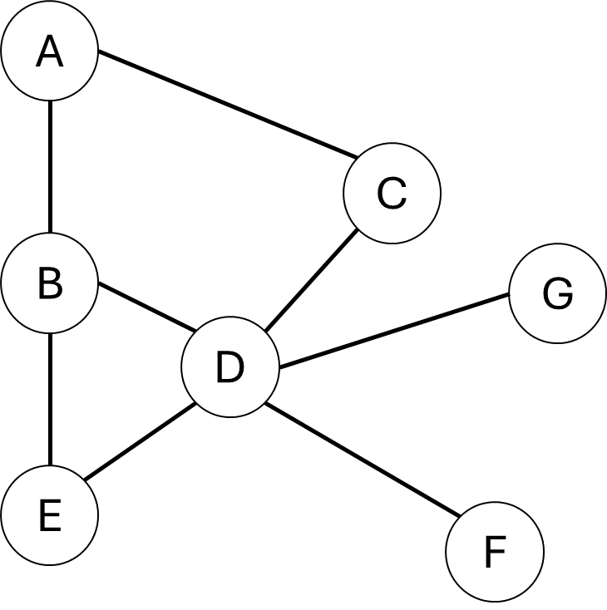
Graphs
Nodes + Edges
Nodes represent data in the graph
Edges represent relationships between the data nodes
Suppose the diagram on the right represents a “social network”
B’s friends: A, D, E
C’s friends: A, D
B + C’s mutual friends: A, D
What else can graphs represent?

Slide 8
THA 2 Tips
Start early!
graphs.py
Edges and nodes are in a list for convenience
analysis.py
Read through the start code thoroughly (come to office hours if you have questions)
Consider what different data structures represent
The two recommendation algorithms will be fairly similar
Creative Component
Refer to the (node, dict) syntax for adding node attributes

Slide 9
Group Work: Best Practices
When working with a new group for the first time:
Introduce yourself!
If possible, angle one of your screens so that everyone can see and discuss together
Be respectful of each other and allow everyone to speak
Tips:
Start with making sure that everyone agrees to work on the same problem
Allow everyone to contribute or a chance to ask questions.
Ask if everyone agrees and periodically ask each other questions.
Call TAs or Adrian over if you need any help.
Don’t sit in silence.

