Slide 1


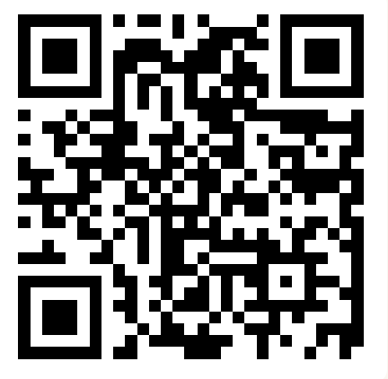
CSE 163
More Objects
Adrian Salguero
Spring 2026
💭Icebreaker (discuss with neighbors): ‘
Which fictional world would you like to live in?
Add to our Slido!
slido.com
#cse163

Slide 2
Announcements
Take Home Assessment 2: Networks due Thursday, April 23rd at 11:59pm!
Lesson 6 Canvas Quiz due tonight at 11:59pm!
Reading Assignment 2 due tonight at 11:59pm!
THA 1 Peer Reviews due on Gradescope Wednesday, April 15th at 11:59pm!
  Instructions
  “I Like”, “I Wish”, and “What If”
  You are only assessed by the review you give
  If you are assigned a blank notebook, please write that it was blank on your response

Slide 3
Class
A class lets you define a new object by specifying what state and behaviors it has
A class is a blueprint that we use to construct instances of the object
class SpiderFolk:
def __init__(self, name: str) -> None:
self.name: str = name
def thwip(self) -> None:
print(self.name + ‘: Thwip!')
A class definition
An initializer that sets fields (state)
A method (behavior)

Slide 4
Private in Python
Python has no way to actually enforce this, but by convention people don’t access things that start with “--”
class Dog:
def __init__(self, name: str) -> None:
self._name: str = name
def bark(self) -> None:
print(self._name + ': Woof')

Slide 5
Private fields/attributes and methods
Both fields (or attributes) and methods can be private if you don’t want them access or changed by the user
class SpiderFolk:
def __init__(self, name: str) -> None:
self._name: str = name
def _secret_identity(self) -> str:
if ‘spider’ not in self._name.lower():
return “Spider-Man!”
else:
return “who?”
def get_me_pictures(self, count: int) -> None:
print(f’{count} pictures of {self._secret_identity()}’)

Slide 6
“Setter” and “Getter” Methods
“Getter” methods return values, like fields or quick manipulations
“Setter” methods update fields or create new values
class SpiderFolk:
def __init__(self, name: str) -> None:
self._name: str = name
def get_name(self) -> str:
return self._name # a getter method
def rename(self, new_name: str) -> None:
self._name = new_name + “(renamed)” # a setter method

Slide 7
Default Parameters
You can use default parameters like you would before
Be careful when using objects as default values, can have negative side-effects
def append_to(element: int,
to: list[int] = []) -> list[int]:
to.append(element)
return to
my_list = append_to(12)
print(my_list)
my_other_list = append_to(42)
print(my_other_list)
Python Tutor

Slide 8
Default Parameters Done Correctly!
Do not use an object as a default parameter, instead use None
# Option 1
def append_to(element: int,
to: list[int] | None = None) -> list[int]:
if to is None:
to = []
to.append(element)
return to
# Option 2
def append_to(element, to=None):
to = [] if to is None else to
to.append(element)
return to

Slide 9
Group Work: Best Practices
When working with a new group for the first time:
  Introduce yourself!
  If possible, angle one of your screens so that everyone can see and discuss together
  Be respectful of each other and allow everyone to speak
Tips:
  Start with making sure that everyone agrees to work on the same problem
  Allow everyone to contribute or a chance to ask questions.
  Ask if everyone agrees and periodically ask each other questions.
  Call TAs or Adrian over if you need any help.
  Don’t sit in silence.

