Slide 1


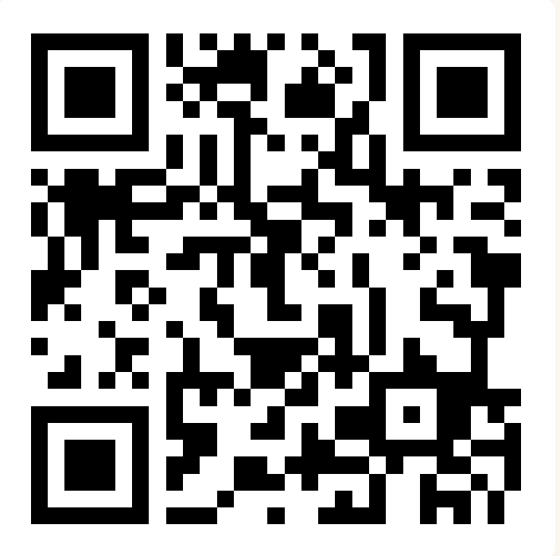
CSE 163
Tuples, Sets, and Dictionaries
Adrian Salguero Spring 2026 💭Icebreaker (discuss with neighbors): ‘
What is your favorite activity to do to relax?
Add to our Slido!
slido.com
#cse163

Slide 2
Announcements
Take Home Assessment 1: Processing due on Gradescope tomorrow at 11:59pm!
Lesson 4 Canvas Quiz due tonight at 11:59pm!
Reading Assignment 2 will be released tomorrow, it is due Monday April 13th at 11:59pm
Section tomorrow!

Slide 3
Grading FAQ
THA 1 Grading
Technical Component is staff-graded on correctness
Creative Component is staff-graded on completeness
Peer review assignments will go out on Friday (April 10th) and be due on Wednesday (April 15)
“I Like, I Wish, What If”
Initial grades expected by next Thursday (April 16)
Resubmissions
“Late THA 1 period” opens on Friday (April 10th) and closes on Tuesday (April 14th)
The later you make an initial submission, the later you will get initial feedback
Submissions made during this time will receive feedback by the following Thursday (April 23)
ONLY TECHNICAL COMPONENT will be assessed in resubmissions

Slide 4
Final Project/Portfolio
Choose which option you want by Thursday, April 30th (Project Part 1 deadline)
Projects can be done with up to 2 partners; portfolios are solo
Partners need not be in your section
Cannot switch once you’ve chosen your option!
Projects are new analyses using existing datasets
Portfolios are “resubmissions” and polishing of quarter-long creative work.

Slide 5
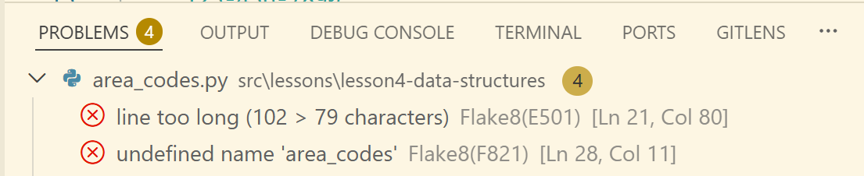
Flake8
Flake8 is the linter we use for this course. You can find flake8 errors in the Problems tab of VS Code:
We will spend some time in class showing how to use flake8 on VS Code and JupyterHub

Slide 6
Lesson Recap
List
Has indices, this can be added/removed at any place
Set
No duplicates, fast membership queries, no order
Dictionary
Key-value pairs. Keys are unique, values are not.
Tuple
“Immutable list”, used for multiple returns, can “unpack”

Slide 7
List Comprehensions
squares = [
for i in range(1, 11)
if i % 2 == 0
i ** 2
squares.append(i ** 2)

Slide 8
List Comprehensions
i ** 2
for i in range(1, 11)
if i % 2 == 0
squares = [
]
squares.append(i ** 2)

Slide 9
List Comprehensions
squares = [
4) Put it all in a list
squares.append(i ** 2)
i ** 2
3) Expression with loop variable
for i in range(1, 11)
1) What are you looping over?
if i % 2 == 0
2) [Optional] Skip if this is false
]

Slide 10
List Comprehensions
expression 🡪 iteration 🡪 condition
i ** 2
for i in range(1, 11)
if i % 2 == 0
squares = [
]
squares.append(i ** 2)
squares = [
]
for i in range(1, 11)
iteration
condition
expression
:
if i % 2 == 0
:
i ** 2
squares.append(i ** 2)

Slide 11
Tuples
A tuple is a lot like a list, but it is immutable!
t = (1, "hello", 3.4)
print(t) # (1, 'hello', 3.4)
print(t[0]) # 1
t[1] = 'goodbye' # Error!

Slide 12
Unpacking Tuples
We can “unpack” tuples to get their contents
The number of variables MUST match the number of tuple elements!
t = (1, "hello", 3.4)
# Good!
a, b, c = t
# Not good!
a, b = t
a, b, c, d = t

Slide 13
Set
Data structure highly optimized for membership queuries
“if x in set” is very fast!
Acts a lot like a list, BUT
Does not allow indexing operations
Does not allow duplicates
set() | Makes an empty set
s.add(x) | Adds x to s
s.remove(x) | Removes x from s
s.clear() | Removes all values from s

Slide 14
Dictionary
Python has a data structure called a dictionary that allows us to use arbitrary data as keys
Keys are unique, but values need not be!
We will see some more advanced uses of dictionaries later in the course!
d = {}
d['a'] = 1
d['b'] = 2
print(d) # {'a': 1, 'b': 2}

Slide 15
Type Annotations
Sometimes our data structures will have many different data types in it!
strings: list[str] = [‘by’, ‘any’, ‘other’, ‘name’]
numbers: dict[str, float] = {“Act 2”: 2.24}
Careful about how you use pipes ( | ) and commas ( , )
list[str | int] means a list of strings, ints, or both
list[str, int] means a list of strings AND ints
This also applies to parameters and returns!
def mystery(a: bool | int, b: int) -> set[str, float]:

Slide 16
Group Work: Best Practices
When working with a new group for the first time:
Introduce yourself!
If possible, angle one of your screens so that everyone can see and discuss together
Be respectful of each other and allow everyone to speak
Tips:
Start with making sure that everyone agrees to work on the same problem
Allow everyone to contribute or a chance to ask questions.
Ask if everyone agrees and periodically ask each other questions.
Call TAs or Adrian over if you need any help.
Don’t sit in silence.

