Slide 1


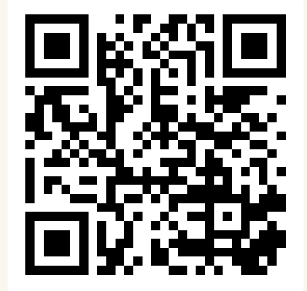
CSE 163
Lists and Files
Adrian Salguero Spring 2026 💭Icebreaker (discuss with neighbors): ‘
How was your first week of Spring Quarter?🌸
Add to our Slido!
slido.com
#cse163

Slide 2
Announcements
Checkpoint 1 due tonight at 11:59pm on Gradescope
Lesson 3 Canvas Quiz due tonight at 11:59pm!
Take Home Assessment 1: Processing due on Gradescope by Thursday, April 9th at 11:59pm!
Attend office hours if you are stuck!

Slide 3
Lesson Recap: Lists and Files
Lists
Introduced function to alter lists
Lists are mutable! Strings are not!
The in keyword
File Processing: Line vs. Token Processing
File Paths
Absolute vs. relative paths
Make sure to use relative paths in Gradescope submissions!

Slide 4
Strings vs. Lists
s = 'hello world'
# Length
len(s) # 11
# Indexing
s[1] # 'e'
s[len(s) - 1] # 'd'
# Looping
for i in range(len(s)):
print(s[i])
for c in s:
print(c)
l = ['dog', 'says', 'woof']
# Length
len(l) # 3
# Indexing
l[1] # 'says'
l[len(l) - 1] # 'woof'
# Looping
for i in range(len(l)):
print(l[i])
for word in l:
print(word)

Slide 5
Advanced Lists
List methods can modify the contents of the list. Lists are mutable!
Can use the in keyword to see if a list contains a value
words = ['I', 'love', 'dogs']
if 'dogs' in words:
print('Found it')
if 'cats' not in words:
print('Not there')

Slide 6
File Processing
Line-by-line processing
Token processing
with open(file_name) as f:
lines = f.readlines()
for line in lines:
# do something with line
with open(file_name) as f:
lines = f.readlines()
for line in lines:
tokens = line.split()
for token in tokens:
# do something with token
When would you use one over the the other?

Slide 7
Group Work: Best Practices
When working with a new group for the first time:
Introduce yourself!
If possible, angle one of your screens so that everyone can see and discuss together
Be respectful of each other and allow everyone to speak
Tips:
Start with making sure that everyone agrees to work on the same problem
Allow everyone to contribute or a chance to ask questions.
Ask if everyone agrees and periodically ask each other questions.
Call TAs or Adrian over if you need any help.
Don’t sit in silence.

