Slide 1



CSE 163
Victory Lap & Next Steps
Adrian Salguero
Spring 2026
💭Icebreaker (discuss with neighbors):
How are you planning on explore data programming after this course?
slido.com
#cse163

Slide 2
Announcements
Lesson 28 Quiz due tonight at 11:59pm
  Your final lesson quiz!
Project Part 3 (Final Deliverables) due June 5th at 11:59pm on Gradescope!
Project Part 5 (Peer Feedback) due June 7th at 11:59pm on Gradescope
Presentations tomorrow during Section and Friday’s lecture (June 5th, if needed)
  Make sure you have signed up for a presentation time
  Order will be determined by last time modified!
Resubmission Cycle 7 due Sunday, June 7th at 11:59pm
  Only THA 5 technical component is eligible
Resubmission Cycle 8 due Sunday, June 7th at 11:59pm
  Any technical OR creative component from any THA
Final Reflection on Monday, June 8th at 8:30am in KNE 220

Slide 3
You did it!!

Slide 4
Class Overview
More advanced programming concepts than CSE 122 or CSE 160 including how to write bigger programs with multiple classes and modules.
How to work with different types of data: tabular, text, images, geo-spatial, etc.
Ecosystem of data science tools including Jupyter Notebook and various data science libraries including scikit image, scikit-learn, and pandas data frames.
Basic concepts related to code complexity, efficiency of different types of data structures, and memory management.
Foundations of data literacy and technical communication for critical and conscientious data science

Slide 5
Competency 1
More advanced programming concepts than CSE 122 or CSE 160 including how to write bigger programs with multiple classes and modules.
Testing code
Data structures: Lists, sets, dictionaries, tuples
Classes and Objects
Modules and Packages
Anonymous functions (lambdas) and functional programming

Slide 6
Competency 2
How to work with different types of data: tabular, text, images, geo-spatial, etc.
Tabular (table)
Unstructured text
Geo-spatial
Images
Joining data from multiple sources

Slide 7
Competency 3
Ecosystem of data science tools including Jupyter Notebook and various data science libraries including scikit image, scikit-learn, and pandas data frames.
Jupyter Notebooks
Pandas
Seaborn / Matplotlib
Scikit-learn
Geopandas
Numpy
Imageio

Slide 8
Competency 4
Basic concepts related to code complexity, efficiency of different types of data structures, and memory management.
Algorithmic efficiency
Python language quirks
Computer memory, objects, and references
Terminal

Slide 9
Competency 5
Foundations of data literacy and technical communication for critical and conscientious data science
Reading assignments
Peer reviews in creative components
Write ups and reflection posts
Ethics discussion and case studies
Humanistic computing
Final Project/Portfolio
Final Reflection (on Monday!)

Slide 10
Data Programming’s Interface with Data Science
While this course is focused as a course in programming, we have a close relationship with the analysis done in data science. We have explored how to support data science in many of our discussions of programming and its impact.
Principles of data visualization
Data literacy and communication
Machine learning
  Neural networks
  Convolutions
Positive/Negative impacts of data science and society
Privacy
Algorithmic Fairness
Statistics, hypotheses, and research

Slide 11
What Next?

Slide 12
Future Classes
Machine Learning
  CSE/STAT 416 - Intro to Machine Learning
  STAT 435 - Intro to Statistical Machine Learning
  INFO 371 - Advanced Methods in Data Sciecne
Societal Implications of Data Science
  SOC 225 - Data and Society
  STAT 303 - Intro to the Ethics of Algorithmic Decision Making
Data Management
  CSE 414 - Intro to Database Systems (non-majors)
  INFO 430 - Database Design and Management
Data Visualization
  CSE 412 - Intro to Data Visualization (non-majors)
  INFO 474 - Interactive Information Visualization
  HCDE 411 - Information Visualization

Slide 13
Online Resources
The internet is filled with tutorials and online classes that teach topics in data science and data processing!
Coursera
Allen School Course Catalog
Berkeley Data8 and DS100
Towards Data Science (on Medium, hit or miss)
Codeacademy

Slide 14
Projects
It’s not really possible to list all the things you can do with what you’ve learned in this class but learning a new tool through a project is a good way to continue building your skill set
Learn a new library
  Data Visualization: Bokeh or Altair
  Natural Language Processing: NLTK or spaCy
  Machine Learning: Tensorflow, Keras, PyTorch
  Images: Open-CV
Learn a new Language!
  R - Numerical Processing
  Scala - Compatible with Java, nice syntax
  Julia - New and up-and-coming language
  Javascript - Language of the web
Contribute to open-source libraries or projects!

Slide 15
Research
You are all in the very unique experience of having some real marketable skills for doing undergrad research!
You have learned the language and the tools used by many researchers across the university
Research opportunities can be found on Interfolio, Handshake, or by cold-emailing or reaching out to professors.
  Please be respectful of their time and don’t be discouraged if they do not reply
You can also pursue projects of your own, in whatever area is interesting to you!
  What problems, questions, or topics excite you?
  What skills do you want to develop?

Slide 16
Become a CSE 163 TA!
Teaching is one of the best ways to learn!
You don’t have to be an expert in Python to be a TA
Keep an eye out for the application deadlines!
Reach out to me or any of your TAs for more advice on preparing for the application and/or interviews!

Slide 17




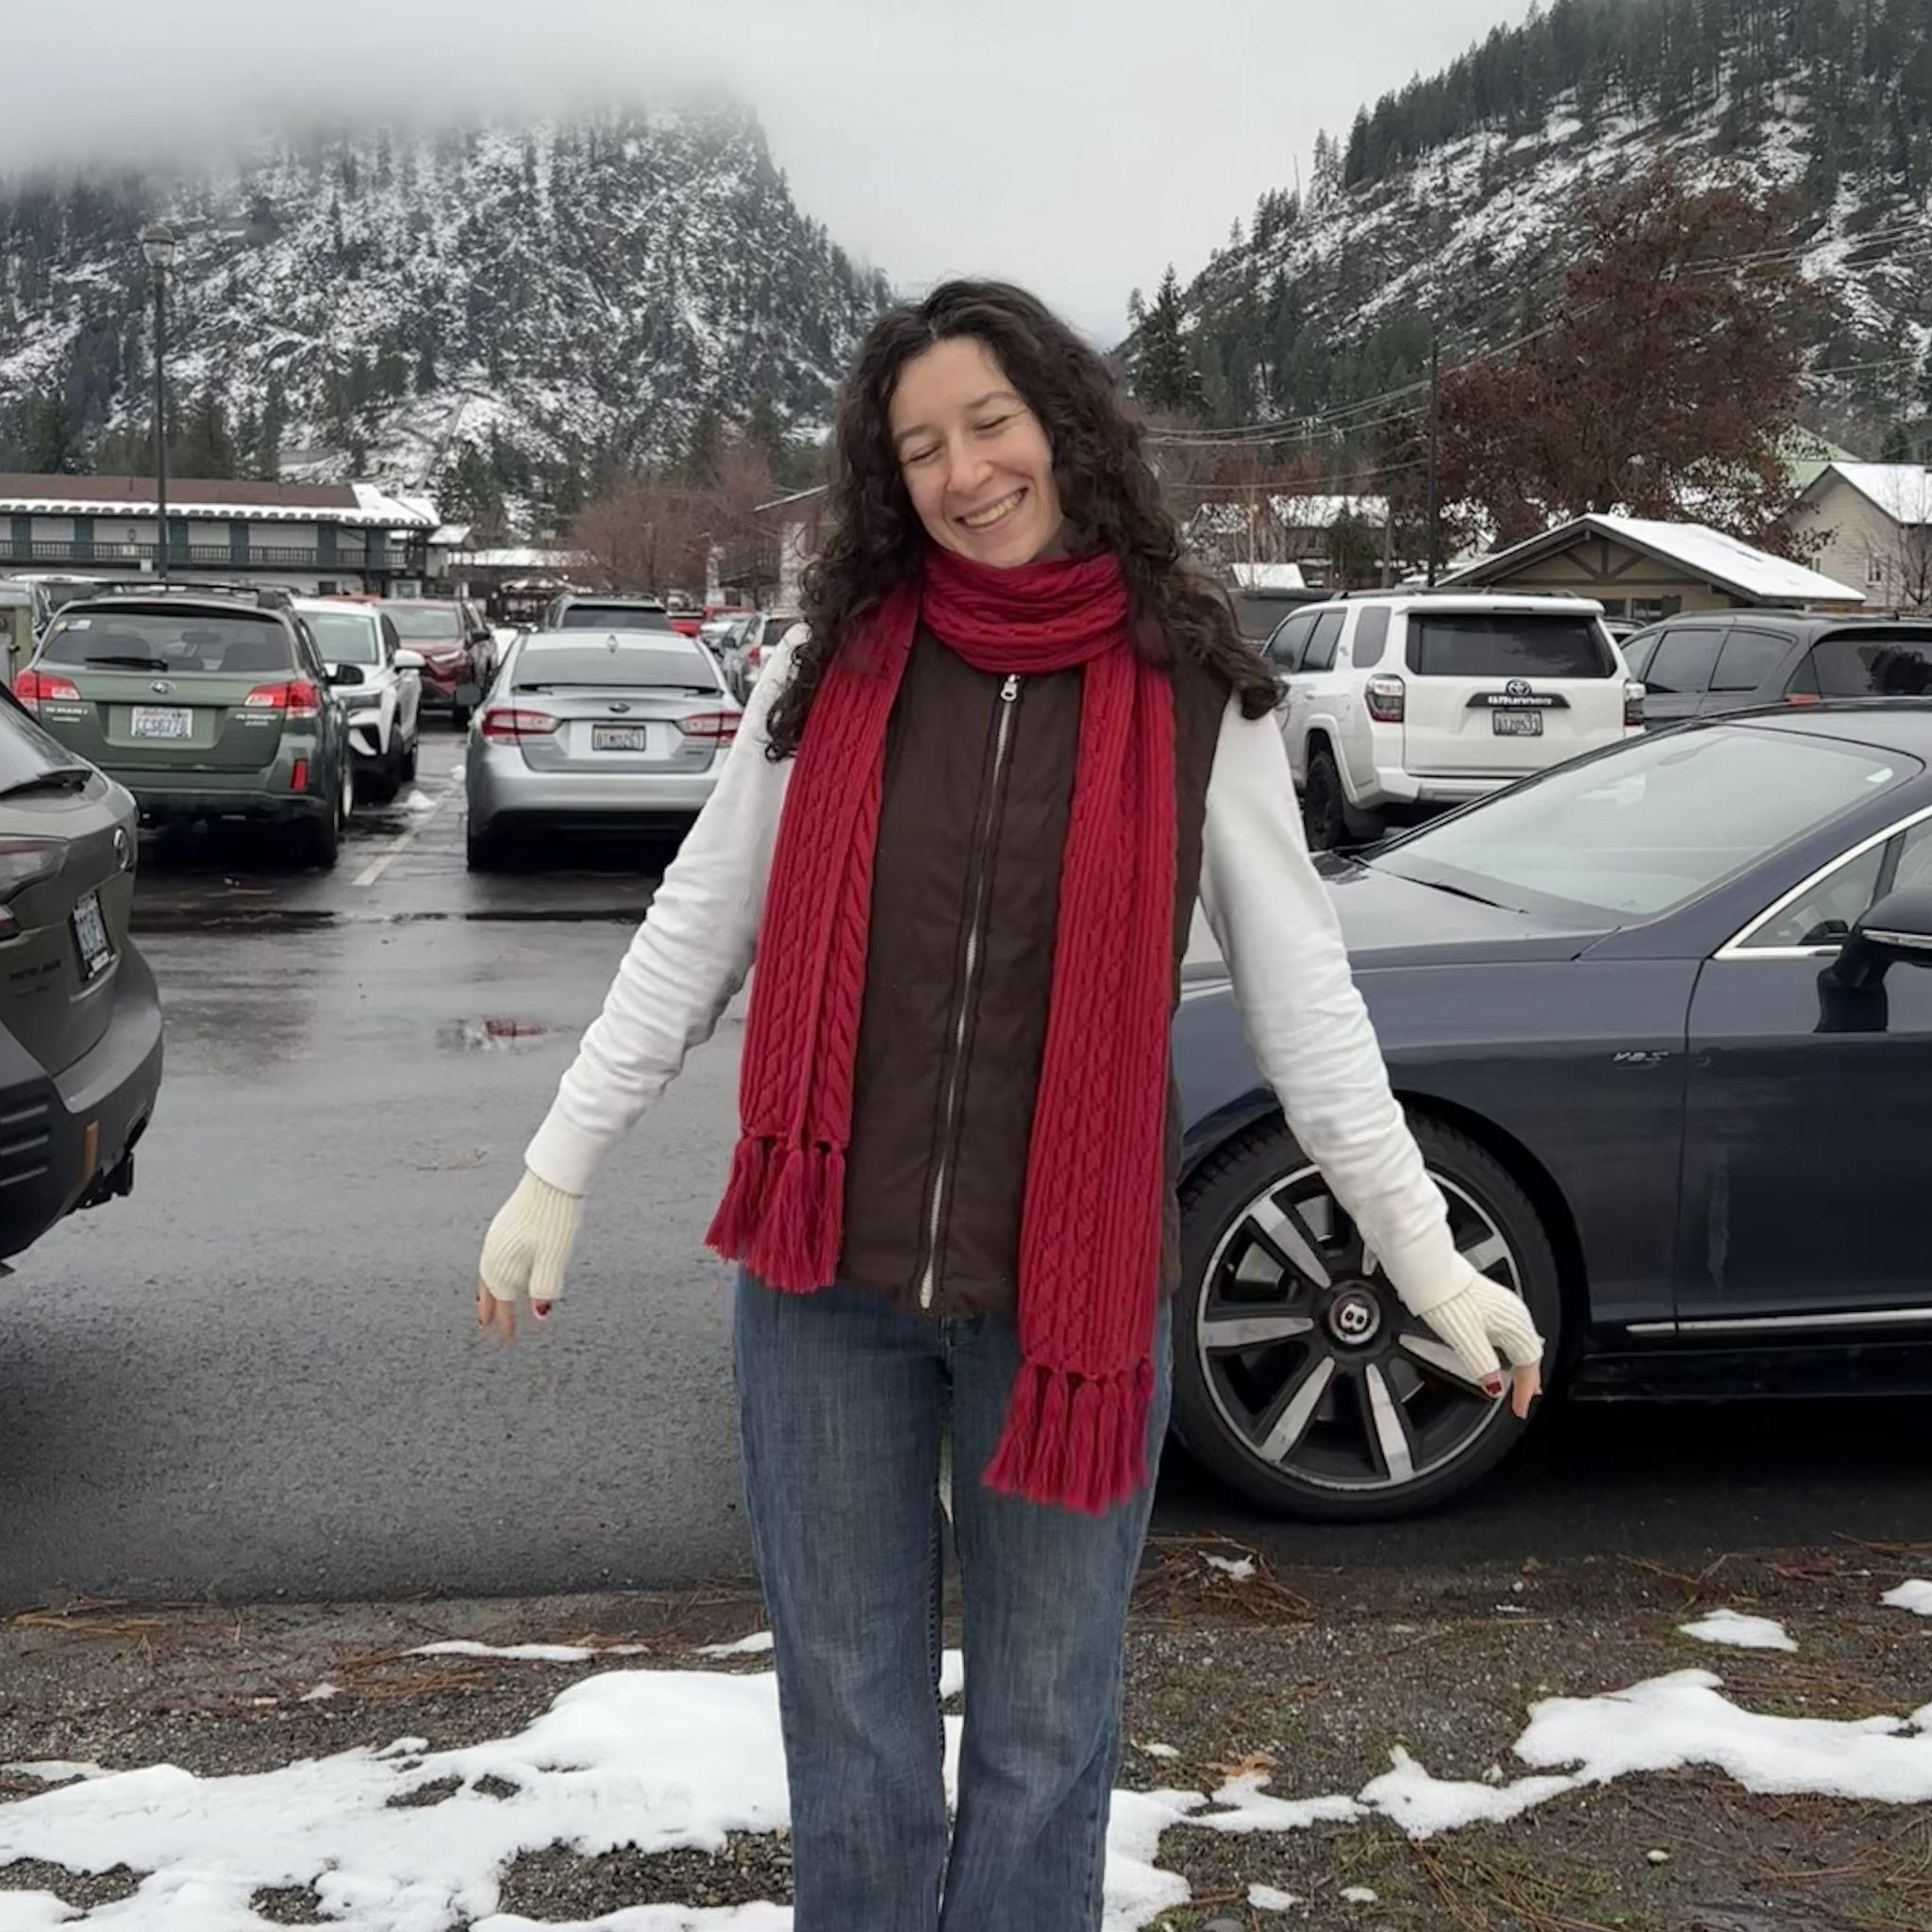
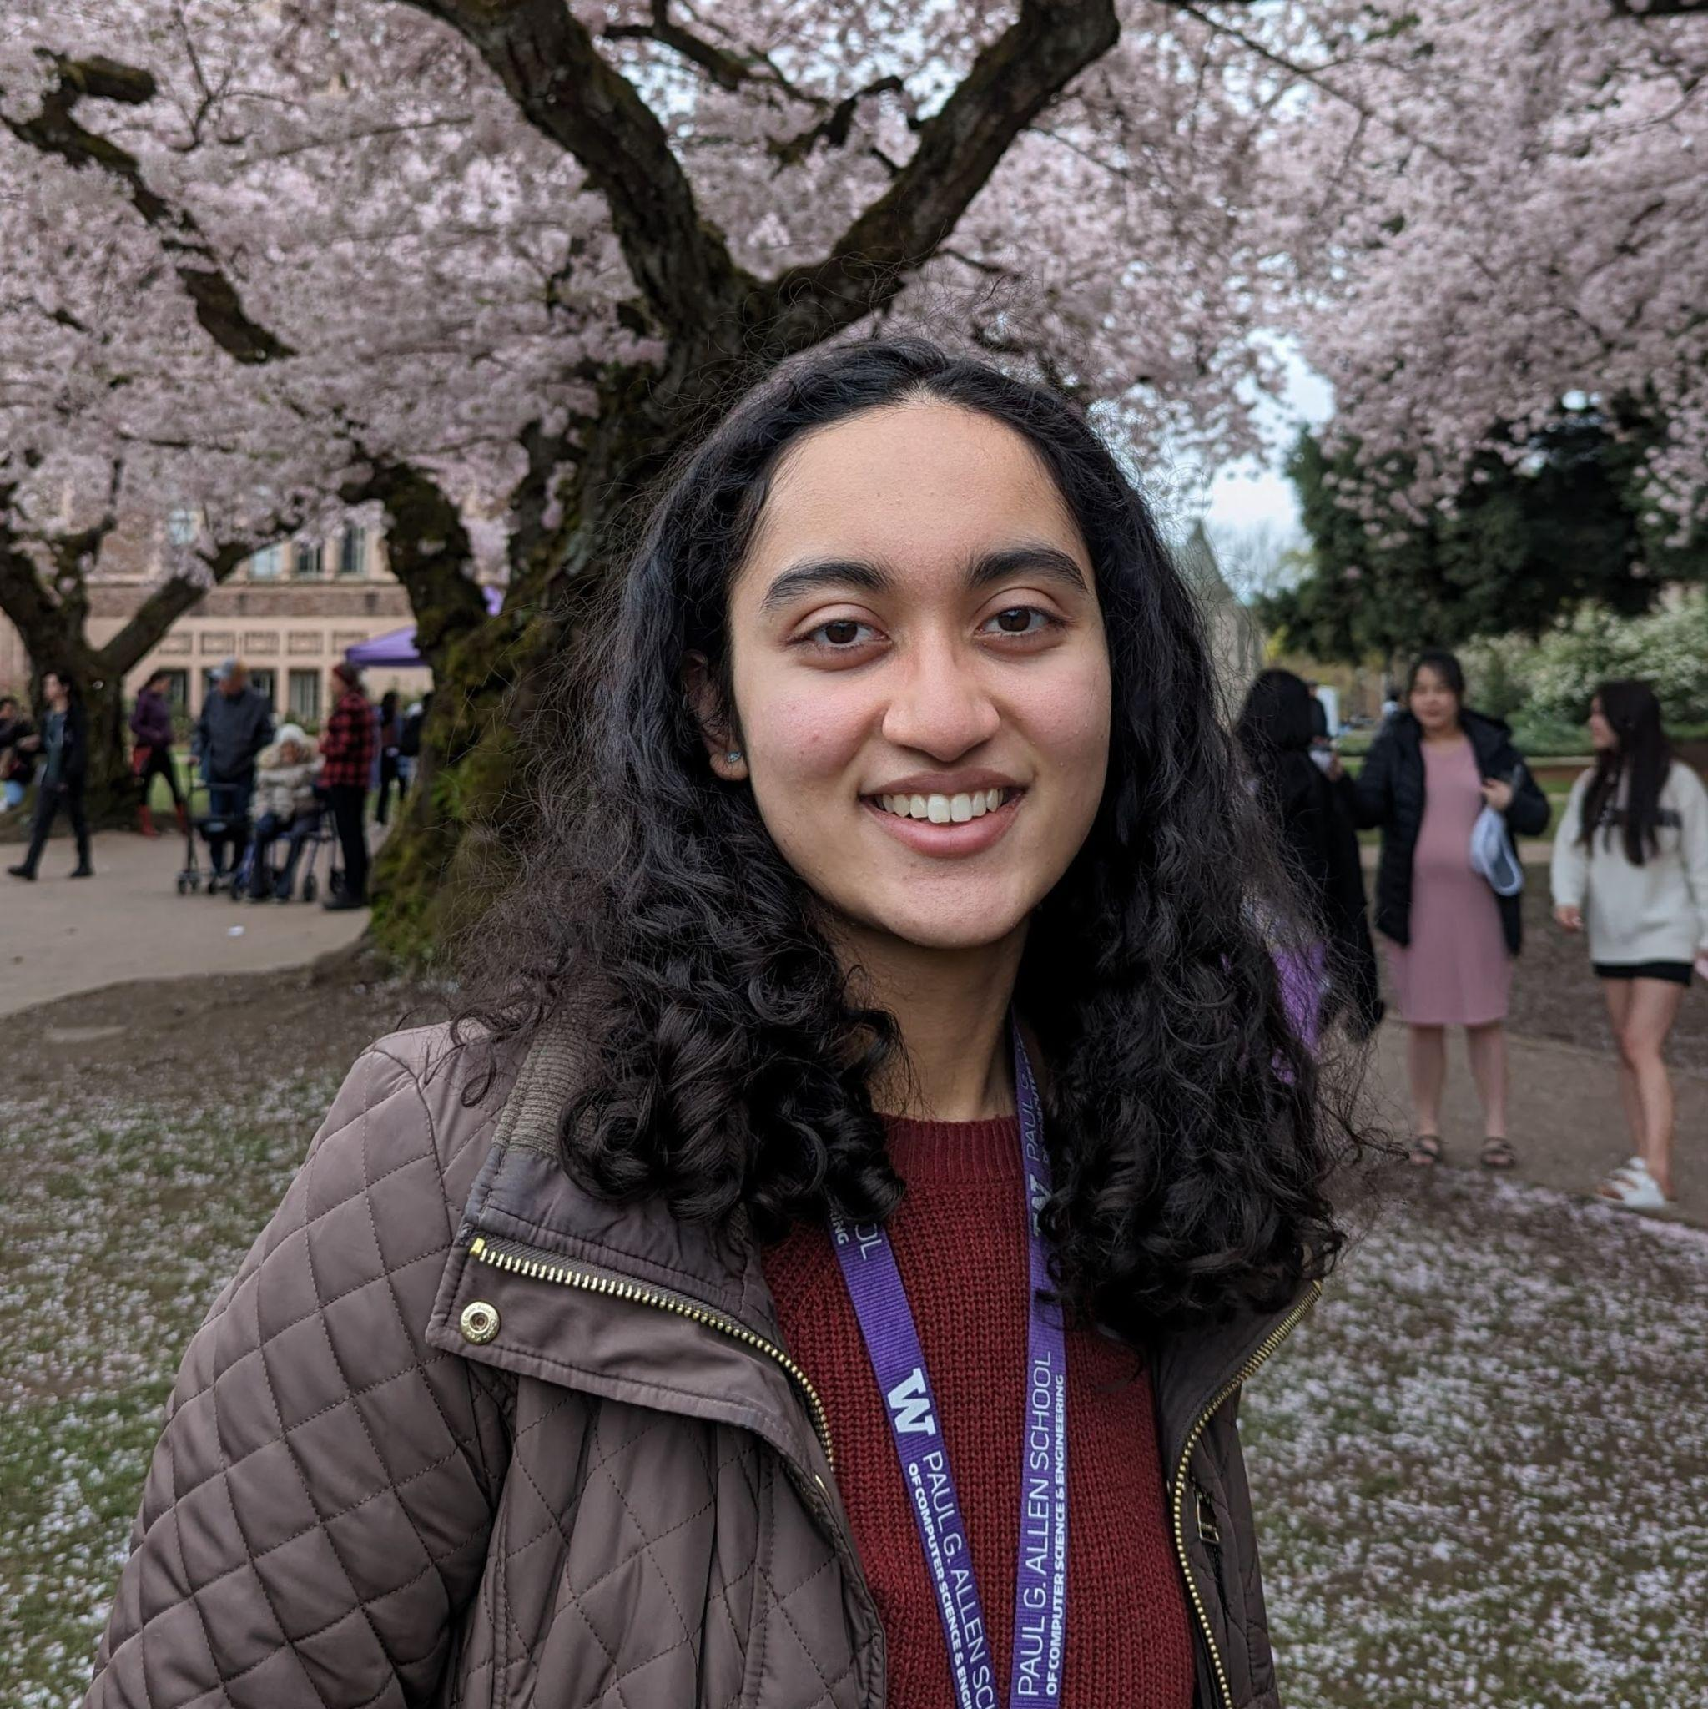
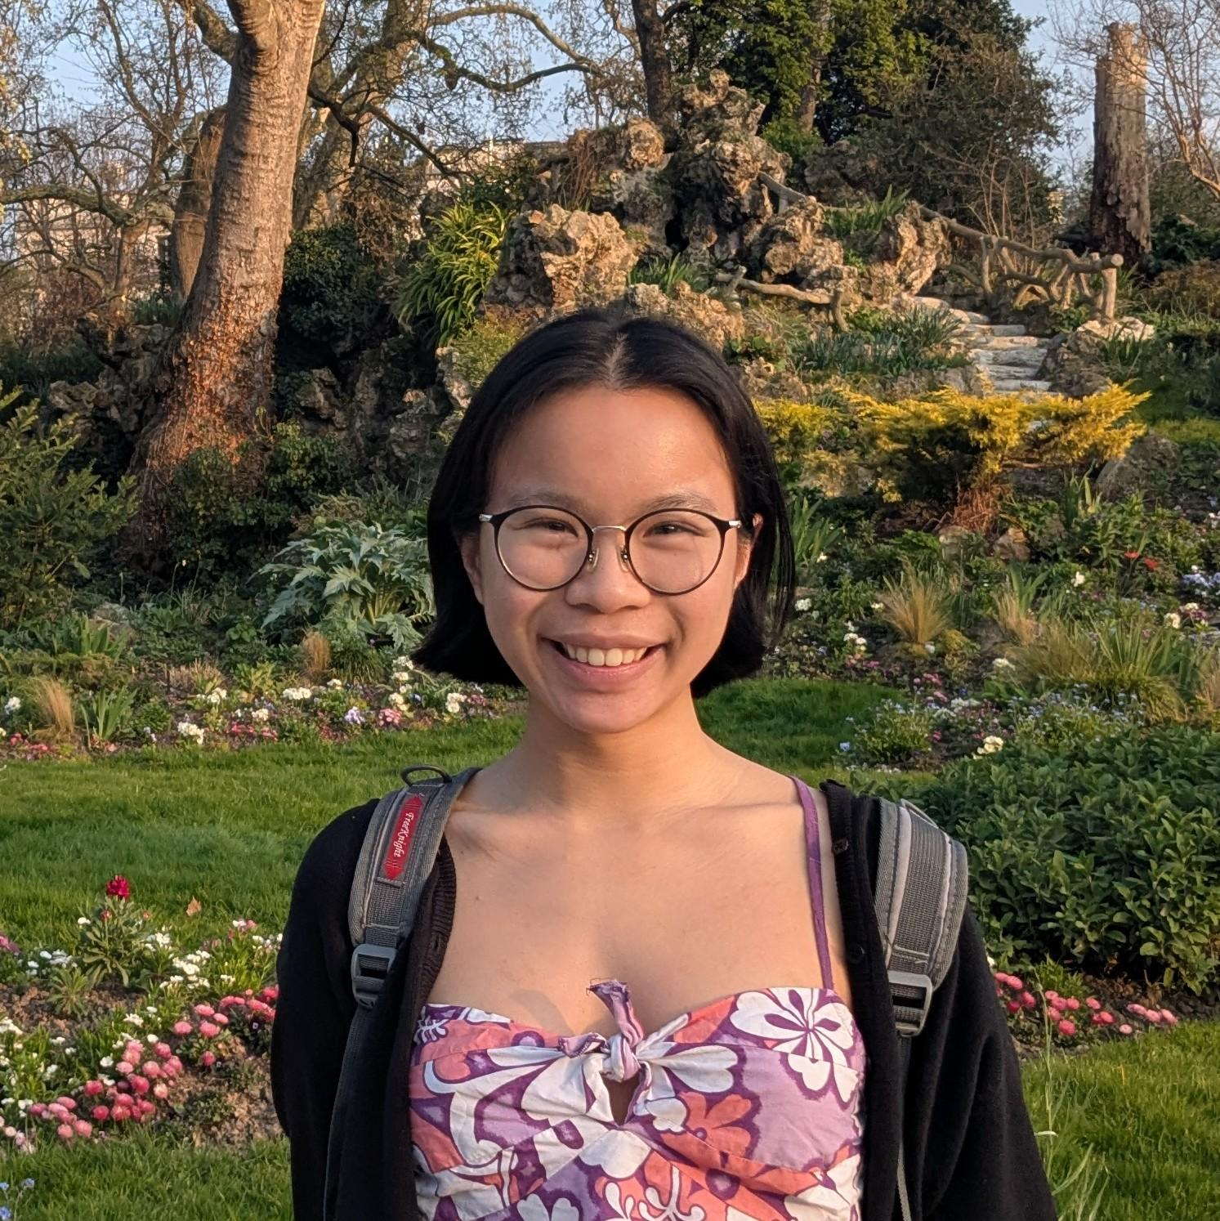




Thank you to the TAs! 🎉
Skyler Choi
Alexis Destefano
Shaurya Jain
Kaiyuan Liu
Daniella Maor
Anaya Pandit
Laura Pong
Kellen Rodriguez
Saesha Wadhwa
Patrick Yu
Guy Zur

Slide 18
Final Reminders!
Lesson 28 Quiz due tonight at 11:59pm
  Your final lesson quiz!
Project Part 3 (Final Deliverables) due June 5th at 11:59pm on Gradescope!
Project Part 5 (Peer Feedback) due June 7th at 11:59pm on Gradescope
Presentations tomorrow during Section and Friday’s lecture (June 5th, if needed)
  Make sure you have signed up for a presentation time
  Order will be determined by last time modified!
Resubmission Cycle 7 due Sunday, June 7th at 11:59pm
  Only THA 5 technical component is eligible
Resubmission Cycle 8 due Sunday, June 7th at 11:59pm
  Any technical OR creative component from any THA
Final Reflection on Monday, June 8th at 8:30am in KNE 220

