Slide 1



CSE 163
Introduction to Git
Adrian Salguero
Spring 2026
💭Icebreaker (discuss with neighbors):
What are you most excited about for summer?
slido.com
#cse163

Slide 2
Announcements
THA 5 Peer Reviews due Monday June 1st at 11:59pm
Checkpoint 5 due Tuesday, June 2nd at 11:59pm!
Lesson 25 Quiz due Sunday, May 31st at 11:59pm
Project Part 3 (Final Deliverables) due June 5th at 11:59pm on Gradescope!
Presentations next week during Section and Friday’s lecture (June 5th)
Final Reflection on Monday, June 8th at 8:30am in KNE 220

Slide 3


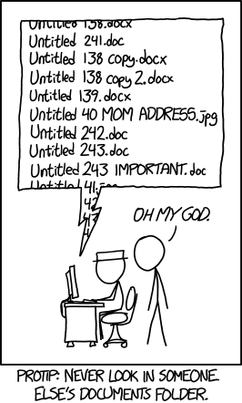
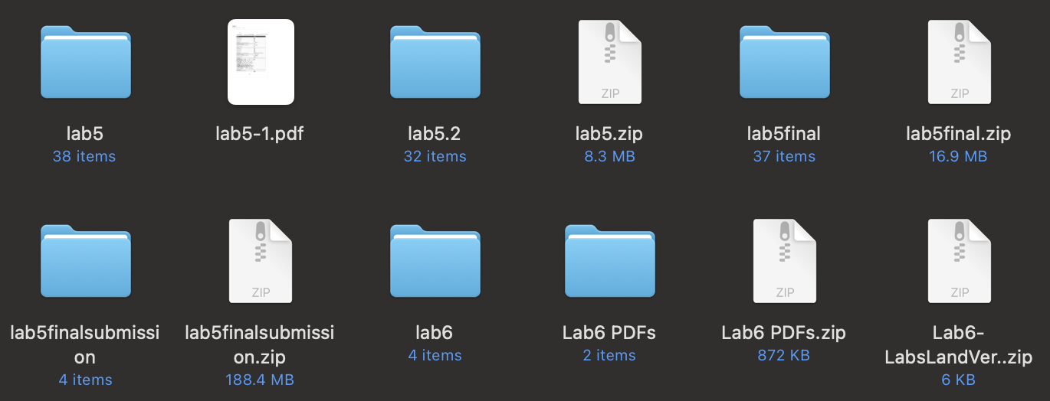
Version Control
Allows for collaboration, makes reverting mistakes easier, accountability

Slide 4
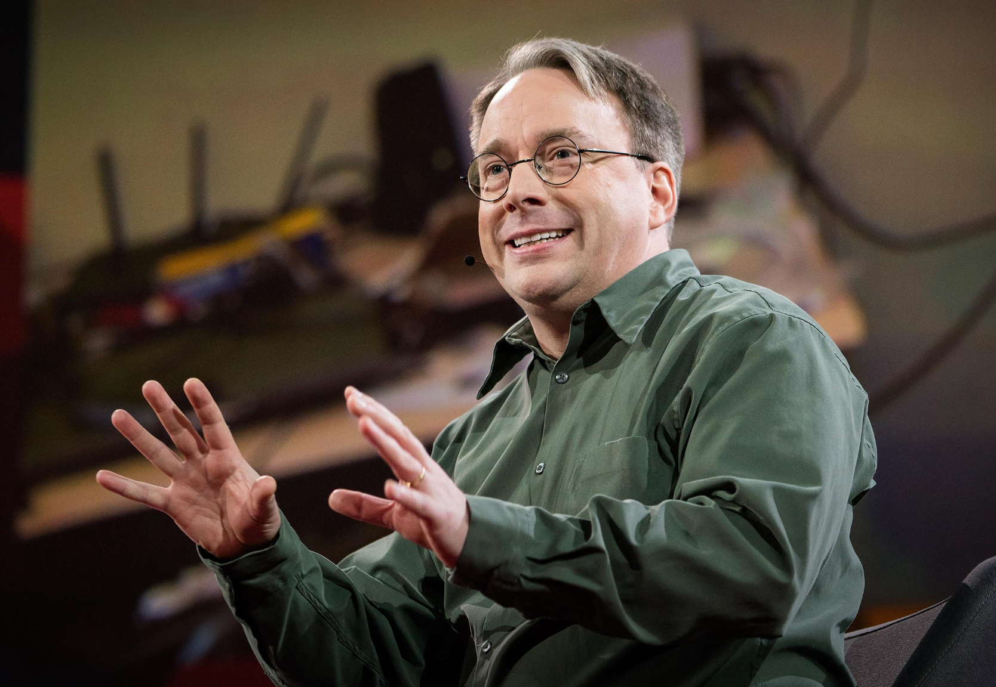

History of Git
Created by Linus Torvalds in 2005
Desired an efficient version control system that supported large scale coding projects
Centralized vs. distributed version control:
  Centralized: a central server processes, maintains, and shares all changes
  Distributed: all users maintain a working copy (local repository) on their own machine
https://git-scm.com/

Slide 5


Git vs. GitHub vs. GitLab vs…
Git is the tool that allows this version control system to function locally
GitHub and GitLab are hosting services for git’s remote functionalities (e.g. hosting remote repositories)
https://github.com/
https://about.gitlab.com/

Slide 6
Repositories
A repository (e.g. “repo”) is a location that stores a copy of all your files
A repo can be considered local or remote
A git repo generally contains:
  Source files such as Python files (.py), Jupyter Notebooks (.ipynb), etc.
  General resource files such as images
  README.md files and notes (generally instructions on what the repo contains and how to use it)
A repo should not contain:
  Executable or generate files
  Data (e.g. .csv files, .shp files, etc.) or files that take up a lot of space
  .gitignore file - specify which files to not commit to repo

Slide 7
Repositories
With git, everyone working on the project has a complete version of the repo
  There is a remote repository, which is the central repository → “source of truth”
  Remote repositories are hosted on services like GitHub and GitLab
  Everyone has a local copy of the repository, which is what we use to send our own changes to the remote repository
Developer 1
Developer 2
Push/Pull Changes
Remote Repository

Slide 8
The 4 Stages of Git
Working Directory
Staging Area
Local Repository
Remote shared repository on Github, Gitlab, etc.
Working changes in your development environment
Changes you’re preparing to commit
Local copy of the repository with your committed changes
Remote Repository
git stage
git commit
git push

Slide 9
Git Clone
git clone <URL>
Used to clone an already existing remote repository onto your local machine
For private repositories, requires authentication (e.g. SSH keys, etc)
After cloning, you can collaborate with others who have access to the remote repository

Slide 10
Git Push
git push
Used to push changes from your local repo to the remote repo
Once you push changes, they are visible to all others!
If someone else wants to grab the changes you pushed, they will use the command on the next slide…

Slide 11
Git Pull
git pull
Used to update your working directory with changes from the remote repository
Combination of the commands fetch and merge
Fetch retrieves the changes from the remote repository to your local repository
Merge combines the changes in your local repository with your working directory

Slide 12
Branching and Diverging Branches
A
B
C
E
D
A developer working on their own branch (with commit “D”) separate from branch “main”
A developer trying to pull changes, but encountering a diverging branch due to conflicting changes from the remote repo

Slide 13
Git Reset
git reset HEAD filename
Used to remove a file previously added to the staging area
Does not affect changes in your working directory

Slide 14
Git Revert
git revert HEAD
Deleting a commit involves altering the entire commit history and can cause issues
While it is possible to “delete” commits, it’s best practice to avoid doing so
Think carefully of what you want to commit instead of going through the process of reverting

