Slide 1


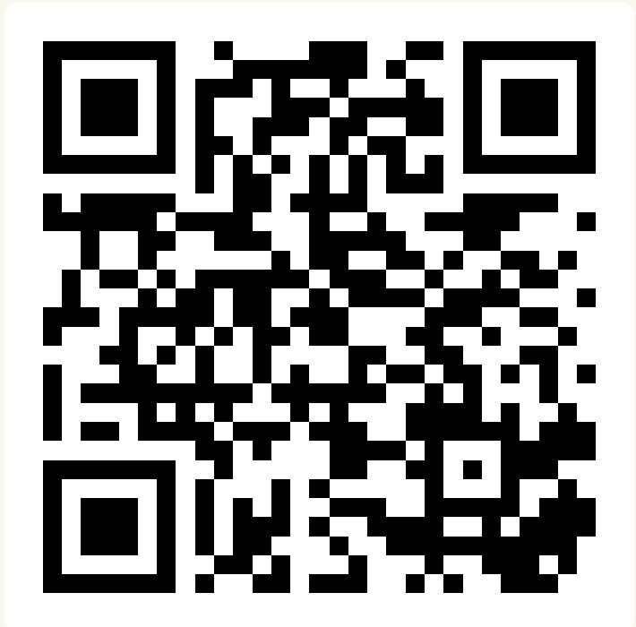
CSE 163
Ethics Case Studies
Adrian Salguero
Spring 2026
💭Icebreaker (discuss with neighbors):
Favorite music genre?
slido.com
#cse163

Slide 2
Announcements
Project Part 3 due June 5th at 11:59pm on Gradescope!
THA 5 Peer Reviews due Monday June 1st at 11:59pm
Checkpoint 5 due Tuesday, June 2nd at 11:59pm!
Lesson 24 Canvas Quiz due tomorrow at 11:59pm!
Project Presentations next week! (Thursday and Friday)

Slide 3
Project Presentations (Project Part 4)
Project presentations will happen next week on Thursday, June 4th (during section) and Friday, June 5th (during lecture)
Presentations should be no longer than 3 minutes
Group projects: all members must be present for the presentation and participate to receive full credit. You only need to present in ONE section
You will be expected to provide feedback on 2-3 presentations which will be assigned to you on the day of the section
If you have a time conflict for section, you will be required to present in lecture on Friday, June 5th.
If neither times work, you will be required to present in Adrian’s office hours on June 2 → you must provide a signed letter/note or other proof of the time conflict no later than Sunday, May 31st at 11:59pm

Slide 4
Fairness Recap
What we call “fair” depends on the groups we want to protect
  Individual fairness vs. group fairness
Tradeoff between fairness and accuracy
  The Pareto frontier can help us assess how models perform with respect to fairness and accuracy
  The “sweet spot” depends on what you prioritize
Two worldviews
  What You See Is What You Get (WYSIWYG)
    Measurements accurately reflect the real world
  We’re All Equal (WAE)
    Flawed systems or institutions

Slide 5
Privacy Recap
Anonymity as a proxy for privacy
  k-anonymity
  Fuzzing the data
Differential privacy
  Data privacy vs. data security
  Jittering
  Randomized response

Slide 6
Statistics Recap
We can describe the data that we have collected
  Summary statistics
  Distributions (normal, bimodal, etc.)
We can also make inferences about the state of the world
  Hypothesis testing
  Type I and Type II errors
  Some pitfalls:
    p-hacking
    Multiple hypothesis testing
    HARKing

Slide 7
Discussion Guidelines
Open this slide deck
You will be working with a discussion group and at least one of the case studies covered in the lesson.
  Introduce yourself to your groupmate(s)!
  Pick at least one note-taker and one presenter.
  Use the questions in the document as conversation starter, but feel free to come up with other questions to discuss!
  If you are done discussing your first case study, you can move on to other readings.
  After 15 minutes of discussion, find another group and discuss your case studies together!
  After 15 more minutes of discussion, we will invite presenters from each paired group to share out.
  Feel free to move around!

Slide 8
Discussion Topics
4 new case studies!
  Potholes and response bias
  Facial recognition technology
  Generative AI in creative spaces
  ChatGPT and mental labor
Feel free to review any of the other case studies from last week
  Lesson 22
  Lesson 23
  Lesson 24

Slide 9
Discussion Questions
What is the data that is being used in your case study? What assumptions are being made of it?
What worldview from the Fairness slides is assumed in your case study? Is it difficult to tell?
What groups are affected by the application in your case study, and in what way? (This can be positive or negative!)
What privacy concerns might arise from using the data in your case study?
Have you used the technology in the case study (or one that is similar)? What did you know about it before using it? Did you learn anything new from the case study?
How can you relate the application from your case study to the ones from Lessons 22 or 23 (also linked in Lesson 24)?
Come up with questions of your own!

