Slide 1



CSE 163
ML and Images
Adrian Salguero Spring 2026 💭Icebreaker (discuss with neighbors):
Favorite band or musical artist?
Add to our Slido!
slido.com
#cse163

Slide 2
Announcements
Take Home Assessment 5: Mapping due Tuesday May 26th at 11:59pm
Lesson 20 Canvas Quiz due tonight at 11:59pm!
Checkpoint 4 due tonight at 11:59pm!
Project Part 3 now available, due June 1st at 11:59pm on Gradescope!

Slide 3
Revisiting ML Terms
Features / Labels
Learning algorithm
Model
Model class
Training set / Test set
Parameters / Hyperparameters

Slide 4
ML on Images
How do we do machine learning on images?
10
20
30
40
50
60
70
80
90
Simplest: Unroll the image into a vector
Complex: Use other tools to extract features from the images
Raw Image
10 | 20 | 30
40 | 50 | 60
70 | 80 | 90
“Unrolled”
Image

Slide 5
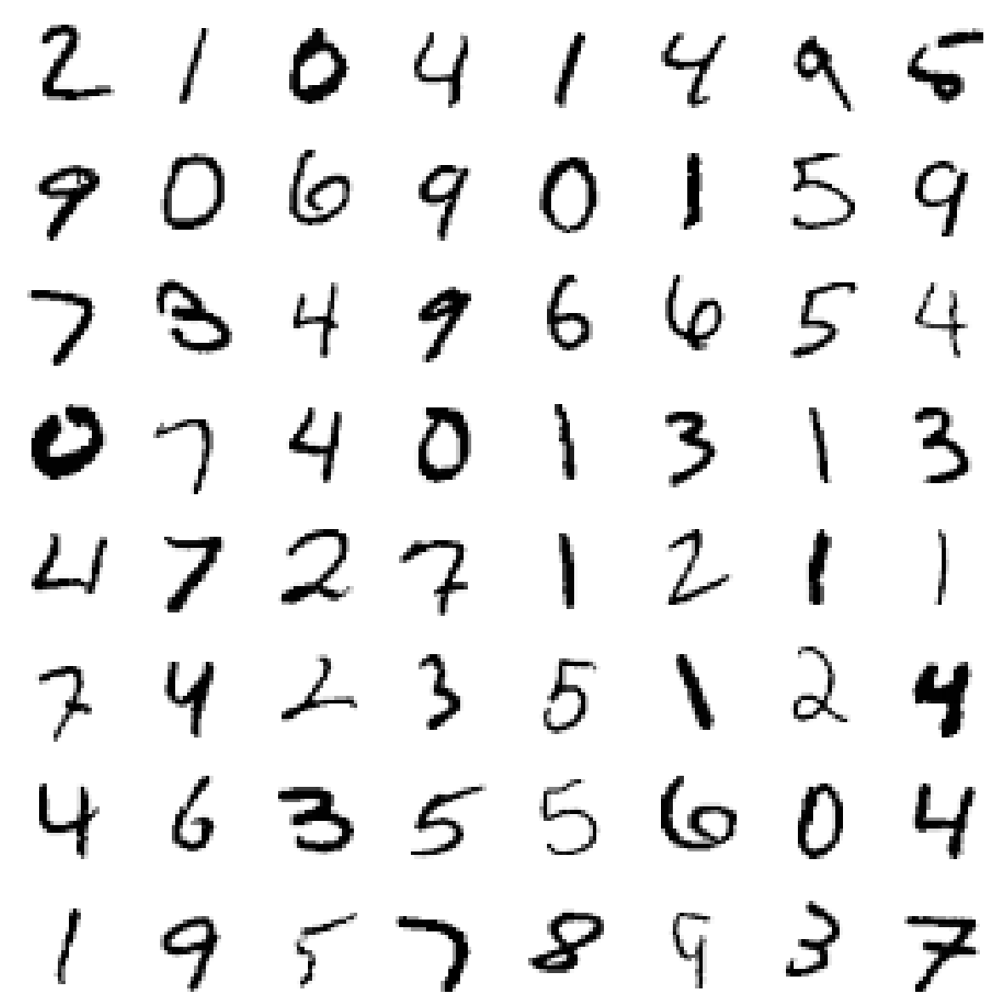
ML on Images
Pros: Simple transformation (call to reshape!)
Cons: Loss of idea of “neighboring” pixels (up/down)
Most machine learning models don’t take position of features into account
More complex models (e.g. convolutional neural networks) come in to encode the local information as features

Slide 6
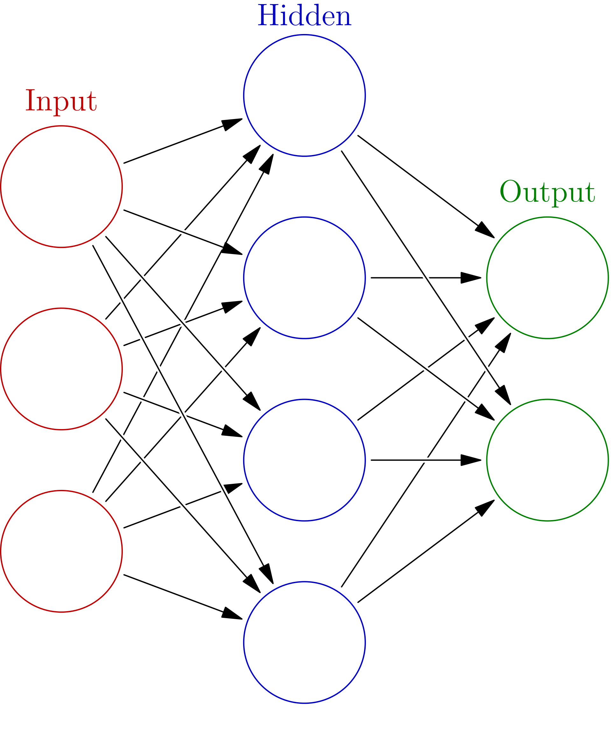
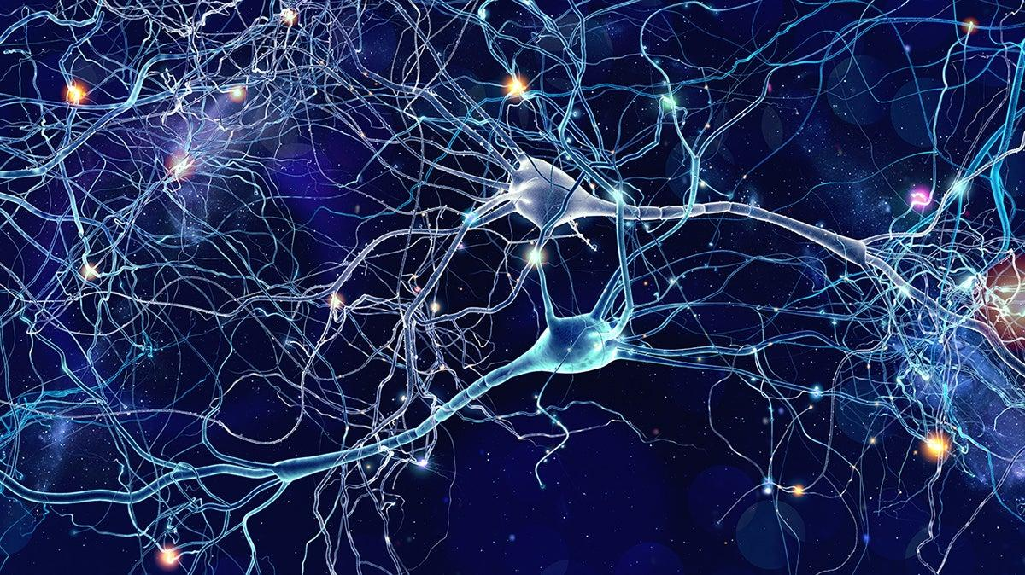
Neural Networks - based on our brains

Slide 7
Neural Networks - Example
What is the output for this neuron if the inputs are 0 for the first input and 1 for the second?
The activation function is the step function (0 if negative, 1 otherwise)
The bias should be subtracted from the weighted sum before applying the activation function
3
4
-2

Slide 8
Neural Networks - Example
What is the output for this neuron if the inputs are 0 for the first input and 1 for the second?
The activation function is the step function (0 if negative, 1 otherwise)
The bias should be subtracted from the weighted sum before applying the activation function
3
4
-2
0 * 3 + 1 *(-2) - 4 = -6

Slide 9
Neural Networks - Example
What is the output for this neuron if the inputs are 0 for the first input and 1 for the second?
The activation function is the step function (0 if negative, 1 otherwise)
The bias should be subtracted from the weighted sum before applying the activation function
3
4
-2
0 * 3 + 1 *(-2) - 4 = -6
squish(-6) = 0

Slide 10
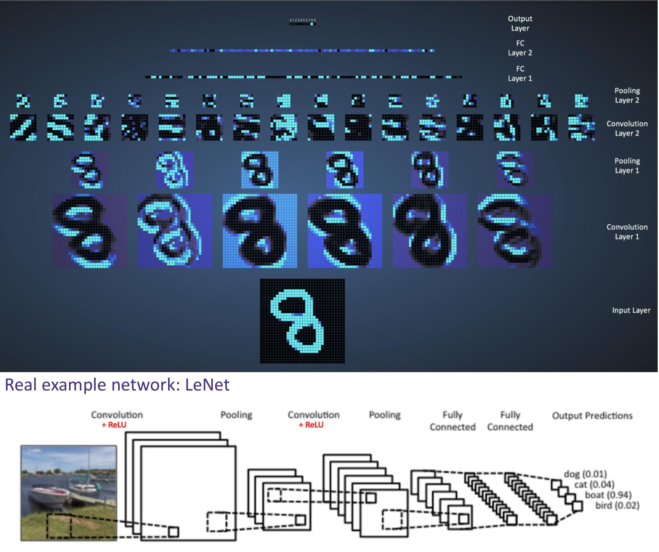
Image Classification

Slide 11
Unsupervised Learning
So far, we have seen supervised machine learning. We explicitly show the algorithm the labels.
Unsupervised machine learning lets the algorithm try to lean the trends on its own without providing explicit labels.
Clustering
Outlier detection
Dimensionality reduction

Slide 12
Project Deliverables

Slide 13
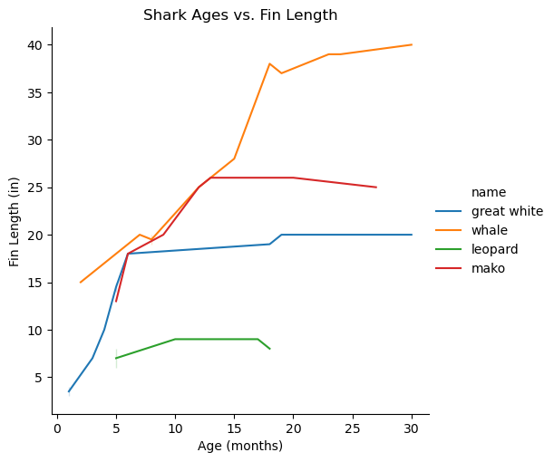
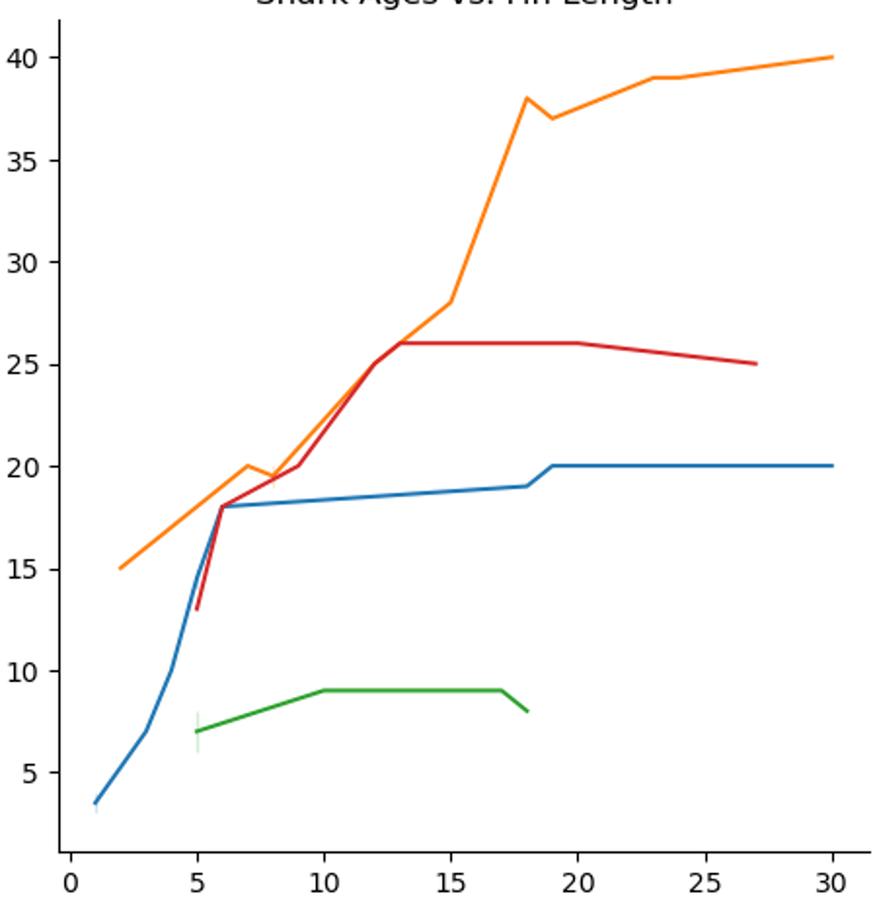
Graphs
Fig 1. A line plot showing the relationship between shark ages in months and caudal fin lengths in inches.
✅

Slide 14
Don’t let numbers float!
Accuracy / MSE – what do these numbers mean for your ML model?
Pearson’s R or R-squared values – what does this imply about the strength or direction of the relationship between variables?
p-values – do you reject or fail to reject the null hypothesis? What does this imply about your results?
Percentages, counts, averages, sums, etc.
Make sure your numbers have context attached to them!

Slide 15
Length Requirements
10 - 15 pages for the reports (excluding optional title page and appendix)
3 minute presentation
Does a 16 page report count if the last page only has one word? – NO!
Does a 3:01 minute presentation count? – Try your best to keep it within 3 min
If your presentation does exceed the time limit by a lot (e.g. 4-5 min presentation) you will be marked down
These are strict maximum length requirements.

