Slide 1



CSE 163
Convolutions
Adrian Salguero Spring 2026 💭Icebreaker (discuss with neighbors):
What is your favorite movie?
Add to our Slido!
slido.com
#cse163

Slide 2
Announcements
Take Home Assessment 5: Mapping due Tuesday May 26th at 11:59pm
Reading Assignment 4 is due on Gradescope tonight at 11:59pm!
Just include your two annotations/comments in the Gradescope submission to receive credit for this assignment
Checkpoint 4 due Monday, May 18th at 11:59pm!
Lesson 20 Canvas Quiz due tonight at 11:59pm!
Project Part 3 will be released on Monday!
Final Project deliverables!
Resubmission Cycle 5 will be released later today, due Tuesday May 19th at 11:59pm
Eligible assignments: THA 3 and THA 4
Only technical component is eligible for resubmission

Slide 3
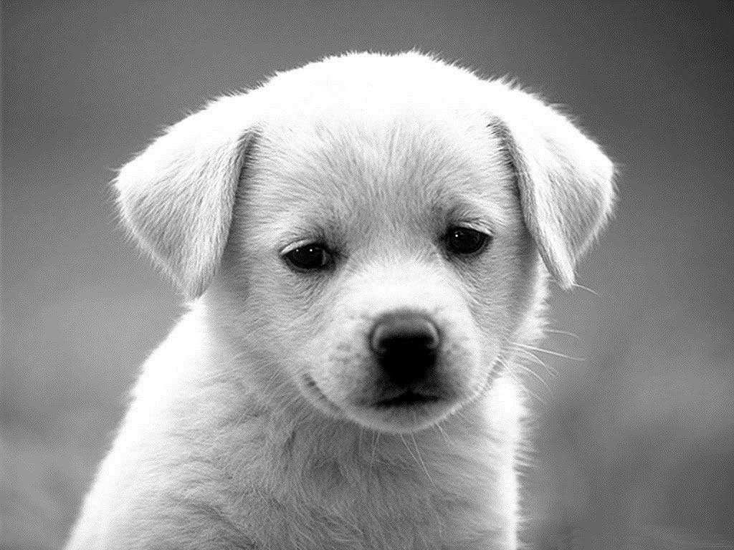
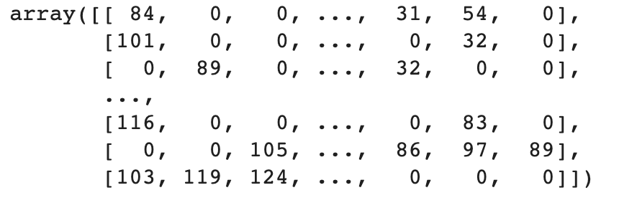
Images as
Matrices
Grey-scale images can be represented as matrices.
Grey-scale: 255
data = iio.imread(‘...’)
data[rows, columns] = #
Grey-scale: 0

Slide 4
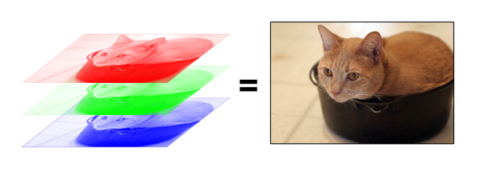
Color Images
When you overlap each color channel, it creates a picture we are used to seeing.
Pixels on your monitor let out specified R/G/B light
data[rows, columns, channels] = #

Slide 5
Convolution
When wanting to use “local” information, we commonly use a sliding window approach (i.e. a convolution)
Move the sliding window across the image, and compute the sum of the element wise product of the window (kernel) and image
Image
3 | 3 | 2 | 1 | 0
0 | 0 | 1 | 3 | 1
3 | 1 | 2 | 2 | 3
2 | 0 | 0 | 2 | 2
2 | 0 | 0 | 0 | 1
Kernel
0 | 1 | 2
2 | 2 | 0
0 | 1 | 2

Slide 6
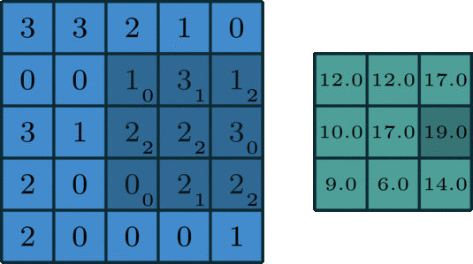
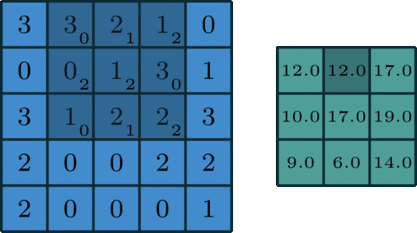
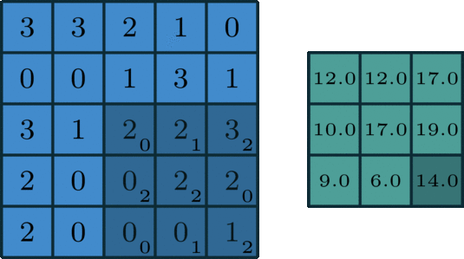
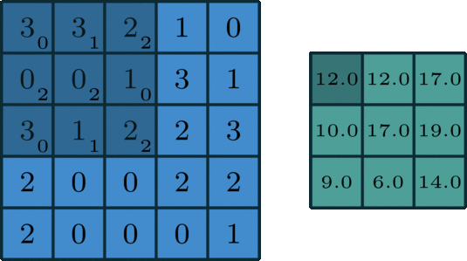
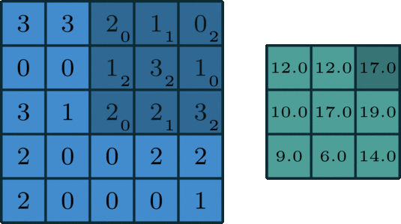
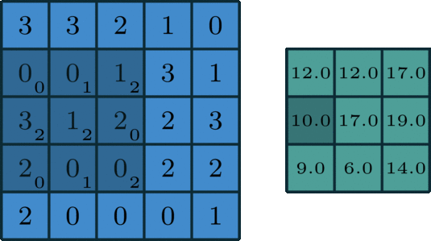
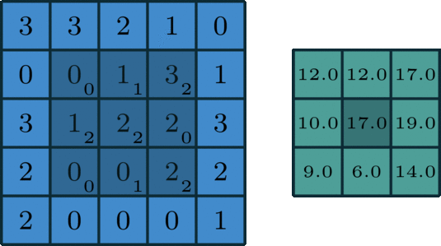
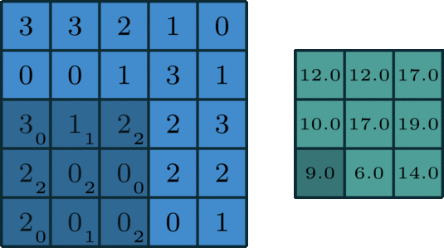
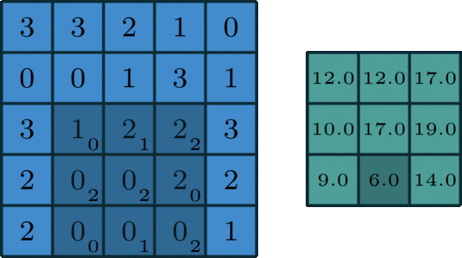
Convolution Example

Slide 7
Image
Kernel
9 | 8 | 7
6 | 5 | 4
3 | 2 | 1
2 | 1

Slide 8
Image
Kernel
9 | 8 | 7
6 | 5 | 4
3 | 2 | 1
2 | 1
Output

Slide 9
Image
Kernel
9 | 8 | 7
6 | 5 | 4
3 | 2 | 1
2 | 1
2
1
Output

Slide 10
Image
Kernel
18
8
18 | 8 | 7
6 | 5 | 4
3 | 2 | 1
2
1
2 | 1
Output

Slide 11
Image
Kernel
18 | 8 | 7
6 | 5 | 4
3 | 2 | 1
2
1
2 | 1
26
18
8
Output

Slide 12
Image
Kernel
18 | 8 | 7
6 | 5 | 4
3 | 2 | 1
2
1
2 | 1
18
8
Output
26

Slide 13
Image
Kernel
9 | 8 | 7
6 | 5 | 4
3 | 2 | 1
2
1
2 | 1
18
8
2
1
Output
26

Slide 14
Image
Kernel
9 | 16 | 7
6 | 5 | 4
3 | 2 | 1
7
2
16
1
2
1
2 | 1
18
8
Output
26

Slide 15
Image
Kernel
9 | 16 | 7
6 | 5 | 4
3 | 2 | 1
2
1
2
1
2 | 1
23
16
7
18
8
Output
26

Slide 16
Image
Kernel
9 | 16 | 7
6 | 5 | 4
3 | 2 | 1
2
1
2
1
2 | 1
16
7
18
8
Output
26
23

Slide 17
Image
Kernel
9 | 8 | 7
6 | 5 | 4
3 | 2 | 1
2
1
2
1
2 | 1
16
7
18
8
17
2
1
Output
26
23

Slide 18
Image
Kernel
9 | 8 | 7
6 | 5 | 4
3 | 2 | 1
2
1
2
1
2 | 1
16
7
18
8
2
1
Output
26
23
17

Slide 19
Image
Kernel
9 | 8 | 7
6 | 5 | 4
3 | 2 | 1
2
1
2
1
2 | 1
16
7
18
8
14
2
1
Output
26
23
17

Slide 20
Image
Kernel
9 | 8 | 7
6 | 5 | 4
3 | 2 | 1
2
1
2
1
2 | 1
16
7
18
8
2
1
Output
26
23
17
14

Slide 21
Image
Kernel
9 | 8 | 7
6 | 5 | 4
3 | 2 | 1
2
1
2
1
2 | 1
16
7
18
8
Output
8
2
1
26
23
17
14

Slide 22
Image
Kernel
9 | 8 | 7
6 | 5 | 4
3 | 2 | 1
2
1
2
1
2 | 1
16
7
18
8
Output
2
1
26
23
17
14
8

Slide 23
Image
Kernel
9 | 8 | 7
6 | 5 | 4
3 | 2 | 1
2
1
2
1
2 | 1
16
7
18
8
Output
5
2
1
26
23
17
14
8

Slide 24
Image
Kernel
9 | 8 | 7
6 | 5 | 4
3 | 2 | 1
2
1
2
1
2 | 1
16
7
18
8
Output
2
1
26
23
17
14
8
5

Slide 25
How many times can we fit the kernel?
Image
Kernel

Slide 26
How many times can we fit the kernel?

Slide 27
How many times can we fit the kernel?
2

Slide 28
How many times can we fit the kernel?
2

Slide 29
How many times can we fit the kernel?
2
3

Slide 30
How many times can we fit the kernel?
Image
Kernel
3 x
2

Slide 31
How many times can we fit the kernel?
Image
Output
Kernel
(1x2)
(3x3)
(3x2)
(image_height – k_height + 1, image_width – k_width + 1)

Slide 32
Generic Formula for Result Size
k_height
Kernel
height
Image
k_width
width
(1, 0)
(width - k_width, 0)
(0, 0)
k[0]
k[1]
…
k[width - k_width]
Total of (width - k_width + 1) kernels because of zero based indexing!
So the shape of the result will be (height - k_height + 1, width - k_width + 1)

Slide 33

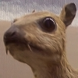



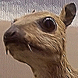


Common Kernels
Identity
Edge Detection
Sharpen
Box Blur

Slide 34
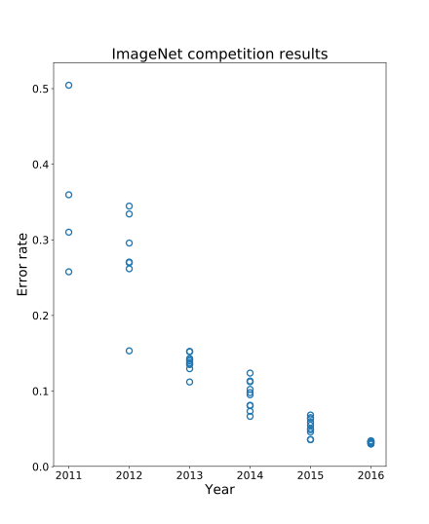
Image Classification
For a really long time, image classification was done by painstakingly crafting these features (like edge detectors), by hand.
This kind of worked, but we quickly hit our peak using this method.
Then came the buzz-word… deep learning

Slide 35
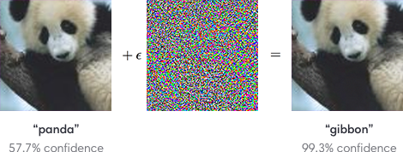
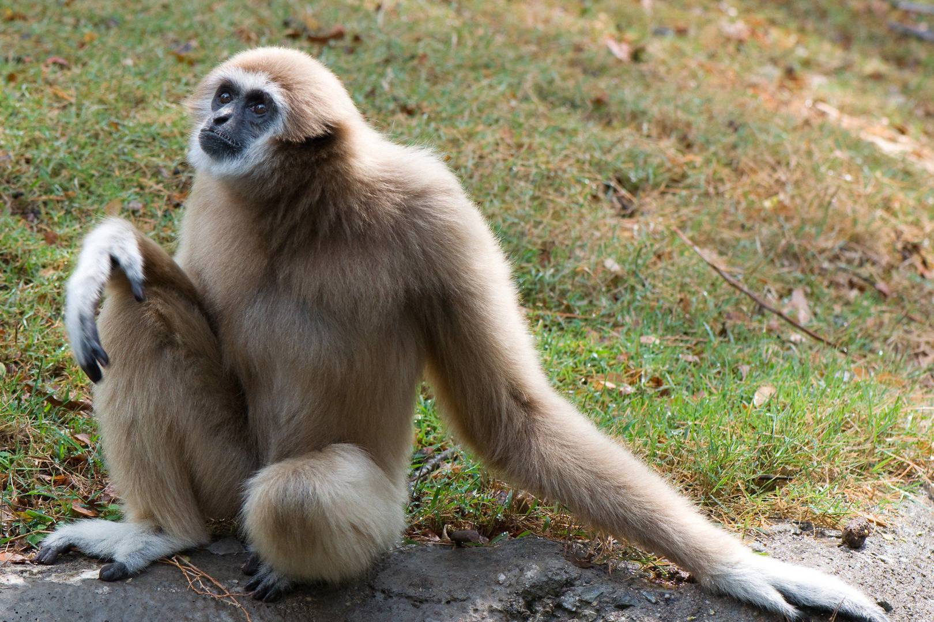
Image Classification
Is this a solved problem?
We get pretty decent error rates on challenges like ImageNet
What we can’t do
Sometimes can’t generalize to other real-world datasets
Adversarial attacks

