Slide 1


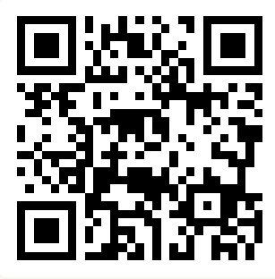
CSE 163
Introduction to Python II: Strings and Lists
Adrian Salguero Spring 2026 💭Icebreaker (discuss with neighbors): ‘
Read any good books lately? Add to our Slido!
slido.com
#cse163

Slide 2
Announcements
Lesson 2 Canvas Quiz due tonight at 11:59pm!
Need to score 100% to count as completion (unlimited attempts)
Checkpoint 1 due on Gradesciope Monday, April 6th by 11:59pm!
Take Home Assessment 1: Processing due on Gradescope on Thursday, April 9th at 11:59pm!
Will be released later today (~5pm)
How was your first section?
Make sure you have access to all the course materials
Ed, Gradescope, Canvas
If you just enrolled: wait about 24 hours for the rosters to update
If you are having trouble running Python files, please come to office hours.

Slide 3
Lesson Recap: Strings and Lists
Strings
Text data that has indices for characters
Has functions to transform (and return new) strings!
String slicing
Lists
Indexed-sequence (like strings) but can hold any value!
For Java people – a lot like an ArrayList
Documentation
Doc-string (““ documentation ”” )

Slide 4
String Methods vs. len
Call functions on strings using syntax
s.function(params)
This is not true for len (or other built-in Python functions)
len(s)
Can you think of other built-in Python functions?

Slide 5
Strings vs. Lists
s = 'hello world'
# Length
len(s) # 11
# Indexing
s[1] # 'e'
s[len(s) - 1] # 'd'
# Looping
for i in range(len(s)):
print(s[i])
for c in s:
print(c)
l = ['dog', 'says', 'woof']
# Length
len(l) # 3
# Indexing
l[1] # 'says'
l[len(l) - 1] # 'woof'
# Looping
for i in range(len(l)):
print(l[i])
for word in l:
print(word)

Slide 6
Function Comments
Function comments are the best way for others to know what your code does!
Maintain good grammar
Focus on what your function does, rather than how it does it?
Ask yourself: If I came back to this code after 1-2 years, can I easily understand what this function does by reading my comment?
Someone else should be able to understand, maintain, and develop with your code
Function comments should be concise and provide a good explanation of what the function is doing. Some things to think about:
What is the overall purpose of your function?
Does your function take in any special parameters?
What does it output? What does it return?

Slide 7
Which function comment is “better”?
def sum_what(nums):
“””
Takes in a list of
numbers and returns the
sum of those numbers.
“””
total = 0
for i in nums:
total += i
return total
def sum_how(nums):
“””
Takes in a list of numbers,
then calculates the sum of
all numbers using a for loop
to iterate through all numbers.
“””
total = 0
for i in nums:
total += i
return total

Slide 8
Recap: Anatomy of a Function
def keyword
Function name
Optional
parameters
def function_name(parameter, ...):
#Function code
return value
colon
Indentation
Function code
Return statment

Slide 9
Recap: Anatomy of a Function
def keyword
Function name
Optional
parameters
def function_name(parameter, ...):
"""
What does this function do?
"""
#Function code
return value
colon
Indentation
Doc-string comment
Return statment
Function code

Slide 10
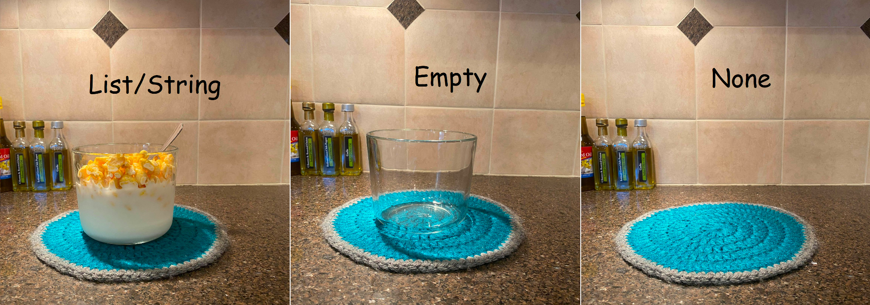
None Value
None is a special value in Python that represents the absence of a value
You don’t have to know a lot about None for this course except:
It can cause your program to crash if you ask a None value to do something
You might have cases where you return None (can lead to unexpected behavior or errors in your program)
Check for None using the is keyword, instead of ==
def increment(x):
if x < 0:
return None
else:
return x + 1
if increment(-1) is None:
print('Failed')

Slide 11
Group Work: Best Practices
When working with a new group for the first time:
Introduce yourself!
If possible, angle one of your screens so that everyone can see and discuss together
Be respectful of each other and allow everyone to speak
Tips:
Start with making sure that everyone agrees to work on the same problem
Allow everyone to contribute or a chance to ask questions.
Ask if everyone agrees and periodically ask each other questions.
Call TAs or Adrian over if you need any help.
Don’t sit in silence.

