Slide 1


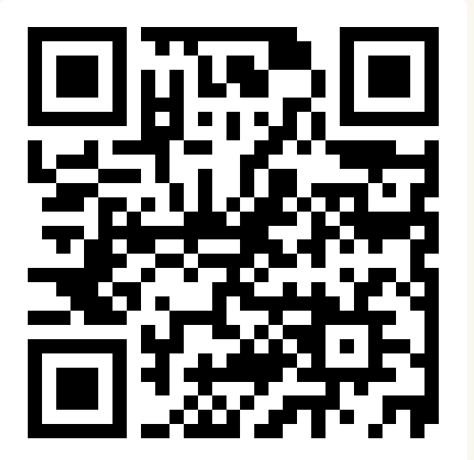
CSE 163
Numpy and Images
Adrian Salguero Spring 2026 💭Icebreaker (discuss with neighbors):
What is your favorite quote?
Add to our Slido!
slido.com
#cse163

Slide 2
Announcements
Take Home Assessment 5: Mapping due Tuesday May 26th at 11:59pm
Reading Assignment 4 is due on Gradescope by Friday, May 15th at 11:59pm!
Checkpoint 4 due Monday, May 18th at 11:59pm!
Project Part 2 due tomorrow at 11:59pm!
Lesson 19 Canvas Quiz due tonight at 11:59pm!

Slide 3
Final Reflection
This course does not have a traditional final exam, but we will still be meeting during Finals Week
In-person: Monday, June 8 at 8:30am-10:20am in KNE 220 (this room!)
Show up with yourself, your ID, and a writing utensil
Written reflection (think like time “essays”)
No notes or reference sheets allowed (we want your in-the-moment thoughts)
Answer 3 of 5 writing prompts
2 required
1 of 3 choice prompts
Prompts and writing tips can be found on the course website
Not meant to be a stressful “exam”

Slide 4
Numpy Arrays
The primary data structure that we work with is called a numpy.array.
a = np.array([12, 6]) # [12, 6]
b = np.arange(5) # [0, 1, 2, 3, 4]
c = np.ones(3) # [1, 1, 1]

Slide 5
Reshaping
We looked at how numpy arrays have shape
x = np.ones((2, 3))
x: array([[1, 1, 1],
[1, 1, 1]])
Numpy provides a function called reshape that allows us to change the shape of an array without change the data inside.
y = np.arange(9)
y = y.reshape((3, 3))
y: array([[0, 1, 2],
[3, 4, 5],
[6, 7, 8]])

Slide 6
Reshaping
We also saw how that numpy arrays have shape
x = np.ones((2, 3))
x: array([[1, 1, 1],
[1, 1, 1]])
Numpy provides a function called reshape that allows us to change the shape of an array without change the data inside.
y = np.arange(9)
y = y.reshape((3, 3))
y: array([[0, 1, 2],
[3, 4, 5],
[6, 7, 8]])

Slide 7
Broadcasting
Numpy lets us perform element-wise operations on arrays that have the same shape (and sometimes with different shape!)
m = np.ones((2, 3))
v = np.arange(3)
m + v
m.shape = (2, 3)
v.shape = (3,)
m: [[1, 1, 1],
[1, 1, 1]]
v: [0, 1, 2]
+

Slide 8
Broadcasting
Numpy lets us perform element-wise operations on arrays that have the same shape (and sometimes with different shape!)
m = np.ones((2, 3))
v = np.arange(3)
m + v
m.shape = (2, 3)
v.shape = (3,)
m: [[1, 1, 1],
[1, 1, 1]]
v: [0, 1, 2]
+

Slide 9
Broadcasting
The Rules of Broadcasting
If the two arrays differ in their number of dimensions, the shape of the one with fewer dimensions is padded on it’s left side.
If the shape of two arrays does not match on any dimension, the array with shape equal to 1 in that dimension is stretched to match the other shape.
If the sizes of any dimension disagree and neither is equal to 1, an error is raised.
m.shape = (2, 3)
v.shape = (3,)
m: [[1, 1, 1],
[1, 1, 1]]
v: [0, 1, 2]
+

Slide 10
Broadcasting
The Rules of Broadcasting
If the two arrays differ in their number of dimensions, the shape of the one with fewer dimensions is padded on it’s left side.
If the shape of two arrays does not match on any dimension, the array with shape equal to 1 in that dimension is stretched to match the other shape.
If the sizes of any dimension disagree and neither is equal to 1, an error is raised.
m.shape = (2, 3)
v.shape = (1, 3)
m: [[1, 1, 1],
[1, 1, 1]]
v: [0, 1, 2]
+

Slide 11
Broadcasting
The Rules of Broadcasting
If the two arrays differ in their number of dimensions, the shape of the one with fewer dimensions is padded on it’s left side.
If the shape of two arrays does not match on any dimension, the array with shape equal to 1 in that dimension is stretched to match the other shape.
If the sizes of any dimension disagree and neither is equal to 1, an error is raised.
m.shape = (2, 3)
v.shape = (1, 3)
m: [[1, 1, 1],
[1, 1, 1]]
v: [[0, 1, 2]]
+

Slide 12
Broadcasting
The Rules of Broadcasting
If the two arrays differ in their number of dimensions, the shape of the one with fewer dimensions is padded on it’s left side.
If the shape of two arrays does not match on any dimension, the array with shape equal to 1 in that dimension is stretched to match the other shape.
If the sizes of any dimension disagree and neither is equal to 1, an error is raised.
m.shape = (2, 3)
v.shape = (2, 3)
m: [[1, 1, 1],
[1, 1, 1]]
v: [[0, 1, 2]]
+

Slide 13
Broadcasting
The Rules of Broadcasting
If the two arrays differ in their number of dimensions, the shape of the one with fewer dimensions is padded on it’s left side.
If the shape of two arrays does not match on any dimension, the array with shape equal to 1 in that dimension is stretched to match the other shape.
If the sizes of any dimension disagree and neither is equal to 1, an error is raised.
m.shape = (2, 3)
v.shape = (2, 3)
m: [[1, 1, 1],
[1, 1, 1]]
v: [[0, 1, 2],
[0, 1, 2]]
+

Slide 14
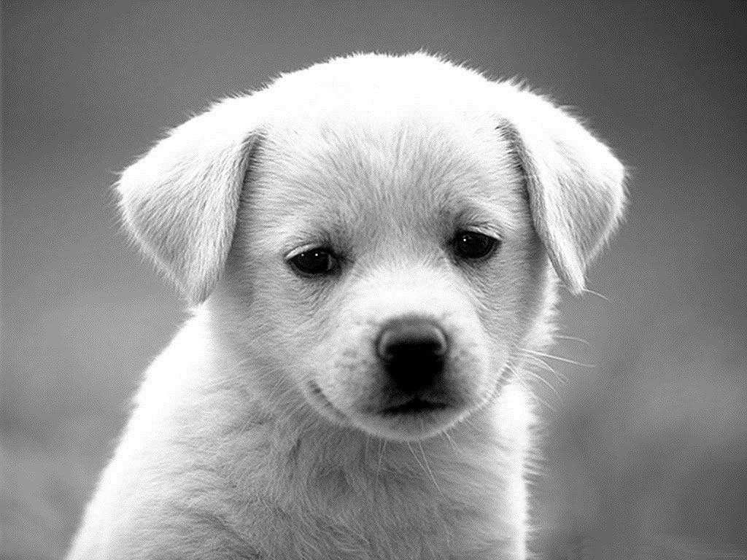
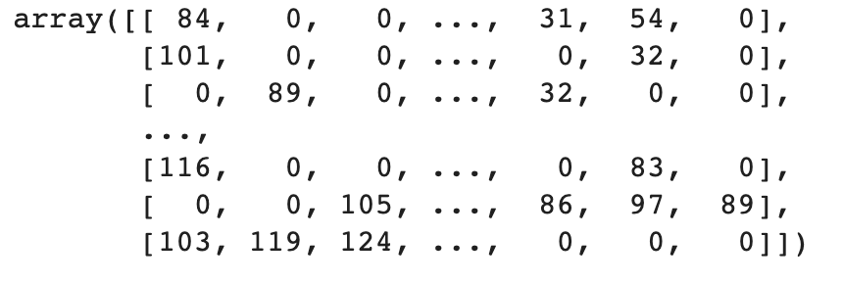
Images as
Matrices
Grey-scale images can be represented as matrices.
Grey-scale: 255
data = iio.imread(‘...’)
data[rows, columns] = #
Grey-scale: 0

Slide 15
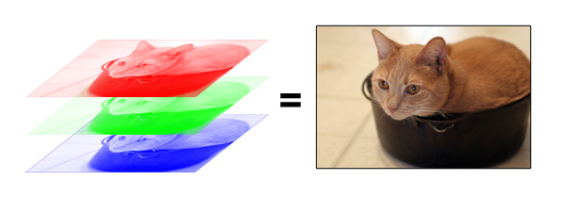
Color Images
When you overlap each color channel, it creates a picture we are used to seeing.
Pixels on your monitor let out specified R/G/B light
data[rows, columns, channels] = #

Slide 16
Practice:
Broadcasting
We started off with the following instructions
x = np.arange(3).reshape((3, 1))
y = np.arange(3)
x + y
x.shape = (3, 1)
y.shape = (3,)
x: [[0],
[1],
[2]]
y: [0, 1, 2]
+

Slide 17
Practice:
Broadcasting
The Rules of Broadcasting
If the two arrays differ in their number of dimensions, the shape of the one with fewer dimensions is padded on it’s left side.
If the shape of two arrays does not match on any dimension, the array with shape equal to 1 in that dimension is stretched to match the other shape.
If the sizes of any dimension disagree and neither is equal to 1, an error is raised.
x.shape = (3, 1)
y.shape = (3,)
x: [[0],
[1],
[2]]
y: [0, 1, 2]
+

Slide 18
Practice:
Broadcasting
The Rules of Broadcasting
If the two arrays differ in their number of dimensions, the shape of the one with fewer dimensions is padded on it’s left side.
If the shape of two arrays does not match on any dimension, the array with shape equal to 1 in that dimension is stretched to match the other shape.
If the sizes of any dimension disagree and neither is equal to 1, an error is raised.
x.shape = (3, 1)
y.shape = (1, 3)
x: [[0],
[1],
[2]]
y: [0, 1, 2]
+

Slide 19
Practice:
Broadcasting
The Rules of Broadcasting
If the two arrays differ in their number of dimensions, the shape of the one with fewer dimensions is padded on it’s left side.
If the shape of two arrays does not match on any dimension, the array with shape equal to 1 in that dimension is stretched to match the other shape.
If the sizes of any dimension disagree and neither is equal to 1, an error is raised.
x.shape = (3, 1)
y.shape = (1, 3)
x: [[0],
[1],
[2]]
y: [[0, 1, 2]]
+

Slide 20
Practice:
Broadcasting
The Rules of Broadcasting
If the two arrays differ in their number of dimensions, the shape of the one with fewer dimensions is padded on it’s left side.
If the shape of two arrays does not match on any dimension, the array with shape equal to 1 in that dimension is stretched to match the other shape.
If the sizes of any dimension disagree and neither is equal to 1, an error is raised.
x.shape = (3, 3)
y.shape = (1, 3)
x: [[0],
[1],
[2]]
y: [[0, 1, 2]]
+

Slide 21
Practice:
Broadcasting
The Rules of Broadcasting
If the two arrays differ in their number of dimensions, the shape of the one with fewer dimensions is padded on it’s left side.
If the shape of two arrays does not match on any dimension, the array with shape equal to 1 in that dimension is stretched to match the other shape.
If the sizes of any dimension disagree and neither is equal to 1, an error is raised.
x.shape = (3, 3)
y.shape = (1, 3)
x: [[0, 0, 0]],
[1, 1, 1],
[2, 2, 2]]
y: [[0, 1, 2]]
+

Slide 22
Practice:
Broadcasting
The Rules of Broadcasting
If the two arrays differ in their number of dimensions, the shape of the one with fewer dimensions is padded on it’s left side.
If the shape of two arrays does not match on any dimension, the array with shape equal to 1 in that dimension is stretched to match the other shape.
If the sizes of any dimension disagree and neither is equal to 1, an error is raised.
x.shape = (3, 3)
y.shape = (3, 3)
x: [[0, 0, 0]],
[1, 1, 1],
[2, 2, 2]]
y: [[0, 1, 2]]
+

Slide 23
Practice:
Broadcasting
The Rules of Broadcasting
If the two arrays differ in their number of dimensions, the shape of the one with fewer dimensions is padded on it’s left side.
If the shape of two arrays does not match on any dimension, the array with shape equal to 1 in that dimension is stretched to match the other shape.
If the sizes of any dimension disagree and neither is equal to 1, an error is raised.
x.shape = (3, 3)
y.shape = (3, 3)
x: [[0, 0, 0]],
[1, 1, 1],
[2, 2, 2]]
y: [[0, 1, 2],
[0, 1, 2],
[0, 1, 2]]
+

