Slide 1



CSE 163
Dissolve & Joins
Adrian Salguero Spring 2026 💭Icebreaker (discuss with neighbors): ‘
What is your favorite snack?
Add to our Slido!
slido.com
#cse163

Slide 2
Announcements
Take Home Assessment 5: Mapping released on Tuesday
Reading Assignment 4 due tonight at 11:59pm on Canvas!
Project Part 2 due May 14th at 11:59pm!
EDA/Milestone
Group Projects: only one person needs to submit but add your teammates to your submission using these instructions
No Lesson Quiz for Today!

Slide 3
Geopandas - pandas with geo data
GeoDataFrame and GeoSeries
import geopandas as gpd
df = gpd.read_file('data_file.shp')
df.plot(column='some_col', legend=True)
plt.savefig('plot.png')

Slide 4
Matplotlib
Default plots gets plotted on a global figure (think like a painting canvas)
Plots would overwrite each other
Extra work to plot multiple graph information on the same set of axes
fig, ax = plt.subplots(1)
<plot1>(ax=ax)
<plot2>(ax=ax)
fig.savefig('plot_together.png')
fig, [ax1, ax2] = plt.subplots(1, 2) # width, height
<plot1>(ax=ax1)
<plot2>(ax=ax2)
fig.savefig('plot_separate.png')

Slide 5
Matplotlib
Default plots gets plotted on a global figure (think like a painting canvas)
Plots would overwrite each other
Extra work to plot multiple graph information on the same set of axes
ax1
ax2
fig

Slide 6
Matplotlib
Default plots gets plotted on a global figure (think like a painting canvas)
Plots would overwrite each other
Extra work to plot multiple graph information on the same set of axes
ax1
ax2
fig

Slide 7
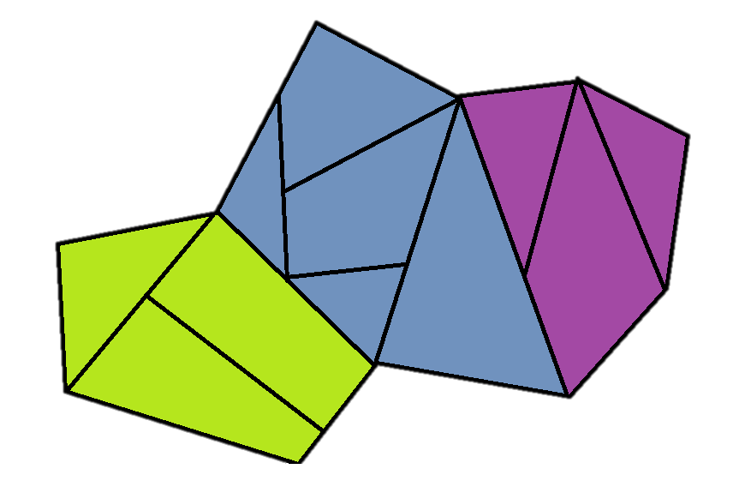

Dissolve
Exactly the same as a groupby for the regular columns
For the geometry columns, overlays all of the geometries
Options for the aggfunc
‘first’, ‘last’, ‘min’, ‘max’, ‘sum’, ‘mean’, ‘median’

Slide 8
Join
tas.merge(grading, left_on='ta_id',
right_on='grader_id')
ta_name | ta_id
Ryan | 1
James | 2
Nicole | 3
ta_name | ta_id | grader_id | student_name
Ryan | 1 | 1 | Wen
James | 2 | 2 | Flora
Nicole | 3 | 3 | Paul
Nicole | 3 | 3 | Andrew
grader_id | student_name
2 | Flora
3 | Paul
1 | Wen
3 | Andrew

Slide 9
Types of Join: what if rows don’t line up?
left.merge(right, left_on = ‘lcol’, right_on = ‘rcol’, how=’type’
Inner (default): Both values must be present
Left: If a value from the left has no match, add NaNs
Right: If a value from the right has no match, add NaNs
Outer: If a value from either table has no match, add NaNs

Slide 10
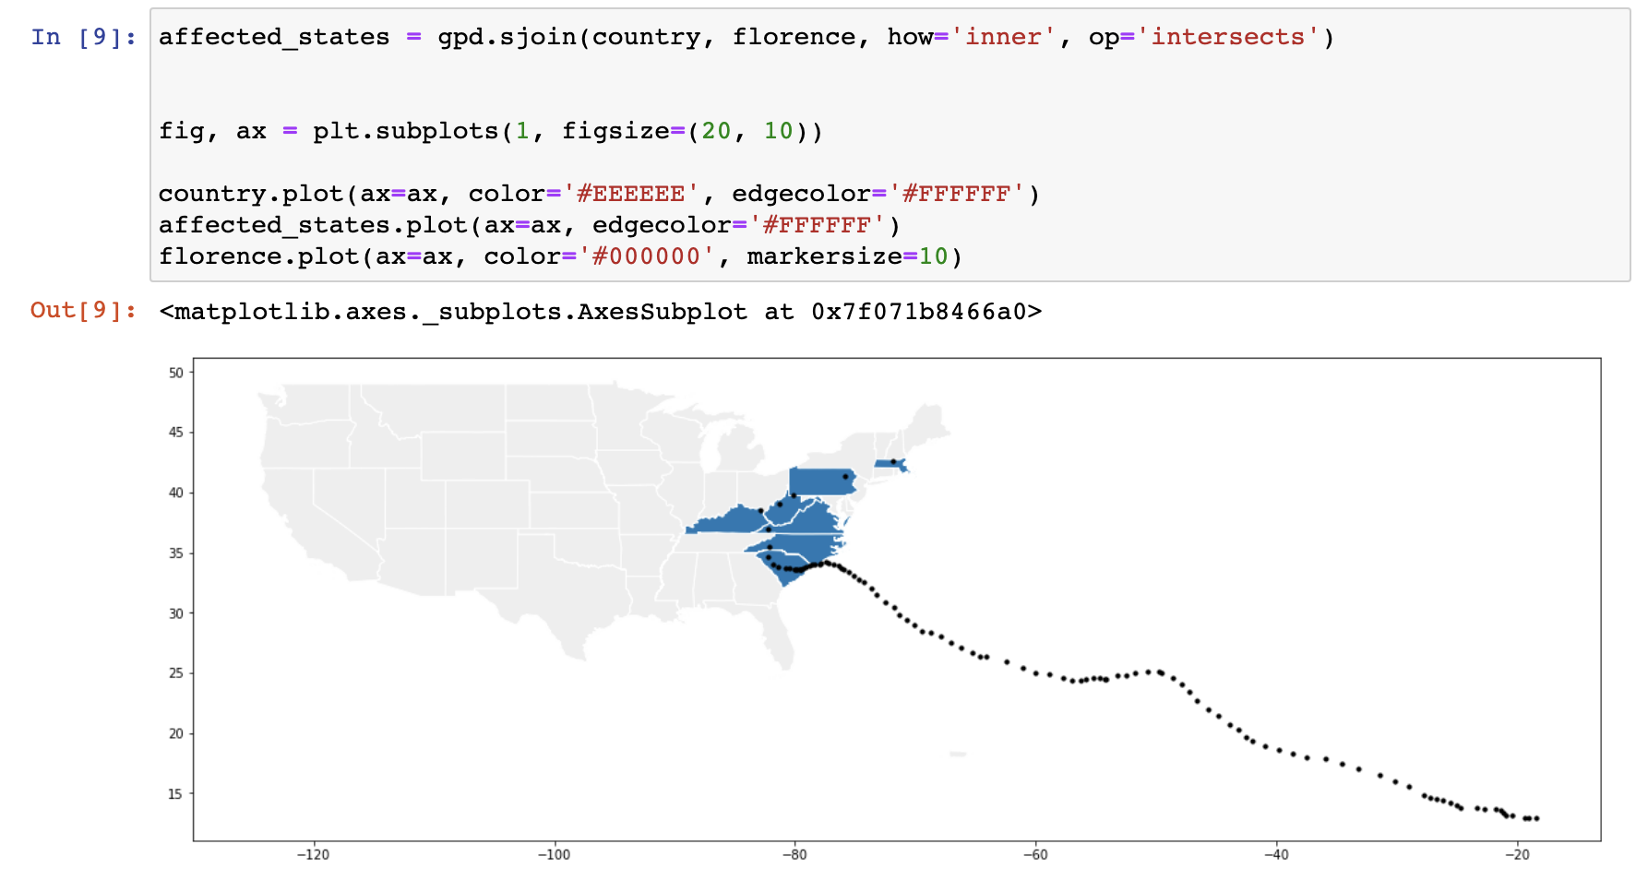
Hurricane Florence

