Slide 1



CSE 163
Geopandas
Adrian Salguero
Spring 2026
💭Icebreaker (discuss with neighbors): ‘
What’s the most difficult sport to play?
Add to our Slido!
slido.com
#cse163

Slide 2
Announcements
Take Home Assessment 5: Mapping will be released early next week
Peer Reviews for THA 4 available tonight, due Wednesday May 13th at 11:59pm!
Project Part 2 due May 14th at 11:59pm!
  EDA/Milestone
  Group Projects: only one person needs to submit but add your teammates to your submission using these instructions
Lesson 17 and 18 Canvas Quizzes will be freebies!
Reading Assignment 4 (tentatively) due May 11th at 11:59pm!
  PDF available on Ed!

Slide 3
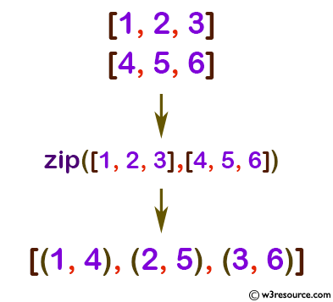
zip
Helpful built-in function to help combine lists
x = [1,2,3]
y = [4,5,6]
zip(x, y)
zip does not return a list! zip returns a generator that you can iterate over once!

Slide 4
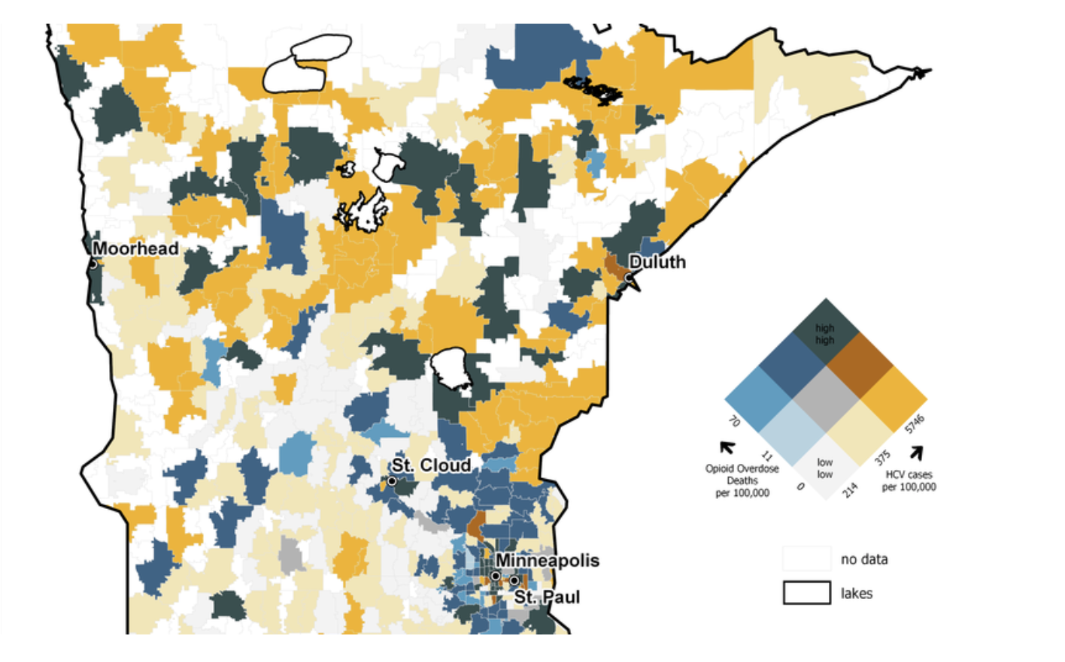
Geospatial Data!: Map representation of data

Slide 5
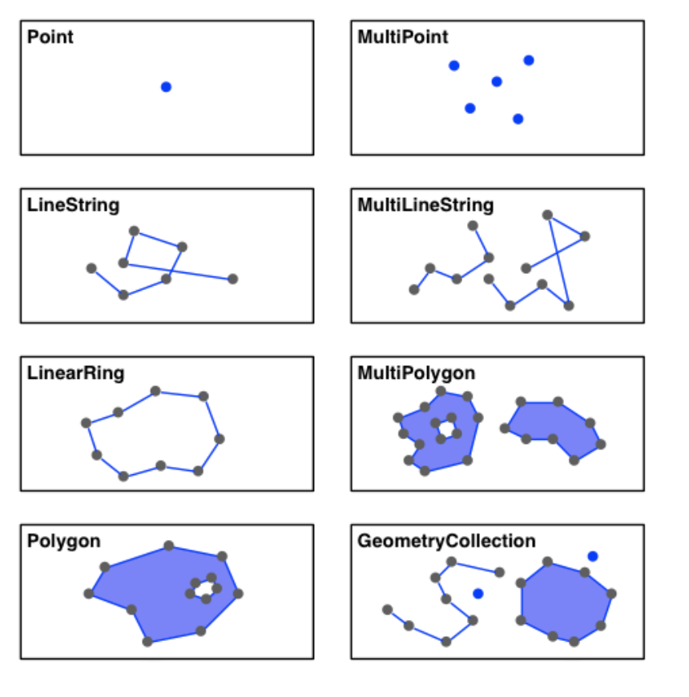
Shapes – the geometry column

Slide 6
Geopandas - pandas with geo data
GeoDataFrame and GeoSeries
import geopandas as gpd
df = gpd.read_file('data_file.shp')
df.plot(column='some_col', legend=True)
plt.savefig('plot.png')

Slide 7
Matplotlib
Default plots gets plotted on a global figure (think like a painting canvas)
  Plots would overwrite each other
  Extra work to plot multiple graph information on the same set of axes
fig, ax = plt.subplots(1)
<plot1>(ax=ax)
<plot2>(ax=ax)
fig.savefig('plot_together.png')

Slide 8
Matplotlib
Default plots gets plotted on a global figure (think like a painting canvas)
  Plots would overwrite each other
  Extra work to plot multiple graph information on the same set of axes
fig, ax = plt.subplots(1)
<plot1>(ax=ax)
<plot2>(ax=ax)
fig.savefig('plot_together.png')
fig, [ax1, ax2] = plt.subplots(1, 2) # width, height
<plot1>(ax=ax1)
<plot2>(ax=ax2)
fig.savefig('plot_separate.png')

Slide 9
Matplotlib
Default plots gets plotted on a global figure (think like a painting canvas)
  Plots would overwrite each other
  Extra work to plot multiple graph information on the same set of axes
ax1
ax2
fig

Slide 10
Matplotlib
Default plots gets plotted on a global figure (think like a painting canvas)
  Plots would overwrite each other
  Extra work to plot multiple graph information on the same set of axes
ax1
ax2
fig

Slide 11
Matplotlib
Default plots gets plotted on a global figure (think like a painting canvas)
  Plots would overwrite each other
  Extra work to plot multiple graph information on the same set of axes
ax1
ax2
fig

Slide 12
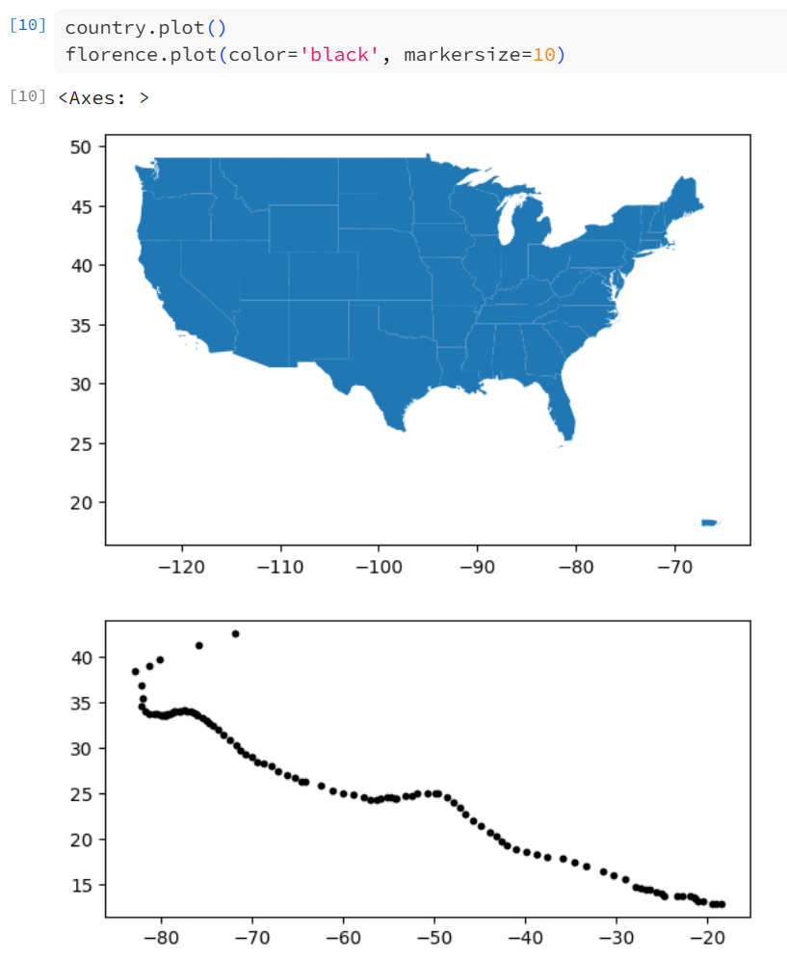
Hurricane Florence

Slide 13
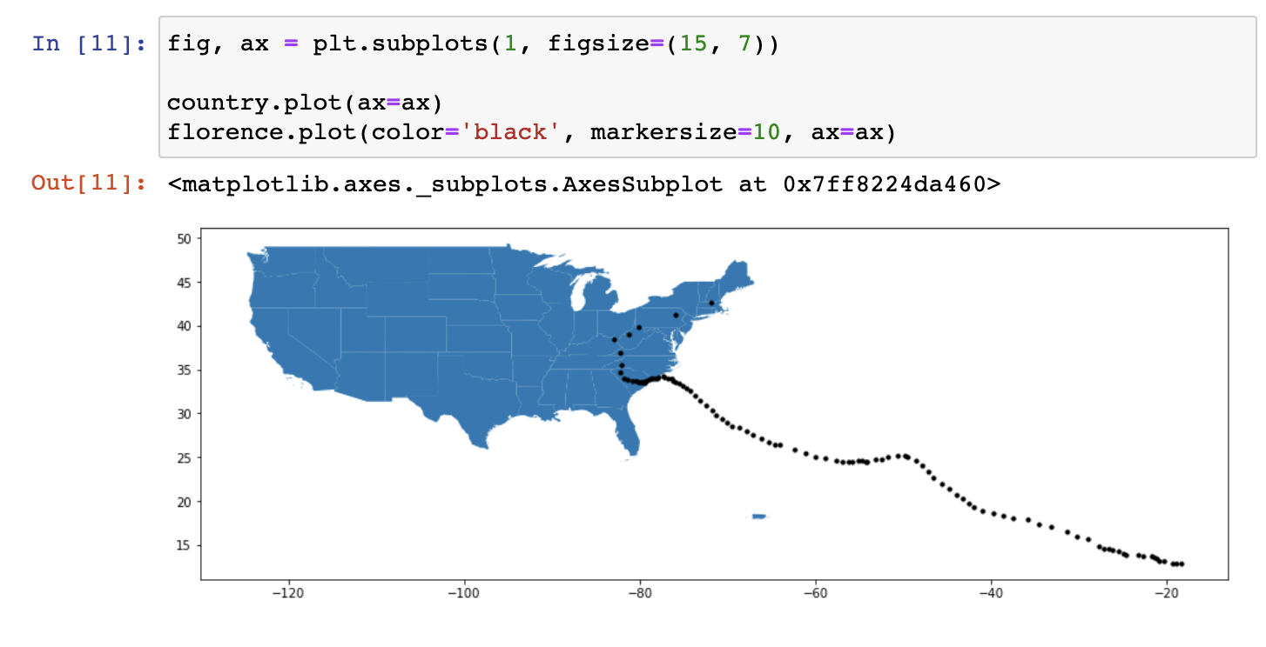
Hurricane Florence

