Slide 1



CSE 163
Model Evaluation
Adrian Salguero
Spring 2026
💭Icebreaker (discuss with neighbors): ‘
Which fictional creature would you like as a pet?
Add to our Slido!
slido.com
#cse163

Slide 2
Announcements
Take Home Assessment 4: Education due tomorrow at 11:59pm!
Peer Reviews for THA 3 due tonight at 11:59pm!
Lesson 16 Canvas Quiz due tonight at 11:59pm!
Reading Assignment 4 now available, due May 11th at 11:59pm!
Project Part 2 now available, due May 14th at 11:59pm!
  EDA/Milestone
  Group Projects: only one person needs to submit but add your teammates to your submission using these instructions

Slide 3
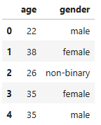
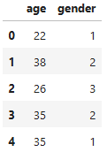
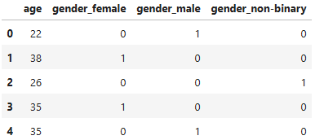
One-Hot Encoding
Mapping categories to numerical numbers can cause unintended consequences
Transform categorical column into multiple columns of binary values (either 0 or 1)
Categories → Numbers
Categories → One-Hot Encoding

Slide 4
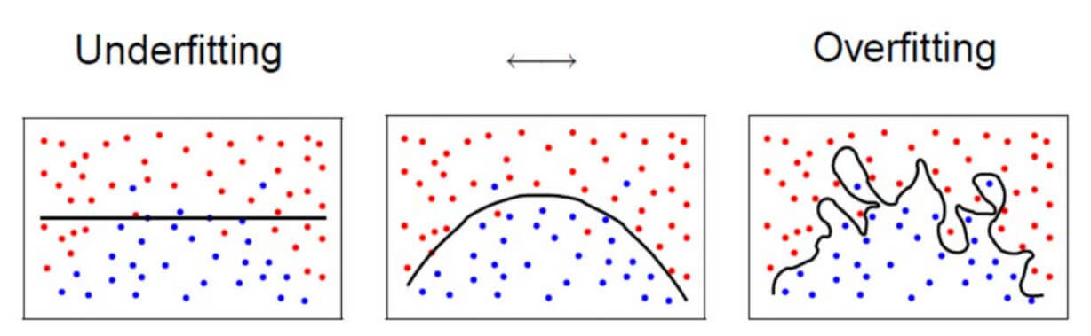
Overfitting
Overfitting: when your model matches the training set so well, that it fails to generalize
  Example: Memorizing answers on a multiple choice test
Tall trees are likely to overfit if you don’t have enough data
  Can learn very complex boundaries
  Very few points at the leaves

Slide 5
Assessing Performance
Why is it bad practice to evaluate your data on your training set?
The purpose of your models are to generalize to new data
  Data your model has not seen
Set aside a test set to evaluate your model
Never train or make decisions based on your test set!

Slide 6
Classification ML Pipeline (w/ categories)
# Separate data
features = data.loc[:, data.columns != 'target']
features = pd.get_dummies(features)
labels = data['target']
# Train/test split
feat_train, feat_test, lab_train, lab_test = \
train_test_split(features, labels, test_size=0.2)
# Create and train model on train set
model = DecisionTreeClassifier()
model.fit(feat_train, lab_train)
# Predict on test data
predictions = model.predict(feat_test)
accuracy_score(lab_test, predictions)

Slide 7
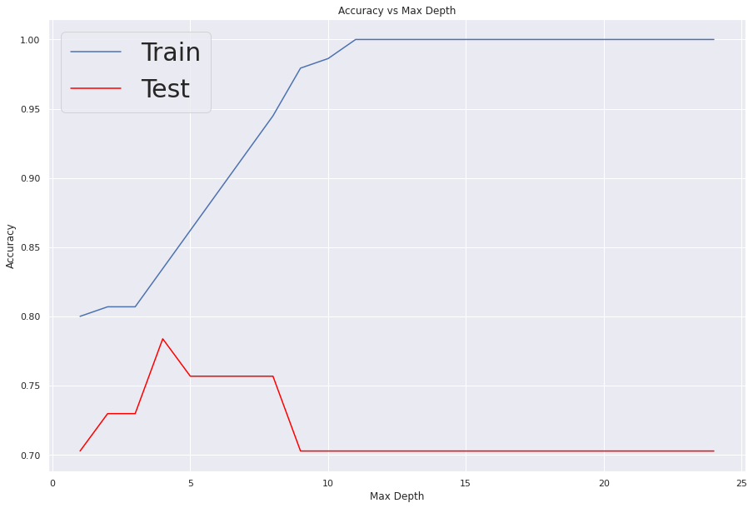
Model Complexity
One hyperparameter to control complexity of decision tree is the max depth (or height) of tree

Slide 8
Model Complexity
One hyperparameter to control complexity of decision tree is the max depth (or height) of tree

Slide 9
Visualize the split
Empty model
Trained model
feat_train
lab_train
fit
feat_test
lab_test

Slide 10
Visualize the split
Empty model
Trained model
feat_train
lab_train
fit
predict
predictions
feat_test
accuracy_score
lab_test

Slide 11
Ground Rules
Talking about social impact and ethics in data science can be challenging since its effects can be deeply personal or harmful
  Many reasonable people have differing opinions on how to draw the line between okay/not okay, there isn’t always an easy yes/no answer
Productive Discussions
  Listen with intention to understand first and forming an opinion only after you fully understand
  Take responsibility for the intended and unintended effects of your words and actions on others
  Mindfully respond to others’ ideas by acknowledging the unique value of each contribution

Slide 12
Discussion – Lesson Quiz
Consider the case of our credit card churn predictor. Suppose we were using it in our first case use of predicting whether a current customer is likely to churn, and if they are, provide them with special offers to incentivize them to stay.
Consider the case of our credit card churn predictor. Suppose we were using it in our second use case of predicting whether a new customer is likely to churn or not, and if they are, don’t provide them with a credit card in the first place.
Would you endorse using either system? Why or why not? Justify what concerns you might have about either system or why you think some potential concerns do not outweigh the benefit of the model.

