Slide 1



CSE 163
Intro to Machine Learning
Adrian Salguero Spring 2026 💭Icebreaker (discuss with neighbors): ‘
What is your favorite tree?
Add to our Slido!
slido.com
#cse163

Slide 2
Announcements
Take Home Assessment 4: Education due Thursday May 7th at 11:59pm!
Peer Reviews for THA 3 due Wednesday May 6th 29th at 11:59pm!
Lesson 15 Canvas Quiz due tonight at 11:59pm!
Checkpoint 3 due tonight at 11:59pm!

Slide 3
Machine Learning Terms
Machine Learning
Model
Machine Learning Algorithm
Data
Training set
Exmaple
Feature
Label
Types of Machine Learning
Regression
Classification

Slide 4
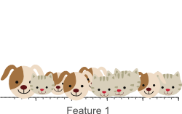
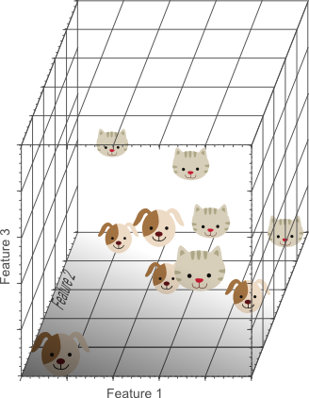
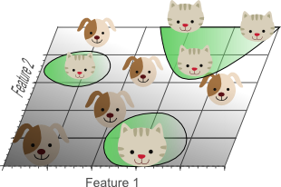
Garbage In, Garbage Out
There exists hundreds of different model types, but the most important thing is having good features to describe your data!

Slide 5
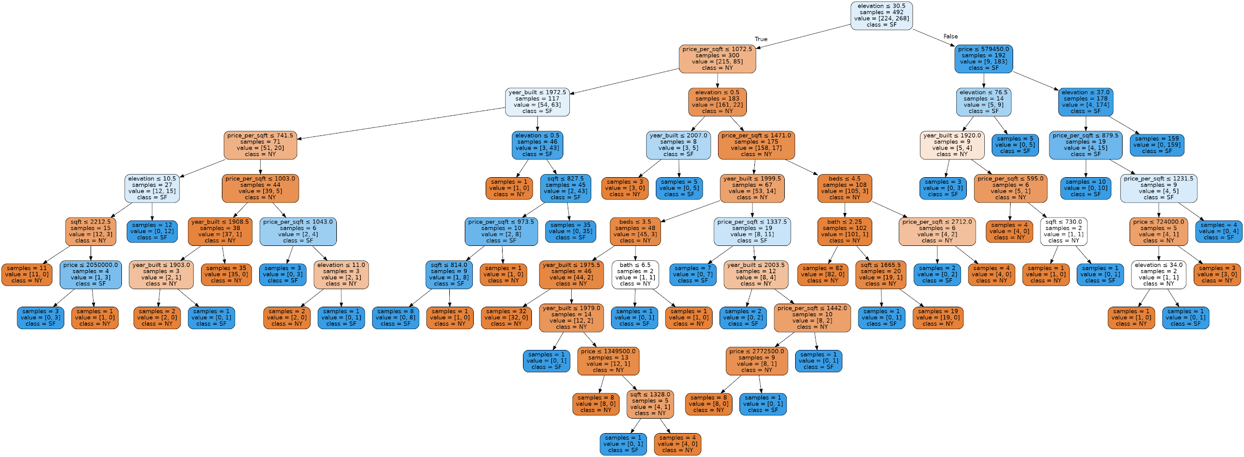
Decision Tree!

Slide 6
(Typical) Classification ML Pipeline
# Separate data
features = data.loc[:, data.columns != 'target']
labels = data['target']
# Create and train model
model = DecisionTreeClassifier()
model.fit(features, labels)
# Predict on some data
predictions = model.predict(features)
# Assess accuracy
accuracy_score(labels, predictions)

Slide 7
(Typical) Regression ML Pipeline
# Separate data
features = data.loc[:, data.columns != 'target']
labels = data['target']
# Create and train model
model = DecisionTreeRegressor()
model.fit(features, labels)
# Predict on some data
predictions = model.predict(features)
# Assess MSE
mean_squared_error(labels, predictions)

