Slide 1


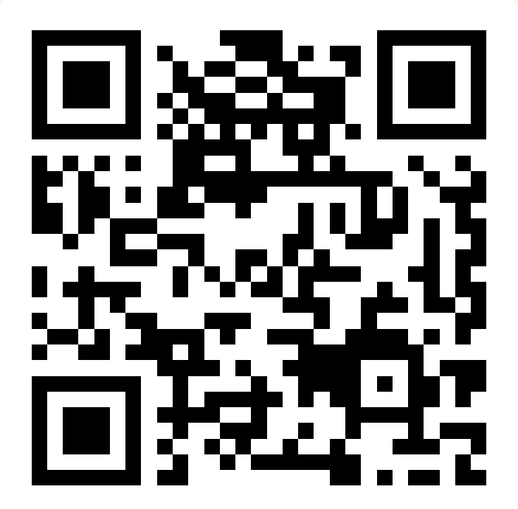
CSE 163
Statistical Learning
Adrian Salguero Spring 2026 💭Icebreaker (discuss with neighbors): ‘
Halfway through the quarter! How are you feeling?
Add to our Slido!
slido.com
#cse163

Slide 2
Announcements
Take Home Assessment 4: Education released tonight, due Thursday May 7th at 11:59pm!
Peer Reviews for THA 3 released tonight, due Wednesday May 6th 29th at 11:59pm!
Project Part 1 due tonight at 11:59pm on Gradescope! (No late submissions!)
Lesson 14 Canvas Quiz due tonight at 11:59pm!
Checkpoint 3 due Monday, May 4th at 11:59pm!

Slide 3
Mid Quarter Feedback
Things going well
THAs – reinforce course content and are reasonable, creative components are good for exploring data in a less restrictive space
Quiz sections – formatted well, good additional practice
Class exercises, resubmission cycles, pre-class readings
Areas for improvement
Quiz sections – more practice problems, more direct help, be less of a repeat of lecture
Reading assignments – seem irrelevant to course topics or assignments
Lecture – not enough time spent going over all practice problems
Too many assignments scattered across different platforms
If you have additional feedback (or just want to share this feedback again for credit towards a weekly token), please fill out this feedback form.

Slide 4
What is Statistics?
“The study of models to gather, understand, and draw conclusions from real-world data.”
- Hunter Schafer, 2020 (and probably other people too)
Applications of statistics:
Predicting disease outbreaks
Product testing
Sports analytics
Machine learning
…and many more

Slide 5
Statistics 101
Summary Statistics
Number of values in our data set
Mean - the “average” value
Median - the value in the middle of our data set
Standard deviation - how spread out our values are
Min, max, mode, range, etc.
Distributions
How are values in our data set distributed?
Uniform distribution
Normal distributions
Other types of distributions (e.g. bimodal)

Slide 6
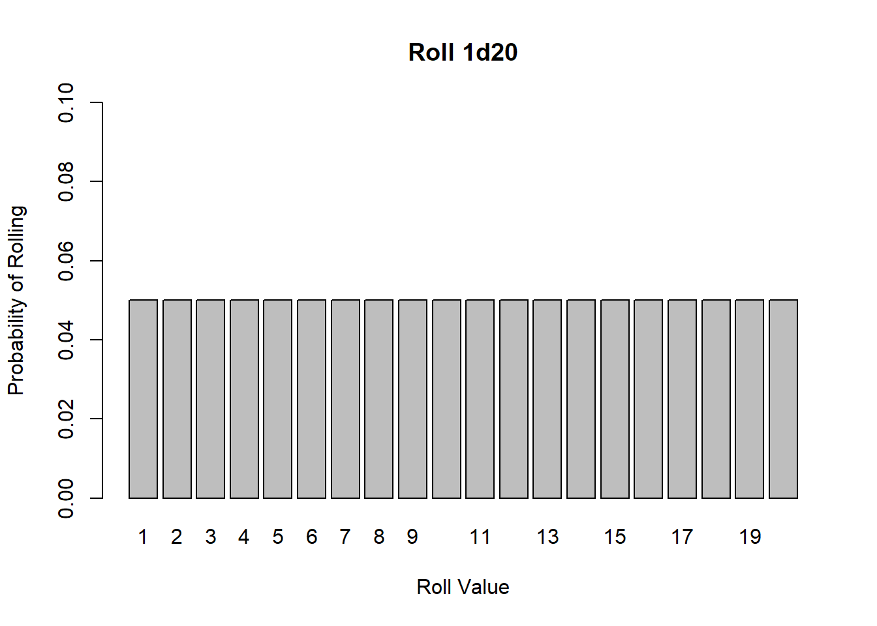
Uniform Distribution - everything equally likely
Coin flip - Heads or Tails
Dice roll - all sides
Perfect random number generator

Slide 7
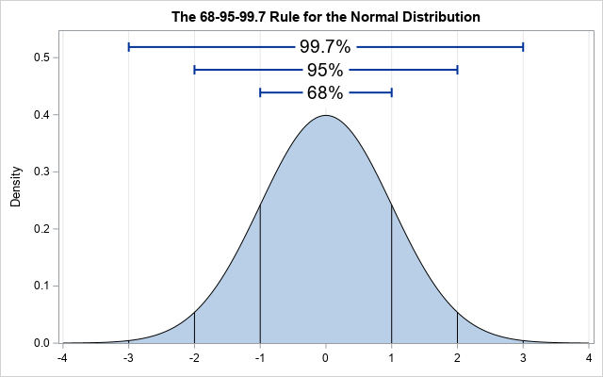
Normal Distribution - bell curved, mean centered
Height
IQ
Grades

Slide 8
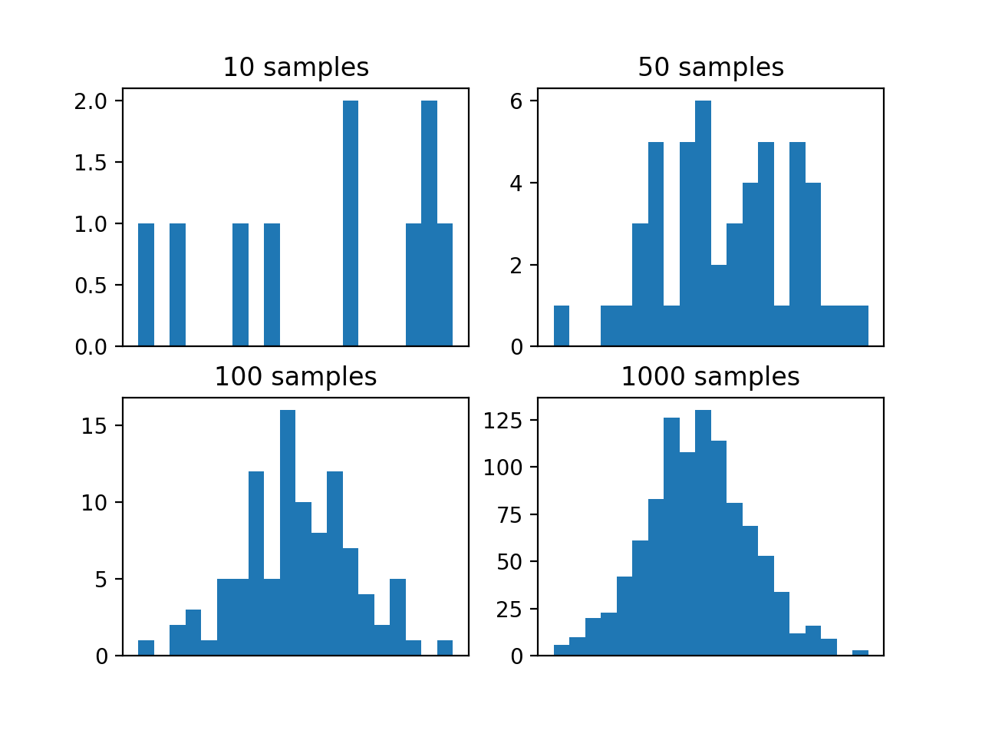
Central Limit Theorem
Distribution of sample means approaches a normal distribution as number of samples increases!

Slide 9
Hypothesis Tests
Null Hypothesis is the hypothesis that supports the pre-existing expectations of probability (e.g. the status quo)
Alternative Hypothesis is the hypothesis that something is different, one that if true, would allow us to reject the null hypothesis.
Our p-value is the chance that this situation would happen in a world bound by the null hypothesis
If our p-value is lower than a given significance level (usually 0.05), it is significant enough to reject the null hypothesis
Be mindful of “p-hacking” - misusing data analysis techniques or data in the hopes of getting significant results
A non-significant result is still valuable and should be reported!

Slide 10
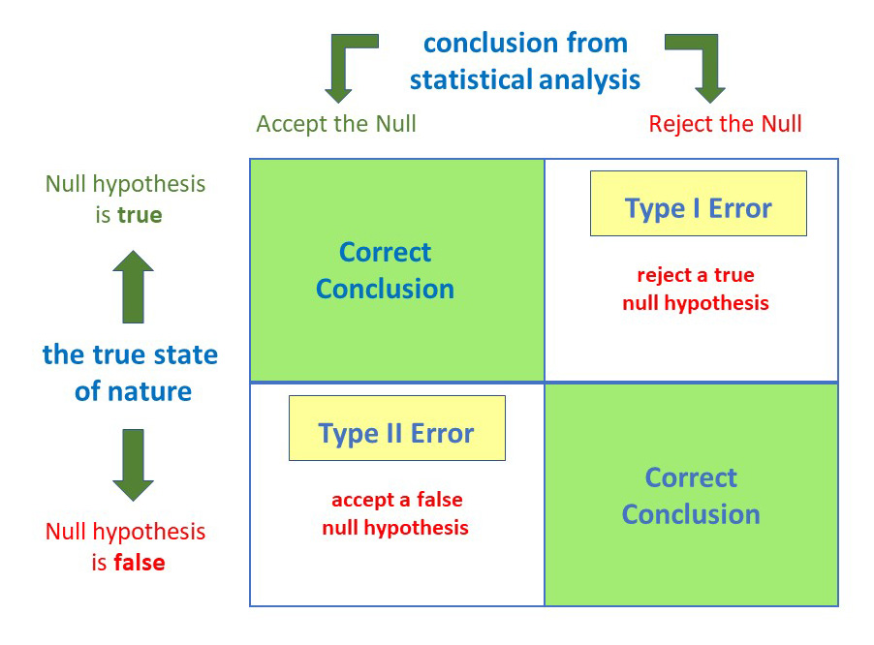
Type 1 and Type 2 Errors
Accept = “fail to reject”

Slide 11
Type 1 and Type 2 Errors
You visited Hall Health Center to check if you have the flu. Your doctor says you don’t have it, while you actually have the flu. What type of error did the doctor make?
Null hypothesis
You don’t have the flu

