Slide 1



CSE 163
Humanistic Computing
Adrian Salguero Spring 2026 💭Icebreaker (discuss with neighbors): ‘
What type of data or question would you like to build a project around? Add to our Slido!
slido.com
#cse163

Slide 2
Announcements
Take Home Assessment 3: Pokemon due tomorrow at 11:59pm!
Peer Reviews for THA 2 due tonight at April 29th at 11:59pm!
Lesson 13 Canvas Quiz due tonight at 11:59pm!
Project Part 1 due Friday May 1st at 11:59pm on Gradescope!
Checkpoint 3 due Monday, May 4th at 11:59pm!

Slide 3
Recall from last lecture
Think of how your analysis might be used or interpreted.
Consider biases in your data and analysis – even the ones that might come from you!
Consider the impacts, ethics, and consequences of your analysis
Data science tells a story – who is our “main character” and what do we want to focus on or highlight?

Slide 4
Humanistic Computing
Data as representation of our reality
Complementary skills over competing ones
Interpretation over prediction
Ask questions, be aware of the context, and consider the consequences
Documentation provides context
File headers
Doc-strings
Type annotations
In-line comments
Separate documents

Slide 5
Objectivity…doesn’t really exist
Analysis creates interpretation rather than certainty
Be mindful of what you can and cannot claim based on the results
What questions were answered and what questions were generated?
These additional questions can be used for future projects

Slide 6
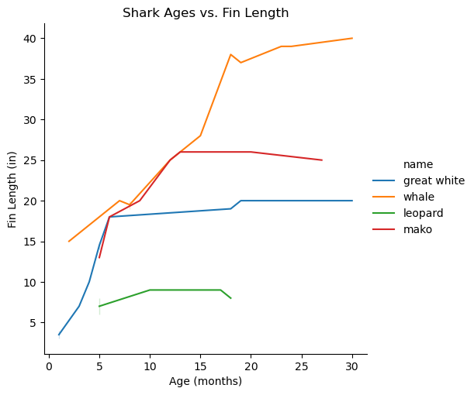
Getting Answers
What questions might this plot answer?

Slide 7
Getting Answers
What questions might we have after viewing this plot?

