Slide 1



CSE 163
Data Visualization
Adrian Salguero Spring 2026 💭Icebreaker (discuss with neighbors): ‘
What do you think the most useless invention is? Or what do you think is the most useful?
Add to our Slido!
slido.com
#cse163

Slide 2
Announcements
Take Home Assessment 3: Pokemon due Thursday, April 30th at 11:59pm!
Peer Reviews for THA 2 due Wednesday, April 29th at 11:59pm!
Lesson 11 Canvas Quiz due tonight at 11:59pm!
Reading Assignment 3 due Monday, April 27th at 11:59pm!
Project Part 1 due Friday May 1st at 11:59pm on Gradescope!
Choose either the Project (group of max 3) or Portfolio (individual)
You cannot switch once you’ve selected your option
If you are doing the Project, only one person need submit on Gradescope but make sure your partners are added to your submission! Instructions on Project Part 1 assignment!
Resub Cycle 2 will be made available today and due on Tuesday, April 28th
Eligible assignment(s): THA 1

Slide 3
Project / Portfolio Part 1
Project
Original data analysis
Go beyond what you have shown in the THAs
Groups of max 3 people
Proposal - what data are you using, what questions are you trying to answer, what are the motivations, and what is your plan?
Portfolio
Polishing and connecting creative component work
Portfolio does not replace original creative component work
Individual
Vision Statement - what are your components, feedback, theme, and plan?

Slide 4
Default Parameters
Python lets you define default values for parameters in case a client does not pass a value for that argument
def greetings(to: str = 'world'):
return 'Hello ' + to + '!'
greetings('Sarah') # 'Hello Sarah!'
greetings(to='Antonio') # 'Hello Antonio!'
greetings() # 'Hello world!'
This allows libraries such as pandas or seaborn to provide default parameters for their functions and initializer functions!

Slide 5
Python Data Visualization
Many libraries exists for Python that alow you to do graphing and data visualization
Two of the most popular graphing libraries for Python are
matplotlib: extremely customizable
seaborn: great out-of-the-box visualizations
We will encourage seaborn since it is quickly becoming the standard for many data scientists
We wil still rely on matplotlib for some things
You are welcome to use it in more depth on your project if you want to make more highly customized charts

Slide 6
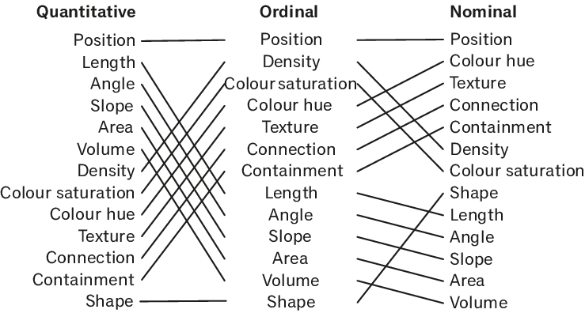
Encoding Effectiveness
[Mackinlay 86]

Slide 7
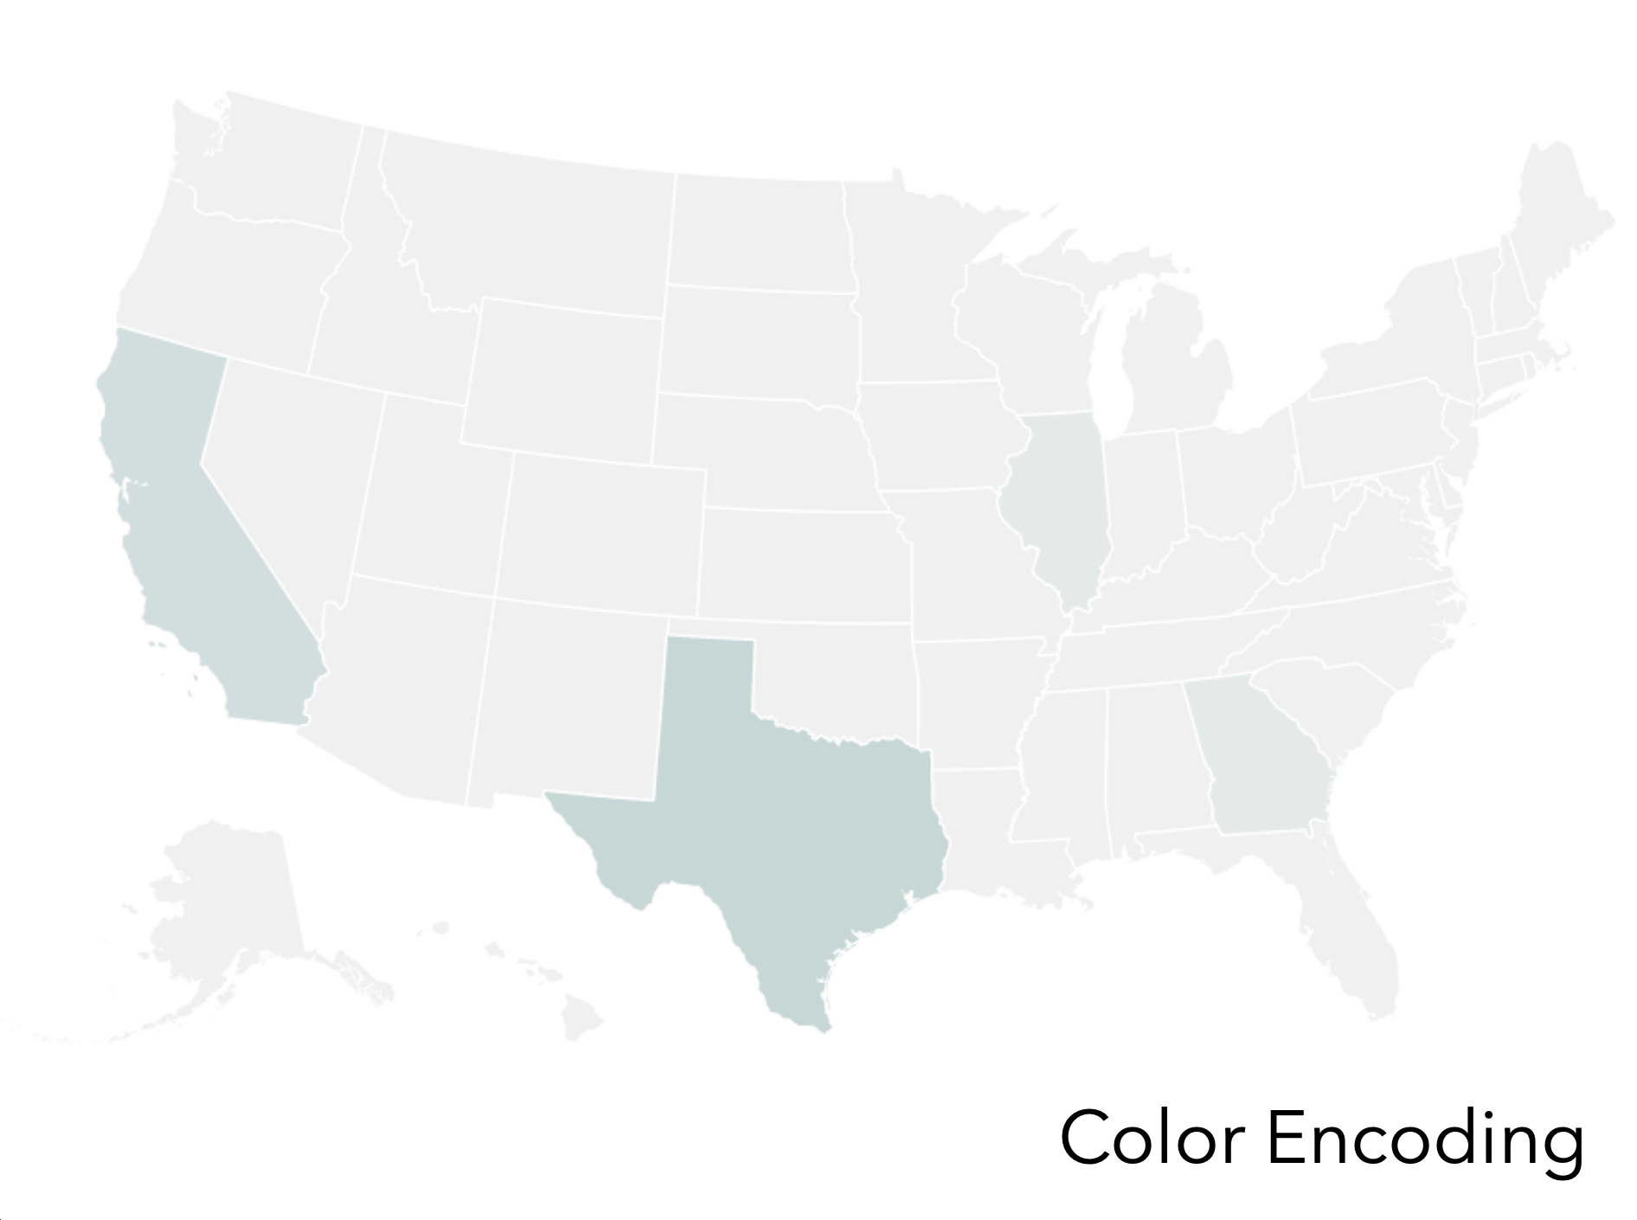
Color Encoding Example

Slide 8
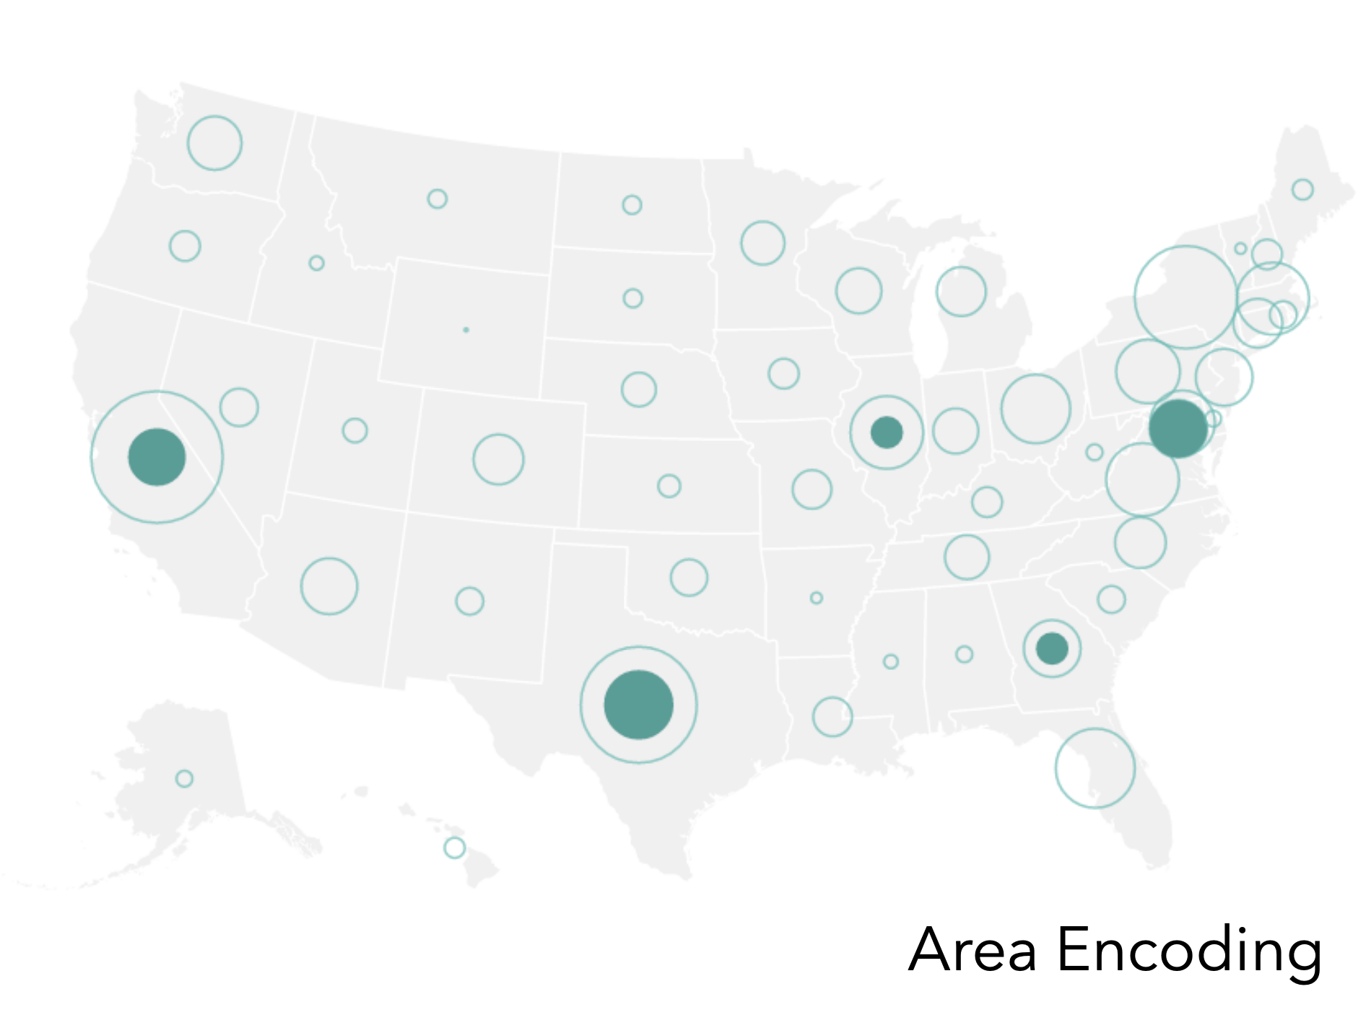
Area Encoding Example

Slide 9
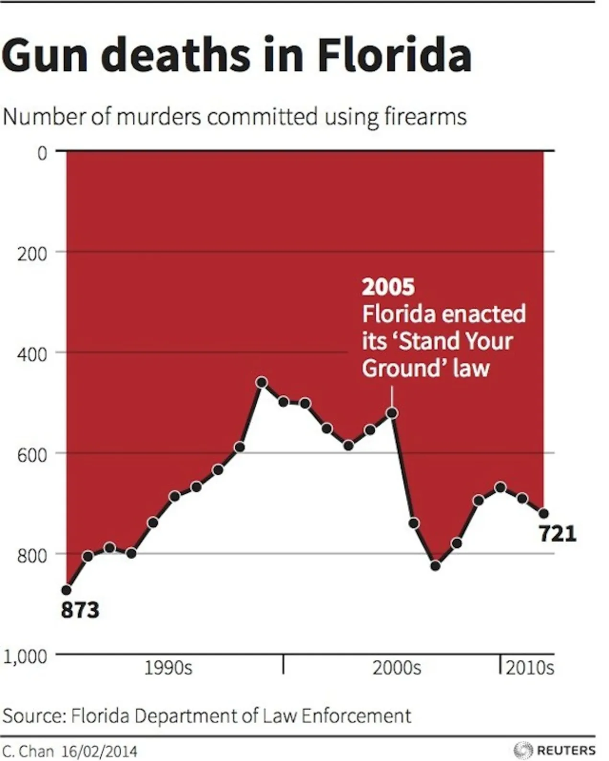
Readability is Important!
Did the number of deaths go up or down after the law was enacted?
This graphic was posted in an articly by Business Insider
(graphic made by Reuters)

Slide 10
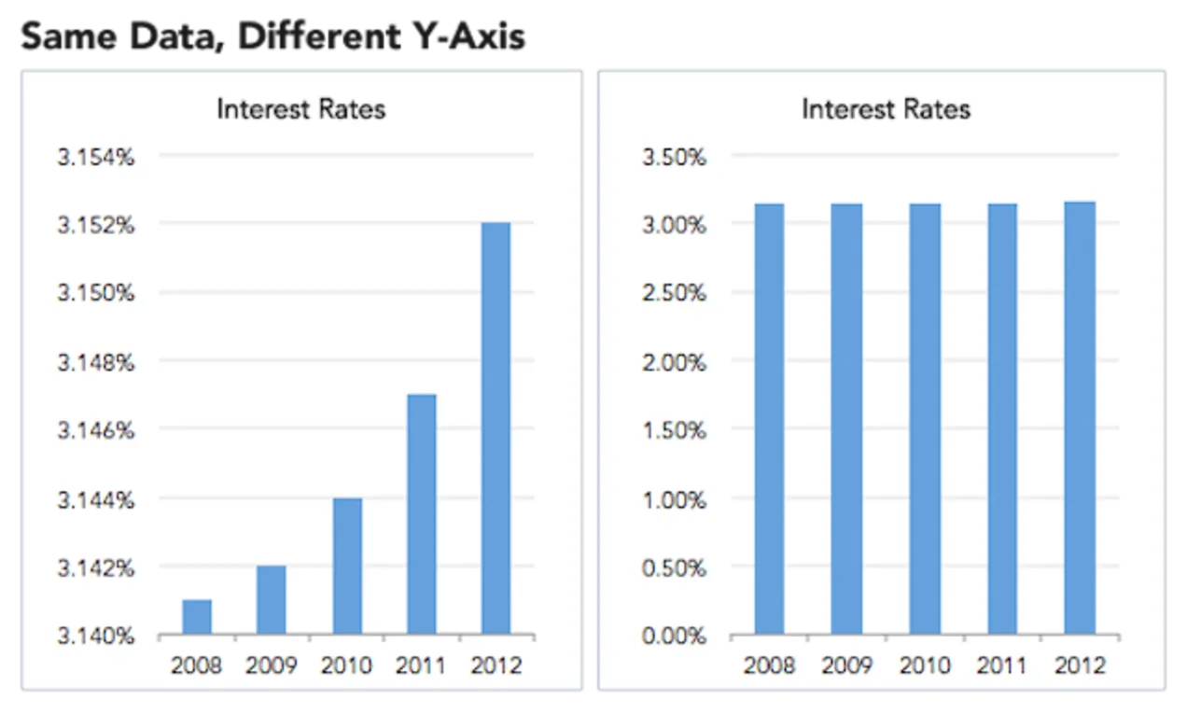
How to Lie with Data Visualization

Slide 11
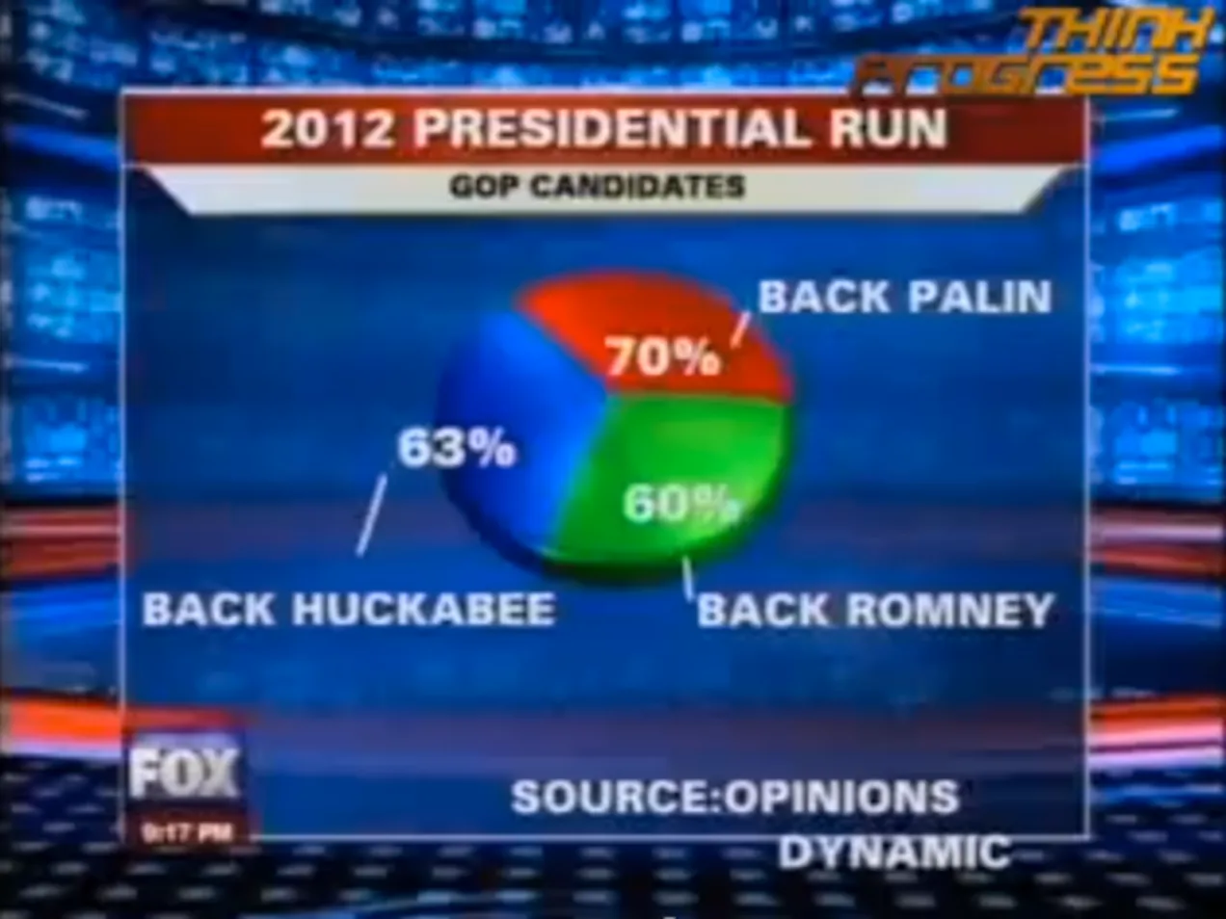
How to Lie with Data Visualization

Slide 12
Remember…
Just because seaborn or matplotlib allow you to do something with your visualizations doesn’t mean that’s the most effective way to to present results.
Be mindful of the ethical and conclusion implications that may come from presenting your data in a specific way.
Data visualizations are meant to give us a relatively quick summary of your results. People should not be trying to decode what your visualization is saying.
Be mindful of the color, font, and font size you use in your graphics
Accessibility matters when it comes to graphics
Good starting point for accessible color palettes.

