Slide 1


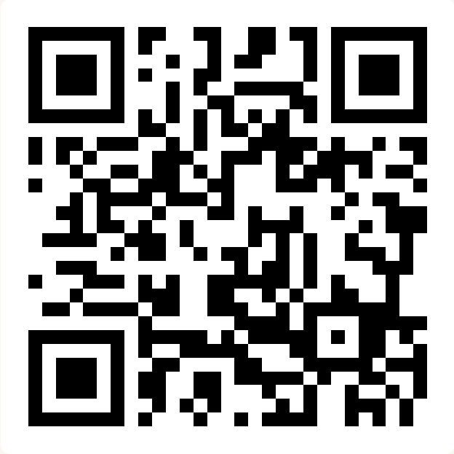
CSE 163
Introduction to Python
Adrian Salguero Spring 2026 💭Icebreaker (discuss with neighbors): ‘
What is your favorite TV show? Add to our Slido!
slido.com
#cse163

Slide 2
Announcements
Reading Assignment 1 due tonight at 11:59pm!
Reading and annotating the syllabus on Hypothesis (through Canvas)
Lesson 1 Canvas Quiz due tonight at 11:59pm!
Need to score 100% to count as completion (unlimited attempts)
Section starts tomorrow!
First section assignment is due Friday at 10:30am (before class)
Office Hours are available this week
Check the course calendar
Make sure you have access to all the course materials
Ed, Gradescope, Canvas
If you just enrolled: wait about 24 hours for the rosters to update
If you are having trouble running Python files, please come to office hours.

Slide 3
Questions during Class
Feel free to raise your hand at any point during class if you have a question.
During group work time, TAs and Adrian will be walking around answering questions individually.
You can also post questions on the Slido
If we miss your question
Ask it after class
Make an Ed post
Add it to the Slido so a TA or Adrian can reply with an answer
After every lecture, Adrian will post a Slido Recap on the course Ed board. This will contain questions and answers to all of the Slido questions for the day

Slide 4
Website/(Quick) Gradescope Tour!
Website is now live!
https://courses.cs.washington.edu/courses/cse163/26sp/
Bookmark this page!
Shorthand: cs.uw.edu/163
If you are every unsure of where to find the assignments, check on the course website!
Things to look out for
Course Calendar (home page)
Lessons (in the left-hand sidebar)
Office Hours (in the left-hand sidebar)
Course Tools (in the left-hand sidebar)
Ed, Canvas, Gradescope, JupyterHub, Anonymous Feedback

Slide 5
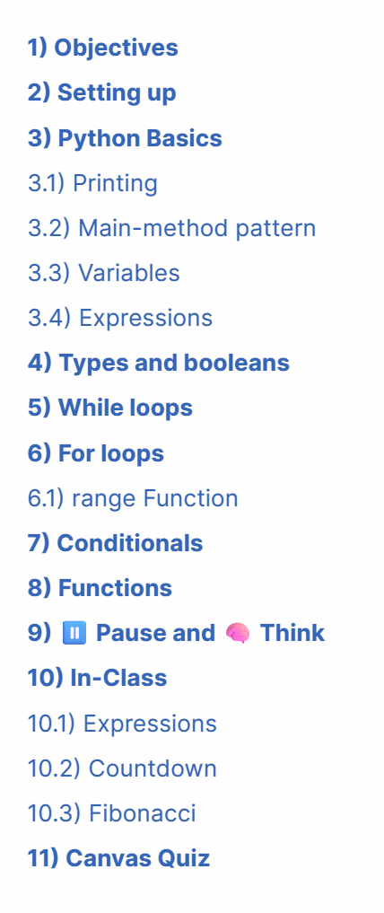
Pre-Class/Lesson Workflow
Each lesson has a table of contents
Download files from “Setting up”
Before class: Read as much as you can up to the “Pause and Think” section
During class: Review the reading and work on the “In-Class” section
After class: Complete the “Canvas Quiz”

Slide 6
Types and Casting
Types in Python
int: integers
float: decimal-point numbers
bool: True or False (Boolean values)
Expressions : values and operations that evaluate to a value (int, float, bool, etc.)
a = 4.0
b = 3 * 2 + 4 ** 2
x = True
y = 9 < 4
Casting: changing the data type of a value to another
3.3 → int?
“3.3” → int?
Other rules apply!

Slide 7
Loops and Conditionals
Two types of loops:
for: runs for a fixed number of iterations
while: runs while a certain condition remains True
Conditionals:
Can change behavior of your function depending on certain conditions
Only one behavior is chosen from the branches
n = 5
if n < 10:
print(‘A’)
elif n < 20:
print(‘B’)
else:
print(‘C’)

Slide 8
Recap: Anatomy of a Function
def keyword
Function name
Optional
parameters
def function_name(parameter, ...):
#Function code
return value
colon
Indentation
Function code
Return statment

Slide 9
Lesson Highlights
Most of this lesson should have been mostly familiar
variables, conditionals, loops, functions, etc.
New Python syntax things may be the “newest” thing you’ve encountered
Colons after function and loop definitions
No brackets, semicolons, or variable type definitions
Main method pattern!
def main():
print('Hello world!')
if __name__ == '__main__':
main()
Syntax is different (which is okay!)
Can’t explain entire grammar. Learn by looking at fragments and playing with code.
Gets better with practice! Try things and see how they change the code.
Indentation is important!

Slide 10
Writing our own Function
Write a file called hello.py that prints “Hello World!”
Attempt 1
print('Hello World!')
Attempt 2
def main():
print('Hello World!')
if __name__ == '__main__':
main()

Slide 11
Group Work: Best Practices
When working with a new group for the first time:
Introduce yourself!
If possible, angle one of your screens so that everyone can see and discuss together
Be respectful of each other and allow everyone to speak
Tips:
Start with making sure that everyone agrees to work on the same problem
Allow everyone to contribute or a chance to ask questions.
Ask if everyone agrees and periodically ask each other questions.
Call TAs or Adrian over if you need any help.
Don’t sit in silence.

Slide 12
Before Next Class
Go to section!
Complete Section Assignment 1 on Gradescope
Complete Lesson 1 Canvas Quiz
Due for EC @ 11:59pm Apr 1st
Read Lesson 2 on the course website
Read lesson, you can stop after completing the “Pause and Think” section
Encourage you to save the “In-Class” problem for class session.
Due for EC @ 11:59pm Friday, April 3rd.
Make sure you are able to run Python files on your computer

