Slide 1

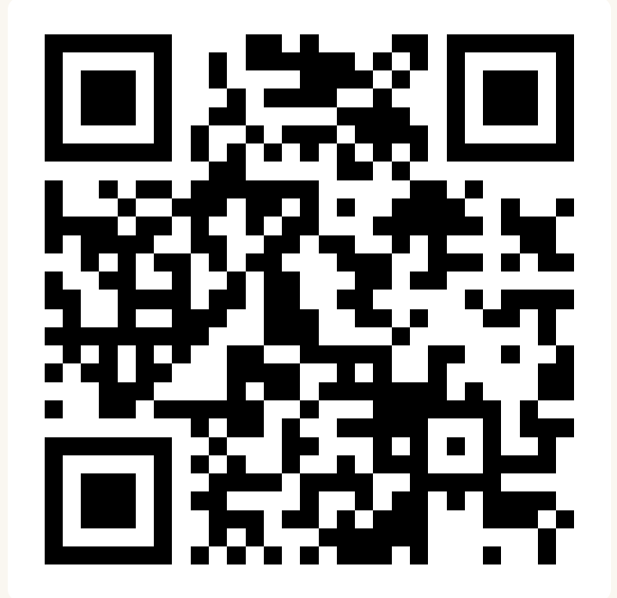
CSE 163
Introduction & Syllabus
Adrian Salguero Spring 2026 💭Icebreaker (discuss with neighbors): How did you spend Spring Break? Add to our Slido!
slido.com
#cse163

Slide 2
Agenda
Overview
What is this class? Who is taking this class?
Who are we (the people leading this class)?
Course structure
Assessments and Grading
Introduction to course tools
Course website – stay tuned for this!
Ed
Gradescope
Hypothesis
Slido Q&A will be open all class

Slide 3
Overview
What is this class?
Competencies
More advanced programming concepts than in CSE 122 or CSE 160 including how to write bigger programs with multiple classes and modules.
How to work with different types of data: tabular, text, images, geo-spatial, etc.
Ecosystem of data science tools including Jupyter Notebook and various data science libraries including scikit-image, scikit-learn, and pandas data frames.
Basic concepts related to code complexity, efficiency of different types of data structures, and memory management.
Foundations of data literacy and technical communication for critical and conscientious data science.

Slide 4
Overview
Who is taking this class?
This class is designed to have students from
122: Know control structures, file I/O, arrays in Java
Will spend first weeks learning 122 in Python fast!
Practice is KEY!
160: Know control structures, file I/O, data structures in Python
First week will be review while everyone learns Python
123 or Beyond: Seen more advanced programming in Java
Class material should be complementary to what you would have learned in 123
Competency 1 is aimed at the 123 level of programming
Poll on Slido!

Slide 5
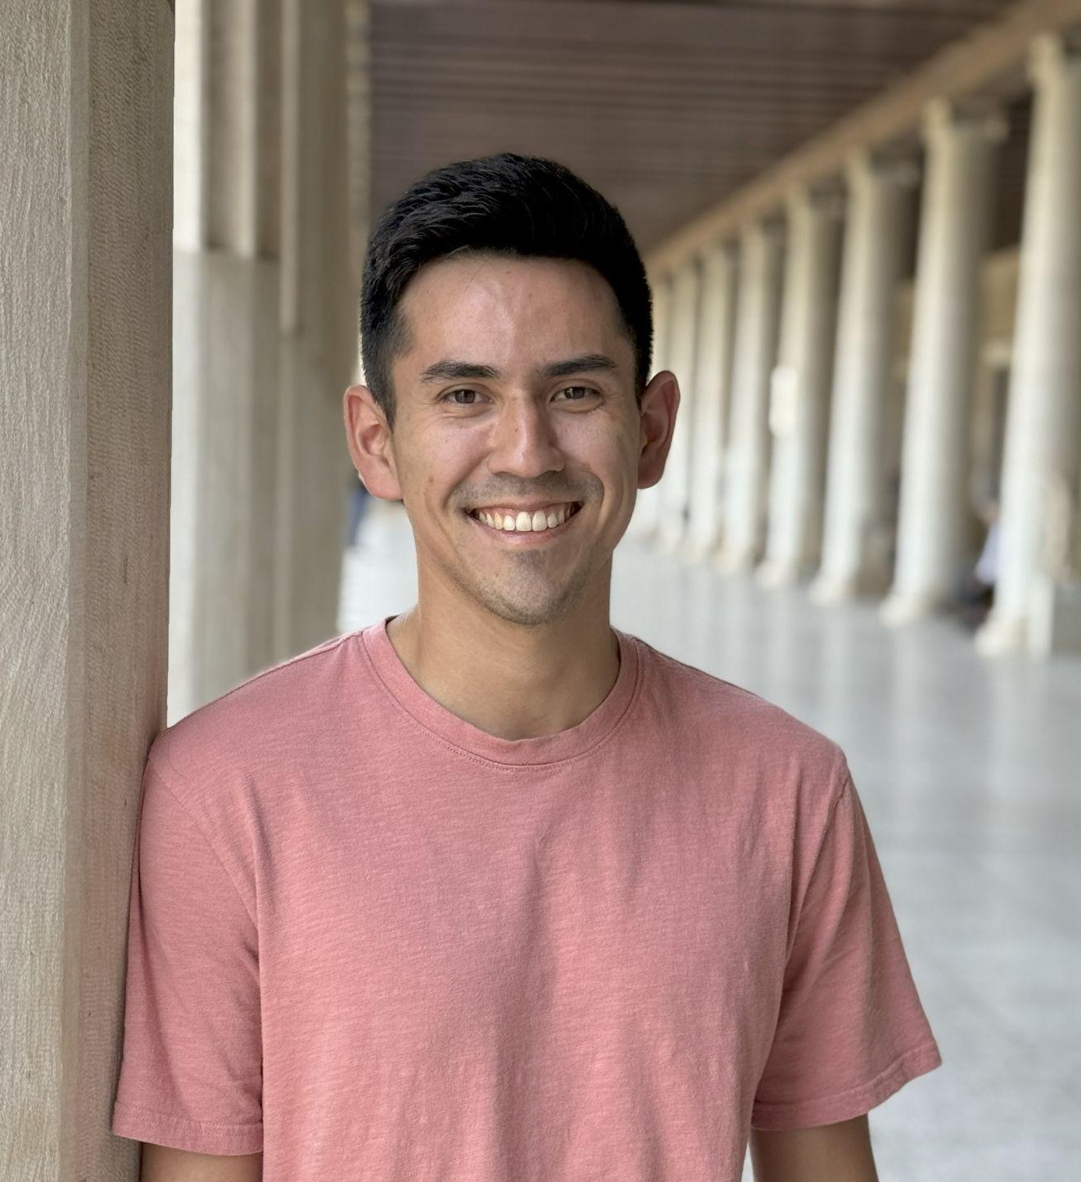
Who am I?
Instructor: Adrian Salguero
From Los Angeles, CA (lived most of life in CA)
Bachelors from UC Santa Cruz
PhD from UC San Diego
Running, comics, video games, weightlifting
Call me: Adrian or Professor Adrian
Teaching Assistants: 11 Amazing TAs!
Available in section, office hours, and discussion board!
Invaluable sources of information and help in this course!

Slide 6
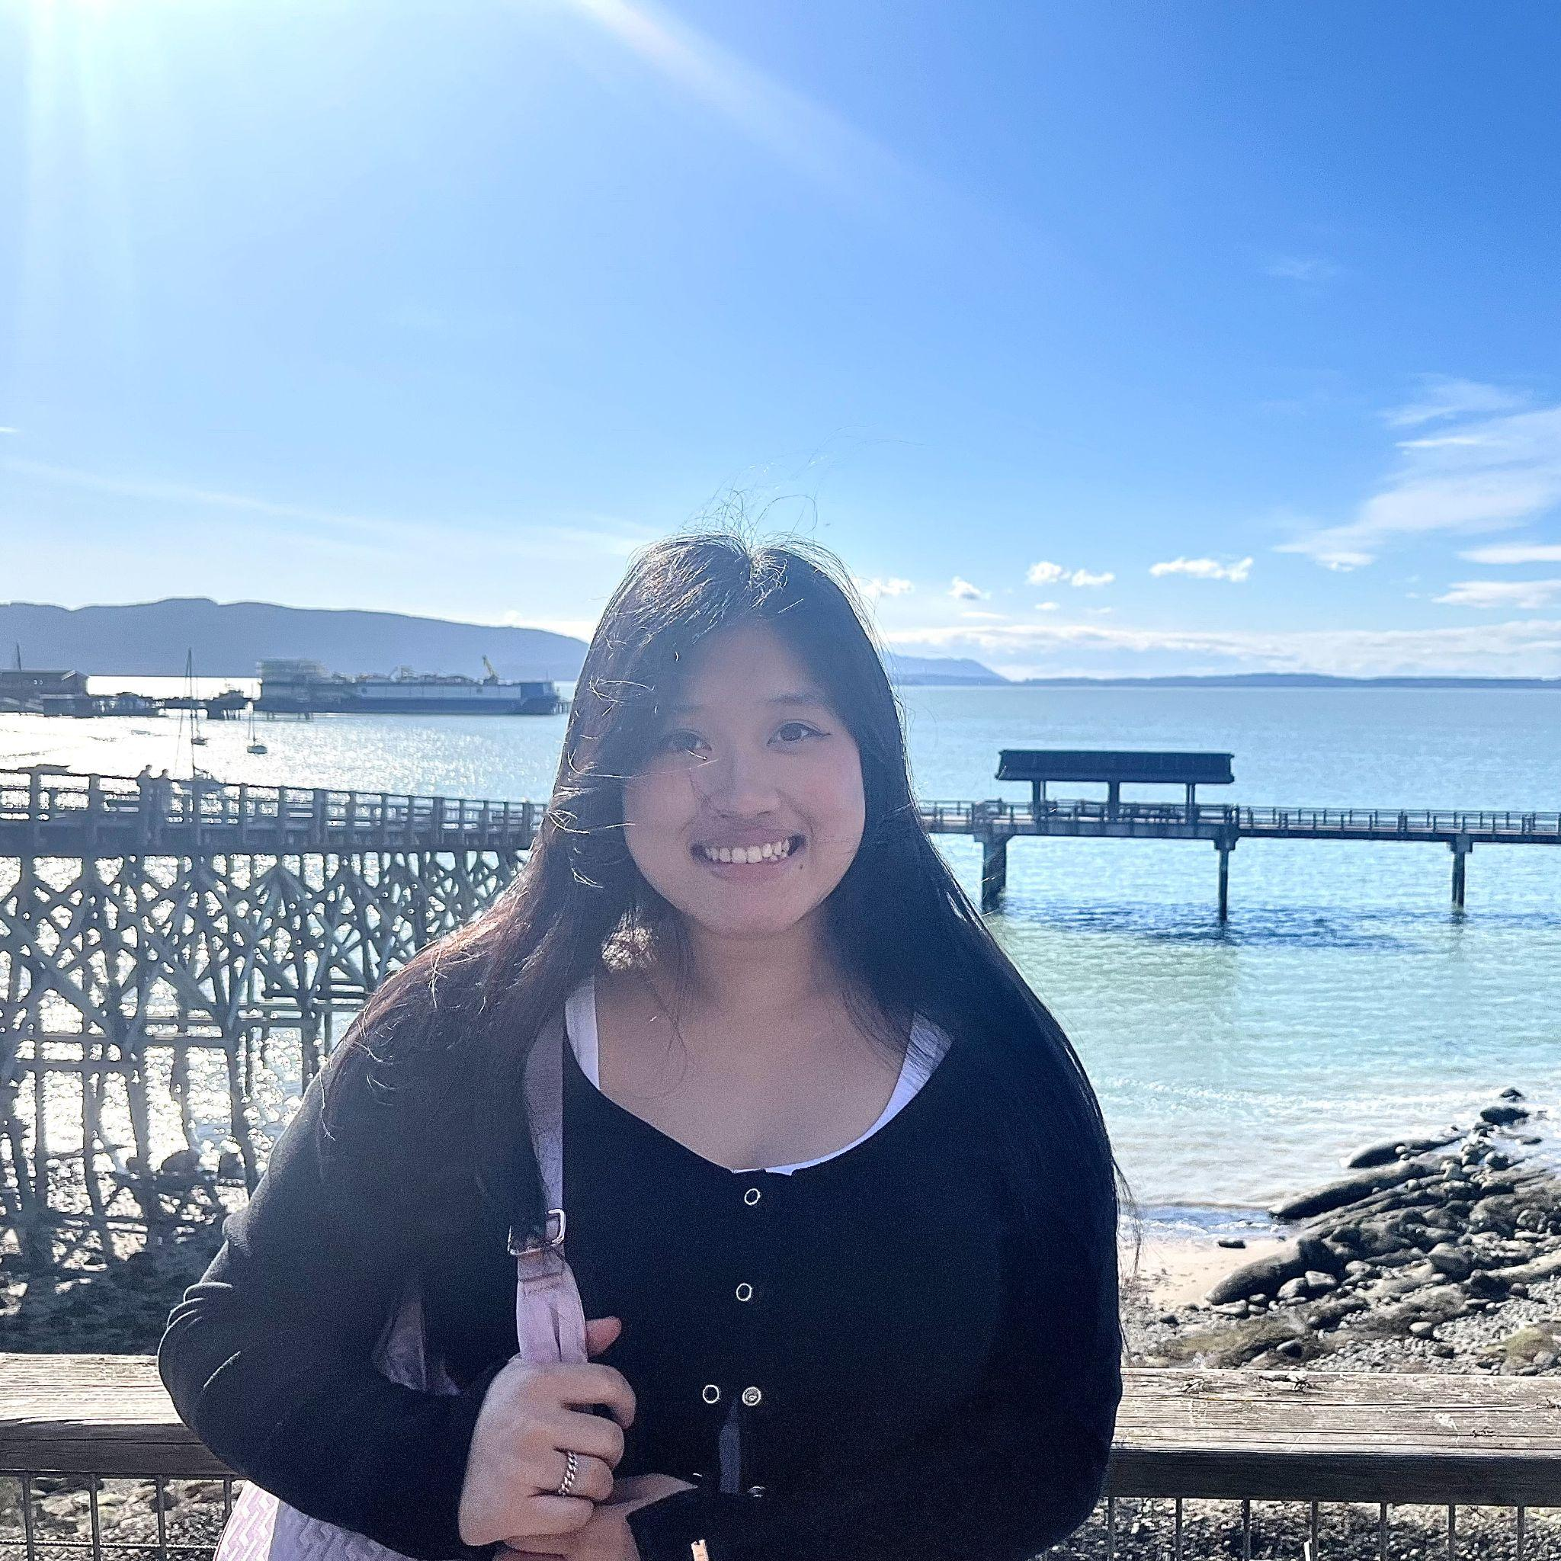
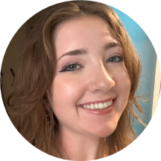
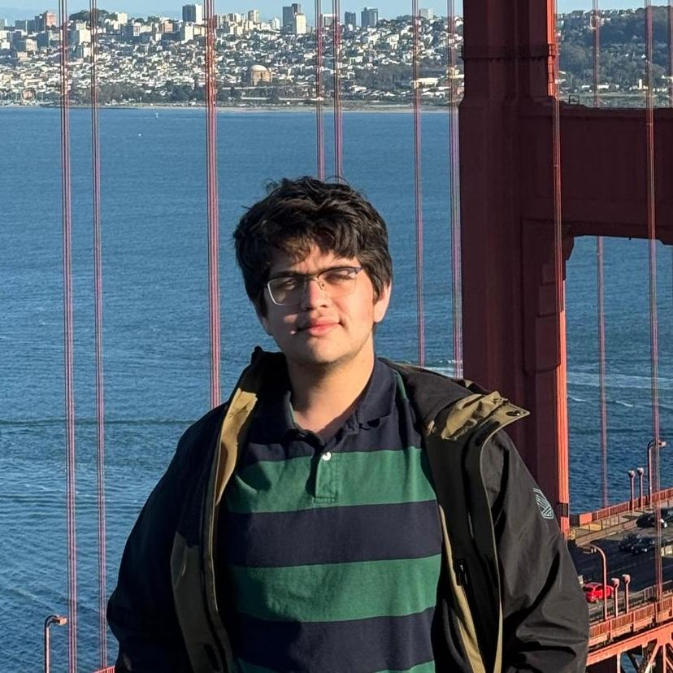


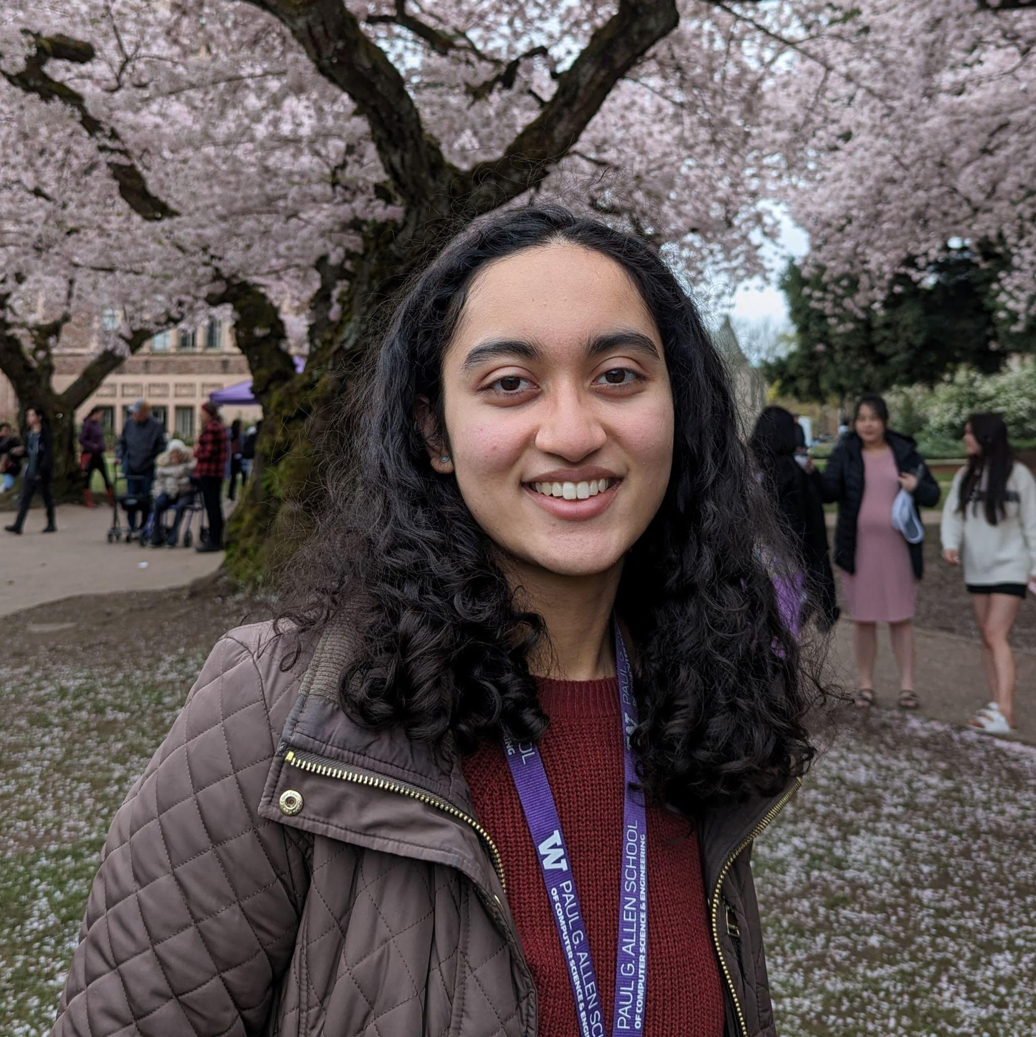
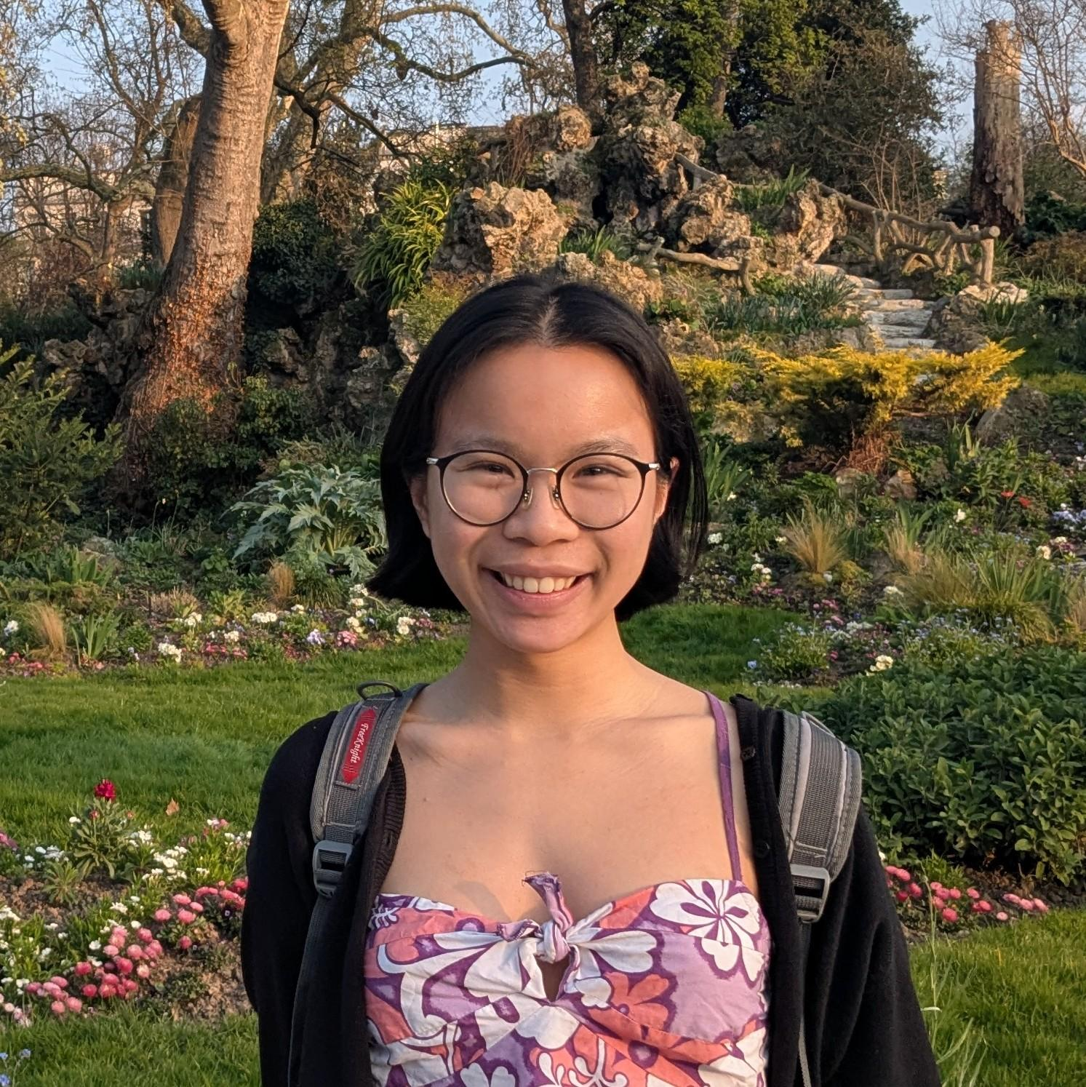


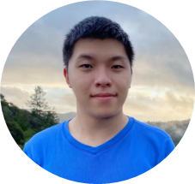

CSE 163 TAs!
Skyler Choi
Alexis Destefano
Shaurya Jain
Kaiyuan Liu
Daniella Maor
Anaya Pandit
Laura Pong
Kellen Rodriguez
Saesha Wadhwa
Patrick Yu
Guy Zur

Slide 7
Syllabus

Slide 8
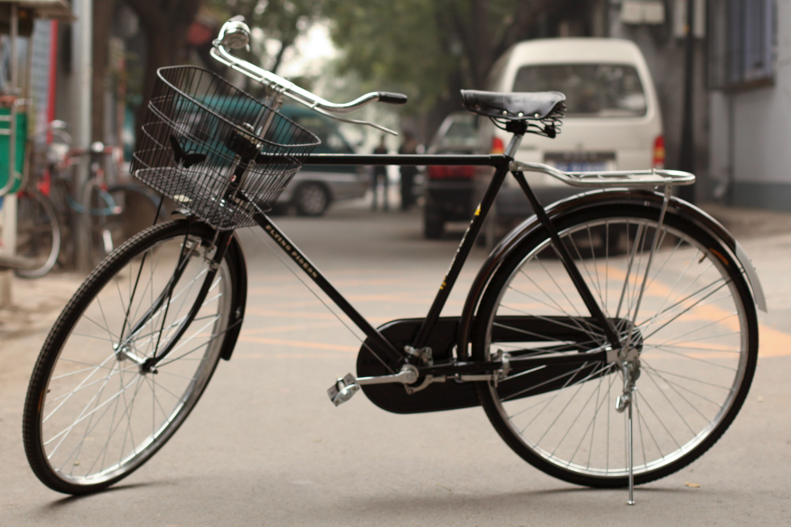
Bicycles?

Slide 9
Having The Talk… ✨
We discourage use of Gen AI in CSE 163
It’s hard to strike a balance that is meaningful and sustainable
Can deprive you of real learning opportunities
We want you to own your craft!
Treat it like any other external resource
If you wouldn’t ask another human being, don’t ask AI!
We value humanity in CSE 163
Being human is messy but rewarding. ☺
Some research on GenAI cognitive impact
Why Johnny Can’t Think: Gen AI’s Impacts on Cognitive Engagement (2026)
Your Brain on ChatGPT (2025)
Measuring the Impact of Early-2025 AI on Experienced Open-Source Developer Productivity (2025)

Slide 10
Lesson Due
Mon
Tue
Wed
Thur
Fri
Prepare:
Read lesson
Attend:
Class Session
Nothing 😢
Prepare:
Read lesson
Attend:
Class Session
Attend:
Quiz Section
Prepare:
Read lesson
Attend:
Class Session
Lesson Due
Weekly Assignment (WA) Due
Next WA Released
Current THA Due
Section Due (@11:59pm)
Lesson Due
Next THA Released
We don’t record attendance in lecture/section, but attending these sessions is expected
There are recordings of the class sessions, but the content comes from the lesson.

Slide 11
Assessments
With the scaffolding from 1 and 2, you are probably now capable to tackle the checkpoints and take-home assessments!. These will be complex and challenging, but you’ll continue to learn by doing.
4
Sections
Practice material covered in 1 and 2 in a context where a TA can help you. Most of the time is spent with you working in groups! The emphasis is still on you learning by doing.
3
Class Sessions
Recap material from readings. Most of time spent in small groups working on the practice problems from the lesson. Emphasis on learn by doing. On the road to proficiency!
2
Lessons
First introduction to material. No where near proficiency yet!
1

Slide 12
Pacing
We are releasing the lessons and assessments as we move throughout the quarter
As a general note: Interacting compassionately and empathetically is key!
Community is built by all of us! We need you to participate in the active classroom environment. This means
Attend class sessions and quiz sections when you can
Participate in discussions on Ed Discussion and chat
Reach out to your peers and the course staff when you need help!

Slide 13
Assessments and Grading
Our goal in the course is for you to become proficient in the concepts and skills we teach.
We assess your proficiency by asking you to apply concepts and skills on tasks or problems. By necessity, we are assessing your work as a proxy for your proficiency
Your final grade should reflect the extent to which you have demonstrated proficiency of the course objectives

Slide 14
Assessments
We will have the following assessments in CSE 163:
Checkpoints (biweekly)
Short assignments consisting of a few problems to assess your learning on ~2 weeks of course content.
Reading Assignments (biweekly)
Reflect on readings related to course content
Section Assignments (weekly)
Structured practice with code and concepts with TAs
Take-Home Assessments (mostly weekly)
Longer programming assignments.
Final Project / Portfolio (parts throughout quarter)
Create something new that you want to share!
Notes:
In CSE 163, you will have four main types of assessments. Checkpoints are short assignments with a couple of quiz problems and/or a coding challenge and they are usually due on Mondays, unless it is a holiday, which happens for July 4th, and that one will be due on Tuesday that week. So by the end of next Monday, you will be expected to turn in checkpoint 0 covering what you have learned on Wednesday and Friday. They are a good starting point for checking your understanding.
Learning reflections are also due weekly, but on Thursdays, and they are usually compose of a couple of check-in questions and a learning summary of what you have learned in the past week. We recommend you to work on writing the learning summary or the study notes as you are working through the lessons during the week as a way to reinforce your understanding and come up with questions on the lesson materials. We will have a clear guideline on what topics we are expecting you to include on those notes just to ensure there is a certain quality standard and can actually be useful reference for you later on.
Take-home assessments are longer programming assignments with a bigger scope, and we encourage you to complete the checkpoints and learning reflections first before working on them, so you can have a quick assessment on your own mastery of the material and review the concepts before diving into the bigger projects.
Finally, we also have a final project, which is for you to complete a data science project on something that you are interested in. You will be able to work in groups of up to three people, and we have smaller parts throughout the quarter to keep you on track, but I will not talk too much about the details project logistics until later. Just know that we don’t have a final exam, but you do need to complete the final project.

Slide 15
Grading
Checkpoints and Reading Assignments on correctness and completion, respectively
Take-Home Assessments are graded on correctness for the following dimensions:
Technical Component
Behavior
Concepts
Quality
Testing/Writeup
Creative Component
Requirements
Review
Final Project / Portfolio is graded on completion and correctness of minimum requirements.
Course component weights and GPA mapping can be found in syllabus

Slide 16
Resubmission
Learning is a challenging process that takes time; it doesn’t always happen on your first try.
One previous take-home assessment can be resubmitted each week.
Must be accompanied by write up explaining changes
Grade on resubmission replaces original grade
To stay on-track with the course, each take-home assessment can only be resubmitted within two weeks of receiving feedback.
If you find an unforeseen circumstance that causes you to fall behind on an assignment, please reach out to the course staff sooner than later!

Slide 17
Resubmission Example
Sun | Mon | Tues | Wed | Thurs | Fri | Sat
Mar 29 | 30 | 31 | Apr 1 | 2 | 3 | 4
5 | 6 | 7 | 8 | 9 | 10 | 11
12 | 13 | 14 | 15 | 16 | 17 | 18
19 | 20 | 21 | 22 | 23 | 24 | 25
26 | 27 | 28 | 29 | 30 | May 1 | 2

Slide 18
Resubmission Example
Sun | Mon | Tues | Wed | Thurs | Fri | Sat
Mar 29 | 30 | 31 | Apr 1 | 2 | 3 | 4
5 | 6 | 7 | 8 | 9 | 10 | 11
12 | 13 | 14 | 15 | 16 | 17 | 18
19 | 20 | 21 | 22 | 23 | 24 | 25
26 | 27 | 28 | 29 | 30 | May 1 | 2

Slide 19
Late Work
Late work will generally only be accepted with one of the mechanisms outlined in the syllabus.
If you can’t finish a take-home assessment by the initial submission date, you will need to use a resubmission in a future week to turn it in.
Checkpoints and reading assignments are generally not accepted late unless you have sufficient Weekly Tokens.
Weekly Tokens: A single token lets you turn in 1 checkpoint or 1 reading assignment late at any point in the quarter before the Friday of finals week.
Every student will start with 1 Weekly Token
Every 6 Lessons you complete on-time (by 11:59 pm the day of the Lesson), get converted to a Weekly Token.

Slide 20
Collaboration Policy
Form study groups (you can use Ed/Canvas chat for this)! You are encouraged to discuss assessments and concepts at a high level
If you have code in front of you in your discussion or showing each other solutions, probably NOT high level
If you discuss your ideas with others, you must cite them
All code and answers submitted must be your own
Any work found to not be your own will receive a grade of a 0 and may not be resubmitted
If it’s not your work, we can’t assess your mastery
Final project can be done in groups of up to 3 (not more!)
Portfolios are individual work

Slide 21
Project
Culmination of all the things you learned in this class.
Open ended project where you find and use real-world datasets to answer an interesting question. Encouraged to work in groups with 1 or 2 other students!
Broken into various checkpoints throughout quarter:
Pick a research question and your datasets + find a partner(s)
Give preliminary findings about the data
Gather results and write final report
Final Project presentations will happen during the last section of the quarter

Slide 22
Portfolio
Reflection and revision for the creative work you have done in class
Polish your creative work from the quarter and give us your best showcase. This is a solo work!
Broken into various checkpoints throughout quarter:
Vision statement describing your work at a high level
Milestone “preview” of your final portfolio
Finish your revisions and make your code presentation-ready
Portfolio presentations will happen during the last section of the quarter

Slide 23
Technology Resources
Course website: https://courses.cs.washington.edu/courses/cse163/26sp/
Everything you need is linked from here!
Check the calendar for all links for that day
Ed: https://edstem.org/us/courses/97148/discussion
For discussion board and announcements
Canvas for gradebook, assignment tracking, reading assignments
VS Code setup guide can be found in Software page of the Course Website
More to come, but we will introduce them as necessary

Slide 24
Next Time
Intro to Python
How to write a program
Loops
Conditionals
Functions, parameters, returns
Before Next Time
Get started on RA 1
Introduce yourself on Ed!
Complete Lesson 1 on the course website
Read lesson slides. Stop after completing “Pause and Think”
Encouraged to save problems for class session!
Due for EC @ 11:59 pm Apr 4/1

