Slide 1


File I/O
Summer 2026
Questions?
Sli.do
#cse160

Slide 2
Announcements
Homework Assignment 2 due tonight at 11:59 PM
Programming Practice 3 due Sunday, July 19th at 11:59pm
Homework Assignment 3 due Monday, July 20th at 11:59pm
Practice Midterms now available on the course website
  Midterm on Monday, July 20th during class (9:40AM-10:40AM)
Grades for Homework 1 will be released later today
  We will make an announcement with Resubmission 1 instructions!

Slide 3
Midterm Exam
Logistics
Held in-class on Monday, July 20th (in HRC 155 - this room!)
You may bring one sheet of 8.5 x 11 inch paper as your own cheat sheet
You will be provided with an additional reference sheet as part of the exam packet
Resources
Past midterm exams (+ answer keys) on course website midterm page
Office Hours + Ed :)
Questions?
Sli.do
#cse160

Slide 4
Today’s Roadmap
What’s in a File?
File Systems
Reading Files
Writing to Files
Jupyter Hub

Slide 5
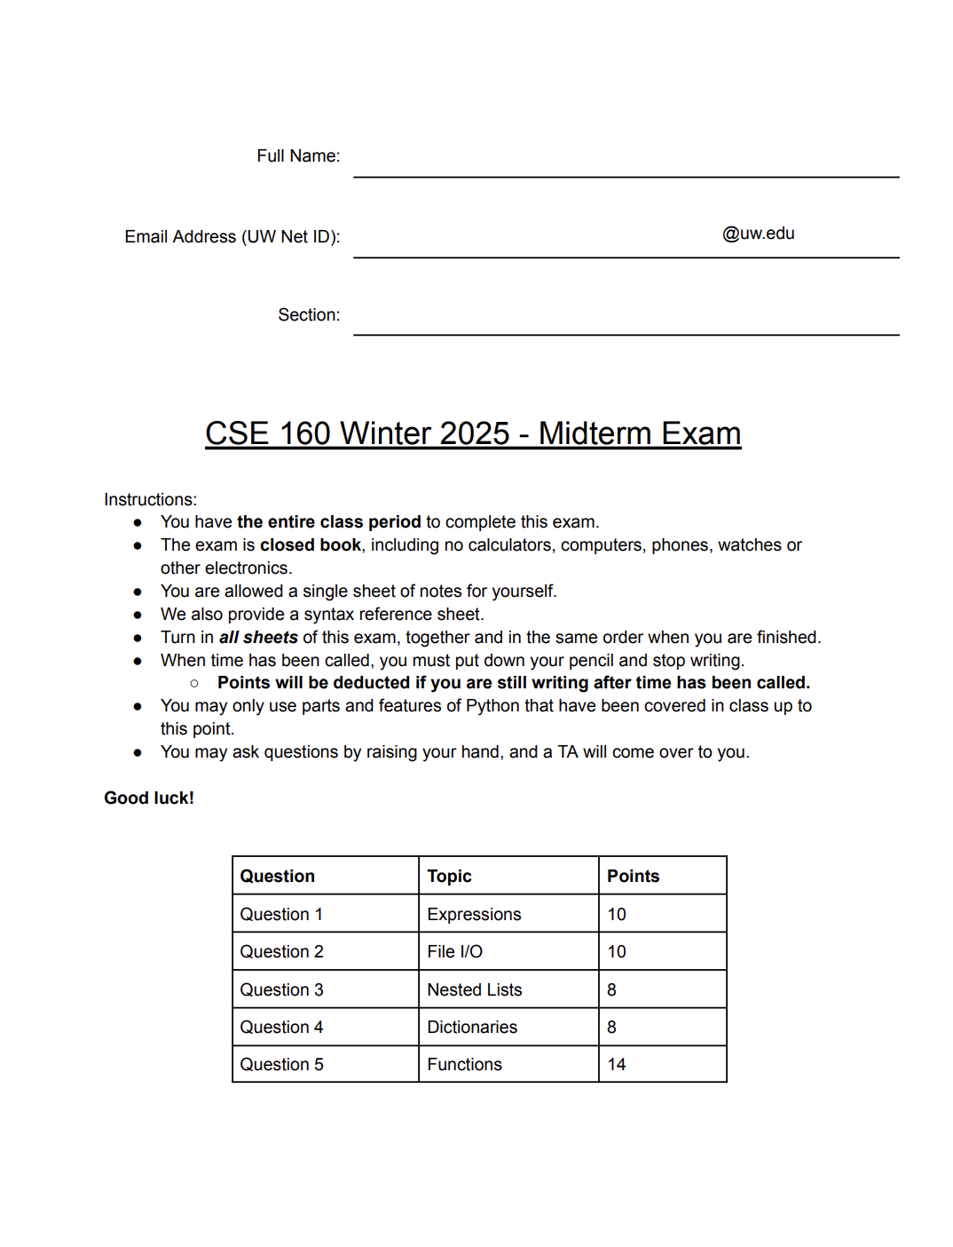
What’s a File?
A file is a collection of data stored in a structured format.
According to all known laws of aviation, there is no way a bee should be able to fly.
Its wings are too small to get its fat little body off the ground.
The bee, of course, flies anyway because bees don't care what humans think is impossible.
Yellow, black. Yellow, black. Yellow, black. Yellow, black.
Ooh, black and yellow!
Let's shake it up a little.
Barry! Breakfast is ready!
Coming!
Hang on a second.
41, 45, 50,
46, 43, 43, 39, 41, 48, 48,
46, 52, 54, 48, 46, 46, 46,
45, 45, 45, 43, 39, 41, 39,
41, 45, 46, 48,
text.txt
exam.pdf
data.dat

Slide 6

Using Files
A file is a collection of data stored in a structured format.
To use a file, we might want to:
Input: get data from the file
Output: store data to the file
In order to do this, we need to know the file’s name and it’s location
file.fl

Slide 7
File Systems
A file system is a hierarchical structure that organizes files using (nested) folders
A file directory is a location (folder) within the file system:
CSE 160
CSE 480
Travel
C:\Users\adrian\Desktop\$
LEC
Vietnam
asalguer:~/COURSE_MATERIALS/lectures/lec09/$
HW
Ireland

Slide 8
Navigating a File System
A file system is a hierarchical structure that organizes files using (nested) folders
A file directory is a location (folder) within the file system
To locate a file within a directory, we need to specify its path from the directory:
CSE 160
CSE 480
Travel
LEC
Vietnam
... ~/Desktop/$ python ./'CSE 160'/HW/hw0.py
HW
Ireland
current directory
file path
hw0.py

Slide 9
Using the Terminal
A file directory is a location (folder) within the file system
We can use the terminal to navigate file systems:
CSE 160
CSE 480
Travel
cd
change directory to path
LEC
Vietnam
ls
list contents of current directory
... ~/Desktop/$ cd ./'CSE 160'/HW/
HW
Ireland
current directory
path to new directory

Slide 10
Questions?
Live and on Sli.do
Sli.do
#cse160

Slide 11
Think Pair Share
What command should Adrian type to run the lec09.py Python file from his current directory?
... ~/Desktop/CSE 160/$
CSE 160
CSE 122
Travel
LEC
Greece
lec09.py
HW
Mexico
Sli.do
#cse160

Slide 12
Using Files in Python
In Python, to load a file into memory, we need to call the open() function.
file = open("file.fl")
file path from directory with Python file
The open() function returns a file object.
file.fl
type(open("file.fl"))
<class '_io.TextIOWrapper'>

Slide 13
Reading Files
In Python, to load a file into memory, we need to call the open() function.
To read the entire contents of a file:
file = open("file.fl")
file.read()
file path from directory with Python file
The read() method returns the entire file contents as a string.
The open() function returns a file object.
type(open("file.fl"))
<class '_io.TextIOWrapper'>

Slide 14
Reading Files (Option 2)
In Python, to load a file into memory, we need to call the open() function.
To read the contents of a file,
one line at a time:
file = open("file.fl")
for line in file:
print(line)
file path from directory with Python file
The file object can be iterated over!
The open() function returns a file object.
type(open("file.fl"))
<class '_io.TextIOWrapper'>

Slide 15
Writing to Files
To load a file into memory and write to it,
call the open() function with "w":
To write content to a file:
file = open("file.fl", "w")
file.write(string)
mode argument specifies how the file will be used. default = "r" (read)
The write() method writes to the file with the string string.
Caution: when in write mode, the existing file contents are overwritten!

Slide 16
Appending to Files
To load a file into memory and append to it,
call the open() function with "a":
To append content to a file:
file = open("file.fl", "a")
file.write(string)
When in append mode, the existing file contents are not overwritten, just added to.
The write() method writes to the file with the string string.

Slide 17
Cleaning Up After Yourself
When you’re finished with a file:
file.close()
Changes to a file may not be fully implemented until close() is called.
Keeping a file open may prevent other applications from using the file
WHY?

Slide 18
Questions?
Live and on Sli.do
Sli.do
#cse160

Slide 19
Files Example 1: Eager Editor
Before
What will happen?
After
Hello!
I am a file :)
f = open("file.fl", "r")
print(f.read())
f.write("New content :)")
f.close()
Hello!
I am a file :)
file.fl
file.fl
ERROR! Cannot write to read-only file

Slide 20
Files Example 2: Do Over
Before
What will happen?
After
Hello!
I am a file :)
f = open("file.fl", "w")
f.write("New!")
f.write("Scratch.")
f.close()
New!Scratch.
file.fl
file.fl

Slide 21
Newline Characters
f.write("New content!")
f.write("Scratch that.")
New Content!Scratch that.
When writing to a file, we have to specify every character to be written.
\n
"\n" is a newline character, that creates a new line.
f.write("New content!\n")
f.write("Scratch that.")
New Content!
Scratch that.

Slide 22
Files Example 3: So Good I Read It Twice
Before
What will happen?
Output
Hello!
I am a file :)
f = open("file.fl", "r")
print(f.read())
print(f.read())
f.close()
Hello!
I am a file :)
file.fl
Reading a file ‘consumes’ the contents of the file object.

Slide 23
Think Pair Share
Write a program that reads in the contents of the file nominees.txt and creates a list containing each movie title as strings.
Frankenstein
Sinners
F1
Hamnet
Bugonia
Sentimental Value
Train Dreams
The Secret Agent
Marty Supreme
One Battle After Another
nominees.txt
Sli.do
#cse160

Slide 24
Processing Data from Files
Frankenstein
Sinners
F1
Hamnet
…
41, 45, 50,
46, 43, 43, 39, 41, 48, 48,
46, 52, 54, 48, 46, 46, 46,
45, 45, 45, 43, 39, 41, 39,
41, 45, 46, 48,
What now?
nominees.txt
temps.dat
lst = [
'Frankenstein\n',
'Sinners\n',
'F1\n',
'Hamnet\n',
'Bugonia\n',
'Sentimental Value\n',
'Train Dreams\n',
'The Secret Agent\n',
'Marty Supreme\n',
'One Battle After Another'
]
lst = [
'41, 45, 50,\n',
'46, 43, 43, 39, 41, 48, 48,\n',
'46, 52, 54, 48, 46, 46, 46,\n',
'45, 45, 45, 43, 39, 41, 39,\n',
'41, 45, 46, 48,'
]

