Slide 1

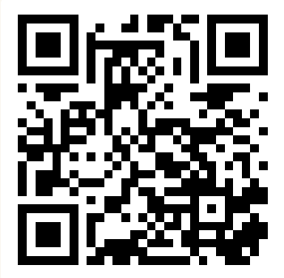
Functions (II)
Summer 2026
Questions?
Sli.do
#cse160

Slide 2
Announcements
Homework Assignment 1 due tonight at 11:59 PM
Programming Practice 1 due tonight at 11:59 PM
Homework Assignment 2 due Monday, July 13th at 11:59 PM
Programming Practice 2 due Sunday, July 12th at 11:59pm

Slide 3
Code Quality
cs.uw.edu/160/resources/code_quality/
Code is meant to be read and understood by humans(!), so maintaining good code style (or ‘code quality’) is an important part of programming.
The CSE 160 Code Quality Guide (i.e. expectations for code style) is on the website.
flake8 is a tool for automatically checking code style in Python files.
use this command to run the flake8 style checker!
jovyan@jupyter-netid:~/…/$ flake8 python_file.py
flake8_demo.py
1
2
3
x=1
print("There's an extra space on this line")

Slide 4
Today’s Roadmap
Functions Recap
Evaluating a Function Call
Practice with Functions
Variable Scope
Jupyter Hub

Slide 5
All About Functions
don’t forget the colon!
def keyword
function name
parameters (optional)
def function_name(param, second_param = 3, ...):
# function code
return expression # optional
print("Hey") # can’t run!
function body
unreachable code!
optional argument
If not specified, parameter value will be 3
return statement

Slide 6
Think Pair Share: Even / Odd
"""
Write a function named is_even.
Arguments:
num: a number
Returns:
True if `number` is even, False otherwise
"""
The modulo (%) operator calculates the remainder of a number divided by another number.

Slide 7
Evaluating a Function Call
What happens when we call a function?
def my_function(a, b):
c = a * b
if c % 2 == 0:
return c - a
d = 1 / 0
return 2 / 0
rv = my_function(10 / 5, 3)

Slide 8
Evaluating a Function Call: Step 1
What happens when we call a function?
Evaluate arguments
def my_function(a, b):
c = a * b
if c % 2 == 0:
return c - a
d = 1 / 0
return 2 / 0
rv = my_function(10 / 5, 3)
2
3

Slide 9
Evaluating a Function Call: Step 2
What happens when we call a function?
Evaluate arguments
Assign argument values to parameters
def my_function(a, b):
c = a * b
if c % 2 == 0:
return c - a
d = 1 / 0
return 2 / 0
a
2
b
3
rv = my_function(10 / 5, 3)
2
3

Slide 10
Evaluating a Function Call: Step 3
What happens when we call a function?
Evaluate arguments
Assign argument values to parameters
Evaluate function body
def my_function(a, b):
c = a * b
if c % 2 == 0:
return c - a
d = 1 / 0
return 2 / 0
a
2
6
b
3
c
6
rv = my_function(10 / 5, 3)

Slide 11
Evaluating a Function Call: Step 4
What happens when we call a function?
Evaluate arguments
Assign argument values to parameters
Evaluate function body
At a return statement, evaluate the expression, skip to step 6
def my_function(a, b):
c = a * b
if c % 2 == 0:
return c - a
d = 1 / 0
return 2 / 0
a
2
b
3
4
c
6
rv = my_function(10 / 5, 3)

Slide 12
Evaluating a Function Call: Step 5
What happens when we call a function?
Evaluate arguments
Assign argument values to parameters
Evaluate function body
At a return statement, evaluate the expression, skip to step 6
No return encountered, return value is None
def my_function(a, b):
c = a * b
if c % 2 == 0:
return c - a
d = 1 / 0
return 2 / 0
a
2
b
3
4
c
6
rv = my_function(10 / 5, 3)

Slide 13
Evaluating a Function Call: Step 6
What happens when we call a function?
Evaluate arguments
Assign argument values to parameters
Evaluate function body
At a return statement, evaluate the expression, skip to step 6
No return encountered, return value is None
Exit, function call evaluates to return value
def my_function(a, b):
c = a * b
if c % 2 == 0:
return c - a
d = 1 / 0
return 2 / 0
Return Val.
4
4
rv = my_function(10 / 5, 3)
rv
4
4

Slide 14
Evaluating a Function Call: Summary
What happens when we call a function?
Evaluate arguments
Assign argument values to parameters
Evaluate function body
At a return statement, evaluate the expression, skip to step 6
No return encountered, return value is None
Exit, function call evaluates to return value
def my_function(a, b):
c = a * b
if c % 2 == 0:
return c - a
d = 1 / 0
return 2 / 0
parameters
return statements
What happens if Python reaches this return statement?
rv = my_function(10 / 5, 3)
arguments

Slide 15
Function Example 1: Mystery
What gets printed?
def mystery(a, b):
return a * b
Nothing! (No print)
What gets returned?
mystery(mystery(2, 6), 3)
36
mystery( , 3)
12
36

Slide 16
Function Example 2: 📝
print != return
What gets printed?
def food():
print("Tacos :)")
Tacos :)
None
What gets returned?
print(food())
None
None
print( )

Slide 17
Function Example 3: Variable-ception
What gets printed?
x = False
def func(x):
print(x)
True
func(True)

Slide 18
Function Example 3: Variable-ception (x2)
What gets printed?
x = False
def func(x):
print(x)
True
False
func(True)
print(x)

Slide 19
Variable Scope
my_function Local Scope
x
10
a
5
The scope of a variable is the area of code in which the variable is defined (has a value).
In Python, there are two scopes:
Local Scope — Variables (including parameters) defined inside a function body
  Value of variable is accessible only within the function
Global Scope — Everything else
  Value of variable is accessible anywhere in the program (including inside functions)
a = 10
def my_function(x):
a = 5
b = False
my_function(a)
a
10
b
False
Global Scope

Slide 20
Revisiting Function Example 3
True
True
False
x = False
def func(x):
print(x)
x
False
x
True
Global Scope
func Local Scope
func(True)
print(x)

Slide 21
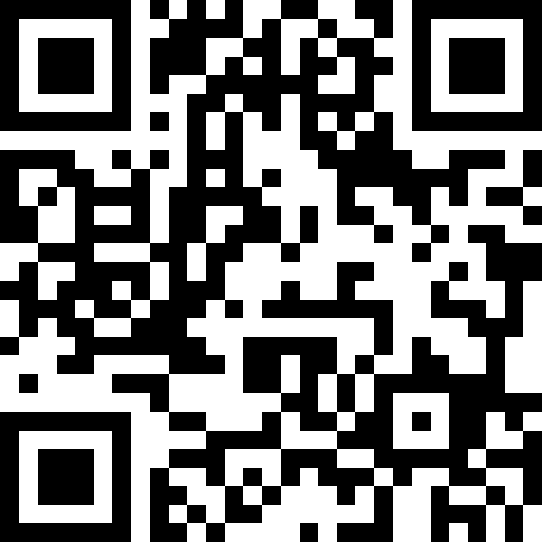
Think Pair Share
x = 1
y = 2
def func1(x):
y = 1
return x + y
def func2(x):
x = 5
x = func1(x)
return x + y
x = func2(x)
print("x = " + str(x))
What gets printed when this program is run?
1
2
8
9
[Error]
A
B
C
D
Sli.do
#cse160
E

Slide 22
Slippery Slope Scope
1
2
3
4
5
6
7
8
9
10
11
12
13
x = 1
y = 2
def func1(x):
y = 1
return x + y
def func2(x):
x = 5
x = func1(x)
return x + y
x = func2(x)
print("x = " + str(x))
Code Execution
Variables

Slide 23
Slippery Slope Scope (1)
Global Scope
x
1
y
2
[1, 2] x, y defined in global scope
1
2
3
4
5
6
7
8
9
10
11
12
13
x = 1
y = 2
def func1(x):
y = 1
return x + y
def func2(x):
x = 5
x = func1(x)
return x + y
x = func2(x)
print("x = " + str(x))
Code Execution
Variables

Slide 24
Slippery Slope Scope (2)
Global Scope
x
1
y
2
[1, 2] x, y defined in global scope
[12] Call func2, parameter x = 1
1
2
3
4
5
6
7
8
9
10
11
12
13
x = 1
y = 2
def func1(x):
y = 1
return x + y
def func2(x):
x = 5
x = func1(x)
return x + y
x = func2(x)
print("x = " + str(x))
func2 Local Scope
x
1
Code Execution
Variables

Slide 25
Slippery Slope Scope (3)
Global Scope
x
1
y
2
[1, 2] x, y defined in global scope
[12] Call func2, parameter x = 1
[8] x (func2 local scope) updated to 5
1
2
3
4
5
6
7
8
9
10
11
12
13
x = 1
y = 2
def func1(x):
y = 1
return x + y
def func2(x):
x = 5
x = func1(x)
return x + y
x = func2(x)
print("x = " + str(x))
func2 Local Scope
x
x
1
5
Code Execution
Variables

Slide 26
Slippery Slope Scope (4)
Global Scope
x
1
y
2
[1, 2] x, y defined in global scope
[12] Call func2, parameter x = 1
[8] x (func2 local scope) updated to 5
[9] Call func1, parameter x = 5
1
2
3
4
5
6
7
8
9
10
11
12
13
x = 1
y = 2
def func1(x):
y = 1
return x + y
def func2(x):
x = 5
x = func1(x)
return x + y
x = func2(x)
print("x = " + str(x))
func1 Local Scope
x
5
func2 Local Scope
x
5
Code Execution
Variables

Slide 27
Slippery Slope Scope (5)
Global Scope
x
1
y
2
[1, 2] x, y defined in global scope
[12] Call func2, parameter x = 1
[8] x (func2 local scope) updated to 5
[9] Call func1, parameter x = 5
[4, 5] y = 1 (func1 local scope), return x + y = 6
1
2
3
4
5
6
7
8
9
10
11
12
13
x = 1
y = 2
def func1(x):
y = 1
return x + y
def func2(x):
x = 5
x = func1(x)
return x + y
x = func2(x)
print("x = " + str(x))
func1 Local Scope
x
y
Return Val.
5
1
6
func2 Local Scope
x
5
Code Execution
Variables

Slide 28
Slippery Slope Scope (6)
Global Scope
x
1
y
2
[1, 2] x, y defined in global scope
[12] Call func2, parameter x = 1
[8] x (func2 local scope) updated to 5
[9] Call func1, parameter x = 5
[4, 5] y = 1 (func1 local scope), return x + y = 6
[9] x (func2 local scope) updated to 6
1
2
3
4
5
6
7
8
9
10
11
12
13
x = 1
y = 2
def func1(x):
y = 1
return x + y
def func2(x):
x = 5
x = func1(x)
return x + y
x = func2(x)
print("x = " + str(x))
Return Val.
6
func2 Local Scope
x
6
5
Code Execution
Variables

Slide 29
Slippery Slope Scope (7)
Global Scope
x
1
y
2
[1, 2] x, y defined in global scope
[12] Call func2, parameter x = 1
[8] x (func2 local scope) updated to 5
[9] Call func1, parameter x = 5
[4, 5] y = 1 (func1 local scope), return x + y = 6
[9] x (func2 local scope) updated to 6
[10] return x (local) + y (global)
→ 6 + 2 = 8
1
2
3
4
5
6
7
8
9
10
11
12
13
x = 1
y = 2
def func1(x):
y = 1
return x + y
def func2(x):
x = 5
x = func1(x)
return x + y
x = func2(x)
print("x = " + str(x))
func2 Local Scope
Return Val.
x
6
8
6
Code Execution
Variables

Slide 30
Slippery Slope Scope (8)
Global Scope
x
8
y
1
2
[1, 2] x, y defined in global scope
[12] Call func2, parameter x = 1
[8] x (func2 local scope) updated to 5
[9] Call func1, parameter x = 5
[4, 5] y = 1 (func1 local scope), return x + y = 6
[9] x (func2 local scope) updated to 6
[10] return x (local) + y (global)
→ 6 + 2 = 8
[12] x (global scope) updated to 8
1
2
3
4
5
6
7
8
9
10
11
12
13
x = 1
y = 2
def func1(x):
y = 1
return x + y
def func2(x):
x = 5
x = func1(x)
return x + y
x = func2(x)
print("x = " + str(x))
🎉
Return Val.
8
Code Execution
Variables

