Slide 1

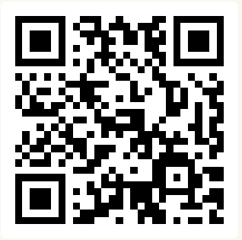
Conditionals & Functions
Summer 2026
Questions?
Sli.do
#cse160

Slide 2
Announcements
Homework Assignment 1 due Monday, July 6th at 11:59 PM
Programming Practice 1 due Monday, July 6th at 11:59 PM
Written Check-In 2 due Monday, July 6th at 11:59 PM
No class on Friday, July 3rd!

Slide 3
Today’s Roadmap
A Loop Problem
Conditionals
Conditionals and Loops
Intro to Functions
Jupyter Hub

Slide 4
A Loop Problem
Write a loop to print out the even numbers between 0 and 10 (inclusive). Your program output should look like this:
0
2
4
6
8
10
*Bonus problem*
Think about how you would print out all the even numbers in a list of random, unordered numbers.
For example, how would you find all the even numbers in this list:
[9, 16, -100, -54, 48, 10, 32]

Slide 5
Python Building Blocks so Far
Print Statements
Expressions
Variables and Assignment Statements
Types
  int, float, string, bool
Loops
A loop nested inside of a loop!
TODAY: conditionals (aka "if statements")

Slide 6
Conditional Statements
A conditional statement allows programmers to control which code block is executed based on whether a condition is true.
Follows decision-based logic we use in our daily lives
  If it’s raining, then bring an umbrella
  If the coffee pot is empty, then brew some coffee
  If I am hungry, then cook dinner
If [condition is True], then [do some action]
Boolean (True/False)
Code to run

Slide 7
Boolean Expressions evaluate to True or False
Some example boolean expressions:
22 > 4
22 < 4
22 == 4
22 >= 22
(22 > 4) and (5 < 6)
(22 > 4) and (5 > 6)
not (5 <= 6)
not True
We can print out the value of an expression: print((22 > 4) and (5 < 6))
We can save the value of an expression in a variable: x = 22 < 4

Slide 8
If statement “Anatomy”
boolean expression
don’t forget the colon!
if condition:
# When condition is True
# Run this code
if keyword
indentation matters!

Slide 9
If Statement Example:
Jupyter Hub
x = 3
if x == 3:
print("x is 3!")

Slide 10
If-else statement “Anatomy”
boolean expression
don’t forget the colon!
if condition:
# When condition is True
# Run this code
else:
# When condition is False
# Run this code instead
if keyword
indentation matters!
don’t forget the colon!
else keyword
indentation matters!

Slide 11
If-else Statement Example:
x = 3
if x == 3:
print("x is 3!")
else:
print("x is NOT 3")
What if we want to choose between more than two possible outcomes?

Slide 12
If-elif-else statement “Anatomy”
if keyword
if condition_1:
# When condition_1 is True
# Run this code
elif condition_2:
# When condition_1 is False
# And when condition_2 is True
# Run this code
else:
# When condition_1 is False
# And when condition_2 is False
# Run this code instead
elif keyword
else keyword

Slide 13
If-elif-else Statement Example:
Python Tutor
x = 3
if x == 3:
print("x is 3!")
elif x == 7:
print("x is 7!")
else:
print("x is neither 3 nor 7")

Slide 14
Think Pair Share
Sli.do
#cse160
Which statements will be printed?
Only statement 1
Only statement 2
Statement 1 and statement 2
Only statement 3
Nothing will be printed
x = 5
y = 5
if x > 0:
print("x is greater than 0")
elif y > 0:
print("y is greater than 0")
else:
print("x and y are not greater than 0")
A
B
1
C
2
D
E
3

Slide 15
If-elif-else: check for more cases!
If-else statements handle two cases
  The case where something is True (if)
  The case where something is False (else)
  Only two possible outcomes
If-elif-else statements can handle more cases!
  Not every situation is binary (it happens or it doesn’t)
  If it’s raining, then bring my umbrella; else if it’s snowing, then bring my snowboard; else if it’s sunny, then bring my paddleboard; else stay indoors.
Hypothetically: you can check as many cases as you’d like
  Be careful because some cases may overlap!
  When the first case is True, all other cases are ignored!

Slide 16
If-elif-else: check many, many cases!
weather = "raining"
if weather == "raining":
print("Wear a jacket")
elif weather == "cloudy":
print("Go for a run")
elif weather == "sunny":
print("Go paddleboarding")
else:
print("Stay indoors")

Slide 17
If-elif-else: Order of conditions matters!
temp = 30
if temp <= 45:
print("Cold!")
elif temp <= 80:
print("Comfortable.")
else:
print("Hot!")
temp = 30
if temp <= 80:
print("Comfortable.")
elif temp <= 45:
print("Cold!")
else:
print("Hot!")

Slide 18
Is there a better way to write this?
val = 0
# calculate absolute value of val
if val < 0:
print("val is negative")
print(val)
result = -val
else:
if val == 0:
print("val is zero")
print(val)
result = val
else:
print("val is positive")
print(val)
result = val
print(result)
If you run this code
All of this code is skipped
Next line of code to run

Slide 19
A Loop Problem, Again
Write a loop to print out the even numbers in the list: [9, 16, -100, -54, 48, 10, 32]
Output should be:
16
-100
-54
48
10
32

Slide 20
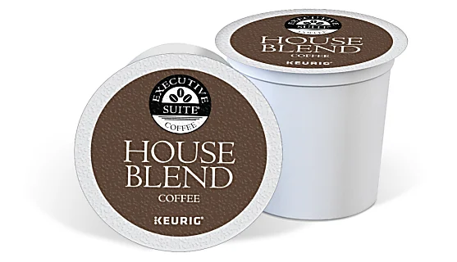
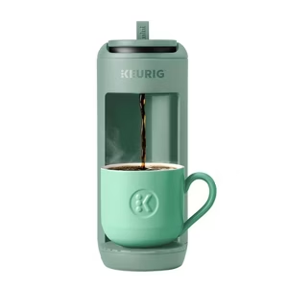
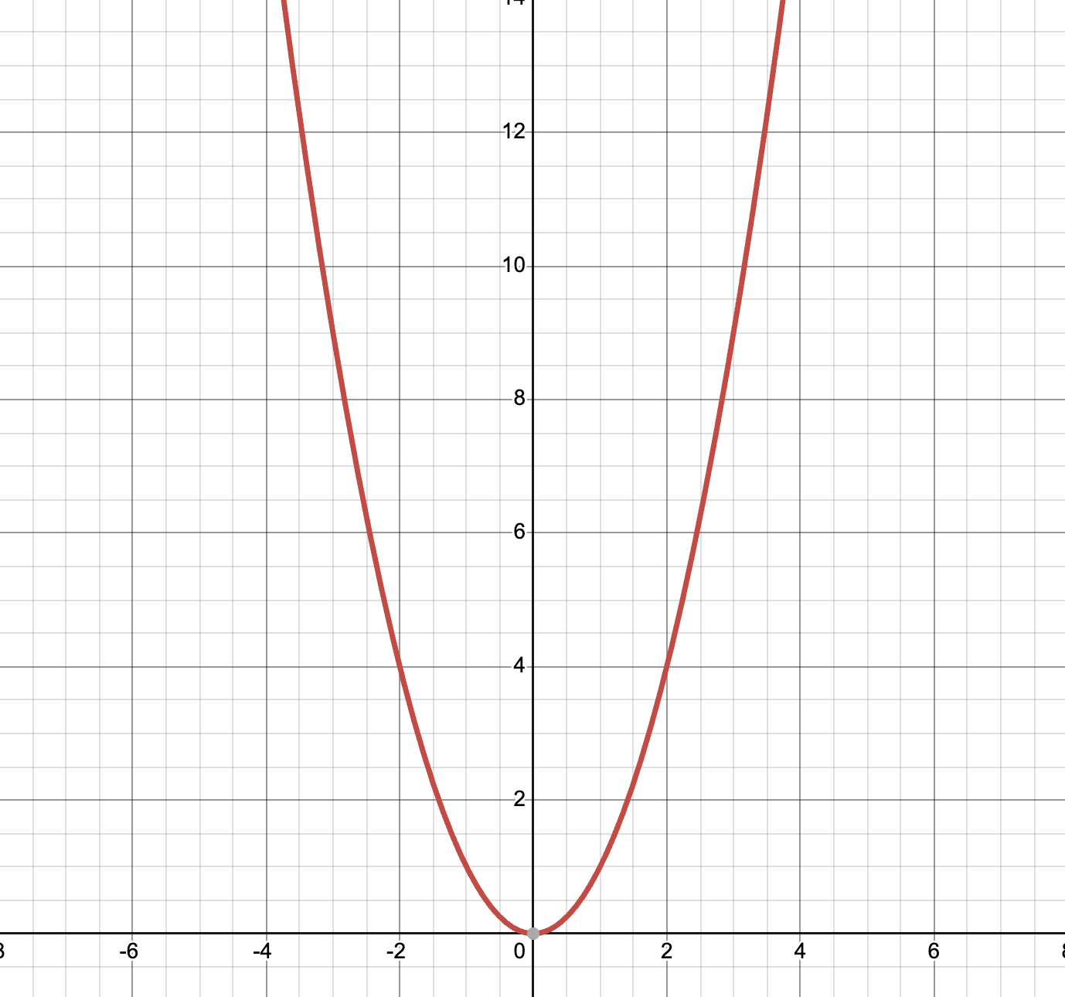


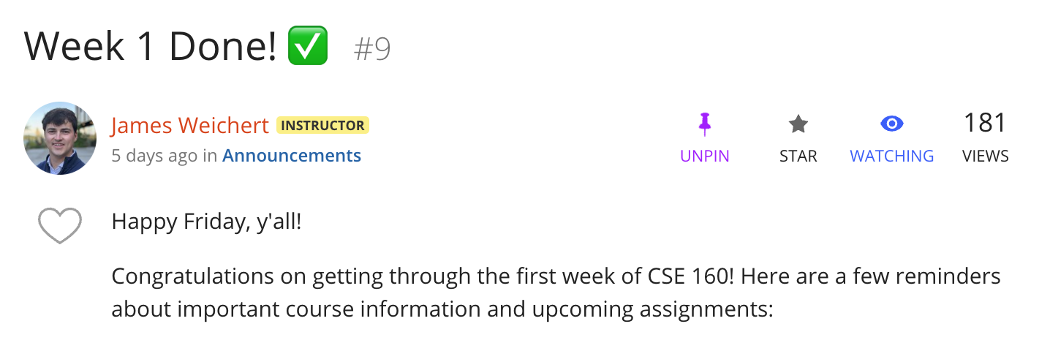
Inputs and Outputs
What things in the world take inputs, process them, and then produce outputs?
Title: “Week 1 Done”
Body: “....”
x
f(x) = x²

Slide 21
Functions
Functions compartmentalize code that can be used (or “called”) when we want.
Functions
def my_func(input):
# do work
return output
Organize code
Reuse code, but with different inputs
Abstract away details

Slide 22
Anatomy of a Function
function name
parameters (optional)
don’t forget the colon!
def function_name(parameter, ...):
# function code
def keyword
indentation matters!
function body
function_name(4, ...)
to call (use) the function

Slide 23
Return Statements
return is a Python keyword that is used to output a value from a function.
def function_name(parameter, ...):
# perform actions
# produce a value
return value
print("Hey") # can’t run!
return statement

Slide 24
Returning from a Function
return is a Python keyword that is used to output a value from a function.
Once a return statement is executed, no more code in the function will be run.
def function_name(parameter, ...):
# perform actions
# produce a value
return value
print("Hey") # can’t run!
unreachable code!

