Slide 1



Lecture 2
Variables & Expressions
Summer 2026

Slide 2
Announcements
Homework 0 is now available on the course website!
  Due this Friday by 11:59pm
First Section is tomorrow, Thursday June 25th
  Written Check-in 1 will start there
Make sure you have access to all the course resources
  Gradescope – submit assignments and see grades/feedback
  Ed – discussion board/Q&A/announcments
  JupyterHub – coding environment

Slide 3
What makes up a Python program?
Python code is composed of (mostly) expressions, statements, variables and methods/functions.
An expression evaluates to a value
A statement causes an effect (does not always evaluate to a value)
Expressions and statements can contain variables and use methods/functions
When put together, you create a Python program 🐍💻
The Python interpreter will help us play around with evaluating expressions and using statements

Slide 4
Examples
Expressions and Statements
(pi * 3) + (r * 2)
print(pi * r ** 2)
3 + print(pi)
Expressions
3 + 4
pi * r ** 2
Statements
pi = 3.14159
print(pi)
ERROR! A statement (e.g. print) cannot appear in the expression.
What does it mean to add the value of 3 to something being printed?
Assigns the value of 3.14159 to the variable pi
Prints the value in the variable pi

Slide 5
Expressions in Python can get complicated
Python expressions can really messy, really quickly depending on how you write them.
Easy to evaluate
3 + 5
8 / 2
A bit harder
2**3/2*3-4
72-32/9.0*5
Use parentheses to control evaluation order
(2**3)/(2*3-4)
(72-32)/(9.0*5)
Not getting the expected value?
Use parentheses to get the order you want.

Slide 6
Order of Operations in Python
Operator | Description | Precedence | Direction
( ) | Parenthesis | 1 (Highest Precedence)
** | Exponentiation | 2
//, /, *, % | Integer division, Float division, multiplication, and modulus (i.e. remainder) (same level of precedence) | 3 | Left to right
+, - | Addition and Subtraction (same level of precedence) | 4 (Lowest Precedence) | Left to right

Slide 7
How is an expression evaluated?
(72 – 32) / (9.0 * 5)
(72 – 32) / (9.0 * 5)
(40) / (9.0 * 5)
40 / (9.0 * 5)
40 / (45.0)
40 / 45.0
.888

Slide 8
Another evaluation example
(72 – 32) / 9.0 * 5
(72 – 32) / 9.0 * 5
(40) / 9.0 * 5
40 / 9.0 * 5
4.44 * 5
22.2

Slide 9
Variables hold values
Variables are “containers” that store values
  Recall algebra (e.g. x = 5)
Variables take the form of variable_name = expression
  x = 5
  y = 3 + 5
  z = x + y
Not all variable names are permitted!
  Must start with a character (e.g. 5 = 5 is not allowed, but five = 5 is!)
  Special keywords (e.g. True/False, lambda, import,...)
Variables have naming conventions/“rules”
  More information in the Code Quality Guide
Evaluate the right hand side to a value
Store the value into the variable

Slide 10
Changing Existing Variables
x = 2
print(x)
y = x
print(y)
z = x + 1
print(z)
x = 5
print(x)
print (y)
print(z)
“Inside” the computer
Printed output
x
❌
2
2
5
2
y
2
3
5
z
3
2
3

Slide 11
Data Types in Python
Not sure what the type of a value or variable is in your code?
Use the built-in type() method
type(5) → int
type(“hi”) → str
type(True) → bool
Integers (int)
  Whole numbers (including negatives)
  1, 2, 3, -1, -100, 1000
Real numbers (float)
  float, for “floating point”
  Includes decimals; 3.14, 2.718, 1.9999
Strings (str)
  Represent words, characters, and sentences
  “Hello”, “Python”, “a”, “I love Python!”
Booleans (bool)
  True or False
  Represents truth values
  Special operators: <, <=, >, >=, ==, not, and, or

Slide 12
Boolean Truth Tables
A | B | A and B | A or B | A ^ B
True | True | True | True | False
True | False | False | True | True
False | True | False | True | True
False | False | False | False | False
A | not A
True | False
False | True
Exclusive or (XOR) which is denoted by
the ‘^’ character will not be used in this class

Slide 13
Data Types determine which operations you can perform
What will each expression evaluate to? Which will cause an error?
(2 ** 3) / 8
11 % 2
“Hello” * 3
“World” - “rld”
True or False
not(100 >= 100)
5 / 2
5 // 2
“CSE” + “160”
3 + “4”
3 + True
3 - False
True * 2
False + (True – 1)
True and (False and False)
not(True or False)
True or False or not(True)

Slide 14
Put it all together to do something useful
x = 1
y = 2
x + y
print(x + y)
print("The sum of", x, "and", y, "is", x + y)
A program is a sequence of instructions performed in a specified order
The computer executes each instruction one after another
  An expression is evaluated
  A statement changes the state of something (e.g. a variable update or prints something out)
Expressions and statements bundled together that can be saved and reused by you or others.

Slide 15
Additional Resources

Slide 16
Using Gradescope for CSE160

Slide 17
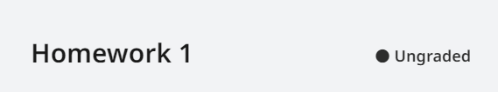
Ungraded
You will see some, but not all of the autograder tests
Can resubmit as many times until the due date

Slide 18
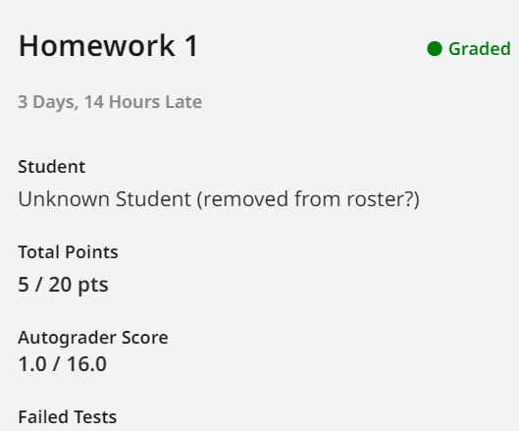
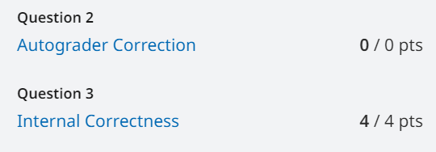
Graded
Automatically Graded
Autograder Score: Points given from all autograder tests
Manually Graded
Autograder Correction: TA’s giving/taking away points in case of autograder error
Internal Correctness: Points given for following directions, good style, efficiency, etc.
Autograder + Autograder Correction + Internal Correctness = Total Score

Slide 19
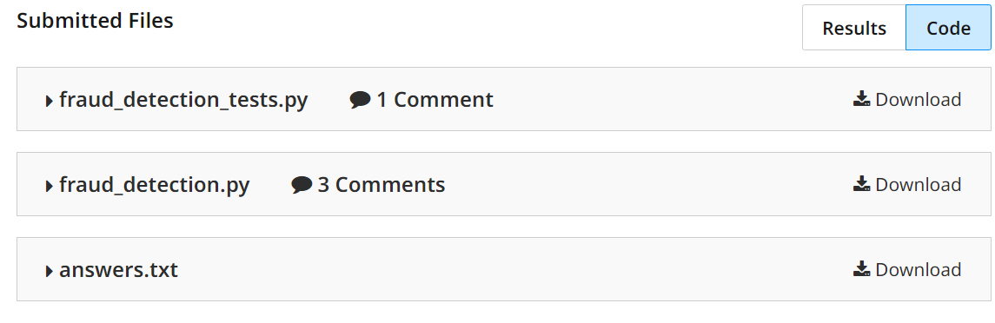
Comments
Two tabs - results and code. Click on ‘Code’ to see list of files you submitted. Each file will have the number of comments that were made on it.

Slide 20
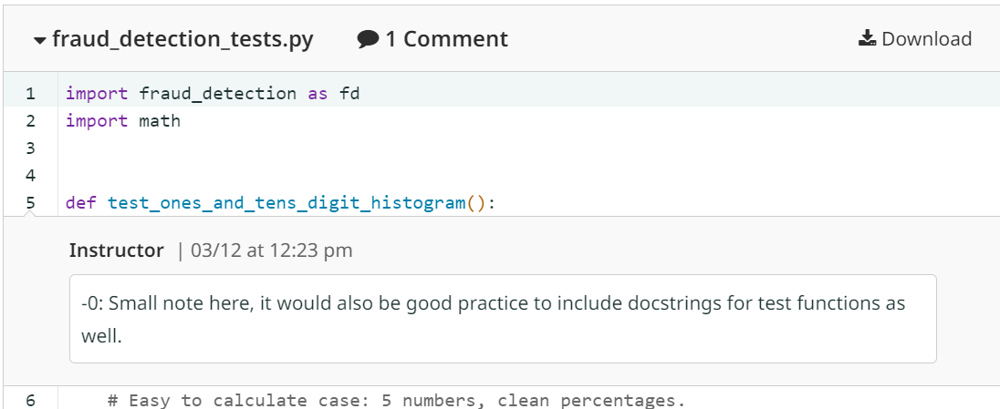
Comments Example

