Slide 1

Introduction to Classes
Data Programming
Questions?
Favorite pokémon?
Icebreaker
Sli.do
#cse160

Slide 2
Announcements
Programming Practice 5 due Sunday, August 2 at 11:59 PM
Homework Assignment 4 due Monday, August 3 at 11:59 PM
Written Check-In 6 due tonight, July 31 at 11:59 PM
Resubmission Cycle 3 opens today

Slide 3
Today’s Roadmap
Organizing Code
Objects (Real and Pythonic)
Classes in Python
Examples
Jupyter Hub

Slide 4
So Far in CSE 160…
Variables, Expressions, Data Types
Loops
Conditionals
Functions
Data Structures
1
2
How can we (further) organize all of this?
3
4
5
Notes:
What is this meant to convey?

Slide 5



Objects
(Real-world) objects have attributes and can (sometimes) perform actions
Attributes
Actions
Color
Cost
Casabrews Model
Type of Coffee Grounds
Brew Time
Shot Type
Turn on/off
Brew 1-shot
(Input: coffee grounds)
Brew 2-shots
(Input: coffee grounds)
Steam (Input: milk)

Slide 6
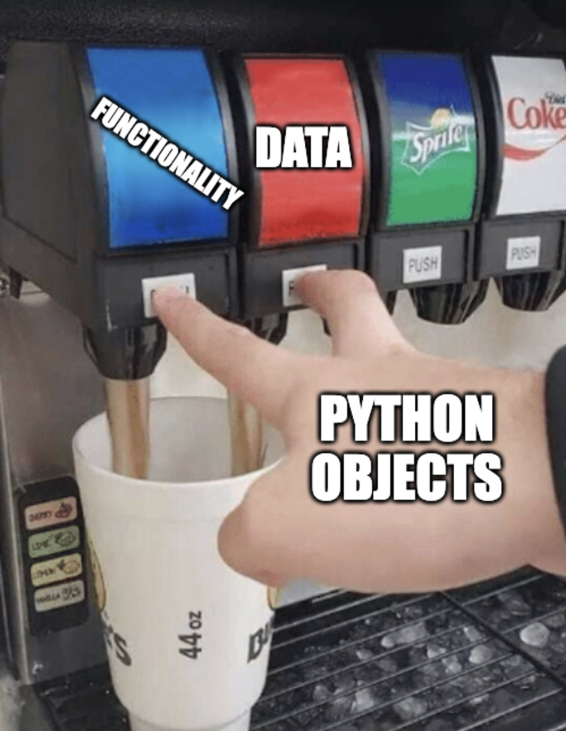
Python Objects
Python objects bundle data and functionality together.
What if built-in data structures don’t suffice?
→ Let’s create our own!

Slide 7




Classes
Classes provide the blueprint for creating an object
Class Blueprint
Specific Object
.fly(...)
number_of_rooms
sqr_footage
color
number_of_rooms = 5
sqr_footage = 2800
color = "Multicolored"

Slide 8


Classes
Class Blueprint
.fly(...)
number_of_rooms
sqr_footage
color

Slide 9


Classes
Classes provide the blueprint for creating an object
Class Blueprint
Specific Object
.brew(...)
color
model
brew_time
color = "Black"
model = "CM5418"
brew_time = 30

Slide 10
Classes in Python
class keyword
class name (uppercase)
class ClassName:
class_var = 42
def my_method(self, parameter):
self.instance_var = parameter
# ...
class attribute (the same for every instance)
function defined inside of class definition
everything is indented!
a method
this is new… (more on this soon!)

Slide 11
Creating an Object
special method that is called when the object is created
class ClassName:
def __init__(self, parameter):
self.parameter = parameter
defining the class (template)
self is a variable that refers to the object itself
not the same variable!
An instance variable is accessible only to the object (instance)
creating an instance of the class (i.e. an object)
my_object = ClassName(18)

Slide 12
Creating an Object
class House:
def __init__(self, sqr_foot, num_rooms, color):
self.sqr_foot = sqr_foot
self.num_rooms = num_rooms
self.color = color
carls_house = House(2800, 5, “Multicolored”)

Slide 13
Questions?
Live and on Sli.do
Sli.do
#cse160

Slide 14

Example: Pokemon
Psyduck
class Pokemon:
hp = 20
def __init__(self, name, kind):
self.name = name
self.type = kind
Water Type Pokemon
psyduck = Pokemon("Psyduck", "Water")

Slide 15

Think Pair Share
What is printed when these two lines of code are run?
psyduck.evolve()
print(wooper.hp)
Consider these two instances of the Pokemon class:
psyduck = Pokemon("Psyduck", "Water")
wooper = Pokemon("Wooper", "Ground")
20
40
60
80
Error
A
B
C
D
Sli.do
#cse160
E

Slide 16
Using an Object
creating an instance of the class (i.e. an object)
my_object = ClassName(18)
class ClassName:
class_var = 160
def __init__(self, parameter):
self.parameter = parameter
my_object.parameter
18
my_object.class_var
160
ClassName.class_var
160

Slide 17
Instance Attribute vs Class Attribute
class PokemonA:
hp = 20
def __init__(self, name, kind):
self.name = name
self.type = kind
def evolve(self):
self.hp = self.hp * 2
wooper = PokemonA(“Wooper”, “Ground”)
psyduck = PokemonA(“Psyduck”, “Water”)
wooper.evolve()
print(wooper.hp)
print(psyduck.hp)

Slide 18

Example: Universities
What attributes and functionality does a university have?
University of Washington

Slide 19

Think Pair Share
Create a class called University with the following attributes and methods:
name, a string
mascot, a string
enrollment, an int
depts, a list of strings
welcome(), that prints:
"[mascot] welcomes you to [name]"
add_dept(new_dept), that adds new_dept to the depts list
University of Washington

Slide 20
Questions?
Live and on Sli.do
Sli.do
#cse160

Slide 21
Anatomy of a Class
A class variable is an attribute of the class (shared across instances)
class name (uppercase)
class keyword
class ClassName:
class_var = 42
def __init__(self, parameter):
self.instance_var = parameter
# ...
special method that is called when object is created
everything is indented!
variable refers to the object itself
The value of an instance variable is unique to the instance of the class

