Slide 1


Visualization (II)
Summer 2026
Questions?
Sli.do
#cse160

Slide 2
Announcements
Midterm Scores available on Gradescope
  Accepting Regrade Requests until Friday, July 31 at 11:59pm
Programming Practice 5 due Sunday, August 2 at 11:59 PM
Homework Assignment 4 due Monday, August 3 at 11:59 PM
Resubmission Cycle 2 due tonight July 29th at 11:59pm
  Homework 1 and Homework 2 are eligible
  Fill out the Google Form!

Slide 3
Things You Might Come Across
How would you implement the following in Python?
Read in a CSV
Draw a graph
Get a random number
Use a machine learning algorithm

Slide 4
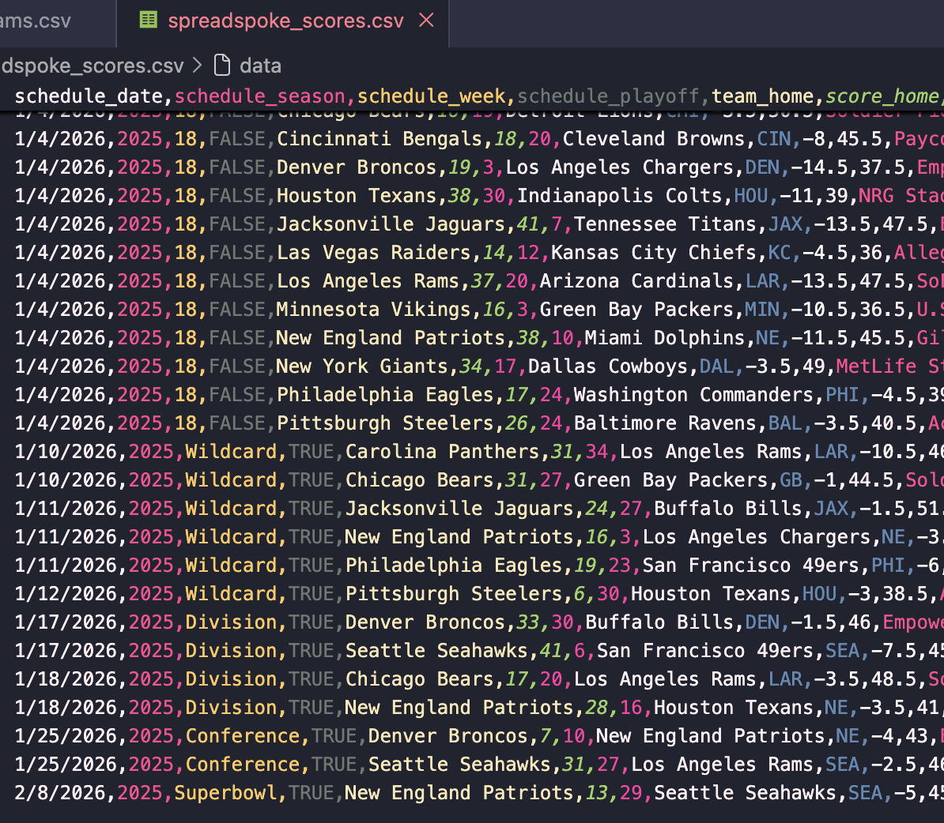
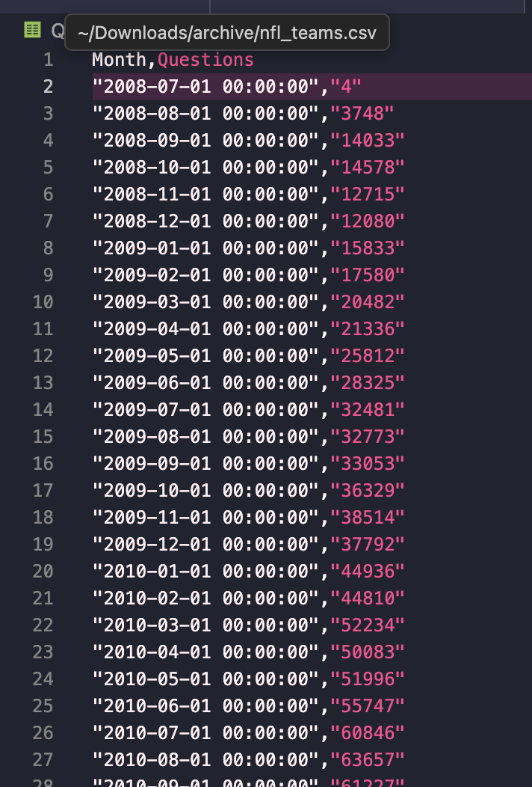
Intro to Visualization (what’s the big deal?)
Source: https://data.stackexchange.com/stackoverflow/query/1926661#resultSets
Source: https://www.kaggle.com/datasets/tobycrabtree/nfl-scores-and-betting-data?resource=download

Slide 5
Anatomy of Calling a Function from a Module
Module name
import keyword
import module_name
Function name from module
to call module functions
module_name.function_name()

Slide 6
Matplotlib
Matplotlib is a Python package with functions that can be used to produce graphs
Matplotlib works well when you have two lists (of the same size)
  List 1 acts as the x (independent) variable
  List 2 acts as the y (dependent) variable
To use the functions we have to import the module!
import matplotlib.pyplot as plt
Alias
Package
Module

Slide 7
Packages vs Modules vs Functions
Package: a folder that contains multiple modules

Slide 8
Packages vs Modules vs Functions
Package: a folder that contains multiple modules
Module: a .py file

Slide 9
Packages vs Modules vs Functions
def add_numbers(num1, num2):
"""
This function takes two numbers and returns their sum.
"""
sum_result = num1 + num2
return sum_result
def add_numbers(num1, num2):
"""
This function takes two numbers and returns their sum.
"""
sum_result = num1 + num2
return sum_result
Package: a folder that contains multiple modules
Module: a .py file
Function: compute calculations

Slide 10
Matplotlib Functions
plt.title("Title")
plt.plot(x_data, y_data)
Pass in a string to title the graph
Pass in two lists of data, with the x values before the y values
Values at the same index are corresponding to one another
Connects points in the order they appear in your list - so x_data should usually be in ascending order
plt.xlabel("X Label")
Pass in a string to label the x axis
plt.ylabel("Y Label")
Pass in a string to label the y axis

Slide 11
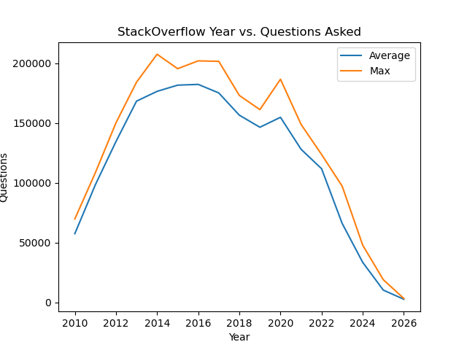
Matplotlib Functions - Data Labels & Legends
plt.plot(x_data, y_data, label = “Your Label”)
Pass in two lists and a string label
plt.legend()
Adds a legend to your graph; you can also modify its location

Slide 12
Matplotlib Functions
plt.savefig("your_filename")
plt.clf()
Pass in a string for the filename
Will save the figures into a .png file on your computer
Will reset your plot so you are not unintentionally adding new data points/lines each time you run your code

Slide 13
Matplotlib Functions
plt.axhline(val)
plt.axvline(val)
plt.xlim(low, high)
plt.ylim(low, high)
Draws axis lines at the specified value
.axhline() is for a horizontal line
.axvline() is for a vertical line
These functions limit the range of the axes
Both numbers are inclusive (unlike range)

Slide 14
NFL

Slide 15
Example: NFL
schedule_season,schedule_date,team_home…..
2018,2019-01-06,Chicago Bears…..
2022,2023-01-08,Atlanta Falcons…..
1981,1981-10-11,San Francisco 49ers…..
2014,2014-10-12,Oakland Raiders…..
2012,2012-10-14,Arizona Cardinals…..
def load_games(csv_file):
...
with open(csv...
...
...
games_data.csv
parse_data.py
def get_avgs_and_seasons(games):
...
season_totals = {}
season_counts = {}
...
plot_nfl.py

Slide 16
Example 2: NFL
schedule_season,schedule_date,team_home…..
2018,2019-01-06,Chicago Bears…..
2022,2023-01-08,Atlanta Falcons…..
1981,1981-10-11,San Francisco 49ers…..
2014,2014-10-12,Oakland Raiders…..
2012,2012-10-14,Arizona Cardinals…..
def load_games(csv_file):
...
with open(csv...
...
...
games_data.csv
parse_data.py
def get_avgs_and_seasons(games):
...
season_totals = {}
season_counts = {}
...
CSV file containing the data
plot_nfl.py

Slide 17
Example 2: NFL
schedule_season,schedule_date,team_home…..
2018,2019-01-06,Chicago Bears…..
2022,2023-01-08,Atlanta Falcons…..
1981,1981-10-11,San Francisco 49ers…..
2014,2014-10-12,Oakland Raiders…..
2012,2012-10-14,Arizona Cardinals…..
def load_games(csv_file):
...
with open(csv...
...
...
games_data.csv
parse_data.py
def get_avgs_and_seasons(games):
...
season_totals = {}
season_counts = {}
...
Python file that contains a function load_games, which parses csv data and returns a dictionary representation of the data
plot_nfl.py

Slide 18
Example 2: NFL
schedule_season,schedule_date,team_home…..
2018,2019-01-06,Chicago Bears…..
2022,2023-01-08,Atlanta Falcons…..
1981,1981-10-11,San Francisco 49ers…..
2014,2014-10-12,Oakland Raiders…..
2012,2012-10-14,Arizona Cardinals…..
def load_games(csv_file):
...
with open(csv...
...
...
games_data.csv
parse_data.py
def get_avgs_and_seasons(games):
...
season_totals = {}
season_counts = {}
...
A file containing a function that parses dictionary data into two lists we can use to graph! Also the place we’ll be putting graphing code
plot_nfl.py

Slide 19
Example: NFL
schedule_season,schedule_date…
2018,2019-01-06,Chicago Bears…..
2022,2023-01-08,Atlanta Falcons…..
1981,1981-10-11,San Francisco 49ers…..
2014,2014-10-12,Oakland Raiders…..
2012,2012-10-14,Arizona Cardinals…..
def load_games(csv_file):
...
with open(csv...
...
...
def get_avgs_and_seasons(games):
...
season_totals = {}
season_counts = {}
...
games_data.csv
parse_data.py
plot_nfl.py
Your Task
Within the plot_nfl.py file, write code that calls the previously defined functions and plots the data returned from get_avgs_and_seasons on a graph (with a title and axis labels)

Slide 20
Example: NFL - Answers
import matplotlib.pyplot as plt
from parse_data import load_games
games = load_games("games_data.csv")
seasons, avg_totals = get_avgs_and_seasons(games)
plt.plot(seasons, avg_totals)
plt.title("Average Total Points per Season")
plt.xlabel("Season")
plt.ylabel("Average Total Points")
plt.savefig("nfl")
plt.clf()

Slide 21
Covid Cases

Slide 22
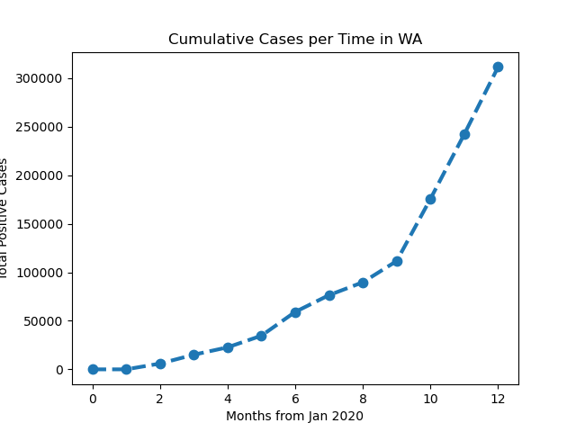
Practice 1 - Cumulative Cases in WA
Write code that will produce the following graph, a visualization of cumulative positive cases in the state of Washington. Include the correct title and axes titles.
x-axis = “Months from Jan 2020”
y-axis = “Total Positive Cases”

Slide 23
Practice 2 - Percentage of Cases per State
Suppose you are given a csv file called state_populations.csv containing state acronyms and their total reported population in 2020 according to the U.S. census. Write a program that reads in this file and plots the percentage of positive cases each state has with respect to their total population across the first 12 months. Your program should also save the generated figure.
Example
California reported 7429 cases in month 0 and has a population of 39,538,223 so you should plot the value 7429/39,538,223 = 0.000187 (you may round to 4 decimal places using round(num, 4) where num is the value you want to round.

