Slide 1


Modules & Visualization
Summer 2026
Questions?
Sli.do
#cse160

Slide 2
Announcements
Midterm Scores available on Gradescope
  Accepting Regrade Requests until Friday, July 31 at 11:59pm
Programming Practice 5 due Sunday, August 2 at 11:59 PM
Homework Assignment 4 due Monday, August 3 at 11:59 PM
Resubmission Cycle 2 now available, due Wednesday July 29th at 11:59pm
  Homework 1 and Homework 2 are eligible
  Fill out the Google Form!

Slide 3
Things You Might Come Across
How would you implement the following in Python?
Read in a CSV
Draw a graph
Get a random number
Use a machine learning algorithm

Slide 4
Things You Might Come Across
How do you implement the following in Python?
Read in a CSV
Draw a graph
Get a random number
Use a machine learning algorithm
Don’t worry about it! Someone’s already written in and we can reuse it!
Introducing Modules!

Slide 5
What are the benefits of using what other people have created?
Sli.do
#cse160

Slide 6
Modules
Allow us to reuse code other people have written
Don’t need to reimplement common functions
Simplify your code
Make debugging easier
Make reading code easier

Slide 7
Using a Module
Import
# Tell Python to use the math module
import math
Calling a Module
# Calculates the square root of 9
print(math.sqrt(9))

Slide 8
Anatomy of Calling a Function from a Module
Module name
import module_name
import keyword
Function name from module
module_name.function_name()
to call module functions

Slide 9
Example of a Module
my_sum.py
Using my_sum
# Return the sum of numbers in a list
def list_sum(my_list):
sum = 0
for num in my_list:
sum += num
return sum
import my_sum
list_1 = [1,2,3,4,5]
print(my_sum.list_sum(list_1))
Sli.do
#cse160

Slide 10
Module Example 1: Random
print(random(1,10))
import random
# How can we print a random number between 1 and 10?
B. print(random.randint(1,10))
C. print(randint(1,10))
Sli.do
#cse160

Slide 11




Popular Packages
A Python package is a collection of available code you can import and use in your program
Packages are a collection of module(s)

Slide 12

Using a Module - From HW3
In a separate utils.py file
Import
# Tell Python what to import and from where
from utils import (read_image, write_image)
Function
# Reads the image file at file_path
def read_image(file_path):
…
return result
Calling a Module
# Calls the read_image function from utils
input_grid = read_image(input_file)

Slide 13
Module Example 2:
utils.plot_2d()
from utils import (plot_2d)
# Given this import statement, how would we use plot_2d?
B. plot_2d()
C. plot_2d.utils()
Sli.do
#cse160

Slide 14
Comparing the Different Ways
Import
Import
# Tell Python to use the math module
import math
# Tell Python which function(s) to import
from utils import (read_image, write_image)
Import the entire universal module
Import specific functions from an existing file

Slide 15
Comparing the Different Ways
Calling a Module
Calling a Module
# Calculates the square root of 9
print(math.sqrt(9))
# Calls the read_image function from utils
input_grid = read_image(input_file)
module_name.function
function_name(parameter)

Slide 16
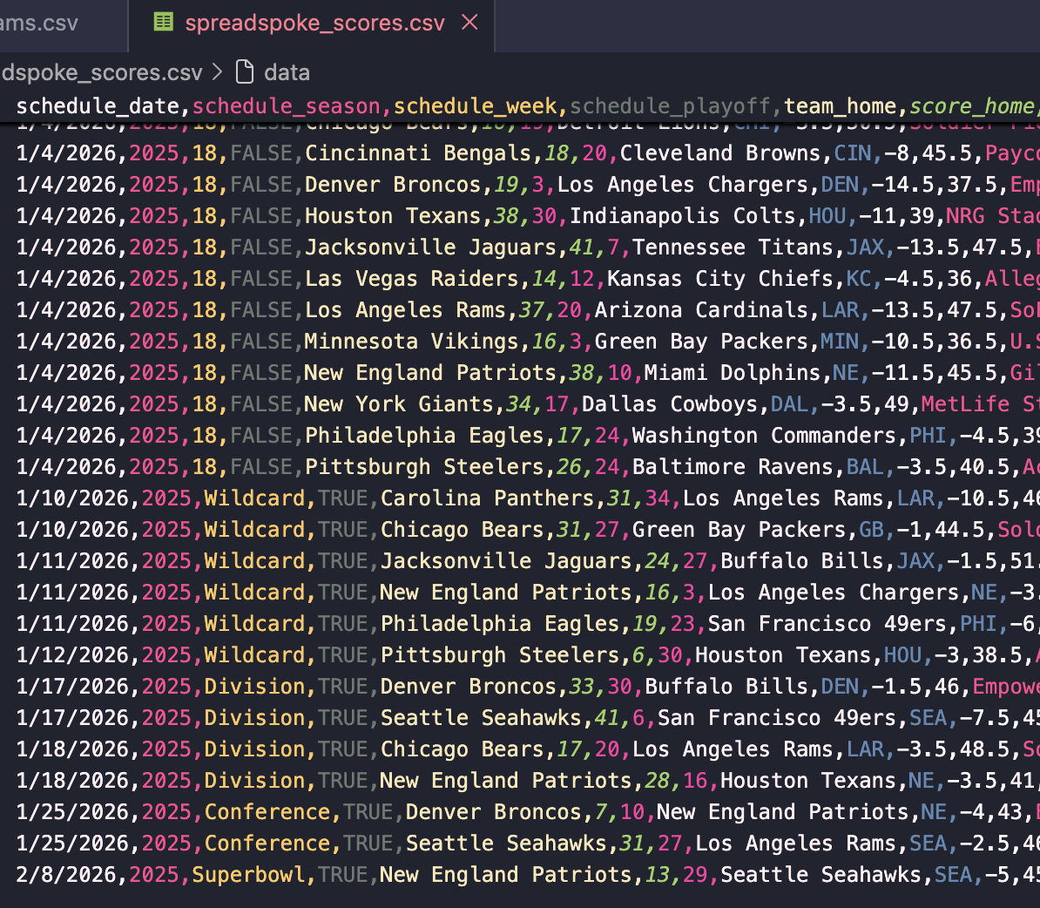
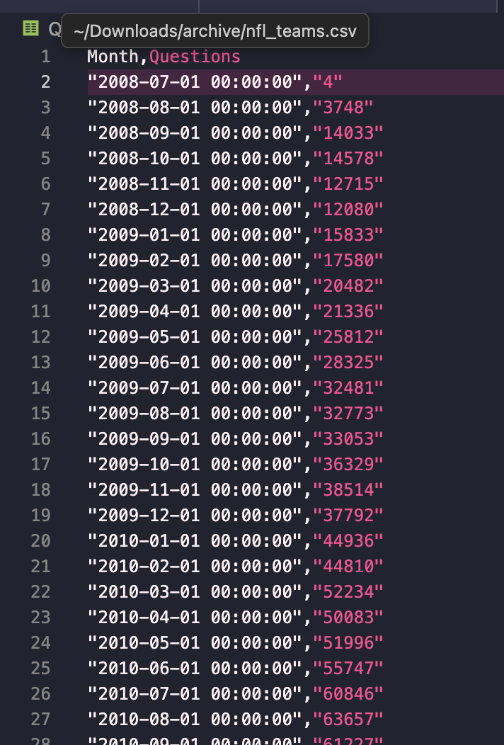
Intro to Visualization (what’s the big deal?)
Source: https://data.stackexchange.com/stackoverflow/query/1926661#resultSets
Source: https://www.kaggle.com/datasets/tobycrabtree/nfl-scores-and-betting-data?resource=download

Slide 17
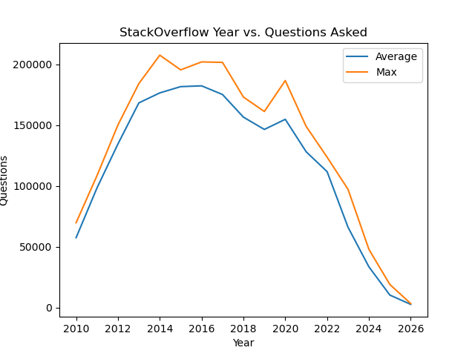
Intro to Visualization (what’s the big deal?)
VS
Graphing data allows us to visually represent trends and notice patterns more easily
Month,Questions
"2008-07-01 00:00:00","4"
"2008-08-01 00:00:00","3748"
"2008-09-01 00:00:00","14033"
"2008-10-01 00:00:00","14578"
"2008-11-01 00:00:00","12715"
"2008-12-01 00:00:00","12080"
"2009-01-01 00:00:00","15833"
"2009-02-01 00:00:00","17580"
"2009-03-01 00:00:00","20482"
"2009-04-01 00:00:00","21336"
"2009-05-01 00:00:00","25812"
"2009-06-01 00:00:00","28325"
"2009-07-01 00:00:00","32481"
"2009-08-01 00:00:00","32773"
"2009-09-01 00:00:00","33053"
"2009-10-01 00:00:00","36329"
"2009-11-01 00:00:00","38514"

Slide 18
Matplotlib
Matplotlib is a Python package with functions that can be used to produce graphs
Matplotlib works well when you have two lists (of the same size)
  List 1 acts as the x (independent) variable
  List 2 acts as the y (dependent) variable
To use the functions we have to import the module!
import matplotlib.pyplot as plt

Slide 19
Anatomy of Calling a Function from a Module
Module name
import keyword
import module_name
Function name from module
to call module functions
module_name.function_name()

Slide 20
Comparing the Different Ways
Import
Calling a Module
# Tell Python to use the math
# module
import math
# Calculates the square root of 9
print(math.sqrt(9))
# Tell Python which function(s) to
# import from the utils module
from utils import (read_image, write_image)
# Calls the read_image function from
# utils
input_grid = read_image(input_file)
module_name.function
function_name(parameter)

Slide 21
Packages vs Modules vs Functions
Package: a folder that contains multiple modules

Slide 22
Packages vs Modules vs Functions
Package: a folder that contains multiple modules
Module: a .py file

Slide 23
Packages vs Modules vs Functions
def add_numbers(num1, num2):
"""
This function takes two numbers and returns their sum.
"""
sum_result = num1 + num2
return sum_result
def add_numbers(num1, num2):
"""
This function takes two numbers and returns their sum.
"""
sum_result = num1 + num2
return sum_result
Package: a folder that contains multiple modules
Module: a .py file
Function: compute calculations

Slide 24
Matplotlib
Matplotlib is a Python package with functions that can be used to produce graphs
Matplotlib works well when you have two lists (of the same size)
  List 1 acts as the x (independent) variable
  List 2 acts as the y (dependent) variable
To use the functions we have to import the module!
import matplotlib.pyplot as plt
Alias
Package
Module

Slide 25
Quick Example!

Slide 26
Matplotlib Functions
plt.title("Title")
plt.plot(x_data, y_data)
Pass in a string to title the graph
Pass in two lists of data, with the x values before the y values
Values at the same index are corresponding to one another
Connects points in the order they appear in your list - so x_data should usually be in ascending order
plt.xlabel("X Label")
Pass in a string to label the x axis
plt.ylabel("Y Label")
Pass in a string to label the y axis

Slide 27
Matplotlib Functions - Data Labels & Legends
plt.plot(x_data, y_data, label = “Your Label”)
Pass in two lists and a string label
plt.legend()
Adds a legend to your graph; you can also modify its location

Slide 28
Matplotlib Functions
plt.savefig("your_filename")
plt.clf()
Pass in a string for the filename
Will save the figures into a .png file on your computer
Will reset your plot so you are not unintentionally adding new data points/lines each time you run your code

Slide 29
Matplotlib Functions
plt.axhline(val)
plt.axvline(val)
plt.xlim(low, high)
plt.ylim(low, high)
Draws axis lines at the specified value
.axhline() is for a horizontal line
.axvline() is for a vertical line
These functions limit the range of the axes
Both numbers are inclusive (unlike range)

Slide 30
Example 1: Stackoverflow
years = [2010, 2011, 2012, 2013, 2014, 2015, 2016, 2017, 2018, 2019, 2020, 2021, 2022, 2023, 2024, 2025, 2026]
avg_questions = [60295, 101322, 137951, 170793, 174519, 182860, 181881, 173728, 155569, 146152, 154152, 126301, 109828, 61857, 30926, 8938, 1894]
max_questions = [79909, 115431, 157836, 188754, 207441, 195373, 201905, 201518, 172998, 161134, 186547, 148842, 123576, 87478, 46149, 18897, 1894]
How can we graph this data to see the pattern between time & questions posted?

Slide 31
Example 1: Stackoverflow - Answers
plt.plot(years, avg_questions, label="Average")
plt.plot(years, max_questions, label="Max")
plt.title("Stackoverflow Years vs. Questions Asked")
plt.xlabel("Years")
plt.ylabel("Questions Asked")
plt.legend()
plt.savefig("stackoverflow")
plt.clf()

Slide 32
Think Pair Share
What happens when this program is run?
x_vals = [1, 2, 3, 4]
y_vals = [10, 20, 30]
plt.plot(x_vals, y_vals)
plt.savefig("plot_1")
A graph is drawn using only the first three values of x_vals
A
A graph is drawn with missing y-values filled in automatically
B
The program crashes with an error
C
A blank graph appears
D
Sli.do
#cse160

Slide 33
Think Pair Share
x_vals = [1, 2, 3, 4]
y1_vals = [10, 20, 30, 70]
y2_vals = [20, 50, 40, 90]
plt.plot(x_vals, y1_vals)
plt.plot(x_vals, y2_vals)
plt.savefig("image")
plt.clf()
What is the difference between the output of the two code blocks on the right?
A
There is no difference in the output.
The top code block will have multiple lines on the graph while the bottom one will have two graphs with one line each.
x_vals = [1, 2, 3, 4]
y1_vals = [10, 20, 30, 70]
y2_vals = [20, 50, 40, 90]
plt.plot(x_vals, y1_vals)
plt.savefig("image_1")
plt.clf()
plt.plot(x_vals, y2_vals)
plt.savefig("image_2")
plt.clf()
B
There will be an error for the bottom code block for calling plt.clf() too many times. The top code block will run normally.
C
Sli.do
#cse160

Slide 34
NFL

Slide 35
Example 2: NFL
schedule_season,schedule_date,team_home…..
2018,2019-01-06,Chicago Bears…..
2022,2023-01-08,Atlanta Falcons…..
1981,1981-10-11,San Francisco 49ers…..
2014,2014-10-12,Oakland Raiders…..
2012,2012-10-14,Arizona Cardinals…..
def load_games(csv_file):
...
with open(csv...
...
...
games_data.csv
parse_data.py
def get_avgs_and_seasons(games):
...
season_totals = {}
season_counts = {}
...
plot_nfl.py

Slide 36
Example 2: NFL
schedule_season,schedule_date,team_home…..
2018,2019-01-06,Chicago Bears…..
2022,2023-01-08,Atlanta Falcons…..
1981,1981-10-11,San Francisco 49ers…..
2014,2014-10-12,Oakland Raiders…..
2012,2012-10-14,Arizona Cardinals…..
def load_games(csv_file):
...
with open(csv...
...
...
games_data.csv
parse_data.py
def get_avgs_and_seasons(games):
...
season_totals = {}
season_counts = {}
...
CSV file containing the data
plot_nfl.py

Slide 37
Example 2: NFL
schedule_season,schedule_date,team_home…..
2018,2019-01-06,Chicago Bears…..
2022,2023-01-08,Atlanta Falcons…..
1981,1981-10-11,San Francisco 49ers…..
2014,2014-10-12,Oakland Raiders…..
2012,2012-10-14,Arizona Cardinals…..
def load_games(csv_file):
...
with open(csv...
...
...
games_data.csv
parse_data.py
def get_avgs_and_seasons(games):
...
season_totals = {}
season_counts = {}
...
Python file that contains a function load_games, which parses csv data and returns a dictionary representation of the data
plot_nfl.py

Slide 38
Example 2: NFL
schedule_season,schedule_date,team_home…..
2018,2019-01-06,Chicago Bears…..
2022,2023-01-08,Atlanta Falcons…..
1981,1981-10-11,San Francisco 49ers…..
2014,2014-10-12,Oakland Raiders…..
2012,2012-10-14,Arizona Cardinals…..
def load_games(csv_file):
...
with open(csv...
...
...
games_data.csv
parse_data.py
def get_avgs_and_seasons(games):
...
season_totals = {}
season_counts = {}
...
A file containing a function that parses dictionary data into two lists we can use to graph! Also the place we’ll be putting graphing code
plot_nfl.py

Slide 39
Example 2: NFL
schedule_season,schedule_date…
2018,2019-01-06,Chicago Bears…..
2022,2023-01-08,Atlanta Falcons…..
1981,1981-10-11,San Francisco 49ers…..
2014,2014-10-12,Oakland Raiders…..
2012,2012-10-14,Arizona Cardinals…..
def load_games(csv_file):
...
with open(csv...
...
...
def get_avgs_and_seasons(games):
...
season_totals = {}
season_counts = {}
...
games_data.csv
parse_data.py
plot_nfl.py
Your Task
Within the plot_nfl.py file, write code that calls the previously defined functions and plots the data returned from get_avgs_and_seasons on a graph (with a title and axis labels)

Slide 40
Example 2: NFL - Answers
import matplotlib.pyplot as plt
from parse_data import load_games
games = load_games("games_data.csv")
seasons, avg_totals = get_avgs_and_seasons(games)
plt.plot(seasons, avg_totals)
plt.title("Average Total Points per Season")
plt.xlabel("Season")
plt.ylabel("Average Total Points")
plt.savefig("nfl")
plt.clf()

