Slide 1
CSE 160 Wrap-Up
Andrew S Fitz Gibbon
UW CSE 160
Winter 2022

Slide 2
Progress in 10 weeks
10 weeks ago: you knew no programming
Goals:
Computational problem-solving
Python programming language
Experience with real datasets
Fun of extracting understanding and insight from data, and of mastery over the computer
Ability to go on to more advanced computing classes
Today: you can write a useful program to solve a real problem

Slide 3
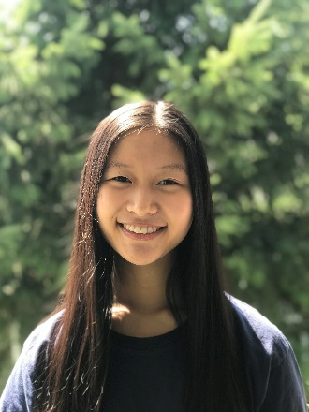
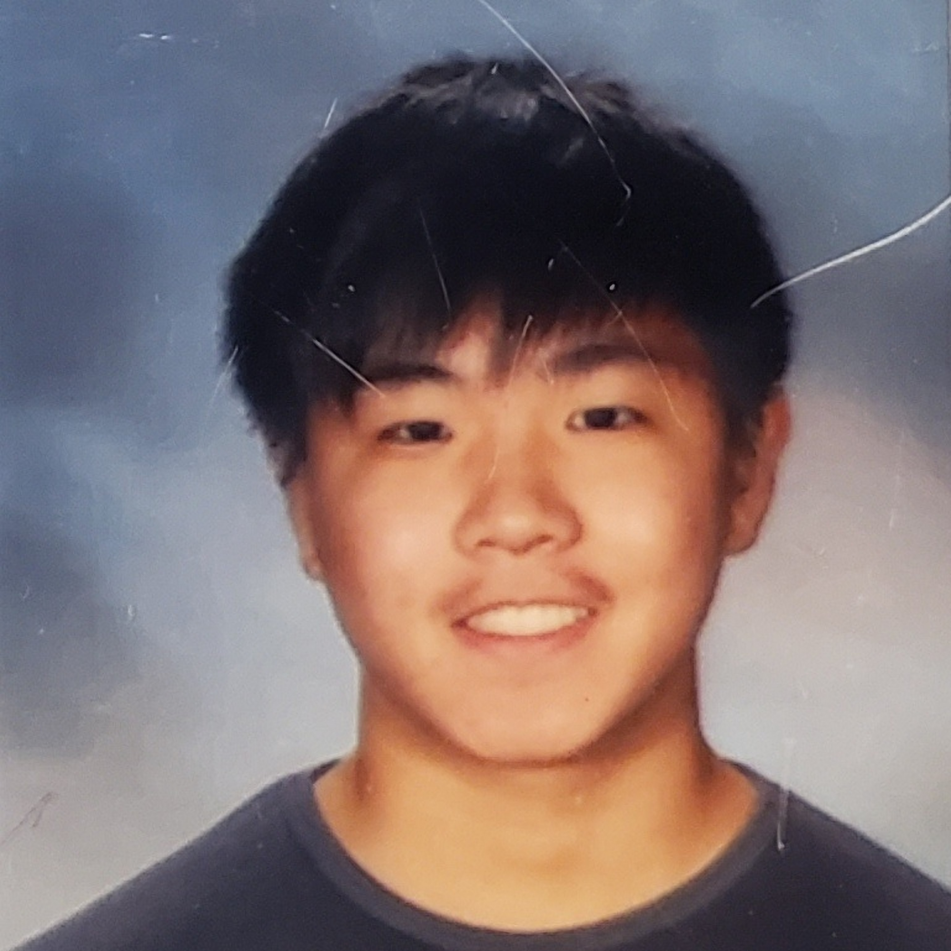
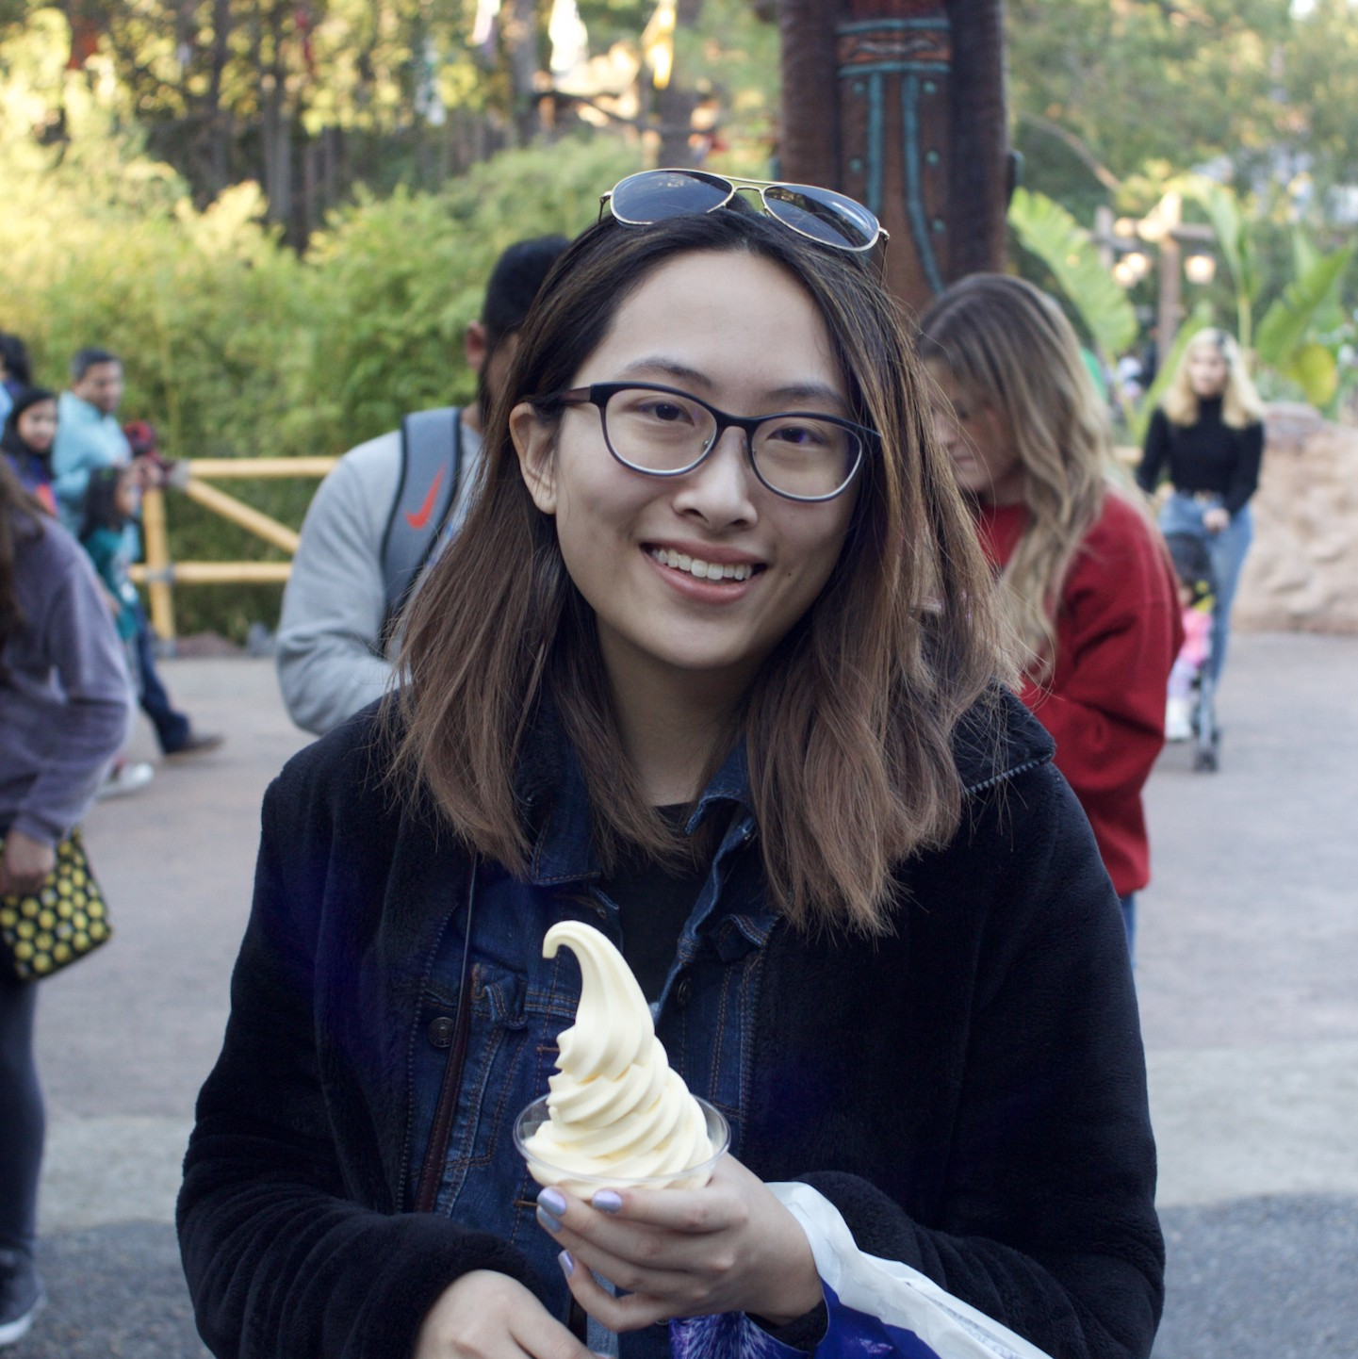
Thanks!

Slide 4
Why do you care about processing data?
The world is awash in data
Processing and analyzing it is the difference between success and failure
for a team or for an individual
Manipulating and understanding data is essential to:
Astronomers
Biologists
Chemists
Economists
Engineers
Entrepreneurs
Linguists
Political scientists
Zoologists
… and many more!

Slide 5
Programming Concepts
Variables
Assignments
Types
Programs & algorithms
Control flow: loops (for), conditionals (if)
Functions
File I/O
Python execution model
How Python evaluates expressions, statements, and programs

Slide 6
Data structures: managing data
List
Set
Dictionary
Tuple
Graph
List slicing (sublist)
List comprehension: shorthand for a loop

Slide 7
Functions
f(x) = x²
Procedural abstraction
avoid duplicated code
the client does not need to know about the implementation
Using functions
Defining functions

Slide 8
Data abstraction
Dual to procedural abstraction (functions)
A module is: operations
An object is: data + operations
Operations: create, query, modify
Clients use the operations, never directly access data
The client does not need to know about the representation of the data
Programmer defines a class. Each instance of a class is an object.

Slide 9
Testing and debugging
Use small data sets to test your program
Write enough tests:
Cover every branch of each boolean expression
especially when used in a conditional expression (if statement)
Cover special cases:
numbers: zero, positive, negative, int vs. float
data structures: empty, size 1, larger
Assertions are useful beyond tests
Debugging: after you observe a failure
Divide and conquer
In time, in data, in program text, in development history
this is also a key program design concept
The scientific method
state a hypothesis; design an experiment; understand results
Think first (“lost in the woods” analogy)
Be systematic: record everything; have a reason for each action

Slide 10
Data analysis
Statistics
Run many simulations
How uncommon is what you actually saw?
Graphing/plotting results

Slide 11
Efficiency & Good Programming Practice
Efficiency:
Focus on expensive operations (e.g. reading & writing files & printing)
Focus on loops (Try to minimize the number of times you iterate over data)
Programming Style Matters!

Slide 12
Data!
DNA
Images
2D points and Handwriting Samples
Social Networks
Election Results

Slide 13
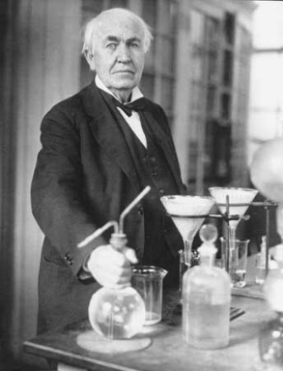
What you have learned in CSE 160
Compare your skills today to 10 weeks ago
The assignments would be easy for you today
This is a measure of how much you have learned
There is no such thing as a “born” programmer!
Your next project can be more ambitious
Genius is 1% inspiration and 99% perspiration.
Thomas A. Edison

Slide 14
Go forth and conquer
System building and scientific discovery are fun!
It’s even more fun when your system works
Pay attention to what matters
Use the techniques and tools of CSE 160 effectively

Slide 15
Final Exam
Topics: Everything in the course up to and including List Comprehensions is fair game.
Part 1 - similar to the midterm: writing small functions, although now dictionaries, sets, and tuples and sorting could be involved.
Part 2 - short answer questions and code writing that involves writing less than an entire function.
Released by 5pm Mon, Mar 14, due by 5:30pm Thurs, Mar 17.
Similar Policies to Midterm – Groups of up to 4

Slide 16
Final Exam
Practice:
https://www.gradescope.com/courses/345007/assignments/1924914
Info: https://courses.cs.washington.edu/courses/cse160/22wi/exams/final.html

Slide 17
Program design
How to write a function:
Choose name, arguments, and documentation string
Write tests
Write body/implementation
How to write a program:
Decompose into parts (functions, modules)
Each part should be a logical unit, not too large or small
Write each part
Define the problem
Choose an algorithm
In English first; test it via manual simulation
Translate into code
When necessary, use wishful thinking
Assume a function exists, then write it later
Can test even before you write it, via a stub

