Slide 1
Visualization
Andrew S Fitz Gibbon
UW CSE 160
Winter 2022

Slide 2
matplotlib
Strives to emulate MATLAB
Pro: familiar to MATLAB users
Pro: powerful
Con: not the best design for a plotting library
One important function for HW6:
plot(xvalues, yvalues)

Slide 3
Plot
import matplotlib.pyplot as plt
xs = [1, 2, 3, 4, 5]
# ys = [x**2 for x in xs]
ys = []
for x in xs:
ys.append(x**2)
plt.plot(xs, ys)
plt.show()
no return value?
Has a side effect on the figure (like “print” statement)

Slide 4
import matplotlib.pyplot as plt
xs = range(-100, 110, 10)
x2 = [x**2 for x in xs]
negx2 = [-x**2 for x in xs]
plt.plot(xs, x2)
plt.plot(xs, negx2)
plt.xlabel("x")
plt.ylabel("y")
plt.ylim(-2000, 2000)
plt.axhline(0) # horiz line
plt.axvline(0) # vert line
plt.savefig("quad.png")
plt.show() # resets state
Incrementally modify the figure.
Save your figure to a file
Display plot
Call savefig before show, show clears the state

Slide 5
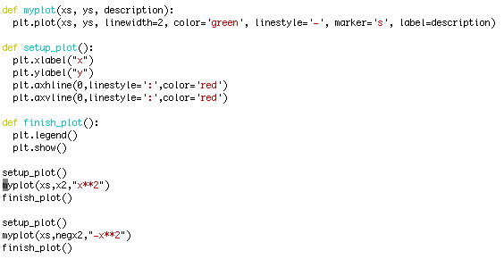
We can group these options into functions as usual, but remember that they are operating on a global, hidden variable (the figure)

Slide 6
Visualization: Pros and Cons
Visualizations can Mislead (link):

Slide 7
Visualizations can be powerful:
London cholera epidemic
Map by Dr. John Snow
1854
Notes:
Some anomalies are worth noting. Although the large workhouse just north of Broad Street housed over 500 paupers, it suffered very few cholera deaths because it had its own well (not shown on the map). Likewise, The workers at the brewery one block east of the Broad Street pump could drink all the beer they wanted; the fermentation killed the cholera bacteria, and none of the brewery workers contracted cholera. Many of the deaths further away from the Broad Street pump were people who walked to work or market on the Broad Street and drank from that well. The water from the Broad Street well reportedly tasted better than water from most of the neighboring wells, particularly the smelly water from the Carnaby Street/Little Marlborough Street well a few blocks to the northeast.

Slide 8
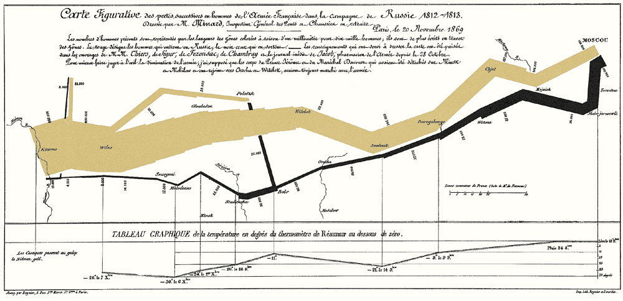
Napoleon’s Russian Campaign of 1812
Graphic by Charles Joseph Minard

