Slide 1
Graphs
Andrew S. Fitz Gibbon
UW CSE 160
Winter 2022

Slide 2
A graph contains nodes and edges
Chicago
Seattle
Salt Lake City
San Francisco
Dallas

Slide 4
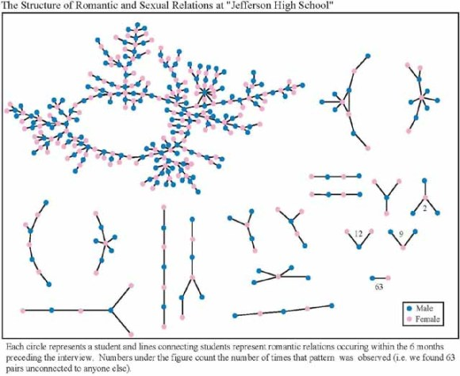
+ 350 students in no romantic and/or sexual relationship
From: “Chains of Affection: The Structure of Adolescent Romantic and Sexual Networks”, American Journal of Sociology, by Peter Bearman of (Columbia), James Moody (Ohio State), and Katherine Stovel (U. of Washngton);
Notes:
This article describes the structure of the adolescent romantic and sexual network in a population of over 800 adolescents residing in a midsized town in the midwestern United States. Precise images and measures of network structure are derived from reports of relationships that occurred over a period of 18 months between 1993 and 1995. The study offers a comparison of the structural characteristics of the observed network to simulated networks conditioned on the distribution of ties; the observed structure reveals networks characterized by longer contact chains and fewer cycles than expected. This article identifies the micromechanisms that generate networks with structural features similar to the observed network. Implications for disease transmission dynamics and social policy are explored.

Slide 5
Graphs
A graph can be thought of as either of:
a collection of edges
Each edge represents some relationship
for each node, a collection of neighbors
The neighbors are those connected by an edge

Slide 6
Operations on a graph
Creation:
Create an empty graph
Querying:
Look up a node: Does it exist? What are its neighbors?
Look up an edge (= a pair of nodes): does it exist? (You know the nodes it connects.)
Iterate through the nodes or edges
Modification:
Add/remove a node
Add/remove an edge

Slide 7
networkx Graph Library
Used in Homework 5
Included in the Anaconda Distribution
https://networkx.github.io/documentation/stable/tutorial.html
import networkx as nx
g = nx.Graph()
g.add_node(1)
g.add_node(2)
g.add_edge(1, 2)
print(g.nodes())
print(g.edges())
Note: It is also o.k. to just add an edge before you add the individual nodes; the nodes will be added for you in that case.

Slide 8
import networkx as nx
import matplotlib.pyplot as plt
g = nx.Graph() # Creates a graph
g.add_edge(1, 2) # Adds edge from node 1 to node 2
g.add_edge(1, 3)
g.add_node(4) # Adds node 4
print("Edges:", g.edges())
print("Nodes:", g.nodes())
print("Neighbors of node 1:", list(g.neighbors(1)))
assert len(g.nodes()) == 4
assert len(g.edges()) == 2
nx.draw_networkx(g) # Draw the graph
plt.show() # Show the graph

