Slide 1
CSE 160 Wrap-Up
Rob Thompson
UW CSE 160
Winter 2021

Slide 2
Progress in 10 weeks
10 weeks ago: you knew no programming
Goals:
Computational problem-solving
Python programming language
Experience with real datasets
Fun of extracting understanding and insight from data, and of mastery over the computer
Ability to go on to more advanced computing classes
Today: you can write a useful program (from nothing!) to solve a real problem

Slide 3
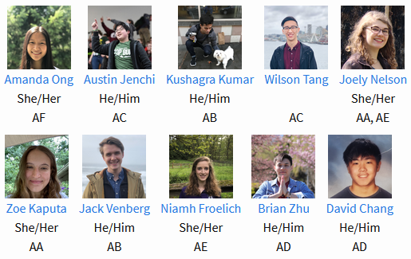
Join me in thanking your TAs!

Slide 4
Why do you care about processing data?
The world is awash in data
Processing and analyzing it is the difference between success and failure
for a team or for an individual
Manipulating and understanding data is essential to:
Astronomers
Biologists
Chemists
Economists
Engineers
Entrepreneurs
Linguists
Political scientists
Zoologists
… and many more!

Slide 5
Programming Concepts
Variables
Assignments
Types
Programs & algorithms
Control flow: loops (for), conditionals (if)
Functions
File I/O
Python execution model
How Python evaluates expressions, statements, and programs

Slide 6
Data structures: managing data
List
Set
Dictionary
Tuple
Graph
List slicing (sublist)
List comprehension: shorthand for a loop

Slide 7
Functions
f(x) = x²
Procedural abstraction
avoid duplicated code
the implementation does not matter to the client
Using functions
Defining functions
Anonymous functions
Lambda

Slide 8
Data abstraction
Dual to procedural abstraction (functions)
A module is: operations
An object is: data + operations
Operations: create, query, modify
Clients use the operations, never directly access data
The representation of the data does not matter to the client
Programmer defines a class. Each instance of a class is an object.

Slide 9
Testing and debugging
Use small data sets to test your program
Write enough tests:
Cover every branch of each boolean expression
especially when used in a conditional expression (if statement)
Cover special cases:
numbers: zero, positive, negative, int vs. float
data structures: empty, size 1, larger
Assertions are useful beyond tests
Debugging: after you observe a failure
Divide and conquer
In time, in data, in program text, in development history
this is also a key program design concept
The scientific method
state a hypothesis; design an experiment; understand results
Think first (“lost in the woods” analogy)
Be systematic: record everything; have a reason for each action

Slide 10
Data analysis
Statistics
Run many simulations
How uncommon is what you actually saw?
Graphing/plotting results

Slide 11
Program design
How to write a function:
Choose name, arguments, and documentation string
Write tests
Write body/implementation
How to write a program:
Decompose into parts (functions, modules)
Each part should be a logical unit, not too large or small
Write each part
Define the problem
Choose an algorithm
In English first; test it via manual simulation
Translate into code
When necessary, use wishful thinking
Assume a function exists, then write it later
Can test even before you write it, via a stub

Slide 12
Speed of algorithms
Affected primarily by the number of times you iterate over data
Nested looping matters a lot

Slide 13
Data!
DNA
Images
Social Networks
Election Results
2D points and Handwriting Samples

Slide 14
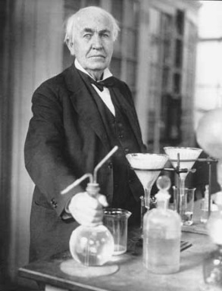
What you have learned in CSE 160
Compare your skills today to 10 weeks ago
Bottom line: The assignments would be easy for you today
This is a measure of how much you have learned
There is no such thing as a “born” programmer!
Your next project can be more ambitious
Genius is 1% inspiration and 99% perspiration.
Thomas A. Edison

Slide 15
Python program to assess treatment efficacy
# This program reads an Excel spreadsheet whose penultimate
# and antepenultimate columns are zip codes.
# It adds a new last column for the distance between those zip
# codes, and outputs in CSV (comma-separated values) format.
# Call the program with two numeric values: the first and last
# row to include.
# The output contains the column headers and those rows.
# Libraries to use
import random
import sys
import xlrd # library for working with Excel spreadsheets
import time
from gdapi import GoogleDirections
# No key needed if few queries
gd = GoogleDirections('dummy-Google-key')
wb = xlrd.open_workbook('mhip_zip_eScience_121611a.xls')
sheet = wb.sheet_by_index(0)
# User input: first row to process, first row not to process
first_row = max(int(sys.argv[1]), 2)
row_limit = min(int(sys.argv[2]+1), sheet.nrows)
def comma_separated(lst):
return ",".join([str(s) for s in lst])
headers = sheet.row_values(0) + ["distance"]
print comma_separated(headers)
for rownum in range(first_row,row_limit):
row = sheet.row_values(rownum)
(zip1, zip2) = row[-3:-1]
if zip1 and zip2:
# Clean the data
zip1 = str(int(zip1))
zip2 = str(int(zip2))
row[-3:-1] = [zip1, zip2]
# Compute the distance via Google Maps
try:
distance = gd.query(zip1,zip2).distance
except:
print >> sys.stderr, "Error computing distance:", zip1, zip2
distance = ""
# Print the row with the distance
print comma_separated(row + [distance])
# Avoid too many Google queries in rapid succession
time.sleep(random.random()+0.5)
23 lines of executable code!

Slide 16
Go forth and conquer
System building and scientific discovery are fun!
It’s even more fun when your system works
Pay attention to what matters
Use the techniques and tools of CSE 160 effectively

Slide 17
Final Exam
Topics: Everything in the course up to and including List Comprehensions is fair game.
Part 1 - similar to the midterm: writing small functions, although now dictionaries, sets, and tuples could be involved.
Part 2 - short answer questions and code writing that involves writing less than an entire function.
Released by end of day Mon 3/15, due by 11pm Thurs 3/18
Similar Policies to Midterm – Groups of up to 4

