Slide 1
Introduction to Data Programming
CSE 160
University of Washington
Winter 2021
Rob Thompson
Slides based on previous versions by Ruth Anderson, Michael Ernst and Bill Howe

Slide 2
Agenda for Today
What is this course?
Course logistics
Python!

Slide 3
Welcome to CSE 160!
CSE 160 teaches basic, key programming concepts with an emphasis on real data manipulation tasks from science, engineering, and business
Goal by the end of the quarter: Given a data source and a problem description, you can independently write a complete, useful program to solve the problem (practical knowledge)

Slide 4
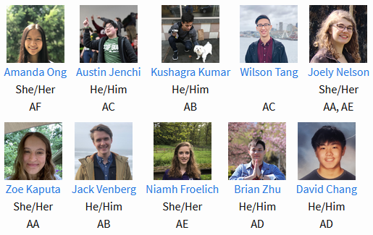
Course staff
Lecturer:
Rob Thompson
TAs:
David Chang
Niamh Froelich
Zoe Kaputa
Austin Jenchi
Joely Nelson
Wilson Tang
Amanda Ong
Jack Venberg
Brian Zhu
Kushagra Kumar
We’re all here for you, so don’t hesitate to ask for help

Slide 5
About Rob
Forever-Student at UW: undergrad in Computer science and Physics, PhD in Computer Science
Teaching CS: for ~4 years, 1 as lecturer
Research Focus: Educational programming environments, effects of dyslexia on children learning to program
Fun Fact: A big part of the data analysis presented in my defense used Python scripts, it’s relevant at all levels!

Slide 6
Course Learning Objectives
Computational problem-solving
Writing a program will become your “go-to” solution for data analysis tasks
Basic Python proficiency
Including experience with relevant libraries for data manipulation, scientific computing, and visualization.
Experience working with real datasets
astronomy, biology, linguistics, oceanography, open government, social networks, and more.
You will see that these are easy to process with a program, and that doing so yields insight.

Slide 7
What this course is not
A “programming language course” in Python
…though you will become proficient in the basics of the Python programming language
…and you will gain experience with some important Python libraries
A data analysis / “data science” / data visualization course
There will be very little statistics knowledge assumed or taught
A “project” course
the assignments are “real,” but are intended to teach specific programming concepts
A “big data” course
Datasets will all fit comfortably in memory
No parallel programming

Slide 8
How to succeed
No prerequisites
Non-predictors for success:
Past programming experience
Enthusiasm for games or computers
Programming and data analysis are challenging
Every one of you can succeed
There is no such thing as a “born programmer”
Work hard
Follow directions
Be methodical
Think before you act
Try on your own, then ask for help
Start early

Slide 9
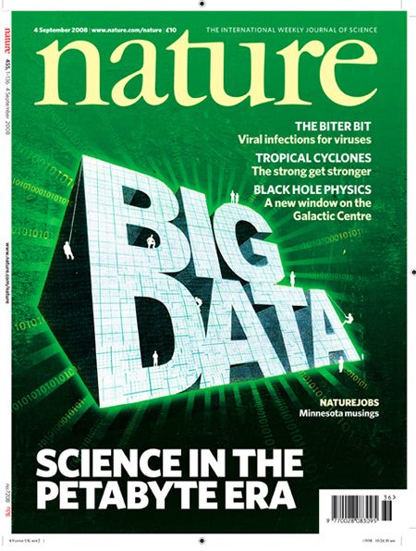
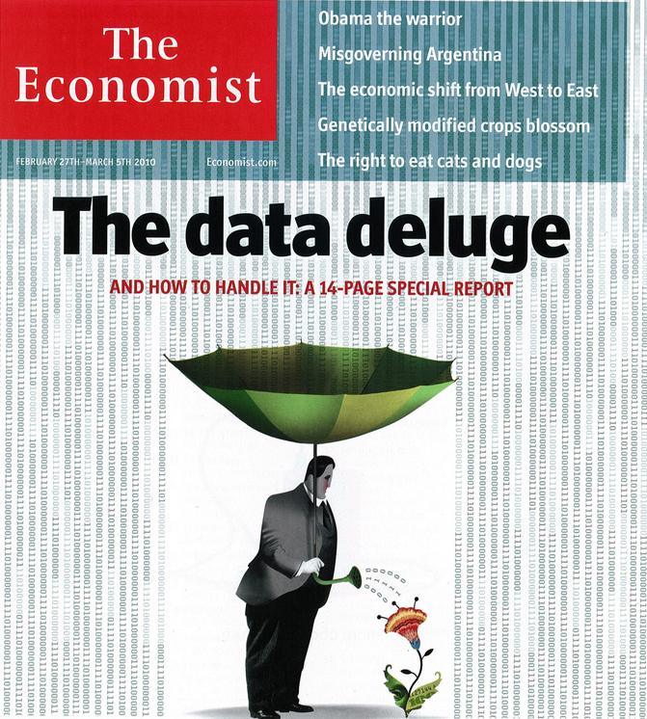
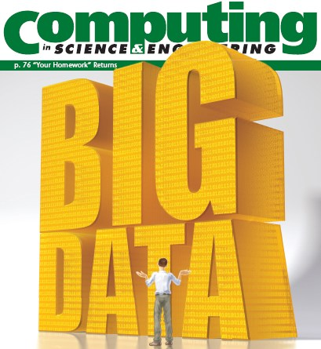
“It’s a great time to be a data geek.”
-- Roger Barga, Microsoft Research
“The greatest minds of my generation are trying
to figure out how to make people click on ads”
-- Jeff Hammerbacher, co-founder, Cloudera

Slide 10
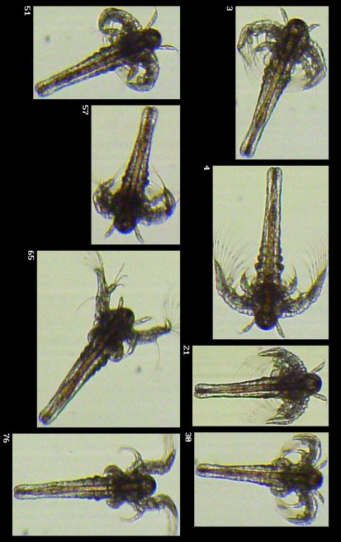
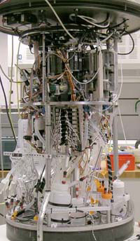
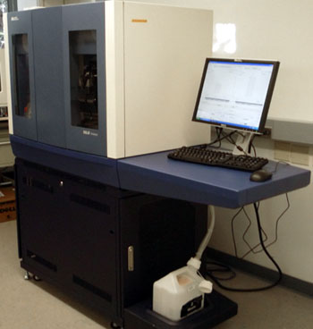
All of science is reducing to computational data manipulation
Old model: “Query the world” (Data acquisition coupled to a specific hypothesis)
New model: “Download the world” (Data acquisition supports many hypotheses)
Astronomy: High-resolution, high-frequency sky surveys (SDSS, LSST, PanSTARRS)
Biology: lab automation, high-throughput sequencing,
Oceanography: high-resolution models, cheap sensors, satellites
40TB / 2 nights
~1TB / day
100s of devices
Slide from Bill Howe, eScience Institute
Notes:
Slide from Bill Howe, eScience Institute, his notes:
Drowning in data; starving for information
We’re at war with these engineering companies. FlowCAM is bragging about the amount of data they can spray out of their device. How to use this enormous data stream to answer scientific questions is someone else’s problem.
“Typical large pharmas today are generating 20 terabytes of data daily. That’s probably going up to 100 terabytes per day in the next year or so.”
“tens of terabytes of data per day” -- genome center at Washington University
Increase data collection exponentially with flowcam

Slide 11
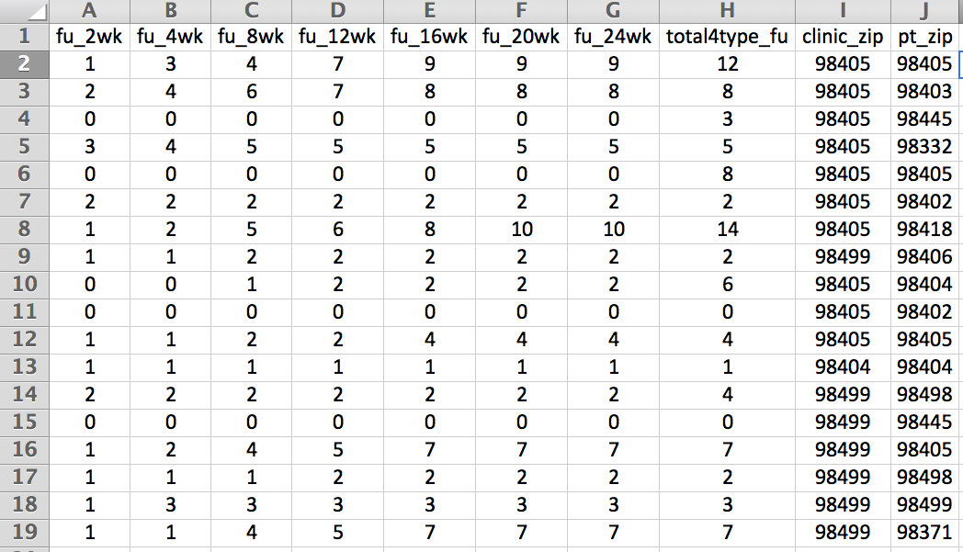
Example: Assessing treatment efficacy
number of follow ups within 16 weeks after treatment enrollment.
Zip code of clinic
Zip code of patient
Question: Does the distance between the patient’s home and clinic influence the number of follow ups, and therefore treatment efficacy?

Slide 12
Python program to assess treatment efficacy
# This program reads an Excel spreadsheet whose penultimate
# and antepenultimate columns are zip codes.
# It adds a new last column for the distance between those zip
# codes, and outputs in CSV (comma-separated values) format.
# Call the program with two numeric values: the first and last
# row to include.
# The output contains the column headers and those rows.
# Libraries to use
import random
import sys
import xlrd # library for working with Excel spreadsheets
import time
from gdapi import GoogleDirections
# No key needed if few queries
gd = GoogleDirections('dummy-Google-key')
wb = xlrd.open_workbook('mhip_zip_eScience_121611a.xls')
sheet = wb.sheet_by_index(0)
# User input: first row to process, first row not to process
first_row = max(int(sys.argv[1]), 2)
row_limit = min(int(sys.argv[2]+1), sheet.nrows)
def comma_separated(lst):
return ",".join([str(s) for s in lst])
headers = sheet.row_values(0) + ["distance"]
print comma_separated(headers)
for rownum in range(first_row,row_limit):
row = sheet.row_values(rownum)
(zip1, zip2) = row[-3:-1]
if zip1 and zip2:
# Clean the data
zip1 = str(int(zip1))
zip2 = str(int(zip2))
row[-3:-1] = [zip1, zip2]
# Compute the distance via Google Maps
try:
distance = gd.query(zip1,zip2).distance
except:
print >> sys.stderr, "Error computing distance:", zip1, zip2
distance = ""
# Print the row with the distance
print comma_separated(row + [distance])
# Avoid too many Google queries in rapid succession
time.sleep(random.random()+0.5)
23 lines of executable code!

Slide 13
Course logistics
Website: http://www.cs.washington.edu/cse160
See the website for all administrative details
Homework 0 - due Friday
Preliminary Survey are due Wednesday
All of this listed and detailed on the website
Questions? robthomp@cs.washington.edu

Slide 14
Introductions on Ed Board
Name
Major
Interesting Fact or maybe what you did over break.
Feel free to try making a video!

