Slide 1
Introduction to Python and programming
Ruth Anderson
UW CSE 160
Autumn 2021

Slide 2
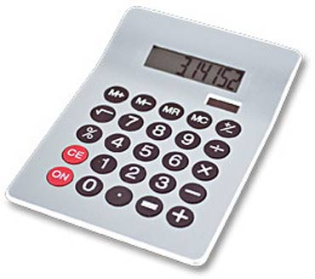
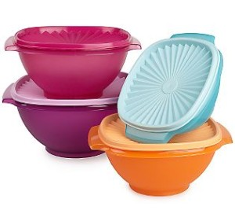
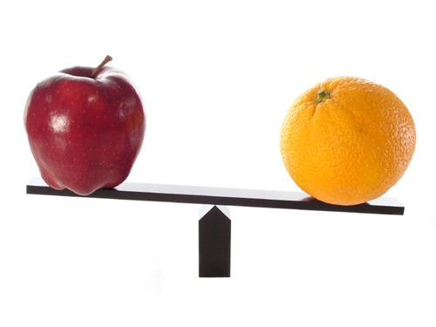
1. Python is a calculator
2. A variable is a container
3. Different types cannot be compared
4. A program is a recipe

Slide 3
0. Don’t panic!
CSE 160 is for beginners to programming
(If you know how to program, you don’t belong)
You can learn to program in 10 weeks
You will work hard
We will work hard to help you
Ask questions!
This is the best way to learn

Slide 4
1. Python is a calculator

Slide 5
You type expressions. Python computes their values.
Try typing some of these expressions into a python interpreter
5
3 + 4
44 / 2
2 ** 3
3 * 4 + 5 * 6
If precedence is unclear, use parentheses
(72 – 32) / 9 * 5

Slide 6
An expression is evaluated from the inside out
How many expressions are in this Python code?
an expression
values
(72 – 32) / 9.0 * 5
(72 – 32) / 9.0 * 5
(40) / 9.0 * 5
40 / 9.0 * 5
4.44 * 5
22.2
Notes:
Note: using 9.0 instead of 9 as on previous slide.

Slide 7
Another evaluation example
(72 – 32) / (9.0 * 5)
(40) / (9.0 * 5)
40 / (9.0 * 5)
40 / (45.0)
40 / 45.0
.888
Notes:
Note: Still using 9.0 instead of 9 as on previous slide.

Slide 8
2. A variable is a container

Slide 9
Variables hold values
Try typing into a python interpreter
Recall variables from algebra:
Let x = 2 …
Let y = x …
In Python: “varname = expression”
pi = 3.14
pi
avogadro = 6 * 10 ** 23
avogadro
22 = x # Error!
Not all variable names are permitted
Nothing printed from an assignment statement
An expression that can be typed into a python interpreter to be evaluated. Not a statement to put into a python program.
Notes:
Variables must start with a letter, can contain letters or numbers or underscore. They are case sensitive.

Slide 10
Changing existing variables (“re-binding” or “re-assigning”)
Try typing into a python interpreter
Nothing printed from an assignment statement
x = 2
x
y =
y
x = 5
x
y
“=” in an assignment is not a promise of eternal equality
This is different than the mathematical meaning of “=”
Evaluating an expression gives a new (copy of a) number, rather than changing an existing one
2
An expression that can be typed into a python interpreter to be evaluated. Not a statement to put into a python program.

Slide 11
How an assignment is executed
This is a python program that could be typed into a text editor.
Evaluate the right-hand side to a value
Store that value in the variable
x = 2
print(x)
y = x
print(y)
z = x + 1
print(z)
x = 5
print(x)
print(y)
print(z)
State of the computer:
Printed output:
To visualize a program’s execution: http://pythontutor.com A custom link to this program is here

Slide 12
How an assignment is executed
This is a python program that could be typed into a text editor.
Evaluate the right-hand side to a value
Store that value in the variable
x = 2
print(x)
y = x
print(y)
z = x + 1
print(z)
x = 5
print(x)
print(y)
print(z)
State of the computer:
Printed output:
2
2
3
5
2
3
x: 2
x: 5
y: 2
z: 3
To visualize a program’s execution: http://pythontutor.com A custom link to this program is here

Slide 13
Boolean Expressions (value is True or False)
Try typing these expressions into a python interpreter
22 > 4
22 < 4
22 == 4
x = 100 # Assignment, not conditional!
22 = 4 # Error!
x >= 5
x >= 100
x >= 200
not True
not (x >= 200)
3 < 4 and 5 < 6
4 < 3 or 5 < 6
temp = 72
water_is_liquid = temp > 32 and temp < 212
Also: see a program printing these expressions in python tutor
Order of Precedence:
Numeric operators: +, *, **
Mixed operators: <, >=, ==
Boolean operators: not, and, or

Slide 14
What do you think?
See this program in python tutor
What is printed out by the following Python code:
print(2 < 7 or 3 > 12)
print(not ((2 < 3) and (4 > 100)))
temp = 72
is_liquid = temp > 32 and temp < 212
print(is_liquid)
temp = 300
print(is_liquid)

Slide 15
More expressions: strings
Try typing these expressions into a python interpreter
A string represents text
'Python'
this_class = "CSE 160"
""
Empty string is not the same as an unbound variable
Operations on strings:
Length:
len(this_class)
Concatenation:
"Ruth" + 'Anderson'
Containment/searching:
'0' in this_class
"O" in this_class
Notes:
Empty string is like the 0 value in arithmetic – Arabic numerals are a great advance over Roman numerals

Slide 16
3. Different types cannot be compared

Slide 17
Types of values
Integers (int): -22, 0, 44
Arithmetic is exact
Real numbers (float): 2.718, 3.1415
float, for “floating point”
Arithmetic is approximate
Strings (str): "I love Python", ""
Truth values (bool): True, False
bool, for “Boolean”
Notes:
Photo is of George Boole, an English mathematician and logician

Slide 18
Operations behave differently on different types
Try typing these expressions into a python interpreter
Also: see a program printing these expressions in python tutor
3.0 + 4.0
3 + 4
3 + 4.0
"3" + "4"
3 + "4" # Error
3 + True # Don’t do this.
Moral: Python sometimes tells you when you do something that does not make sense.

Slide 19
Operations behave differently on different types
Try typing these expressions into a python interpreter
15.0 / 4.0
15 / 4 # Would have been truncated in Python 2.
15.0 / 4
15 / 4.0
Type conversion:
float(15)
int(15.0)
int(15.5)
int("15")
str(15.5)
float(15) / 4
See a program printing these expressions in python tutor

Slide 20
4. A program is a recipe

Slide 21
What is a program?
See this program in python tutor
A program is a sequence of instructions
The computer executes one after the other, as if they had been typed to the interpreter
Saving your work as a program is better than re-typing from scratch
x = 1
y = 2
x + y
print(x + y)
print("The sum of", x, "and", y, "is", x + y)

Slide 22
Interlude: The print statement
See this program in python tutor
The print statement always prints one line
The next print statement prints below that one
Write 0 or more expressions inside the parentheses, separated by commas
In the output, the values are separated by spaces
Examples:
print(3.1415)
print(2.718, 1.618)
print()
print(20 + 2, 7 * 3, 4 * 5)
print("The sum of", x, "and", y, "is", x + y)

Slide 23
Expressions, statements, and programs
An expression evaluates to a value
3 + 4
pi * r ** 2
A statement causes an effect
pi = 3.14159
print(pi)
Expressions appear within other expressions and within statements
(fahr – 32) * (5.0 / 9)
print(pi * r ** 2)
A statement may not appear within an expression
3 + print(pi) # Error!
A program is made up of statements
A program should do something or communicate information
Just evaluating an expression does not accomplish either goal

Slide 24
1. Python is a calculator
2. A variable is a container
3. Different types cannot be compared
4. A program is a recipe

